Slide 1


Tulika Chaudharie / Harikharan Krishnaraju
Escalation Engineer, Microsoft
Workflow Automation with Logic Apps

Slide 2

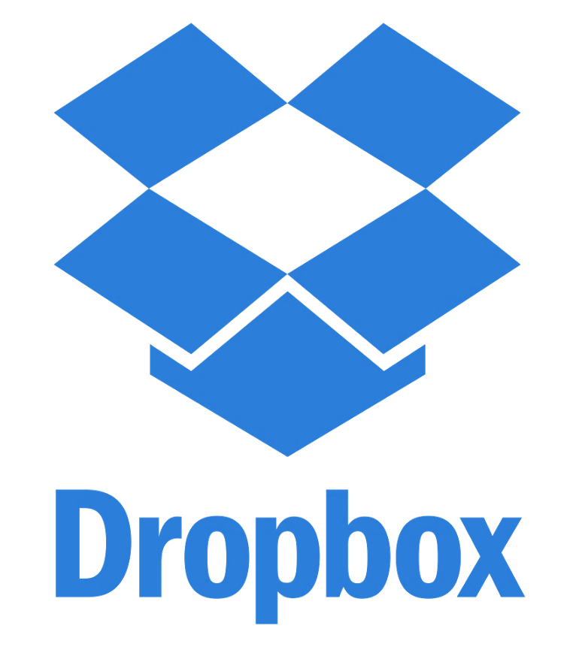



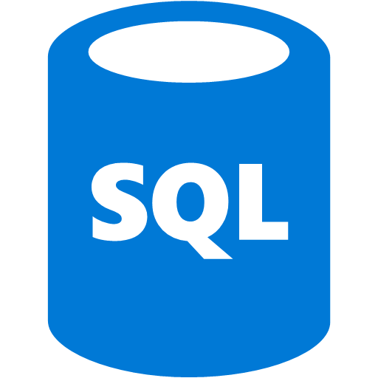
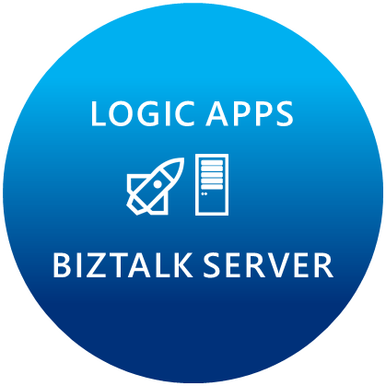

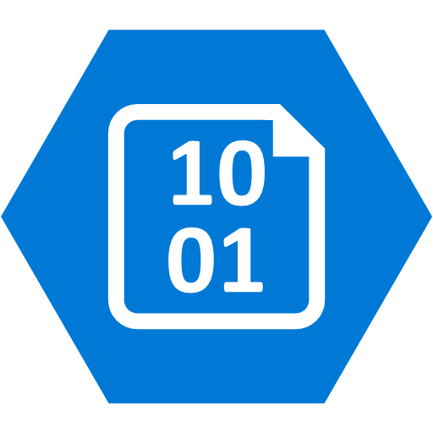



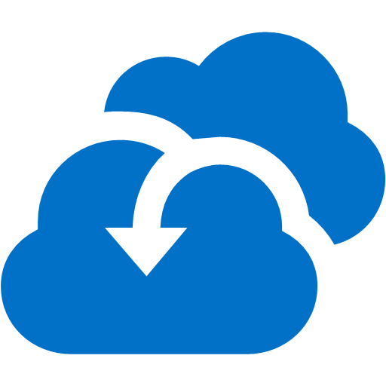

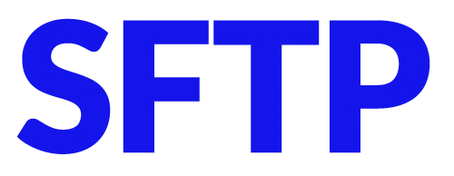
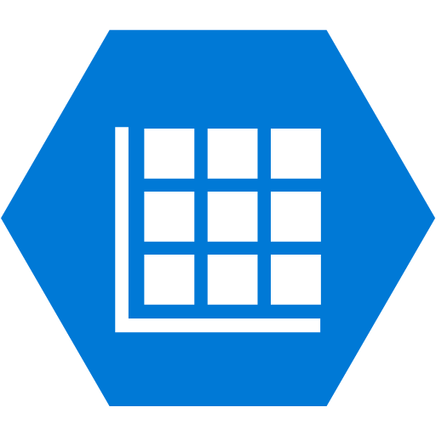


Microsoft’s Enterprise integration vision
LOGIC APPS
BIZTALK SERVER
About 39% of developers are focused on building cloud based Application integration
API MANAGEMENT
AZURE SERVICE BUS
IoT/Event Hub
Azure Search
SQL Database
CONNECTORS
AZURE SERVICES
AZURE
SERVICE BUS
DocDB
BLOB Storage
Functions
API
MANAGMENT
Azure ML
HD Insight
Site Recovery
B2B/EDI
Tables
Search
DNS

Slide 3
Automate business processes in the cloud with Logic Apps
Create business processes and workflows visually
Integrate with SaaS and enterprise applications
Unlock value across on-premises and cloud
Automate EAI, B2B/EDI, and business processes
Leverage Integration Platform as a Service (iPaaS)

Slide 4
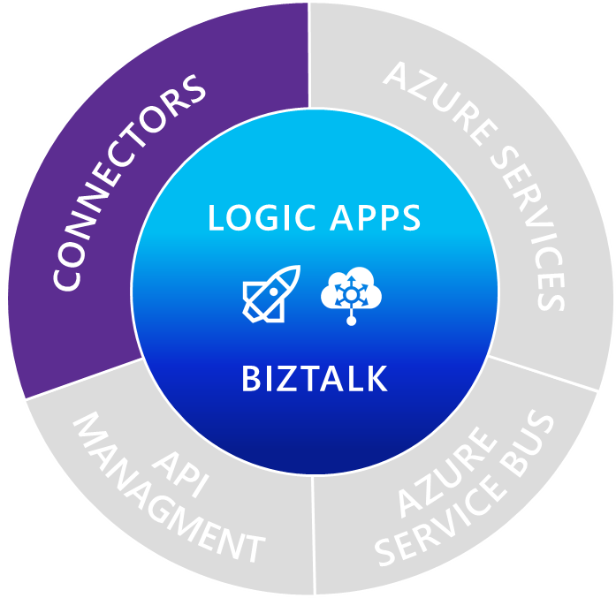
Managed connectors
Cloud APIs and
platform functionality
  Dozens of built-in connectors
  Hosted and managed within the platform
  Scales to meet your needs
  First class designer experience
  Rapid development
LOGIC APPS
BIZTALK
API connections
  Authenticate once and reuse
  Differentiate connection configuration
  Simple to deploy
  Portal experience for managing API Connections

Slide 5
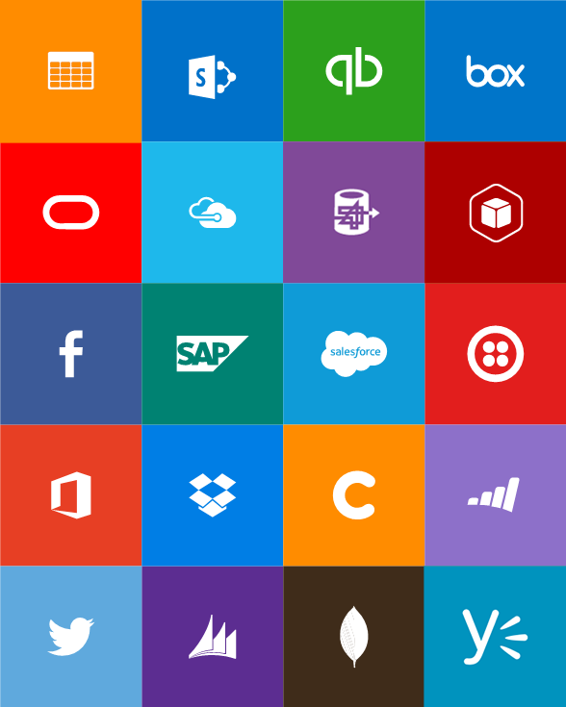
Out-of-box connectors
SaaS
Azure Service Bus
Azure Storage Blob
Bing Search
Box
Dropbox
Dynamics CRM Online
Facebook
GitHub
Google Calendar
Google Drive
Google Sheets
Google Tasks
Instagram
MailChimp
Mandrill
Microsoft Project Online
Microsoft Translator
Office 365
Office 365 Users
OneDrive
OneDrive for Business
Outlook.com
Project Online
Salesforce
SendGrid
SharePoint Online
Slack
SparkPost
SQL Azure
Trello
Twilio
Twitter
Wunderlist
Yammer
YouTube
Protocols
Enterprise messaging
Hybrid
HTTP, HTTPS
HTTP Webhook
FTP, SFTP
SMTP
RSS
Delay
Workflow
Validate
Transform (+Mapper)
Convert (XML-FF)
X12
AS2
SQL Server

Slide 6
Upcoming connectors
SaaS
Hybrid
DocuSign
Google Mail
Lithium
OneNote
Stripe
Bing Search
UserVoice
Trello
VSTS
ZenDesk
IBM DB2
Informix
SharePoint Server
Oracle DB
File
Websphere MQ
SAP
Oracle EBS
CICS
Enterprise messaging
EDIFACT
Party resolution

Slide 7
Demo: Logic App

Slide 8
Custom APIs, Code and Componentization
Nested Workflows
API Apps
Azure Functions
Auto-discovery
First-class designer experience
Extend Logic Apps capabilities with custom code
Auto-discovery of your Azure Functions
Create Azure Functions inline
Componentize logic across workflows for re-use
Auto-discovery of Workflows in subscription
Built in long running asynchronous support
Secure using RBAC
Host custom web services
Utilize the power of App Services

Slide 9
Connecting to other services
HTTP + Swagger
Direct HTTP REST
HTTP Webhook
Declaratively reference external APIs
Connect to any RESTful service
Subscribe to external service’s events using a webhook

Slide 10
Triggering a Logic App instance
Recurring schedule
Polling an API
HTTP POST Request
Webhook subscription
Notes:
Manual - makes the Logic app an endpoint for you call
Recurrence - a simple trigger that fires based on a schedule
HTTP - polling an HTTP web endpoint. The HTTP endpoint must conform to a specific triggering contract - either by using a 202-async pattern, or by returning an array
ApiConnection - polling like HTTP, however, takes advantage of the Microsoft managed APIs
HTTPWebhook - opens an endpoint like Manual, but will also call out to the specified URL to register and unregister
ApiConnectionWebhook - like HTTPWebhook, but taking advantage of the Microsoft managed APIs

Slide 11
Demo: Using Swagger and Webhooks

Slide 12
Workflow Definition Language

Slide 13
Control flow
Response
For Each
Split On
Do Until
Conditions

Slide 14
Built-in Workflow Definition Functions
@if(<expression>, <true>, <false>)
@xml(<string/object>)
@xpath(<xml>, <xpath>)
@json/base64/binary/datauri/string()
@result(<scope>, <status>)

Slide 15
Demo: Control Flow

Slide 16
Demo: Logic Apps Designer in Visual Studio

Slide 17
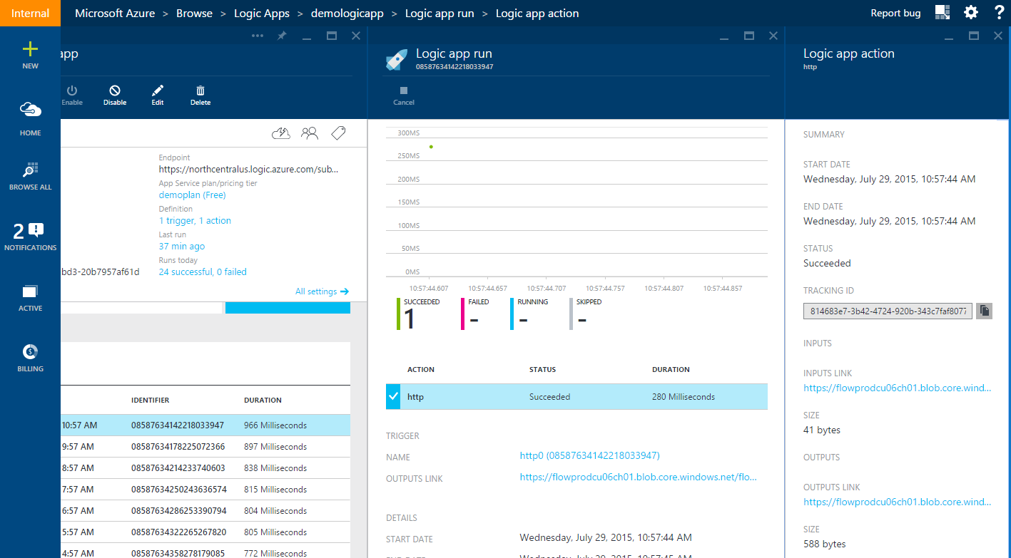
Debugging and History
Trigger history works for polling triggers
Action history shows all runs for the logic app
  For each action you can see:
  All of the inputs to the action
  All of the outputs from the action
  What the status was and any errors

Slide 18
Logic Apps Pricing Model
Consumption pricing
  All actions that were executed, whether they were successful or failed are metered as an action execution.
  As an example, if a Logic App was created which polls for data every one minute over the course of ten days, the resulting billable actions would be 14,400.
  (1 poll / min) x (60 min / hr) x (24 hrs/day) x (10 days) = 14,400 billable actions.
App Service Plans
  No longer required
  Previously created logic apps in an App Service Plan will continue working
  Throttling based on the plan
More details at
  https://azure.microsoft.com/en-in/pricing/details/logic-apps/

Slide 19
Questions?

Slide 20
Thank You!

