Slide 1
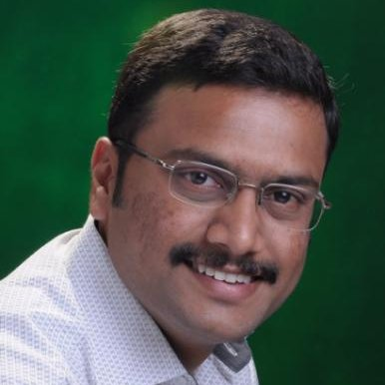
Arunkumar Kumaresan
Technical Lead, BizTalk360
EventHubs & Stream Analytics

Slide 2
What is Data?
a set of values of
..variables
Qualitative
Quantitative

Slide 3
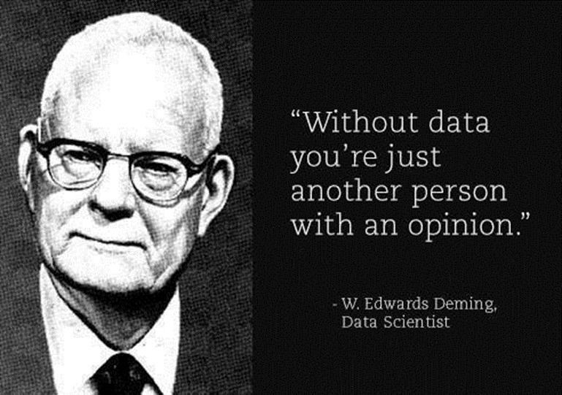
Why Data is so important?

Slide 4
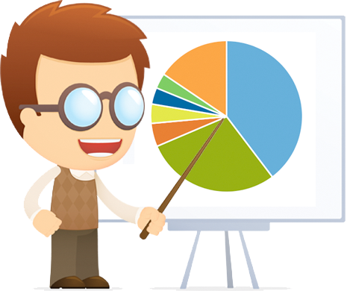
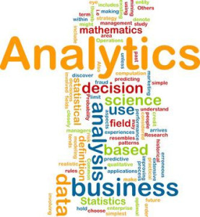
Data Scientists – Analysts we have more and more facts, more and more data

Slide 5
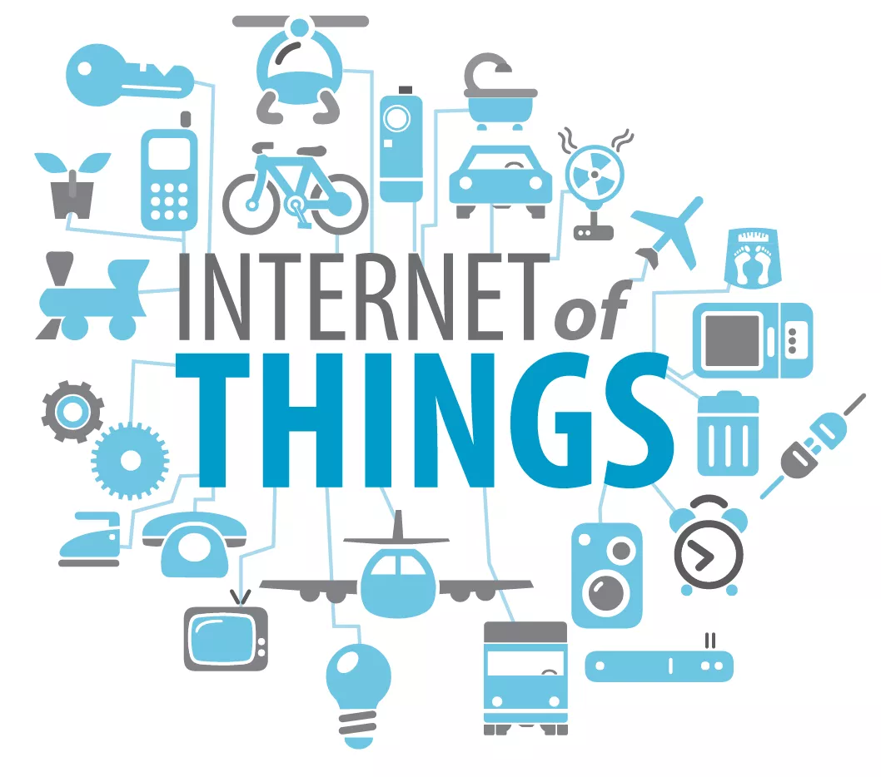
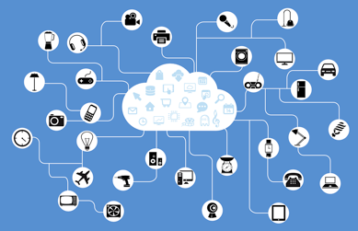
Source of Data?

Slide 6
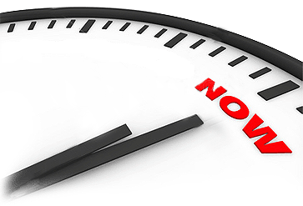
Real Time Data
information that is delivered immediately after collection
no delay in the timeliness of the information provided

Slide 7
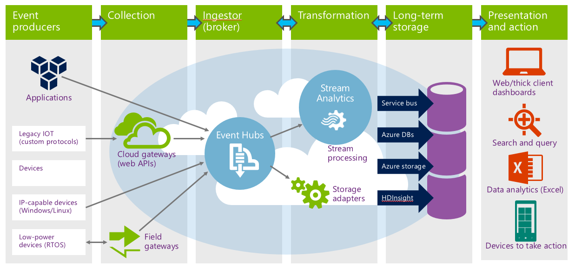
Data Flow – Real Time Architecture

Slide 8
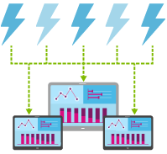
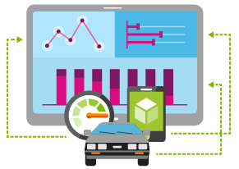
Event Hubs
Cloud-scale telemetry ingestion from
websites, apps, and devices
Stream millions of events per second
Process events with variable load profiles
Connect millions of devices across platforms

Slide 9
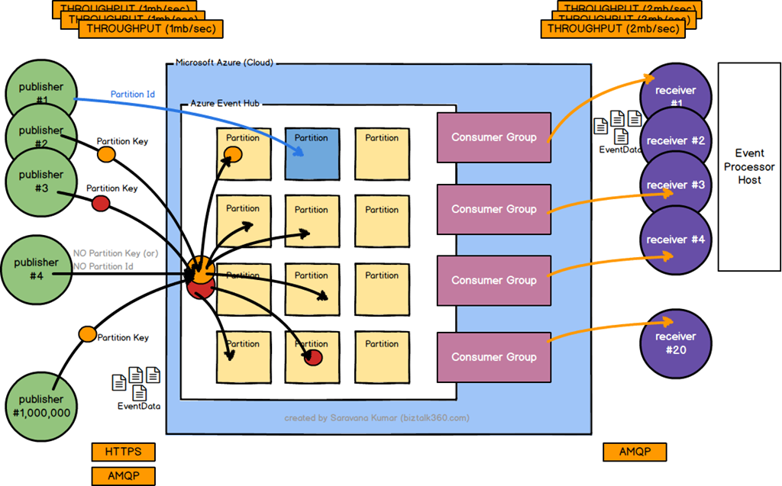
Event Hubs

Slide 10
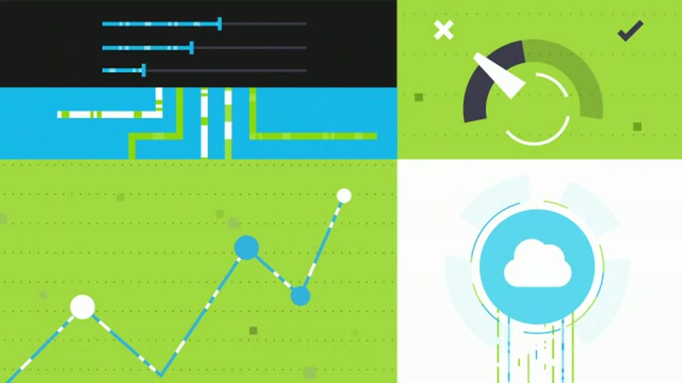
Stream Analytics
Correlate across multiple streams of data
Gain real-time insights
Perform real-time analytics

Slide 11
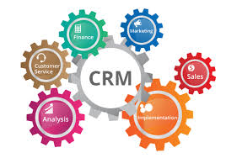
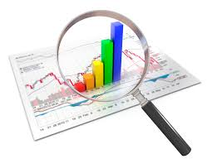
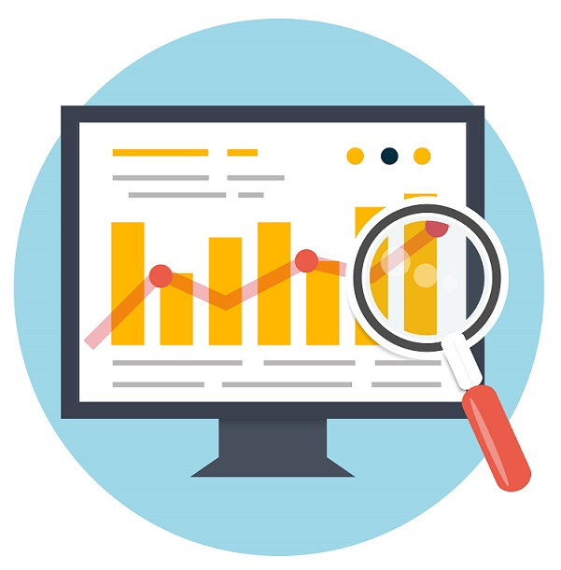
Stream Analytics - Where to Use?

Slide 12
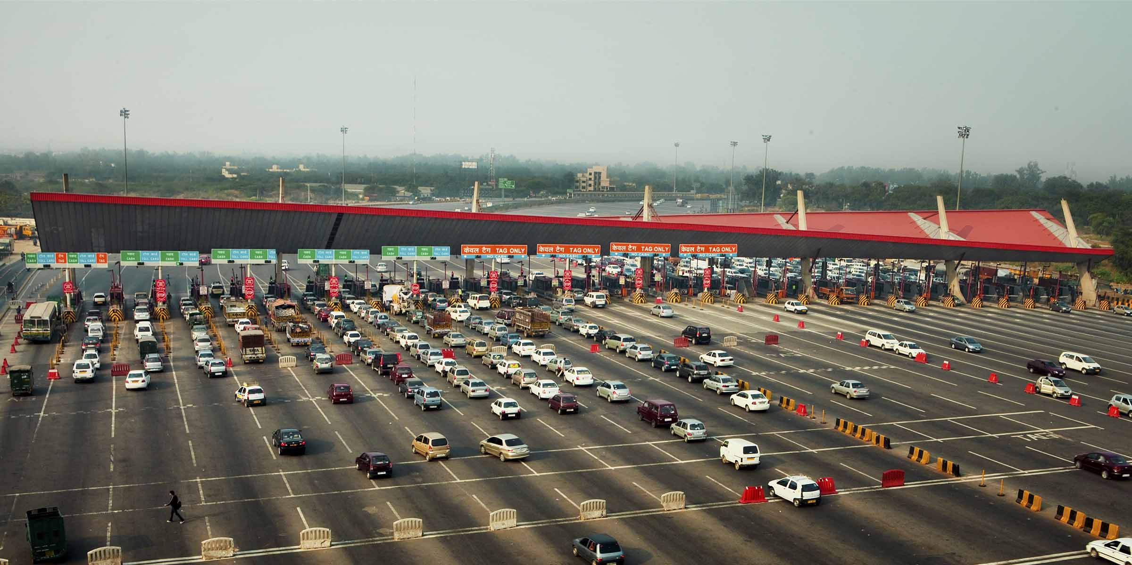
Demo – Toll Booth Scenario

Slide 13
Demo – Toll Booth Scenario
Average Vehicle flow in each lane every 5 minutes?
Average charges collected in each lane every 5 minutes?
Max collection at each lane on 5 minute average?
How many vehicles have not paid?
Vehicle numbers that have not paid?

Slide 14
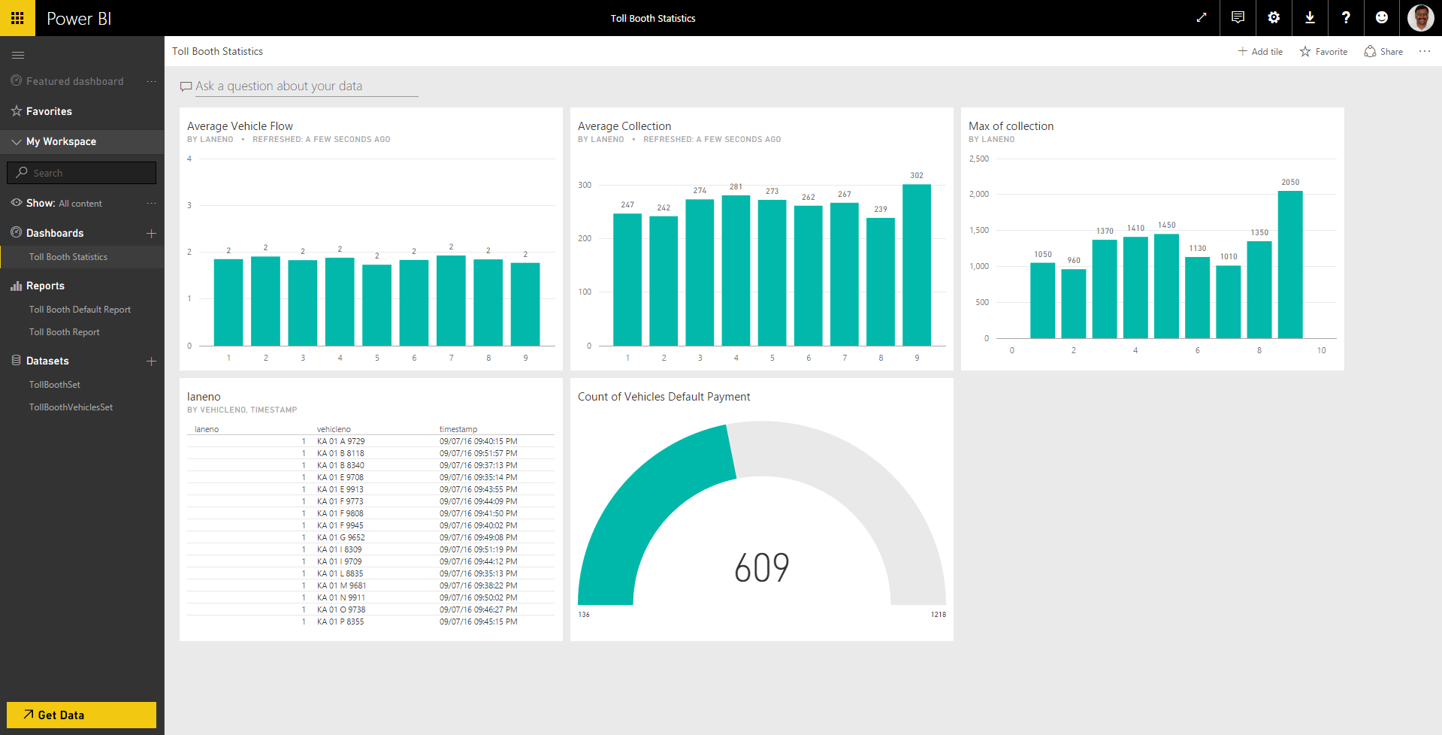

Slide 15
https://in.linkedin.com/in/arunkumarkumaresan
@arunkumaresan
https://www.facebook.com/arunkumarkumaresan

