Slide 1
Tord Glad Nordahl
Program Manager - Microsoft
BizTalk Server Deep Dive into Feature Pack 1

Slide 2
How BizTalk Server 2016 almost got a pink theme

Slide 3
BizTalk Connector in Logic Apps is now general available

Slide 4
Migrate your applications
FEATURES
Windows Services
File Shares w/Permissions
Project Folders + Config file
App Pools
Web Sites
Website Bindings
Web Apps +Virtual Directories
Website IIS Cert mapping
Local Computer Certs
Service Account Certs
Hosts
Host Instances
Host Settings
Adapter Handlers
BizTalk Applications
Role Links
Policies + Vocabularies
Orchestrations
Port Bindings
Assemblies
Parties
Agreements
BAM Activities
BAM Views + Permissions
Get it now: https://aka.ms/btsmigration

Slide 5
Take advantage of the cloud
Through BizTalk Server

Slide 6
AUTOMATIC DEPLOYMENT

Slide 7
Automatically deploy your applications
Deploy using tokens
Deploy to multiple environments
Deploy from any repository*
*All repositories supported by Visual Studio Team Services

Slide 8
MANAGEMENT API

Slide 9
Partner Management
UPDATE
Partner 1
AcountName
AccountId
Partner 2
AcountName
AccountId
Partner 3
AcountName
AccountId
Partner 4
AcountName
AccountId
Partner 5
AcountName
AccountId
Partner 6
AcountName
AccountId
Partner 7
AcountName
AccountId
Partner 8
AcountName
AccountId
Partner 9
AcountName
AccountId
REQUEST
UPDATE PARTNERS REMOTLEY

Slide 10
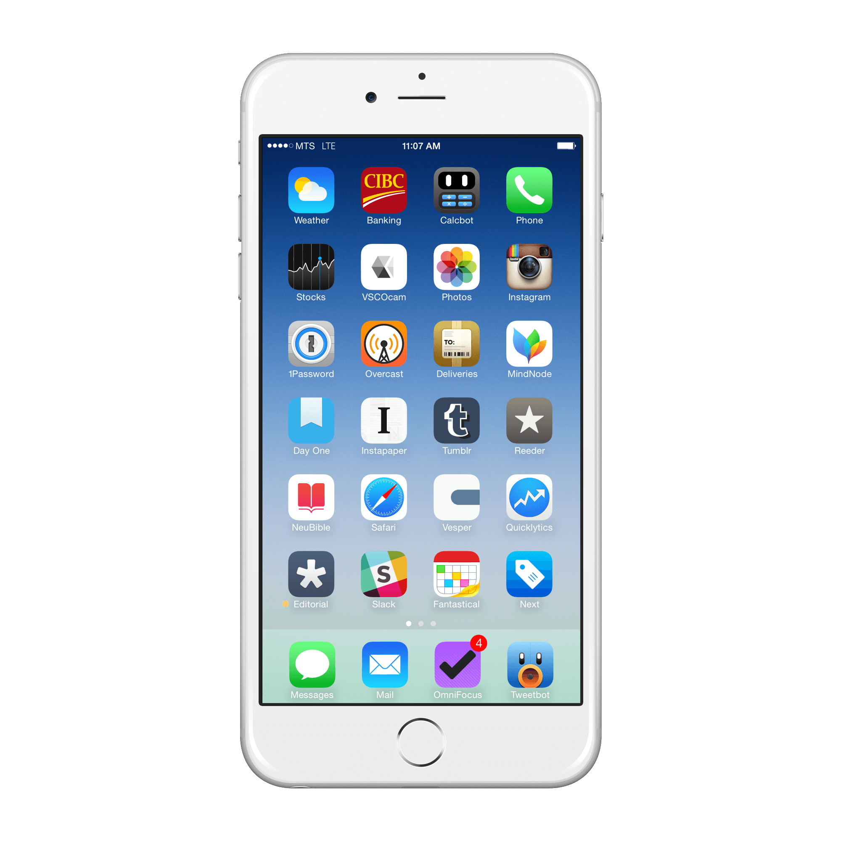
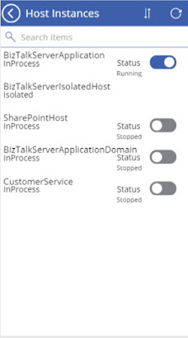
REMOTE MANAGEMENT

Slide 11
APPLICATION INSIGHTS

Slide 12
BIZTALK TRACKING DATA
ANYWHERE
AZURE
USAGE AND
PERFORMANCE
ANALYTICS
ANYWHERE

Slide 13
OPERATIONAL DATA

Slide 16
ADVANCED SCHEDULING

Slide 17
MONTHLY
WEEKLY
DAILY

Slide 18
ALWAYS ENCRYPTED

Slide 19
BIZTALK
10010
01101
10100
01110
ENCRYPT AND
DECRYPT
ENCRYPT
DECRYPT
PatientId SSN ADDRESS STATE
234432 0x01700000016C006F0 Microsoft… WA
432765 0x01700000016C006F0 Microsoft… WA
843978 0x01700000016C006F0 Microsoft… WA
684324 0x01700000016C006F0 Microsoft… WA
234432 321-2313-44 Microsoft… WA
432765 432-9870-56 Microsoft… WA
843978 143-7654-23 Microsoft… WA
684324 982-5634-78 Microsoft… WA

