Slide 1
Stephen W. Thomas
Integration MVP
Overcoming Challenges When Taking Your Logic App into Production

Slide 2
Contact Me
Stephen@StephenWThomas.com
@StephenWThomas

Slide 3
Lightning Clothing Lab
It’s Striking!
http://www.StephenWThomas/Labs

Slide 4
New Pluralsight Course
BizTalk Server Administration with BizTalk360

Slide 5
Session Outline
Phase 1 – Decisions
Phase 2 – Wrong and Right
Phase 3 – Tips

Slide 6
Phase 1 - Decisions

Slide 7
Client Scenario
Client did not have BizTalk Server
Very small IT staff
Landed a new 2-year contract that required EDI Transactions for payments
No experience with EDI or flat files
Very poor integration requirements from the vendor
Latency was not an issue
Data lives in SQL Azure Database

Slide 8
Integration Accounts
Adds BizTalk-like features to Logic Apps
Maps, Schema, Partners, Agreements, and Certificates
Support for EDI and Flat File
Current cost for Integration Account is $1000 per account
Less expensive Developer Editions available

Slide 9
Integration Accounts
Are Integration Accounts worth the price?

Slide 10
BizTalk-Based Solution
Lack of skills and resources
Expensive even for Standard Edition after adding SQL
Plus server setup and development time on top of that

Slide 11
Custom .Net Parsing
Resources available
Would run in Azure
Estimate (for 4 inbound and 2 outbound)
Design and build outbound process flows: 15 days
Build outbound EDI files with mapping x2: 30 days
Design and build inbound process flow: 20 days
Parse inbound custom flat file with mapping x4: 45 days
Design and build triggering and retry process: 15 days
Design and build process monitoring: 10 days
Testing custom components: 20 days
Deployment process: 5 days
Total Effort – 160 days
Cost $20,000
Cost over 2 years: $25,000

Slide 12
Logic Apps with Integration Accounts
Skills available and would run in Azure
Estimate (for 4 inbound and 2 outbound)
Create Inbound and Outbound Logic Apps: 5 days
Setup EDI Transaction in Integration Account: 1 day
Create custom flat file scheme for inbound message: 3 day
Create BizTalk maps for transformation: 3 day
Deployment process: 3 days
Total Effort – 15 days
Cost $2,000
Cost over 2 years: $2,500 + $1000 * 24 = $26,500

Slide 13
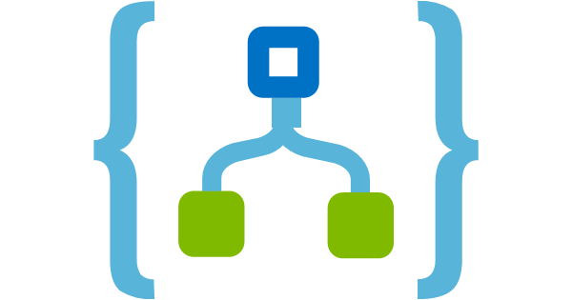
Logic Apps

Slide 14
Why did Logic Apps Win?
The .Net way is the Chicken Way
Pricing for Integration Accounts was not released before development started
Timeline
The client is planning to use the Serverless platform on other projects down the road
On May 1st every single schema changed unexpectedly
Total time to get back live in production with Logic Apps
2 days!

Slide 15
Existing BizTalk Customer?
Harder decision
If you already use EDI in BizTalk it probably makes sense to keep doing so
If you are new to EDI, need to take a look at Logic Apps
If you are doing new development work outside of Integration Accounts, need to take a look at Logic Apps

Slide 16
Phase 2 – Wrong and Right

Slide 17
Rethinking Architecture
Making design decisions based on the RULES of the Serverless platform
Factoring in cost per Action
Release cadence is about every 2 weeks
Made us constantly re-think some approaches
Had to stay on top of release notes
Few times new features impacted our development process
For-each loops limits
Nested For-each loops

Slide 18
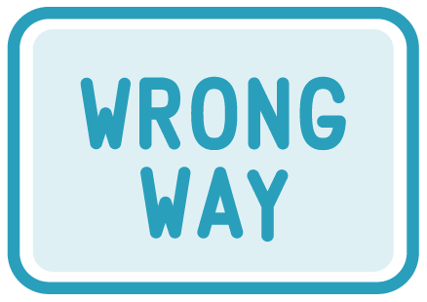
Subscriptions
Used 2 Subscriptions
Used 2 Regions
Dev S1 R1, UAT in S1 R2, Production in S2 R1
Deploy across regions using Visual Studios

Slide 19
Subscriptions
Deployment across regions was hard
Not supported in the UI
Needed to Touch and Save each Logic App after deployment

Slide 20
Subscriptions
Need one subscription for each Environment
Do not cross Regions with Logic Apps

Slide 21
Solution Structure
Solution Level maps to a Resource Group
One Project per Logic App
Maintained 3 parameter files, one for each environment
Created a custom VM for all deployments (done by Bruce)
Deployment using PowerShell for 1 or all Logical Apps
Development using web portal first then move to Visual Studio
Manually re-creating the Logic App
Note the Visual Studio designer lags a few weeks behind the web designer

Slide 23
Serverless
Serverless is AZAMING!
Sometimes things break for no fault of your own
Faced 3 issues since go-live
One was client schema issue
Two were platform problems needed to be resolved by Microsoft

Slide 24
Phase 3 – Tips

Slide 25
Do Not be Afraid of JSON
Caution: could brick your Logic App inside Visual Studio or web editor when editing JSON
Always Save or check into TFS before switching to JSON
Sometimes you can not switch back until you have a valid expression
Make sure you can configure the whole Action otherwise you might not be able to save
Ensure you name the Action correctly as soon as you create it

Slide 26
Microsoft Accounts
Using more than one Microsoft account caused all kinds of issues locally
Best to use one account if you can
Needed to always access Azure Portal via Incognito Windows
If you get odd deployment results, close your browner and try again

Slide 27
Auto-merge
Avoid deploying from Visual Studio when you have the Logic App open inside the web editor
Sometimes they will try to auto-merge

Slide 28
Connections
Defined at the Logic App level
Lives at the Resource Group level
Last deployment or update wins

Slide 31
Connections
Defined all connection parameters in one Logic App
Use one connection per destination per Resource Group and share it across many Logic Apps

Slide 32
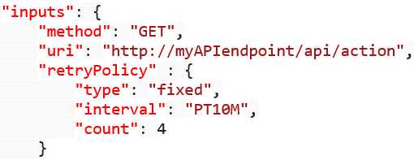
Default Retries
By default, all actions retry 4 additional times over 20-second intervals
Control using Retry Policy
When calling custom APIs you can control reties based on response code
Any 5xx or 429 response triggers a retry
See “Handle errors and exceptions in Azure Logic Apps”

Slide 33
Resource Group Level Artifacts
Examples include Functions and Integration Accounts
See the issue?
Replace:
With:
Delete the variable above

Slide 34
For-each Loops
Limited to 100,000 loops
See “Logic App limits and configuration”
Noticed For-each running out of order
For-each defaults to multiple concurrent loops
Change this like:

Slide 35
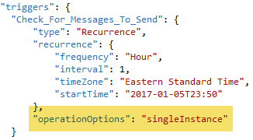
Recurrence - Singleton
Triggers with recurrence can be set to under single instance
Add this:

Slide 36
User Permissions
Under Access Control (IAM)
Logic App Contributor - Provides access to view, edit, and update a logic app. Cannot remove the resource or perform admin operations.
Logic App Operator - Can view the logic app and run history, and enable/disable. Cannot edit or update the definition.
Found you needed Contributor permissions on the Resource Group in order to edit and update Logic Apps with SQL Connections

Slide 37
Summary
Looked at an analysis of when to use Logic Apps with Integration Accounts
Reviewed what I did Wrong and Right in my first Logic Apps project
Stepped through Tips on how to make your Logic App design experience more enjoyable

Slide 38
Questions, Comments, Feedback
Stephen@StephenWThomas.com
@StephenWThomas

