Slide 1
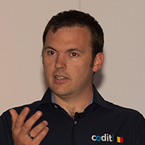
Sam Vanhoutte
CTO Codit, Azure MVP
Integration of Things. Why integration people build good IoT solutions?

Slide 2
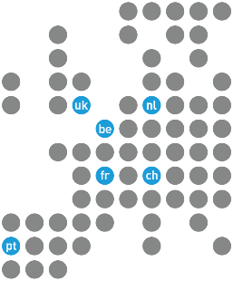
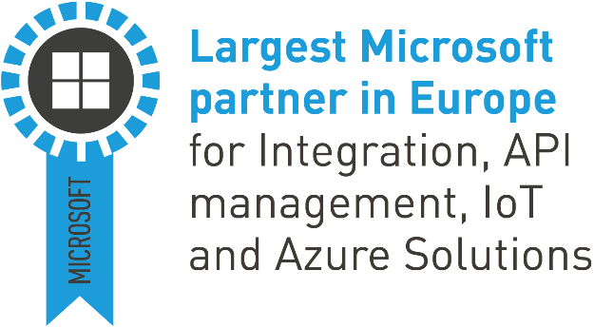
Codit
2000 Belgium
2004 France
2013 Portugal 2016 Switzerland
2016 UK
2016 The Netherlands
2017 Malta
Customers
Entities

Slide 3
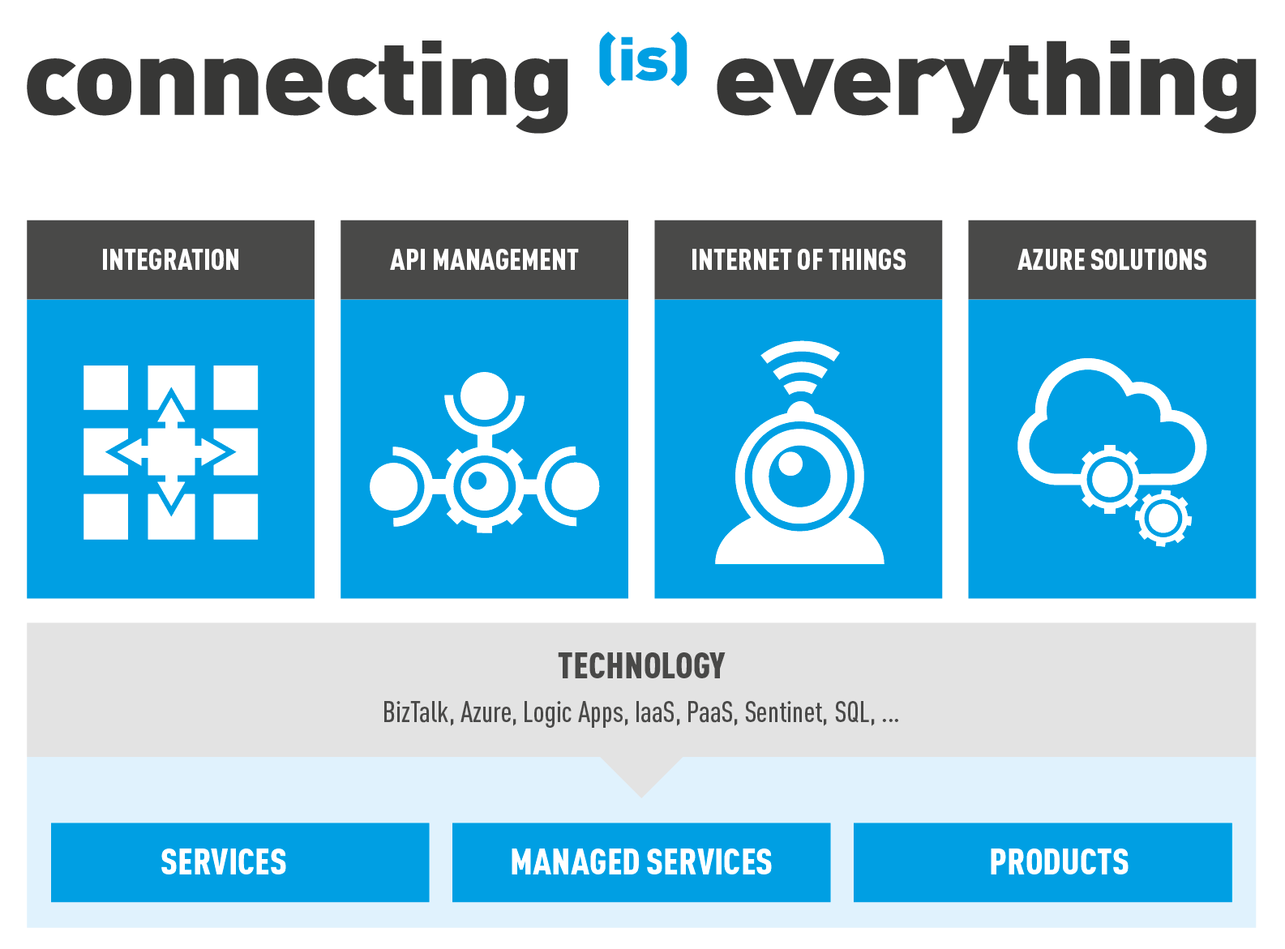
Codit & Microsoft
Partner Programs
7 P-Sellers
20+ Azure Advisors
Azure CAT support
Private Preview partner
Azure IoT Elite Partner
1 of 5, worldwide !
Azure Time Series Insights
Launch partner
Community
MVP
User Groups
Speakers
Bloggers

Slide 4
What can you expect in this session

Slide 5
learnings concepts sharing experiences
no demos

Slide 6
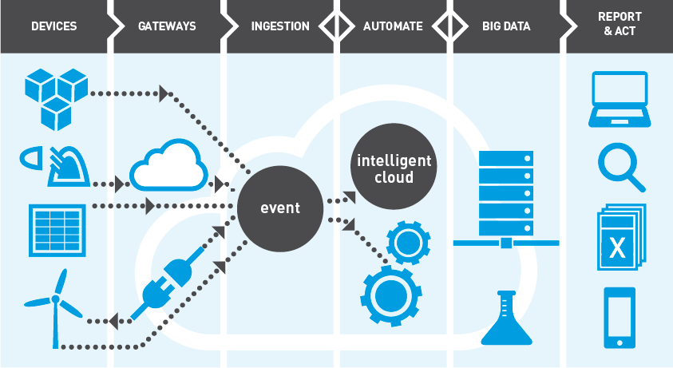
IoT End-to-End Value Chain
Notes:
Things to add
Diff poc/real world
Federated integration/esb
Edge capabilities
Rules

Slide 7
Connectivity is key and integration matters

Slide 8
The connectivity challenge
Direct connectivity
Cloud gateways
Field gateways
Easiest to install and configure
Mixing machine logic with IoT logic
Complexity of IoT (retries, command handling…) on every machine
Not possible for legacy systems
“Feels” less secure
Devices come with embedded connectivity (LoRa, SigFox…) to a propriatary cloud
Cloud to Cloud integration needed
Forwarding capabilities available to IoT platforms
Easy to start in the cloud
Requires extra hardware
Machine logic seperated from IoT logic
Complexity of IoT in one single place
Way to Internet-enable legacy systems
“Feels” more secure

Slide 9
Proof of concepts vs reality
Focus on quick value creation
Quick & fast connectivity
Often using simulated devices
Telemetry ingestion
Reporting, visualization & basic integration
Data storage & basic analytics (time series)
Business rules
Proof of concepts
Focus on robustness & security
Reliability, buffering & retries
Remote updates
Security hardening
Bandwith & compute optimization
Edge capabilities & local actions
Multi-tenancy, privacy & GDPR
Logistics & deployment automation
Real world deployments

Slide 10
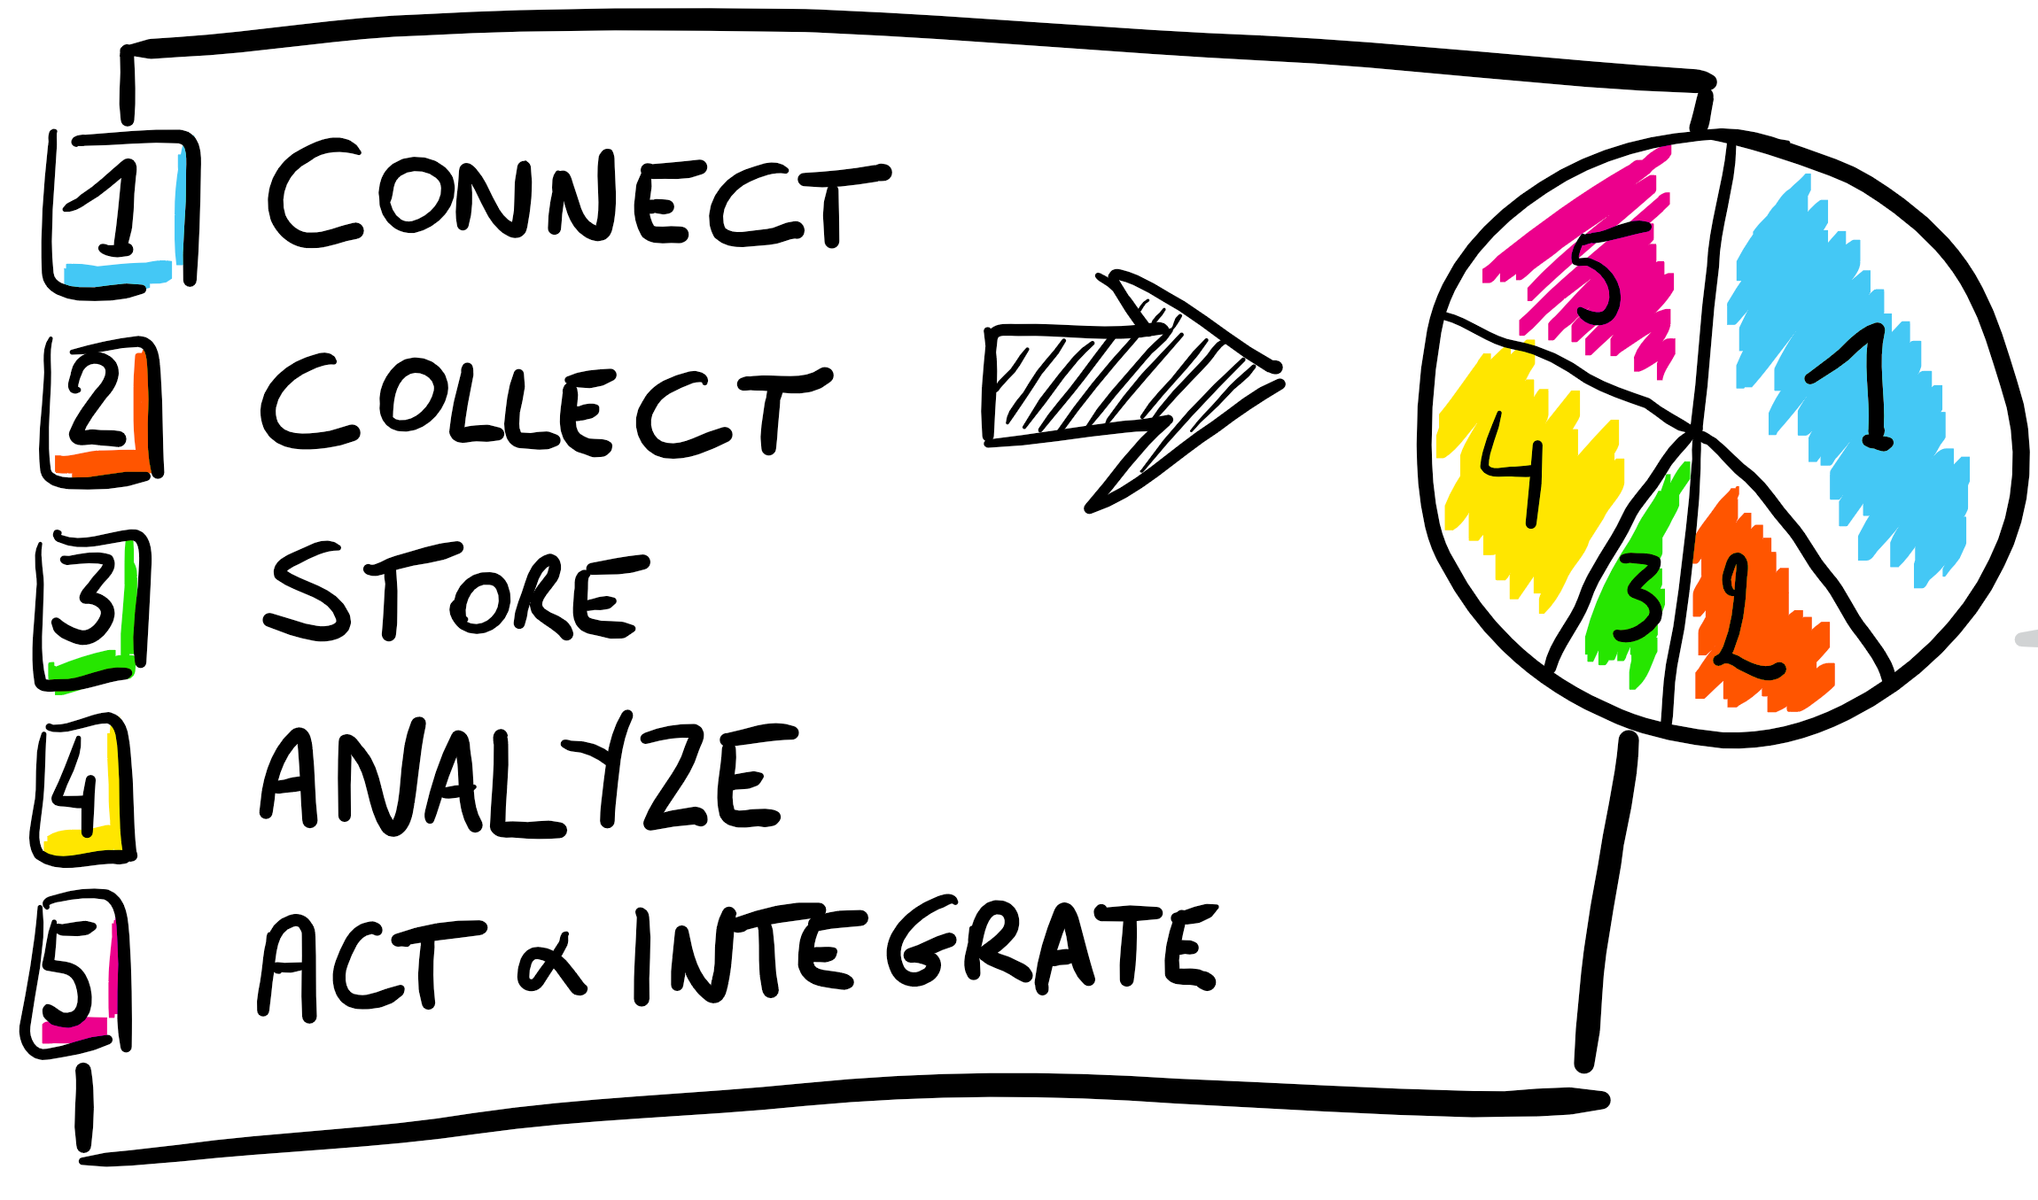
Proof of concepts vs reality
Time spent in project phases
Proof of concepts
Time spent in project phases
Real world deployments

Slide 11
Neglecting your current installed-base means your project will have a time-to-value of years

Slide 12
The retro-fitting challenge
Why is a field gateway important?
85% of devices are not Internet-ready
Development effort in time and money (~ 9months+)
60% cloud cost reduction with edge processing
Network optimization (batching, compression, message composition, queuing, throttling)
Consistent implementation of infrastructure capabilities (security, credentials management)

Slide 13
Spend your time and money wisely
Don’t spend effort developing these:
Message handling implementation
Transport protocol implementation
Credential management
Health reporting and diagnostics
Message persistence
Generic infrastructure
Spend effort developing these:
Edge analytics
Backend automation
Data Analytics & predictions
Own protocol implementations
Business logic modules
Rich reporting, visualizations & apps
Value generators

Slide 14
Gateway responsibilities
Activation & Security
Health monitoring
Configuration Management
Remote updates
Command processing
Edge filtering & aggregation
Extensibility
Buffering & reliability

Slide 15
Common gateway activities

Slide 16
Nebulus™ IoT Gateway
Runs on a variety of operating systems & hardware platforms
Secure by design, from activation to connectivity
Fully remotely managed & updated
Fully extensible, by (y)our development team
Lives on the edge, but controlled by the cloud

Slide 17
Bringing cloud capabilities to the edge, is key in most enterprise IoT solutions

Slide 18
The edge matters for Enterprise IoT
Microsoft Azure
Secure Zone
IoT in the Cloud
Remote monitoring and control
Merging remote data from across multiple IoT devices
Near infinite compute and storage to train machine learning and other advanced AI tools
IoT on the Edge
Low latency tight control loops require near real-time response
Public internet inherently unpredictable
Privacy of data and protection of IP

Slide 19
Edge Processing Scenarios & Requirements
Straightforward Business Logic | Smart Building Protocol Translation |  | Industrial IoT Adapters | Autonomous Driving
Straightforward Filtering
Batch Data Processing | Home Automation Hubs |  |  | Smart Meeting Solutions w/ People Recognition
Reliability Requirements
Low Medium High
Low
Portable Modules / Functions
Medium
E.g.: Custom Code in Containers
High
E.g.: ML/DNNs in Containers
Custom Code Requirements
Interactive Tier (Single CPU, 128MB Memory)
Gateway Tier or Higher
Typical Hardware Requirements

Slide 20
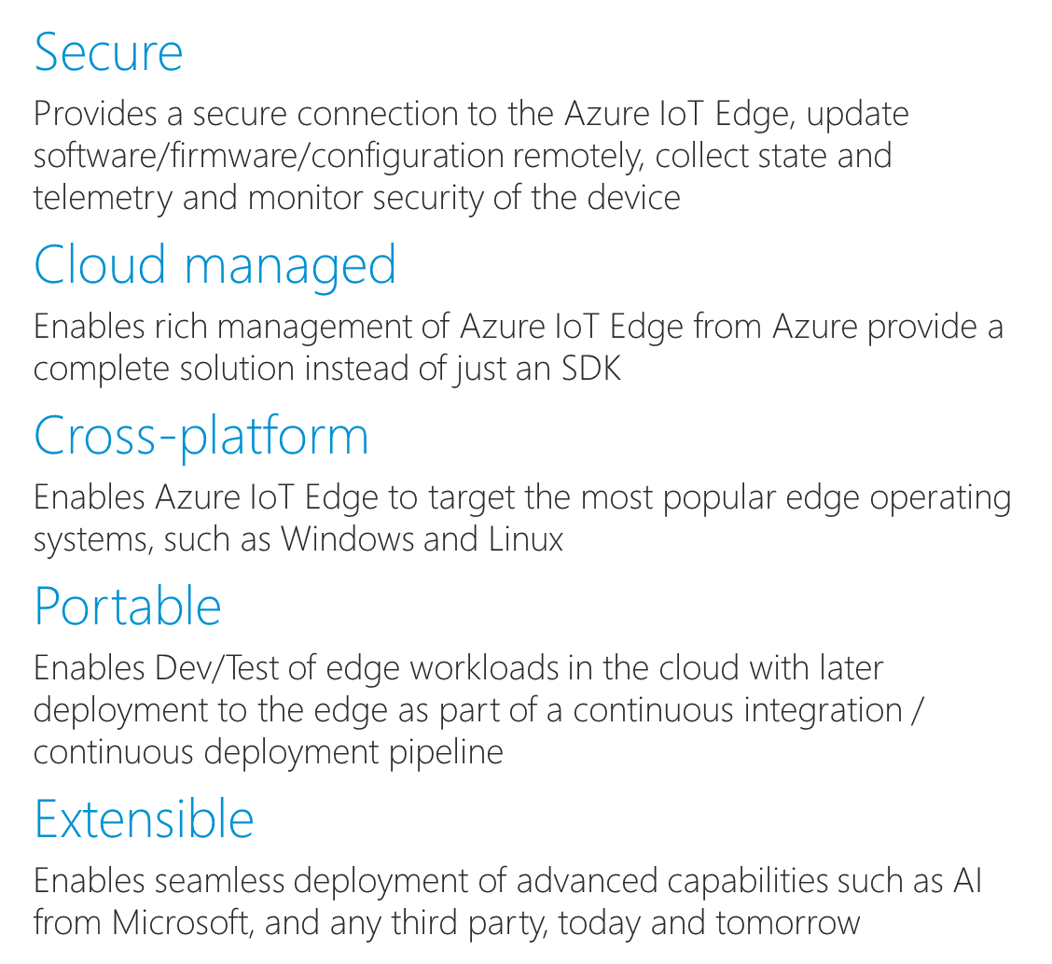
Azure IoT Edge
Simple processing
filtering, batching, compression
Complex processing
Azure Stream Analytics, Cognitive Services

Slide 21
Example: Azure IoT Edge
Container based modules
Azure Functions
Azure Stream Analytics
Azure Machine Learning
Cognitive Services
Offline / Synchronized Device Twins
Local Storage
Cloud Management & Deployment
High Availability / Fault Tolerance
Cloud Dev/Test Support
Azure IoT Edge
IoT Hub
Nebulus IoT Gateway
(Container)
Azure Stream Analytics
(Container)
Azure Functions
(Container)
Cognitive Services
(Container)
Azure Machine Learning
(Container)
Devices
Module
Twin
Module
Twin
Module
Twin
Module
Twin
Module
Twin
Container
Management
Functions
Runtime
Local Storage
Device
Twin
Device
Twin
Module
Twin
Module
Twin
Module
Twin
Module
Twin
Module
Twin

Slide 22
Hardware for Azure IoT Edge
Ability to run on devices smaller than a Raspberry Pi
128MB memory
Support best in class operating systems such as Windows, and Linux

Slide 23
Dynamic rules & business logic will increase adoption & flexibility of your IoT solution

Slide 24
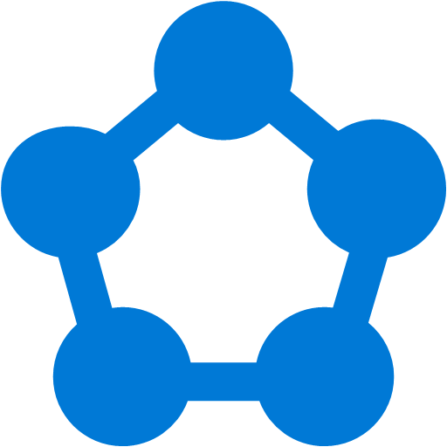
Business Rules
Seperate rules evaluation from action processing
Require flexibility & dynamic creation
Azure Service Fabric
Azure Stream Analytics

Slide 25
Flexible business rules for IoT
An example: Nebulus™ IoT rules engine
Configure rules in a friendly ‘Excel like’ syntax
WHEN
device.battery.voltage < 120mV
AND device.location.building = 'Codit'
AND state.enabled = 'true'
THEN
Send e-mail
Combine state (truck is driving) & telemetry data
Support for time windowing (average over time)
Condition
Telemetry
State
Action
UnitOfMeasure
Support for geo location (point, polygon…)
WHEN
DISTANCE(truck.location, truck.dest) < 10km
AND truck.telemetry.speed > 20
THEN
Trigger integration message
Support for Service Fabric, Cloud Services & On prem

Slide 26
Integration people make great IoT solutions

Slide 27
Integration points in the IoT chain
Legacy protocols
Backend
integration
Data integration
API’s & queues
Messaging & Routing
Filtering & message handling
Event processing
API management

Slide 28
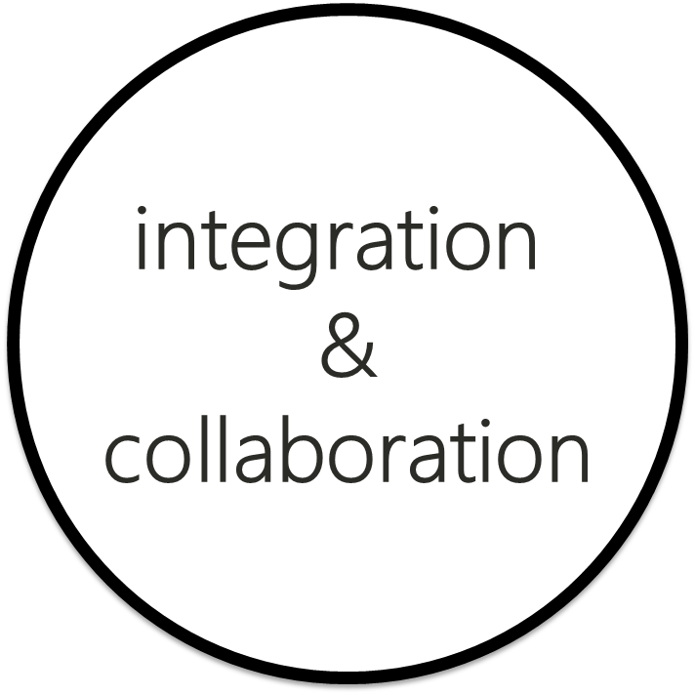
IoT Skills
Developers
The thing developer
Strict real time
Reliability / fault tolerance before everything
Direct impact on the physical world
Process / procedural development
Systems resource aware
Mostly C/C++
Focus on process, machine, device
The internet/integration developer
Distributed & decoupled
Availability & data guarantees
Data driven business process impact
(Micro)-service oriented design
Scalability through design
C#, NodeJs, Open source…
Focus on consolidation, multi-tenancy

Slide 29
New skills needed
Data analytics / data science
Multi-tenancy
Resource deployment & automation
Specific protocol knowledge
Custom development

Slide 30
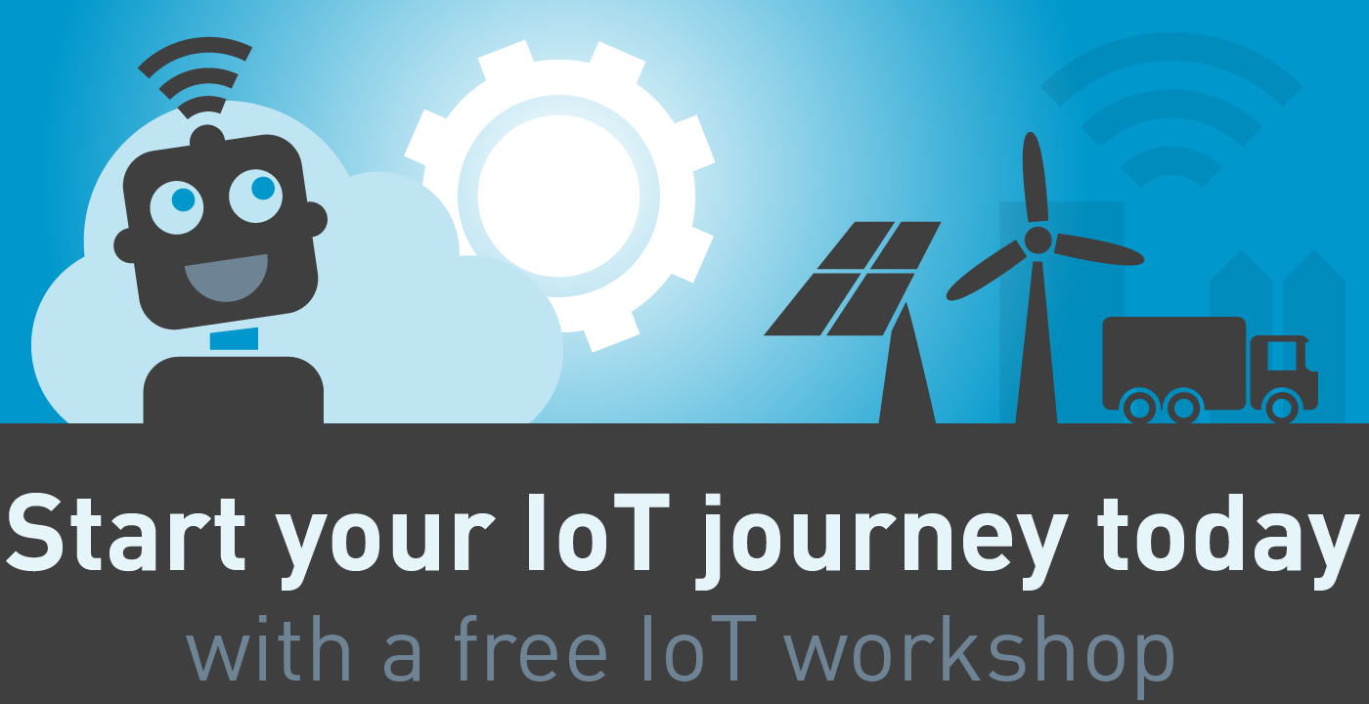
codit.eu/iotworkshop

Slide 31
Discover more about our IoT offering
Two IoT white papers:
IoT field gateways : codit.eu/iotfieldgateways
Integration of Things : codit.eu/IntegrationofThings
Nebulus IoT Gateway: www.nebulus-iot.com
Webinar “The truth about IoT field gateways”:
Accessible via YouTube channel Coditcompany
Questions?

