Slide 1
Richard Seroter
Integration MVP
Moving to Cloud-Native Integration

Slide 2
MOVING TO
CLOUD-NATIVE
INTEGRATION
Richard Seroter
@rseroter
Notes:
https://www.flickr.com/photos/deegephotos/3715701976/sizes/l

Slide 3
Meet Steef-Jan.
He likes to run.
@rseroter

Slide 4
His speed goes to waste if I’m holding him back.
@rseroter

Slide 5
theory of constraints
@rseroter

Slide 6
Software teams face the same reality.
@rseroter

Slide 7
Don’t allow app integration be the bottleneck.
@rseroter

Slide 8
You need a cloud-native approach to integration.
@rseroter

Slide 9
#1 Integration today
#2 What is “cloud-native”?
#3 Delivering cloud-native integration
@rseroter

Slide 10
#1 Integration today
#2 What is “cloud-native”?
#3 Delivering cloud-native integration
@rseroter

Slide 11
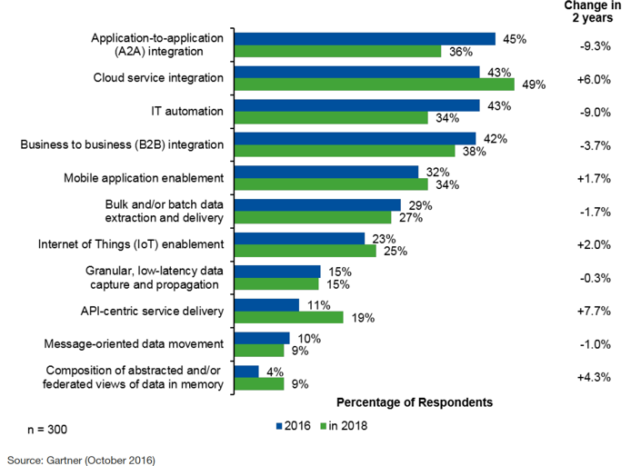
Today, application-to-application is most critical integration scenario.
In two years? Cloud service integration rises to the top.
Gartner's 2016 Application Integration Pulse Survey
@rseroter

Slide 12
Spending on integration platforms is accelerating, with fastest growth in iPaaS and API management.
Gartner "Forecast Analysis: Enterprise Application Software, Worldwide, 4Q16 Update,"24 January 2017
@rseroter

Slide 13
“By 2020, more than 75% of large organizations will establish a hybrid integration platform using integration infrastructure that they assemble from multiple vendors.”
Gartner :Use the Integration Maturity Model to Assess
and Improve Your Integration Competency (2016)
@rseroter

Slide 14
“By 2021, at least 50% of large organizations will have incorporated citizen integrator capabilities into their strategic integration infrastructure.”
Gartner: Citizen Integrators Bring Application and Data
Integration Into a Common Focus (2017)
@rseroter

Slide 15
#1 Integration today
#2 What is “cloud-native”?
#3 Delivering cloud-native integration
@rseroter

Slide 16
What is “cloud-native” all about?
This is an approach to building and operating software that takes advantage of the cloud-computing model. Often see as a combination of microservices, continuous delivery, containers, and DevOps.
Built for scale, built for continuous change, built to tolerate failure.
@rseroter

Slide 17
Traditional Enterprise | Cloud-Native
Orgs arranged in silos without common goals | Balanced teams with shared objectives
Dissimilar environments; “works on my machine” | Consistent setups everywhere
Changes are an exceptions, deployments risky | Changes are an asset, deployments boring
Security via perimeter, triaged patches | Security everywhere, 3 R’s (repair/repave/rotate)
Try to prevent mistakes; focus on MTBF | Embrace resilience engineering; focus on MTTR
Scaling requires careful planning, entire stack | Dynamic scaling of individual components
Software planned and delivered in bulk | Software delivered in small batches
Single, long-lived technology stacks | Diverse, on-demand technologies leveraged
@rseroter

Slide 18
Which one of those sounds like your integration practice?
@rseroter

Slide 19
#1 Integration today
#2 What is “cloud-native”?
#3 Delivering cloud-native integration
@rseroter
Notes:
12 factor apps and other principles for building software, not so much for integration

Slide 20
Today’s integrations are often built by siloed teams, managed manually, use centralized platforms with on-premises focus, and aren’t designed for elasticity.
@rseroter
Notes:
more composable
more “always on” endpoints
more scale
more self-service
more endpoints
more automation (on-demand)

Slide 21
MORE COMPOSABLE
Loosely coupled
Choreographed services
Logic in endpoints
Offers targeted updates
@rseroter

Slide 22
DEMONSTRATION
Logic App as data pipeline
@rseroter
Notes:
Open primary Logic App and explain that this is the general processor; enriches data (SHOW, EXPLAIN), calls function (SHOW) to get fraud score
I have another Logic App that pulls a batch file from OneDrive, debatches, and sends to queue
SHOW IT RUNNING
Drop batch file into OneDrive
Start up .NET Core app that pulls from queue
I have ANOTHER Logic App that takes in individual HTTP requests
Now, what if I want to update one component without redeploying everything? If I decompose correctly, and am using cloudy CI/CD practices, possible
Show VS Code app that publishes a message to the HTTP endpoint
Start up publisher, start up subscriber
Go to enrichment service, make a change to first customer record, update in GitHub and almost immediately published with zero downtime
See changes after a few more requests
POINT: Ways to ease into real-time data, while also enabling targeted upgrades to pieces of the flow

Slide 23
MORE “ALWAYS ON”
Events always arriving
No maintenance windows
Blue/green upgrades
Smarter failure handling
@rseroter

Slide 24
MORE SCALE
Unpredictable usage
Targeted scale
Avoid shared capacity
Right tool, right job
@rseroter

Slide 25
MORE SELF SERVICE
Create ad hoc integrators
Offer diverse platforms
Embed experts in teams
Consider simple facades
@rseroter

Slide 26
DEMONSTRATION
Making BizTalk Server easy
@rseroter
Notes:
OPEN: RDP session, STS, Postman
Show BizTalk in remote session; no send/receive stuff, only file shares
show Swagger page of APIs in FP1
make request from Postman
flip through some of the Java code that calls APIs
Start app
Create pipe
Copy link and send message to new instance of Postman
application/xml, <name>Richard</name>
Show generated ports, files on disk
POINT: Simplified access to BizTalk messaging capabilities that anyone could use; extends life of platform, while offering new use cases

Slide 27
MORE ENDPOINTS
Embrace modern sources
Fast and slow streams
Embrace new patterns
Logic Apps for cloud
@rseroter

Slide 28
MORE AUTOMATION
Build via automation
Automate test & deploy
No manual server access
Source control for all
@rseroter

Slide 29
DEMONSTRATION
Automate Azure via Service Broker
@rseroter
Notes:
[BEFORE: Do cf push]
Do cf marketplace and see what all the brokers advertise
Show Azure Portal and no resource group or namespace
Show STS and code that sends to and receives from queue; notice it has no connection info
See in Apps Manager that I have an app, deployed to save time (also, service broker)
cf create-service azure-servicebus standard integratesb -c service-bus-config.json
cf services
cf bind-service integrate-service-bus-console integratesb [WOULD TYPICALLY HAVE IN MANIFEST)
cf restart integrate-service-bus-console
SHOW AZURE PORTAL
open app in browser and send/receive
could do cf delete-service and broker cleans itself up
POINT: The whole lifecycle of my dependent integration service was managed for me; whether that’s an Event Hub, RMQ cluster, SB queue, as a dev I trust that everything is automated for me

Slide 30
Introduce cloud-native integration and start delivering integration as a service at scale.
If not …
@rseroter
Notes:
as a service!

