Slide 1
Paul Larsen / Steve Melan
Principal Program Manager – Microsoft / Integration MVP
Integrate heritage IBM systems using new cloud and on-premises connectors

Slide 2
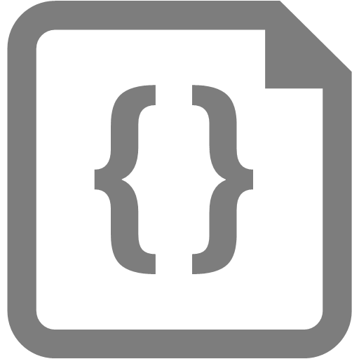
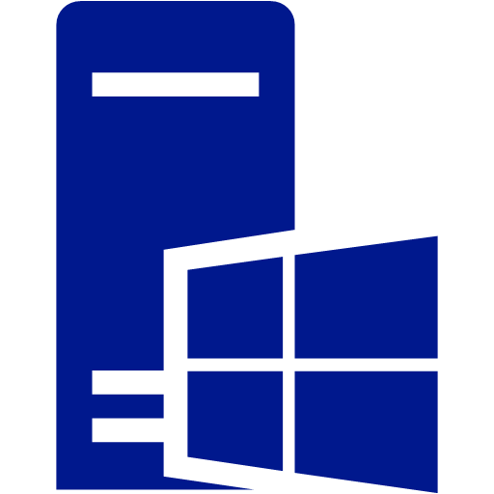
Integrate heritage IBM systems
Azure
On-premises
On-premises
Microsoft
Connectors for IBM Systems
On-premises Data Gateway
TCP/IP
CICS, IMS, TSO, TPF
COBOL, PLI, RPG, CL Programs
WebSphere MQ
DB2, Informix, VSAM, Files
RACF, i5 Security
Flow
Logic Apps
PowerApps
Azure Data Factory
Azure Web Services
TCP/IP
Host Integration Server
BizTalk
SQL
IIS Power BI
Bi-Directional Connectivity
IBM Protocols and Formats
Standard Protocols and Formats
TCP/IP and HPR/IP
Windows Server
IBM z/OS and i5/OS,
AIX, Linux, UNIX, Windows
Windows
Hyper-V
Azure
Virtualization

Slide 3
DB2 Connector
Azure
Cloud
Logic Apps, Power Apps, Flow
DB2 Server
DRDA
Protocol
API Hub
SWAGGER
DB2 Connector
TCP/IP
Data Services API
Mashup Engine
Service Bus
On-premises
Power BI Mashup Engine
TCP/IP
On-premises Data Gateway
DB2 Function
Mashup Engine
DB2.Database (over ADO.NET)
DRDA Protocol
Microsoft DRDA Client
DB2 Server
TCP/IP

Slide 4
DB2 Client On-Premises
On-Premises Datacenter
On-Premises Datacenter
Catalog, Schema,
Tables, Views,
Stored Procedures
BizTalk Adapter
Power BI
Connector
SQL Server
Office
ADO.NET Provider
OLE DB Provider
ODBC
Driver
Standard DRDA Protocol and Formats
DRDA Client
(.NET)
DRDA Client
(native)
IBM DB2 Server
TCP/IP
Windows
Linux, UNIX, Windows
IBM z/OS, i5/OS

Slide 5
Informix Connector
Azure
Cloud
Logic Apps, Power Apps, Flow
Informix Server
DRDA
Protocol
API Hub
SWAGGER
DB2 Connector
TCP/IP
Data Services API
Mashup Engine
Service Bus
On-premises
Power BI Mashup Engine
TCP/IP
On-premises Data Gateway
Informix Function
Mashup Engine
Informix.Database (over ADO.NET)
DRDA Protocol
Microsoft DRDA Client
Informix Server
TCP/IP

Slide 6
MQ Connector
Azure
Cloud
Logic Apps, Power Apps, Flow
MQ Server
MQ
Protocol
API Hub
SWAGGER
MQ Connector
TCP/IP
Data Services API
Mashup Engine
Service Bus
On-premises
Power BI Mashup Engine
TCP/IP
On-premises Data Gateway
MQ Functions
Mashup Engine
MQ.Queue
MQ.Receive
MQ.Send
MQ Protocol
Microsoft MQ Client
MQ Server
TCP/IP

Slide 7
MQ Client On-Premises
On-Premises Datacenter
On-Premises Datacenter
Messages
Messages
Queues
WCF
Channel
BizTalk
MQS
BizTalk
MQSC
IBM MQ Protocol and Formats
IBM Client
(native)
IBM Server
(native)
IBM Client
(native)
Microsoft Client (.NET)
IBM MQ Server
TCP/IP
Linux, UNIX, Windows
IBM z/OS, i5/OS
Windows

Slide 8
Demo – Contoso Fitness Cafes

Slide 9
Integrate heritage IBM systems
Azure
On-premises
On-premises
Microsoft
Connectors for IBM Systems
On-premises Data Gateway
TCP/IP
CICS, IMS, TSO, TPF
COBOL, PLI, RPG, CL Programs
WebSphere MQ
DB2, Informix, VSAM, Files
RACF, i5 Security
Flow
Logic Apps
PowerApps
Azure Data Factory
Azure Web Services
TCP/IP
Host Integration Server
BizTalk
SQL
IIS Power BI
Bi-Directional Connectivity
IBM Protocols and Formats
Standard Protocols and Formats
TCP/IP and HPR/IP
Windows Server
IBM z/OS and i5/OS,
AIX, Linux, UNIX, Windows
Windows
Hyper-V
Azure
Virtualization

Slide 10
HIS 2016 – Supported Platforms
Operating Systems
Windows 10
Windows 8.1
Windows Server 2016
Windows Server 2012 R2
Virtualization with Azure and Hyper-V
Framework
.NET Framework 4.6
Tools (Designer)
Visual Studio 2015 (CTP2)
Visual Studio 2013 with Update 5
BizTalk (Adapters)
BizTalk Server 2016
BizTalk Server 2013 R2
Database (ESSO)
SQL Server 2016
SQL Server 2014 with Service Pack 2
Operating Systems
IBM z/OS 2.2, 2.1
IBM z/VM 6.3, 6.2
IBM z/VSE 6.1, 6.2
IBM i 7.2, 7.1
Transaction Processing Systems
IBM CICS 5.3, 5.2
IMS 14.1, 13.1
IBM i 7.2, 7.1
Message Processing Systems
IBM MQ 8.0, 7.5
File Systems
IBM DFSMS DFM z/OS 2.2, 2.1
IBM i 7.2, 7.1
Relational Database Management Systems
IBM DB2 for z/OS 11.1, 10.1
IBM DB2 for i 7.2, 7.1
IBM DB2 for LUW 11.1, 10.5
Informix V12.1, 11.7

Slide 11
HIS 2016 – New and Improved
New installation program
New configuration program
New Client (.NET) for MQ
New Client (.NET) for DB2 and Informix
New ADO.NET Providers for DB2 and Informix
New BizTalk Adapters for DB2 and Informix
New BizTalk Adapter for MQ
Designer plug-ins for VS 2015
Data Tools for VS 2015
Improved documentation
Telemetry events and exceptions

Slide 12
Resources
HIS 2016 Evaluation
https://aka.ms/his2016eval
HIS 2016 Client
https://aka.ms/his2016eval
HIS 2016 SDK
https://aka.ms/his2016sdk
HIS 2016 CU1
https://aka.ms/his2016cu1
HIS 2016 What’s New
http://go.microsoft.com/fwlink/?LinkId=799228
HIS Feedback Survey
https://aka.ms/hisfeedback
Paul Larsen
mailto:plarsen@microsoft.com
Steve Melan
mailto:steve.melan@live.com

Slide 13
Roadmap
HIS 2016 CU2
IBM DB2 for z/OS V12
IBM MQ V9
.NET Framework 4.7
Visual Studio 2017
SQL Server 2017
Let us know what you want for vNext
DB2 CALL, INSERT identity, UPDATE (partial columns)
PowerShell for generating TI and host files metadata
MQ Listener for host-initiated messaging

Slide 14
Appendix

Slide 15
Microsoft Host Integration Server
Infrastructure and device emulation
Network services (SNA gateway, Host Print and TN services, Session Integrator)
Client applications (3270 and 5250 emulators, SNA APIs)
Session Integrator for 3270 and LUA programs
Enterprise Single Sign-On for credential mapping
Data
Clients, data providers and BizTalk adapters for DB2, Informix, Host Files
Service for DRDA (DB2-to-SQL gateway)
Messages and programs
Client, BizTalk adapter and WCF channel for MQ
Transaction Integrator and BizTalk adapter for CICS, IMS, IBM i

Slide 16
DB2 Client On-Premises
On-Premises Datacenter
On-Premises Datacenter
Catalog, Schema,
Tables, Views,
Stored Procedures
BizTalk Adapter
Power BI
Connector
SQL Server
Office
ADO.NET Provider
OLE DB Provider
ODBC
Driver
Standard DRDA Protocol and Formats
DRDA Client
(.NET)
DRDA Client
(native)
IBM DB2 Server
TCP/IP
Windows
Linux, UNIX, Windows
IBM z/OS, i5/OS

Slide 17
Informix Client On-Premises
On-Premises Datacenter
On-Premises Datacenter
Catalog, Schema,
Tables, Views,
Stored Procedures
BizTalk Adapter
Power BI Connector
SQL Server
ADO.NET Provider
OLE DB Provider
Standard DRDA Protocol and Formats
DRDA Client
(.NET)
DRDA Client
(native)
TCP/IP
IBM Informix Server
Linux, UNIX, Windows
Windows

Slide 18
DRDA Client for DB2 and Informix
Common managed DRDA Client
Fully async implementation
Informix ADO.NET provider
Informix XA transactions
Transport Layer Security 1.2
SYSIBM catalog stored procedures
Improved Data Access Tool, Data Source Wizard and Schema Gen Wizard
DB2 for z/OS high performance DBATs (Database Access Threads)
DB2 for z/OS parameterized command performance (literal replacement)
Improved static SQL package binding and server cursors

Slide 19
Power BI Connectors for DB2 and Informix
Based on HIS 2016
Common managed DRDA Client and ADO.NET Provider
On-premises consumers
Power BI Desktop
Power Query
Excel Data Source
Cloud services
Logic Apps, Flow, Power Apps
Azure Data Factory
Replaces IBM ODBC driver
Connects to IBM DB2 for z/OS and IBM DB2 for i, as well as DB2 for LUW
Default is Microsoft Connector, with switch to enable IBM ODBC Driver

Slide 20
BizTalk Adapters for DB2 and Informix
Common managed DRDA Client
Fully async implementation
Supports datetime tokens (today, yesterday, current)
<sync> block = transaction
Upon failure, unprocessed <sync> blocks re-posted to Message Box
Supports attributes and elements
Restrictions added to schema
Receive/send handler properties (dynamic ports, e.g. ESB Toolkit)
Multiple tables per <sync> block
Caching for metadata and ports
Detailed error messages
Compatible with previous adapter
Retrieves identities during insert (for use later in subsequent block)

Slide 21
MQ Client On-Premises
On-Premises Datacenter
On-Premises Datacenter
Messages
Messages
Queues
WCF
Channel
BizTalk
MQS
BizTalk
MQSC
IBM MQ Protocol and Formats
IBM Client
(native)
IBM Server
(native)
IBM Client
(native)
Microsoft Client (.NET)
IBM MQ Server
TCP/IP
Linux, UNIX, Windows
IBM z/OS, i5/OS
Windows

Slide 22
VSAM Client On-Premises
On-Premises Datacenter
On-Premises Datacenter
BizTalk Adapter
SSIS
ADO.NET Source
Catalog, Keys,
Files, Commands
ADO.NET Provider
IBM DDM Protocol and Formats
DDM Client
(.NET)
TCP/IP (IBM i)
SNA APPC HRP/IP (IBM z and i)
IBM DDM Server
Windows
IBM z/OS, i5/OS

Slide 23
DB2 for z/OS accessing SQL Server
TSO
SPUFI
QMF
CICS
IMS
MQ
Databases
Schemas
Tables, Views,
Functions
Procedures
IBM DB2 Attachment Facilities
Microsoft SQL Server Relational Database Engine
IBM DB2 Relational Database Engine
Microsoft ADO.NET Data Provider for SQL Server
IBM Distributed Data Facility for DRDA
IBM RACF
CA-ACF2
CA-Top Secret
Metadata
Microsoft Service for DRDA
Microsoft Enterprise SSO
Encoder
Trace
DRDA
TCP/IP
IBM
z/OS
Microsoft Windows

Slide 24
Transaction Integrator
COBOL Program
COBOL Program
Customer Information Control System Transaction Server
Information Management Server Transaction Server
CICS Inter-System Communications
TCP/IP
Listener
IMS Connect
BizTalk Adapter
.NET client app
Communications
Server
Transaction Integrator .NET Runtime
TCP/IP or HPR/IP (transactional)
Microsoft Windows
IBM
z/OS

Slide 25
Transaction Integrator – Host-Initiated
COBOL Program
COBOL Program
Customer Information Control System Transaction Server
Information Management Server Transaction Server
.NET server app
CICS Inter-System Communications
Custom COBOL Sender Program
Custom COBOL
Sender Program
Transaction Integrator .NET Runtime
Communications
Server
Transaction Integrator
Host Initiated Processing Service
TCP/IP (non-transactional)
IBM
z/OS
Microsoft Windows

