Slide 1

Jon Fancey
Principal Program Manager - Microsoft
Enterprise Integration with Logic Apps

Slide 2
Agenda
What is Enterprise Integration?
More about batching
Quick Lap Around B2B and XML
Operational monitoring
Some other things

Slide 3
Member Benefits
Health Insurance discounts for active members
Make 12 visits a month to receive benefit
Linked to gate system to automatically notify insurer
Courtesy notification to member
Batch
Trigger
Send to Insurer
Member
Visit
Batch up visits by member ID
Send to member

Slide 4
Batching
How it works
  2 Logic Apps – sender and receiver
  ‘batcher’ aware of batching logic app
  Batching logic app not aware of batcher(s) – 1:n
Batch
Trigger
Partition within batch
Event

Slide 5
Coming Soon
Batch Flush
Time-based Batch release trigger options
EDI Batching

Slide 6

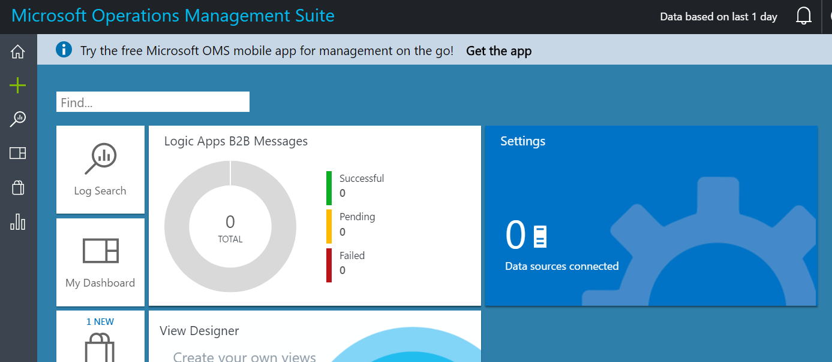




Integration Account
Core to our XML and B2B capabilities
Provides partner creation and management
Provides for XML validation, mapping, flatfile conversion
Provides tracking

Slide 7
Message Handling
Flexibility in content types
Flexible content, binary, JSON, XML, primitives
Schema support for JSON schema and XSD
Mapping
XSLT-based – use existing assets
Visual Studio mapper to create xslt-based maps
Parameters support
Validation
Check for errors in selected schema
Flatfile
Convert to/from flatfile – csv, delimited, positional
Built-in type conversion json<>xml<>base64
Flexible processing
  Decoupled messaging from processing
  Ability to send data to a batch
  Release on specific criteria e.g. size/time
  Group by user-defined data (partitioning)
Or use Flush action to release batch immediately
EDI
  Outbound encoders, X12, EDIFACT will make use of batching for B2B
  Out of box X12 and EDIFACT schema
  Leverage batching capabilities

Slide 8
Enterprise messaging
Validate
Extract
Transform
Enrich
Route
XML Validation
@xpath
XSL Transform
Compose
Send message to topic
VETER Pipeline
Reference schema in Integration Account
Select literals, single nodes or node-sets
BizTalk mapper compatibility
Parameter support (enrich)
Construct a new message

Slide 9
Dealing with XML
XML Parameters
Code and functoids
Enhancements soon
  Transform output format (XML, HTML, text)
  BOM handling

Slide 10
Disaster recovery with B2B
Many organizations have stringent RTOs
  Feature allows you to be in control
Integration Account holds stateful data e.g. EDI control numbers
Primary and Secondary Integration Accounts
  Created in different regions
  Can have multiple secondaries
Logic Apps replicates integration account state
  Triggers from changes in primary
AS2 – Just click deploy the template
https://github.com/Azure/azure-quickstart-templates/pull/3302

Slide 11
How it works
Trading Partner
Traffic Manager
Primary
Secondary
APIM
Synchronizing
Logic App
Integration
Account
AS2/X12/EDIFACT
Logic App
KeyVault
KeyVault
ERP/LOB System

Slide 12
On Failover
Trading Partner
Traffic Manager
Primary
Secondary
Secondary
Primary
APIM
Synchronizing
Logic App
Integration
Account
AS2/X12/EDIFACT
Logic App
KeyVault
KeyVault
ERP/LOB System

Slide 13
Monitoring and Tracking
Integration Account
  Use the API
  Provides documented event schema
  Call from your code, Functions etc.
Turn on Azure Diagnostics
  Enable Log Analytics
  Enjoy all that lovely data
Tracked Properties
  Currently code view only
"trackedProperties": {
"OrderNumber":
"@{
outputs('Compose')
['OrderLine']
['@OrderNumber']
}" }

Slide 14
Operational Monitoring…futures

Slide 15
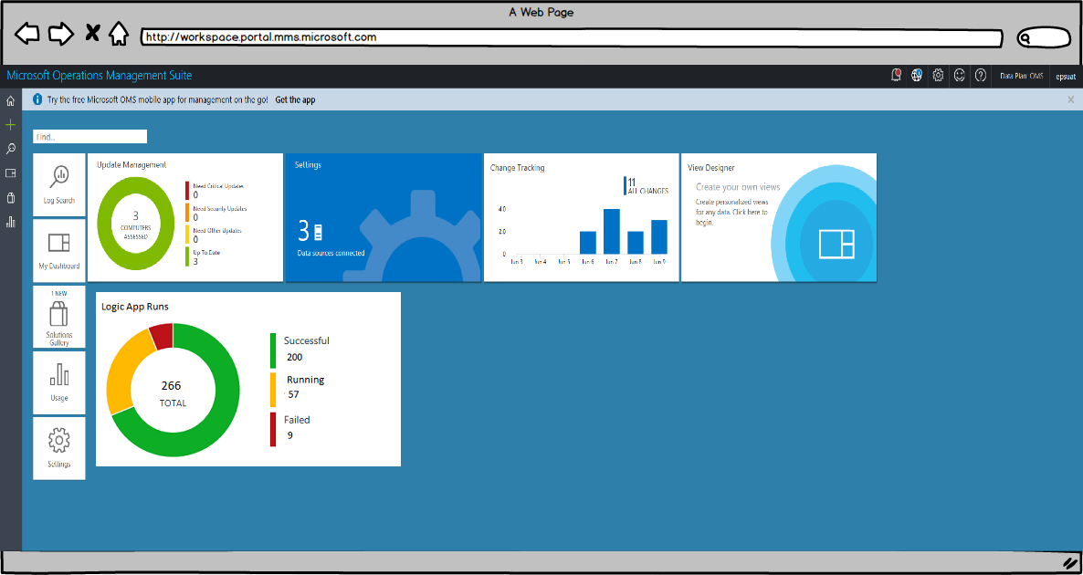
Overview Page with LA Runs Summary

Slide 16
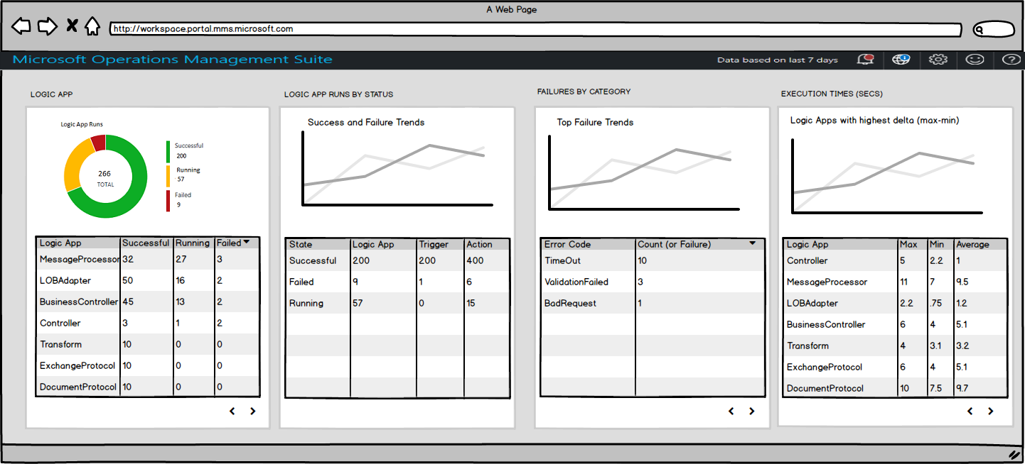

Slide 17
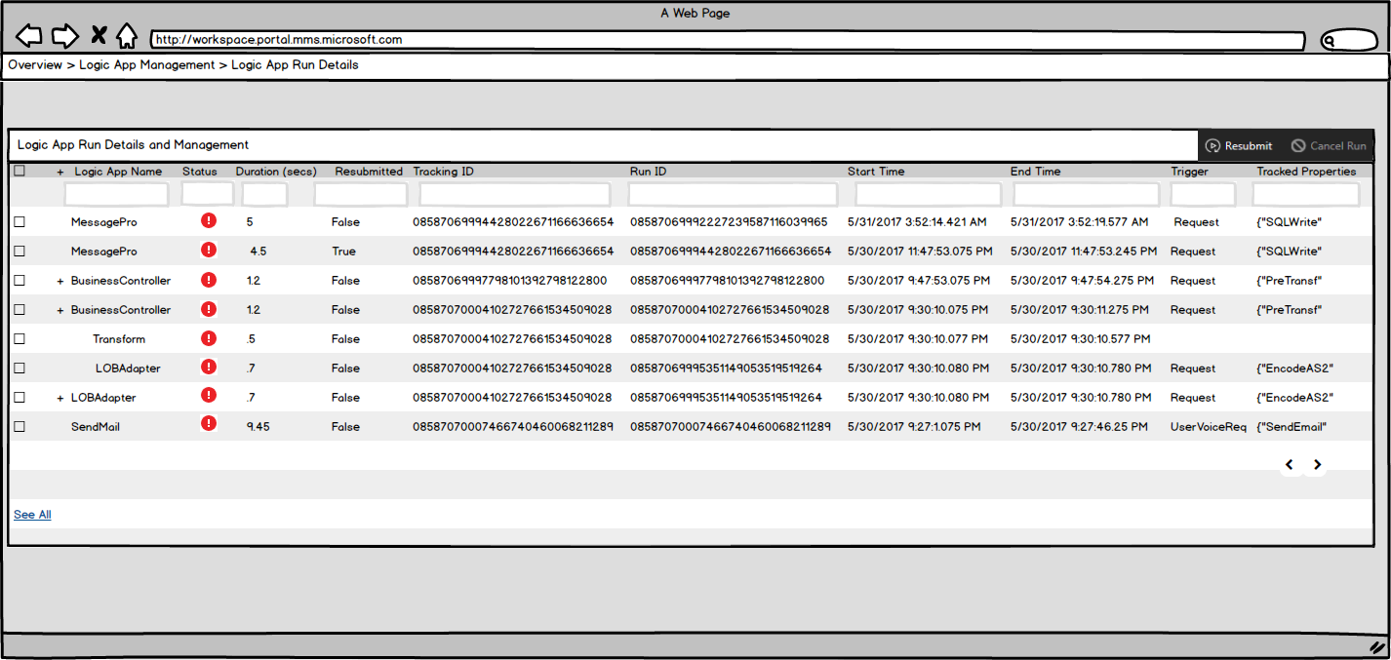
View Nested Workflows (one level)

Slide 18
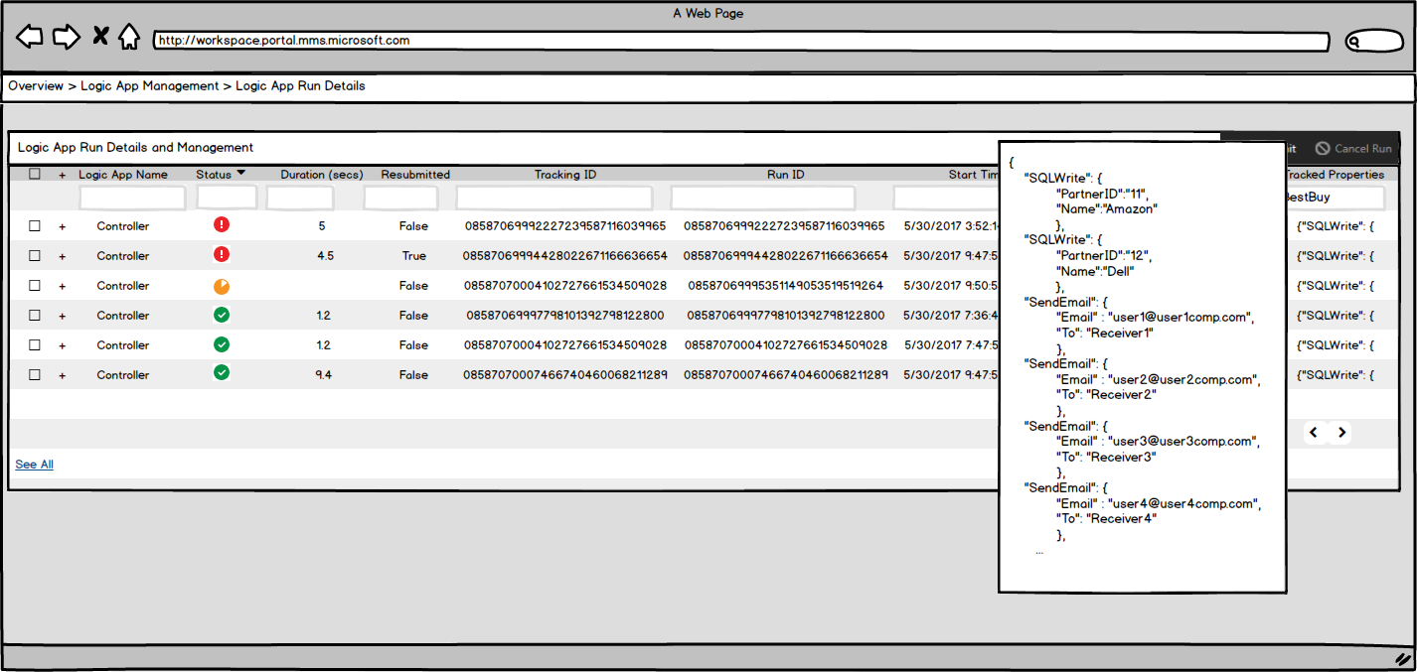
Tracked Properties more than a page

Slide 19
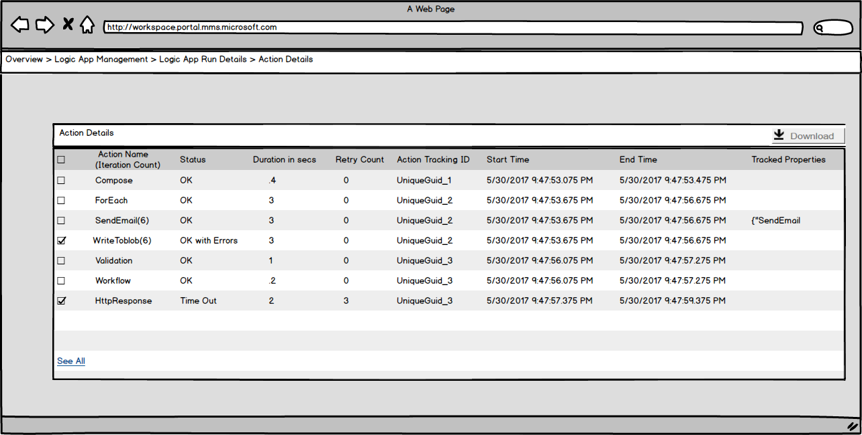
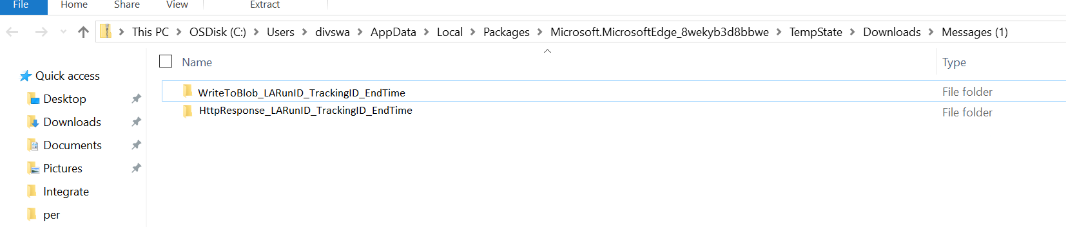
Bulk Select and Download

Slide 20
Operational Monitoring
New query engine
  Language shared with AppInsights
  Powerful features such as joins
Coming mid-July

Slide 21
One more thing

Slide 22
Thankyou

