Slide 1
Jeff Hollan / Derek Li
Program Manager – Microsoft
Azure Logic Apps – Advanced integration patterns

Slide 2
Azure Logic Apps Advanced Integration Patterns
Jeff Hollan
Derek Li

Slide 3
Agenda
Logic Apps Architecture
Parallel Actions
Exception Handling
Other “Operation Options”
Workflow Expressions

Slide 4
Understanding the PaaS Black Box

Slide 5
Understanding the PaaS Black Box

Slide 6
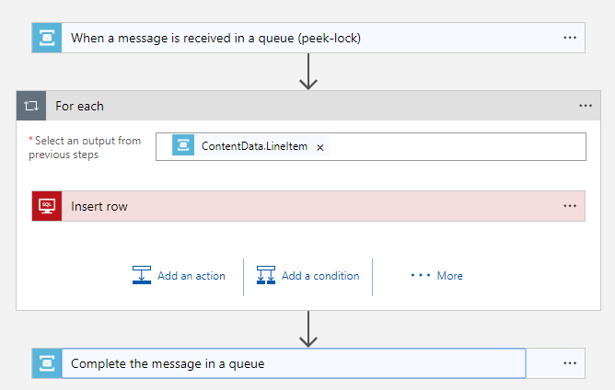
Understand the PaaS “Black Box”

Slide 7
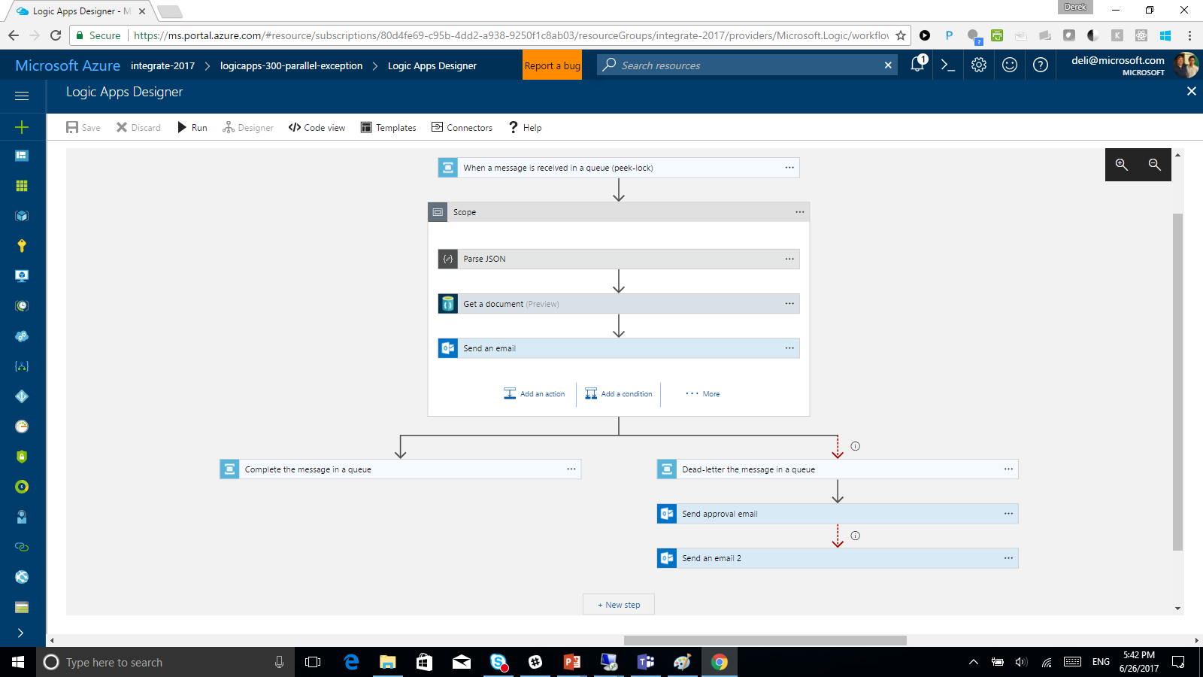
Logic Apps Designer

Slide 8
TypeScript/React app
Uses OpenAPI (Swagger) to render inputs & outputs
Generates workflow definition (JSON)

Slide 9
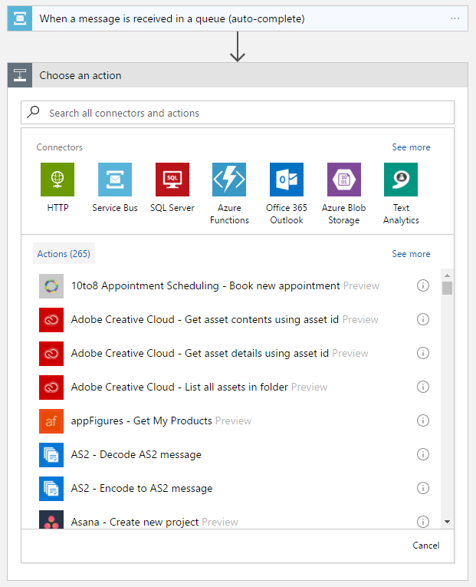
Logic App Designer
TypeScript React App
Uses OpenAPI (Swagger) for rendering inputs/outputs
Generates a workflow definition (JSON) to send to the backend

Slide 10
Logic App Runtime
Reads the workflow definition and breaks down into a composition of tasks with dependencies
Distributed compute/workers are coordinated to complete tasks on-demand
At least once guaranteed execution
No active thread management – tasks and runs can exist in parallel and at massive scale

Slide 11
Workflow Definition
Service Bus
Trigger Task
Run
Save
ForEach
On new message
SQL Insert
Workflow Orchestrator
Complete Message
Workflow Complete

Slide 12
Task Resiliency
Transient failures invoke retry-policies (DNS issues, throttles, or 5xx responses)
If the task doesn’t respond, workflow orchestrator will assign a new task (at least once guarantee)

Slide 13
Demo

Slide 14
Workflow Expressions
Any input that will be dynamic (change every run) is an expression
@triggerBody() @body(‘actionName’) @items()
@guid() @utcnow() @rand(0, 2)
@json() @xml() @formDataValue(‘actionName’)

Slide 15
@
Used to indicate an expression, can be escaped with @@
e.g. @UtcNow()

Slide 16
( )
Encapsulate expression parameters
e.g. @length(‘Hello World’)

Slide 17
{ }

Slide 18
{ }
Curly braces means string. Same as doing @string(), but allows for interpolation
e.g. This is @{add(1,1)} == @concat(‘This is ’, string(add(1,1)))

Slide 19
[ ]
Used to parse properties in JSON objects
e.g. @body(‘JsonBody’)[‘person’][‘address’][‘streetName’] 🙂

Slide 20
[ ]
Used to parse properties in JSON objects
e.g. @body(‘XmlResponse’)[‘not’][‘xpath’] ☹️

Slide 21
[ ]
Used to parse properties in JSON objects
e.g. @xpath(body(‘XmlResponse’), ‘/this/is/good’) 🙂

Slide 22
[ ]
Used to parse properties in JSON objects
e.g. @json(xml(body(‘XmlResponse’)))[‘this’][‘works’][‘too’] 🙂

Slide 23
Breaking Down an Expression
@contains(tolower(triggerBody()['user']['displayName']), 'jeff’)
triggerBody()[‘user’][‘displayName’]
Get the body from the trigger, and Access the “displayName”
tolower(triggerBody()[‘user’][‘displayName’] )
Convert to lowercase – in this case make the “displayName” lower case
contains(tolower(triggerBody() [‘user’][‘displayName’] ), ‘jeff’)
See if a value is contained in the first – in this case see if the lower-cased “displayName” contains “jeff”
Result is: TRUE or FALSE

