Slide 1
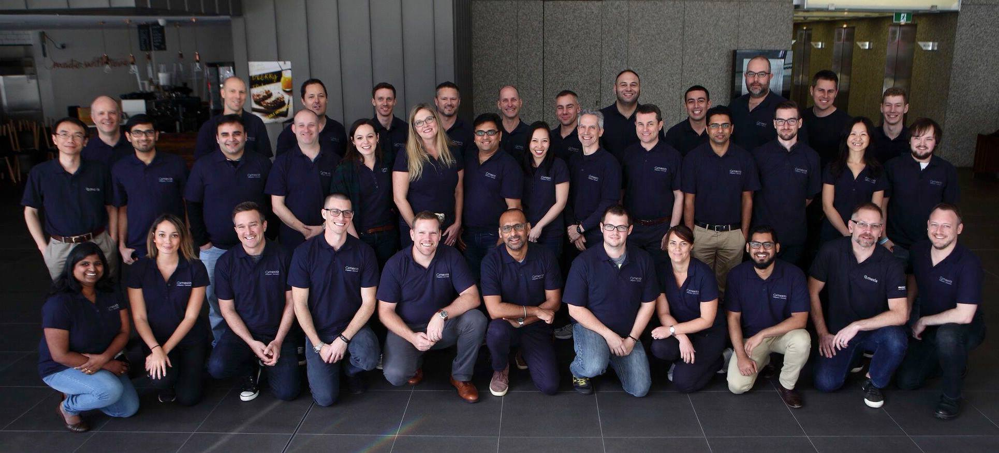

Microsoft 2017 Australian Partner of the Year!
Notes:
Gold Partner in Cloud Platform and Application Integration
Microsoft Australian Partner of the Year!
BizTalk360 partner as well

Slide 2

Dan Toomey
Integration MVP
The Hitchhiker’s Guide to Hybrid Connectivity

Slide 3
What This Talk is NOT About
Integration Patterns
  Specifically focuses on connectivity options
  Excludes async patterns (i.e. Service Bus queues / topics)
Demos
  Theoretical talk only due to time constraints
Network Level Connectivity
  Mentioned as an option, but not the primary focus
  Concentrates on non-network options
Notes:
Must limit scope to fit into 30 minutes
This is about real-time connectivity – not integration patterns
Focussing on non-network solutions (less IP Pro)

Slide 4
The Hitchhiker’s Guide to Synchronous Hybrid Connectivity with
Limited Network Changes
Notes:
Possibly a better title? But not as sexy…

Slide 5
Agenda
Network Based Options
  VNET Types (P2S, S2S, ExpressRoute)
  VNET Integration
Non-Network Based Options
  Azure Relay
  On-Prem Data Gateway
Scenarios

Slide 6
Network Based
Options
Notes:
Solutions can be categorised into two groups:
Options based on network level changes
Options that do NOT require network changes

Slide 7

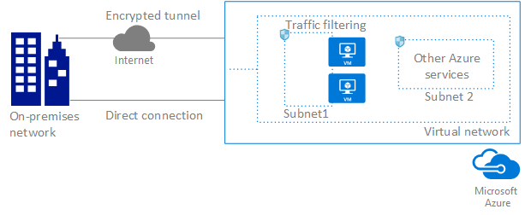
Azure Virtual Network
P2S, S2S
Types:
  Point to Site (P2S)
  Site to Site (S2S)
  ExpressRoute
ExpressRoute
image: https://docs.microsoft.com/en-us/azure/virtual-network/virtual-networks-overview
Notes:
Point-to-site virtual private network (VPN):
Established between a single PC connected to your network and the VNet.
Uses the SSTP protocol to provide encrypted communication over the Internet between the PC and the VNet.
The latency for a point-to-site VPN is less predictable, since the traffic traverses the Internet.
Site-to-site VPN:
Established between your VPN device and an Azure VPN Gateway.
Connection is an IPSec/IKE VPN that provides encrypted communication over the Internet between your on-premises device and the Azure VPN gateway.
The latency for a site-to-site connection is less predictable, since the traffic traverses the Internet.
Azure ExpressRoute:
Established between your network and Azure, through an ExpressRoute partner.
This connection is private. Traffic does not traverse the Internet.

Slide 8
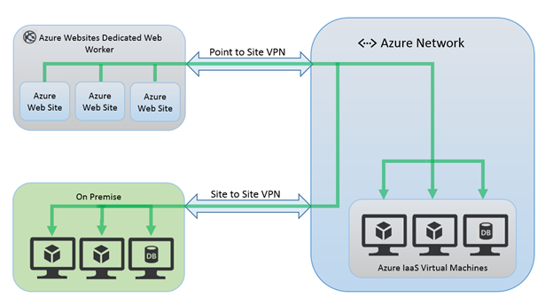
VNET Integration for Web / Mobile Apps
Requires Standard or Premium App Service Plan
VNET must be in same subscription as ASP
Must have P2S enabled
Must have Dynamic routing gateway
image: https://docs.microsoft.com/en-us/azure/app-service-web/web-sites-integrate-with-vnet
Notes:
VNET Integration only works with apps in a Standard or Premium pricing plan.
If your target virtual network already exists, it must have point-to-site VPN enabled with a Dynamic routing gateway before it can be connected to an app. Does not support Static routing.
The VNET must be in the same subscription as your App Service Plan(ASP).
The apps that integrate with a VNET will use the DNS that is specified for that VNET.
By default your integrating apps will only route traffic into your VNET based on the routes that are defined in your VNET.

Slide 9
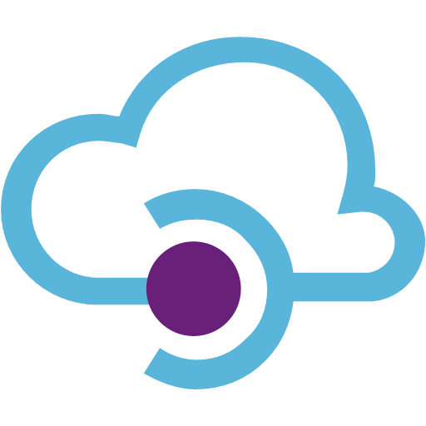
VNET with API Management
Added layer of security
All the benefits of APIM
Notes:
APIM: Caching, security, Agility, Analytics

Slide 10
Non-Network Based
Options
Notes:
No reliance on IT Ops, Security governance, etc.

Slide 11
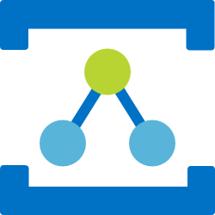
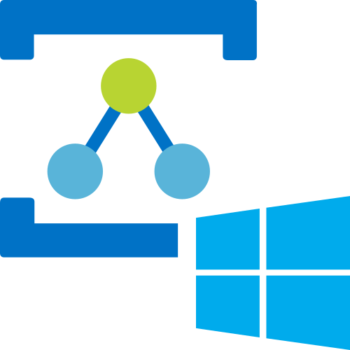
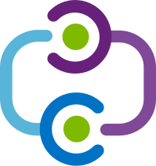
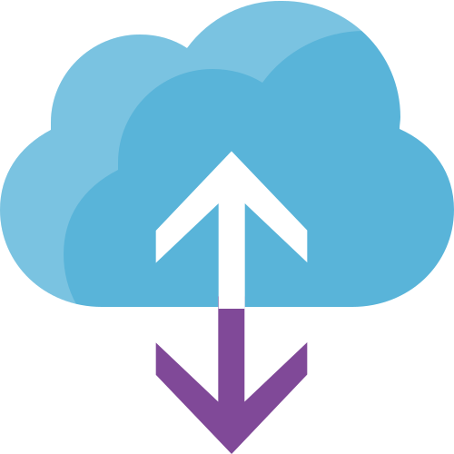
Relay – An Alternative Approach
Relay underpins all of the non-network connectivity options
  Azure Relay
    WCF Relay
    Hybrid Connections
  On Prem Data Gateway

Slide 12
Why the Relay?
Traffic OUT is not usually a problem
Traffic IN – different story!
Notes:
Getting out of your corporate network is usually easy
Getting in is typically very difficult!

Slide 13
How Relay Works
Concepts:
  Secured listener endpoint in the cloud
  Opened via an outbound connection from within corporate network
  Clients send messages via the listener’s endpoint
  No changes to corporate firewall or network required
    As long as it allows outbound traffic on
    port 80/443
Notes:
Michael Stephenson: “Secure router in the sky”
Quick Win: Hybrid Integration in a day

Slide 14
Azure Relay
Generally Available as of 27 March 2017
One of the three Service Bus offerings
Comprised of two services:
  WCF Relay
  Azure Relay Hybrid Connections
Notes:
Service Bus Relay has been “rebranded” as part of Azure Relay (but still basically the same)
Hybrid Connections (v2) has been overhauled and improved tremendously

Slide 15
WCF Relay – How It Works
WCF Relay point within a Service Bus namespace
Outbound connection from an on-prem WCF service
Uses WCF relay bindings:
  NetTcpRelayBinding
  BasicHttpRelayBinding
  WS2007HttpRelayBinding
  NetOnewayRelayBinding
  NetEventRelayBinding
  WebHttpRelayBinding
  NetMessagingBinding
Security via Shared Access Signatures (SAS)
Accessible from a variety of services & locations
Notes:
Service Bus offered relays almost from the beginning of Azure
Built on the WCF capability
Security was originally ACS, but now SAS
can be consumed by lots of different tech, eg biztalk, soap, rest, crm online and is very reusable

Slide 16
WCF Relay – Constraints
Needs a self-provided listener service
Relies on Windows / .NET framework
Optimised for XML messaging

Slide 17
WCF Relay – Pricing
WCF RELAY PRICING
Relay hours | $0.10 for every 100 relay hours
Messages | $0.01 for every 10,000 messages
The monthly prices are calculated based on 744 hours of use. Connections will be charged in one hour increments.
MONTHLY USAGE SCENARIO:
1 connection x 744 hours + 1 million messages** = US $1.74*
*Excludes data egress charges
**Message size up to 64KB
Notes:
FIND OUT: Are there associated data egress charges??

Slide 18
Hybrid Connections
Works at the transport level (web sockets)
Relies on port forwarding (hostname + port)
Requires only a Service Bus namespace (no MABS)
Cross Platform (Windows & Linux)
Codeless experience for Web Apps / Mobile Apps
API accessible for other scenarios
Notes:
Built on Web Sockets so not confined to Windows
Examples include Apache Thrift

Slide 19

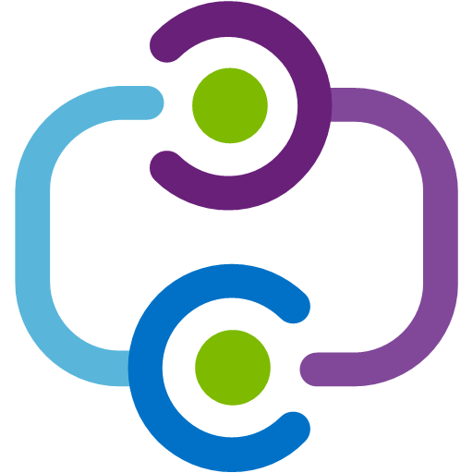


Hybrid Connections – How It Works
Connection created in Azure (Service Bus)
Hybrid Connection Manager installed on prem
Corporate Network
Microsoft SQL Server
Web App
Other published resources
Hybrid Connection
Hybrid Connection Manager
Mobile App
Hostname & Port
Hostname & Port
Notes:
Easy to setup – download the HCM
Codeless solution!
Lift & shift

Slide 20
Hybrid Connections – Scalability
Connection created in Azure (Service Bus)
Hybrid Connection Manager installed on prem
Corporate Network
Web App
Microsoft SQL
Server Cluster
Hybrid Connection
Hybrid Connection Manager
Mobile App
Cluster Name & Port
Cluster Name
& Port
Notes:
Multiple instances of the Hybrid Connection Manager can be used on-premises for resiliency and load-balancing.

Slide 21
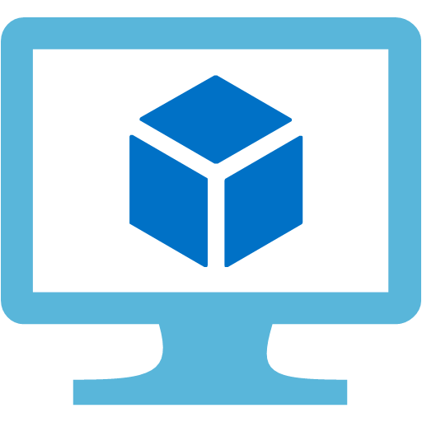

Hybrid Connections – Using the API
Port Bridge code option (running as a Windows service)
Corporate Network
Client Agent Code
Server Agent Code
Microsoft SQL Server
Other published resources
Azure VM
Hybrid Connection
Server
Samples: github.com/Azure/azure-relay-dotnet/
Notes:
Using the API to manage port bridge connections
Can connect almost anything!

Slide 22
Azure Relay Hybrid Connections
Constraints:
Maximum 10,000 relay endpoints per namespace
Maximum 25 listeners per relay
Best for Azure-hosted clients
Codeless experience limited to Web/Mobile Apps
  … but plenty of examples of the rest on GitHub!
  github.com/Azure/azure-relay-dotnet/

Slide 23
Azure Relay Hybrid Connections – Pricing
HYBRID CONNECTION PRICING
Connection Charge (includes 5 GB of data/month) | US $10 per Listener
Data Transfer Overage (Data exceeding the included 5 GB/month)* | US $1/GB
*The data transfer limit of 5 GB covers total data transfer across all listener units.
MONTHLY USAGE SCENARIO:
2 HC listeners + 10 GB data = US $25.00 [ ($10 x 2) + $ 5 data overage ]
3 HC listeners + 100 GB data = US $125.00 [ ($10 x 3) + $ 95 data overage ]
Notes:
Watch out for high data usage

Slide 24
Which Azure Relay to Use?
WCF Relay
(WCF Application Stack)
Application
Layer
Transport
Layer
Hybrid Connections
(TCP, Port Forwarding)

Slide 25
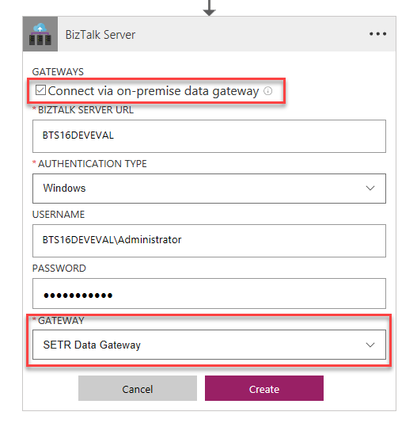
On-Premises Data Gateway
Generally Available as of 4th May 2017
Acts as a bridge between Azure PaaS and on-prem resources
Works with connectors for Logic Apps, Power Apps, Flow & Power BI:
  BizTalk Server
  DB2
  File System
  Informix
  MQ
  MySQL
  Oracle Database
  PostgreSQL
  SAP Application Server
  SAP Message Server
  SharePoint for HTTP only, not HTTPS
  SQL Server
  Teradata
Notes:
This is THE solution for PaaS based integrations!
160+ connectors at the Azure side
Codeless solution

Slide 26
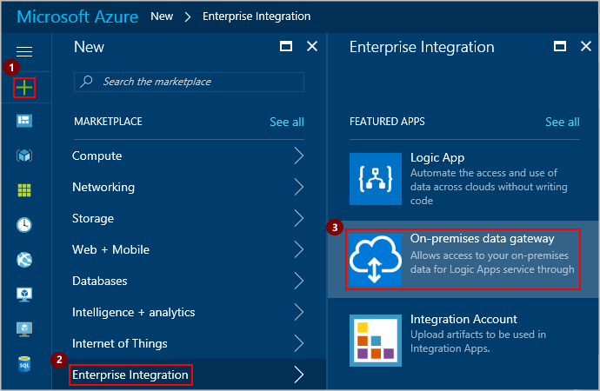
On-Premises Data Gateway – How It Works
Download and install the gateway on-premises
Create and associate a data gateway in Azure
Connect Logic App / Power App / etc to gateway
Can run over ExpressRoute

Slide 27
On-Premises Data Gateway – Constraints
Accessible only from within managed connectors (no API)
Only one gateway installed per machine
Cannot be hosted on a domain controller
Requires Windows host (Win 7 / 2008 R2 or later)
Must use Azure school or work account
No current support for High Availability (but on roadmap)

Slide 28
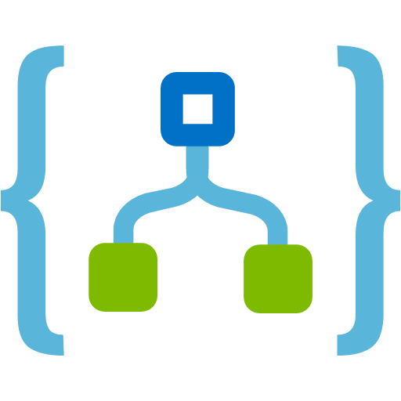
On-Premises Data Gateway – Pricing
On-premises data gateway PRICING
FREE!! | (but you pay for the services that use it)
MONTHLY USAGE SCENARIO:
Logic App Action | Quantity / month | Price | Cost
Polling trigger (1 min interval) | 43,200 | 0.0008 | $ 34.56
Execution shape (first 250K) | 206,800 | 0.0008 | $ 165.44
Execution shape (next 750K) | 750,000 | 0.0004 | $ 300.00
TOTAL COST: |  |  | $ 500.00
Notes:
OPDG is just an add-on feature, not an independent service like WCF Relay / Hybrid Connection

Slide 29
Scenarios

Slide 30
Scenario 1: Azure Web/Mobile App to On-Prem
Corporate Network
?
Microsoft SQL Server
Web App
Notes:
Maybe ask the audience:
How many people think that a WCF Relay is the best solution here?
How many think a Hybrid Connection is best?
How many would use an On Prem Data Gateway?
How many think a VNET is the only way to solve this?

Slide 31
Scenario 1: Azure Web/Mobile App to On-Prem
Corporate Network
Microsoft SQL Server
Web App
Hybrid Connection
Hybrid Connection Manager
Notes:
Primary Solution: Azure Relay Hybrid Connections
Super easy to configure
Can use multiple HC’s to talk to multiple systems
Very inexpensive
No network reconfiguration

Slide 32
Scenario 1: Azure Web/Mobile App to On-Prem
Alternatives:
 | WCF Relay | Point 2 Site VNET | Logic App + OPDG
Expose resources at a fine-grained level | ✓
Leverage WCF stack features | ✓
Use Active Directory Authentication | X | ✓ | X
Move large amount of data |  | ✓
Minimise ongoing cost | ✓
Notes:
WCF Relay (if need to restrict to a single application/endpoint or wish to use WCF application stack, i.e. Message Security, Reliable Sessions, etc)
VNET integration (if cannot identify system by hostname & port number, or if require Active Directory authentication)
ExpressRoute w/App Service Environment (massive data / bandwidth / low latency requirements)

Slide 33
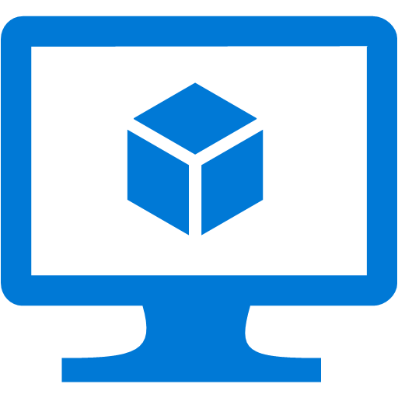
Scenario 2: IaaS Server (VM) to On-Prem
Corporate Network
?
Microsoft SQL Server
Other published resources
VM

Slide 34

Scenario 2: IaaS Server (VM) to On-Prem
Corporate Network
Microsoft SQL Server
Other published resources
VM
Hybrid Connection
Port Bridge
Server
Notes:
Primary Solution: Azure Relay Hybrid Connections
Port Bridging service in both IaaS and On-Prem server
Requires some custom code (mostly from GitHub sample)
Deploy a Windows service both on-prem and on IaaS VM

Slide 35
Scenario 2: IaaS Server to On-Prem
Alternatives:
 | WCF Relay | Logic App + OPDG | Site 2 Site VNET
Expose resources at a fine-grained level | ✓
Leverage WCF stack features | ✓
Use Active Directory Authentication | X | X | ✓
Move large amount of data |  | ✓ | ✓
Minimise ongoing cost | ✓
Leverage managed connector(s) | X | ✓
Notes:
WCF Relay (if need to restrict to a single application/endpoint or wish to use WCF stack)
Logic App + On-Prem Data Gateway (if supported connector exists for the target on-prem system)
S2S VNET (if cannot identify system by hostname & port number OR require Active Directory authentication)
Can use ExpressRoute for massive data / bandwidth / low latency requirements

Slide 36
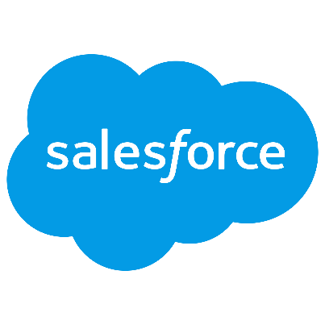

Scenario 3: SaaS Service to On-Prem
Corporate Network
?

Slide 37
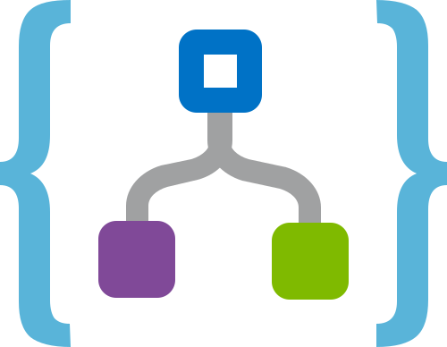

Scenario 3: SaaS Service to On-Prem
Corporate Network
Logic App
On-Prem Data Gateway
OPDG Manager
Notes:
No-Brainer Solution: On-Prem Data Gateway
Use with Logic App and managed connectors
Fully PaaS solution
On-Prem BizTalk Server improves the story even more! (plug Wagner’s presentation)

Slide 38
Scenario 3: SaaS Service to On-Prem
Alternatives:
 | API Gateway w/VNET | WCF Relay | Hybrid Connection
Expose resources at a fine-grained level | ✓ | ✓
Leverage WCF stack features |  | ✓ | X
Move large amount of data | ✓ | (✓) | X
Minimise ongoing cost |  | ✓
Protocol translation | ✓ | X
Tracking / Monetization | ✓
Notes:
API Management (connected to a VNET)
WCF Relay (if client can talk .NET or REST)
Azure Relay Hybrid Connections (via Web App)

Slide 39

Scenario 4: Business to Business
Partner Network
Corporate Network
?

Slide 40
Scenario 4: Business to Business
Partner Network
Corporate Network
Enterprise Integration Pack
Schemas
Maps
TPM
Logic App
On-Prem Data Gateway
OPDG Manager
Notes:
Primary Solution: On-Prem Data Gateway
Use with Logic App and Enterprise Integration Pack
Fully PaaS solution
Supports EDI if req’d

Slide 41
Scenario 4: Business to Business
Alternatives:
 | API Gateway w/VNET | WCF Relay | Hybrid Connection
Expose resources at a fine-grained level | ✓ | ✓
Leverage WCF stack features |  | ✓ | X
Move large amount of data | ✓ | (✓) | X
Minimise ongoing cost |  | ✓
Protocol translation | ✓ | X
Tracking / Monetization | ✓
Notes:
API Management (connected to a VNET)
Azure Relay (Hybrid Connections or WCF Relay)
For EDI support, can connect to an on-prem BizTalk Server
Custom solution?

Slide 42
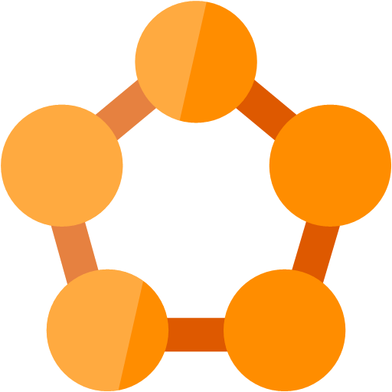
Scenario 5: Service Fabric Cluster to On-Prem
Corporate Network
?
Microsoft SQL Server
Other published resources
Service Fabric

Slide 43
Scenario 5: Service Fabric Cluster to On-Prem
Corporate Network
{}
Microsoft SQL Server
{}
{}
Other published resources
Hybrid Connection
Port Bridge
Server
Service Fabric
Notes:
Primary Solution: Azure Relay Hybrid Connections
Port Bridging service hosted in a microservice and an On-Prem server (haven’t tested this…)
Requires some custom code (mostly from GitHub sample)
NOT TESTED!

Slide 44
Scenario 5: Service Fabric Cluster to On-Prem
Alternatives:
 | WCF Relay | Logic App + OPDG | Site 2 Site VNET
Expose resources at a fine-grained level | ✓
Leverage WCF stack features | ✓
Use Active Directory Authentication | X | X | ✓
Move large amount of data |  | ✓ | ✓
Minimise ongoing cost | ✓
Leverage managed connector(s) | X | ✓
Notes:
WCF Relay (if need to restrict to a single application/endpoint or wish to use WCF stack)
Logic App + On-Prem Data Gateway (if connector exists for the target system)
S2S VNET (if cannot identify system by hostname & port number OR require Active Directory authentication)
Can use ExpressRoute for massive data / bandwidth / low latency requirements

Slide 45
Use <this> technology when…
VPN
Multiple resources and protocols require connectivity
Client is outside of Azure
Fine-grained exposure of WCF services required
Hybrid Connections
A fully PaaS solution is desired
LOB is one of the supported managed connection types
High bandwidth low latency demands
WCF Relay
Integration with a single AD is required
Tracking is required
Desire to leverage features of the WCF stack
Supporting B2B/EDI via Logic Apps & EIP
Network reconfiguration is justified
Client is a Web App or Mobile App (codeless)
Connecting to a TCP resource that is not .NET or even Windows
Administrators want fine-grained control and auditing
On-Prem Data Gateway
Target is a port based connection to an application server
Client is not a Web Site or Mobile Service
Ongoing costs is a factor
Notes:
Is this slide useful?

Slide 46



Cost/Effort Comparison
ID | Description | Operational Qty/mo
1 | WCF Relay | 1 relay, 1m msgs
2 | OPDG w/Logic App | 5x actions, 1 min trigger
3 | VNET w/Web App | Std ASP S1, 1 Web App
4 | VNET w/APIM | APIM Std
5 | VNET w/APIM & App Gateway & WAF | APIM Std, AG Med
6 | HC w/Web App | 1 listener, 10GB data, Std ASP
7 | HC w/VM | 1 listener, 10GB data + D2 v2 VM
High
1
D
E
V
E
F
F
O
R
T
Dev effort pertains to hybrid integration part only, not application functionality
Med
7
5
4
6
3
2
Low
$10 $100 $200 $500 $750 $1000
O N G O I N G M O N T H L Y C O S T
Scale is non-linear
Notes:
This slide attempts to show a relative comparison of ongoing cost and development effort required for each technology.

Slide 47
References
The New Azure Hybrid Connections
https://www.mexia.com.au/the-new-azure-hybrid-connections/
Hybrid Connectivity Options in the Microsoft Cloud
https://www.biztalk360.com/integrate-2014/hybrid-connectivity-options-microsoft-cloud/
Why use Service Bus Relay now I have Hybrid Connections?
http://microsoftintegration.guru/2014/07/07/use-service-bus-relay-now-hybrid-connections/
On-Premises Data Gateway
https://docs.microsoft.com/en-us/azure/analysis-services/analysis-services-gateway
What Is Azure Relay?
https://docs.microsoft.com/en-us/azure/service-bus-relay/relay-what-is-it
Understanding Azure Relay
https://www.servicebus360.com/blogs/understanding-azure-relay/
Azure Relay Samples on GitHub
https://github.com/Azure/azure-relay/tree/master/samples/WCF%20Relay

Slide 48
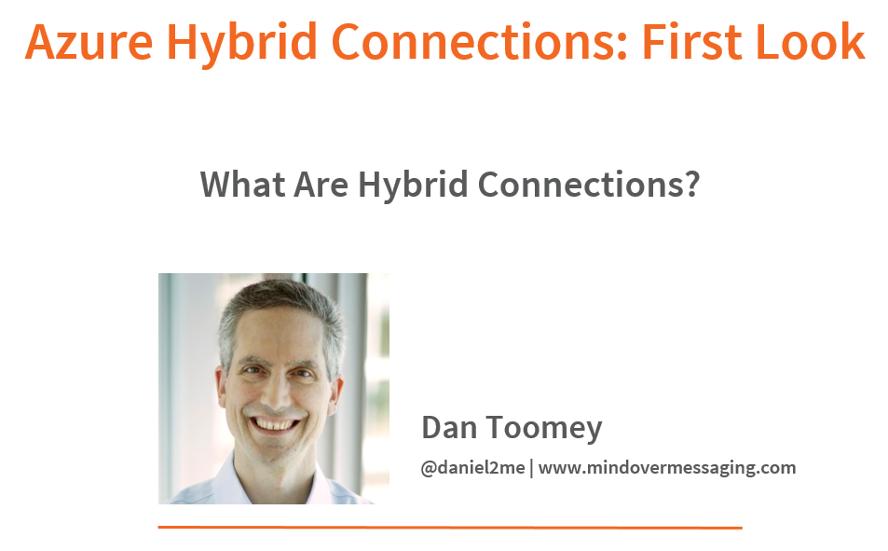
Pluralsight Course
Notes:
80% of this course still relevant for the codeless option (ignore MABS setup bit)

Slide 49




Let’s connect!
dan@mexia.com.au
@daniel2me
mindovermessaging.com
linkedin.com/in/danieltoomey

