Slide 1

Vladimir Vinogradsky
Principal PM Manager, Microsoft
Harnessing the Power of APIs

Slide 2
Next 45 min
Explain API Management and how we think about its value
Show API Management in action
Report progress and highlight a few customers
Answer questions
@AzureApiMgmt

Slide 3








The rise of APIs
“In the age of the customer, every business is a digital business. This means software is central for today’s enterprises, and APIs are central for today’s software.”
”... APIs play on the frontlines of business opportunity, creating new sources of revenue and market presence; they play behind the scenes, unlocking data and transactions buried in back-office systems; and they play anywhere in between.”
“Sizing The Market For API Management Solutions”
Randy Heffner and Michael Yamnitsky
Forrester Research Inc.
April 2, 2015
Notes:
More organizations adopt API-centric business strategies. Importance of APIs and investment in them are rising. APIs need to protected, measured and harnessed. In other words they need API management.

Slide 4

Azure API Management
AZURE API MANAGEMENT
Facade
decouple
modernize
optimize
...
Middleware
secure
protect
cache
...
Monitoring
usage
health
monetization
...
Developer
discover
document
on-board
...
Notes:
First is APIM creates a public facade over your APIs and decouples API implementations or backends from API consumers enabling them to evolve independently. This includes hiding all APIs regardless of their location behind a single domain name and API address. Exposing only a subset of backend capabilities to API consumers. Modernizing and normalizing APIs by changing their URL structure and response formats. Optimizing APIs for specific consumers and scenarios by conditionally stripping down the responses. Dynamically routing requests to implement advanced versioning approaches
Second, APIM allows API implementers to externalize and centralize common cross cutting concerns and focus on the core value, the domain related logic. Security, throttling, cross domain access and response caching are just a few horizontal capabilities you'll get from APIM. APIM supports API key, JWT token validation as well as IP based authorization. We offer a number of cross domain techniques including full support for CORS. APIM implements distributed quota and rate limiting policies that allow a great degree of flexibility and scale. It comes with built in response cache and policies that allow fine grained control over what and how gets cached
Having insight into usage and health of your APIs is important and APIM captures metrics and provides key reports out of the box. For those customers who are looking to monetize their APIs we collect and offer via API data allowing them to implement a variety of subscription business models.
With APIM Developer portal you can treat internal and external developers the same way from the get go and provide them with a self service on-boarding experience, AP catalog, documentation, samples, and allow them to send request to your APIs without writing a line of code.
■ Know who API users are and engage them like customers. Whether the developers programming to one’s APIs are inside the organization or outside, knowing who they are
is a foundation of API success. For an API provider that charges for API use, like Twilio
and SendGrid, this is of course necessary for collecting revenue, but even for free access, as with New York’s and Chicago’s transit systems’ APIs, knowing API users enables greater understanding of how APIs are used and what direction to take APIs in the future. API users, whether they pay or not, should be engaged as customers.
■ Clarify the rules of API access. For reasons of capacity management and security, access to APIs is rarely unlimited. But customers (i.e., API users in this case) don’t like surprises, so the
rules for access must be clear, such as what data may be accessed and how many requests are allowed per minute or per month. is may include de nition of di erent access plans with di erent rules for di erent API users.
Make it easy to use the API. rough documentation, examples, and discussion forums, it must be easy for API users to understand the API, get answers to questions, test API usage, and migrate between API versions. Although REST services are needed for mobile, other styles of services may also be part of an enterprise API strategy (e.g., SOAP, message queuing).
Enforce the rules of API access. API providers must validate that incoming API requests are authorized and comply with the rules de ned by the access plan each API user is associated with.
Proactively manage API success by treating it as a product. Whether API users are internal, external, or both, to optimize the business value of an API, the API provider must treat it as a product with customers and a life cycle. Whether via basic reporting or advanced analytics, API providers must understand patterns of API access, including error rates that may indicate the
API is di cult to understand. New versions of the API need a smooth and managed rollout to API users.
■ Connect API access to functions and data within their technology estate. APIs deliver their value by connecting to the API provider’s data and applications. Some of these assets may be API- ready, while others may need some manner of integration connectivity to make them accessible.

Slide 5
Azure API Management
AZURE API MANAGEMENT
Facade
decouple
modernize
optimize
...
Middleware
secure
protect
cache
...
Monitoring
usage
health
monetization
...
Developer
discover
document
on-board
...
APIs on Azure
Azure APIs
On-prem APIs
3rd party APIs
Notes:
APIM is a management layer atop all of your APIs regardless of their location or technology stack. You can also use it to publish on-prem APIs, expose 1st party Azure APIs in a simplified manner directly to your partners, or expose functionality provided by 3rd party APIs.

Slide 6
Azure API Management
API consumers
AZURE API MANAGEMENT
Facade
decouple
modernize
optimize
...
Middleware
secure
protect
cache
...
Monitoring
usage
health
monetization
...
Developer
discover
document
on-board
...
APIs on Azure
Azure APIs
On-prem APIs
3rd party APIs

Slide 7



AZURE API
MANAGEMENT
APP DEVELOPERS
Developer Portal
DIRECT OR
VPN
BACKEND
APIs
APPS
Gateway
Hosted anywhere.
Developed using any technology.
API PUBLISHERS
Publisher portal
Notes:
APIM on Azure is provided as a fully managed cloud service. It has 3 key components.
Publisher portal is used by API publishers, people who own the APIs, to manage the APIs. On the Publisher portal one can add and edit APIs, configure API policies, view analytics, etc. Metadata and settings entered on the Publisher portal drive both the gateway and the developer portal. Management operations can be automated by using a comprehensive but easy to learn and use API.
Developer portal is turn key and shows auto-generated API catalog, interactive documentation and samples. Its look-and-feel and behavior can be customized to reflect customer brand and needs.
Gateway acts as a front door and mediates all the requests to your APIs, collecting usage and health data and applying policies configured via Publisher portal. It can connect to backends located anywhere and implemented and running on any technology stack either directly or via VPN. Gateway supports both Basic HTTP and mutual certificate authentication.

Slide 8
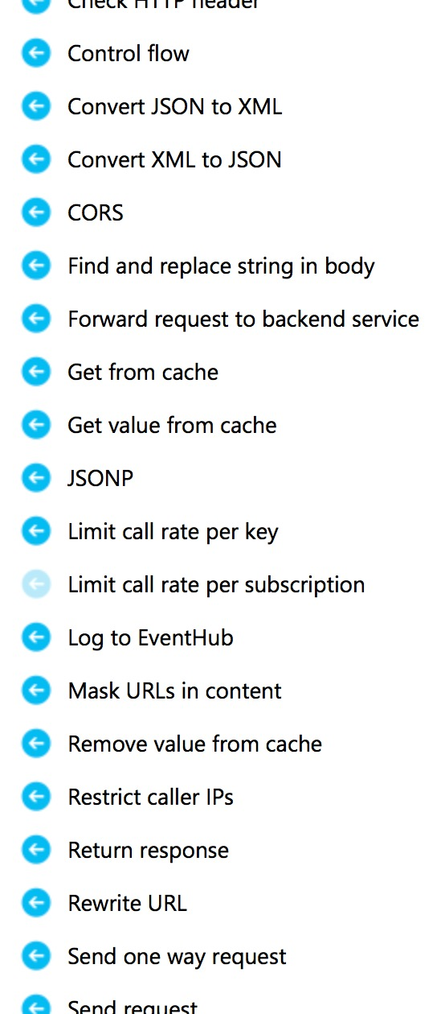
Briefly about policies and expressions
Policies
  Encapsulate common API management capabilities
  Mutate request context or change API behavior
  Can be set in the inbound and outbound directions
  Have global, product, API or operation scope
Expressions
  C# “snippets” embedded in policies
  Have read-only access to the request context
  Can use whitelisted .NET types only
  Are used to dynamically configure policies

Slide 9
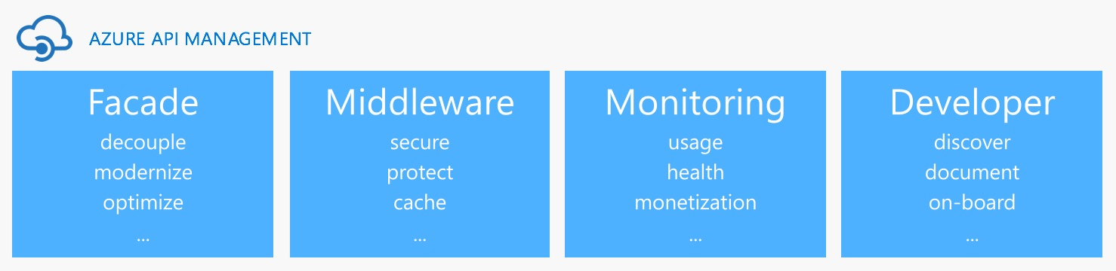
Demo

Slide 10









Logic App
Machine Learning
SQL Database
Function
Event Hub
Stream Analytics
Power BI
Data Late Cluster
Data Lake Storage
Stream Analytics
JSON, XML, CSV...
<log-to-eventhub
logger-id=“id”
partition-key=“@(expression)”>
@{expression}
</log-to-eventhub>
BACKEND
SERVICES
AZURE API
MANAGEMENT
APPS

Slide 11
4.7K
Customers
6K
Service instances
4B
Calls per month
137K
Developer
2x
Yearly customer growth
4x
Yearly call growth

Slide 12

Available worldwide
Customers in all 18 regions!

Slide 13
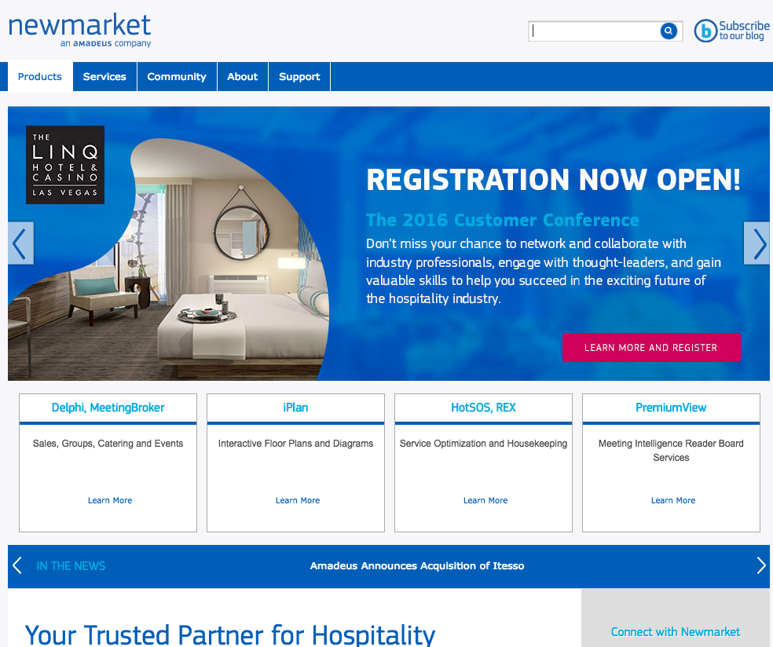
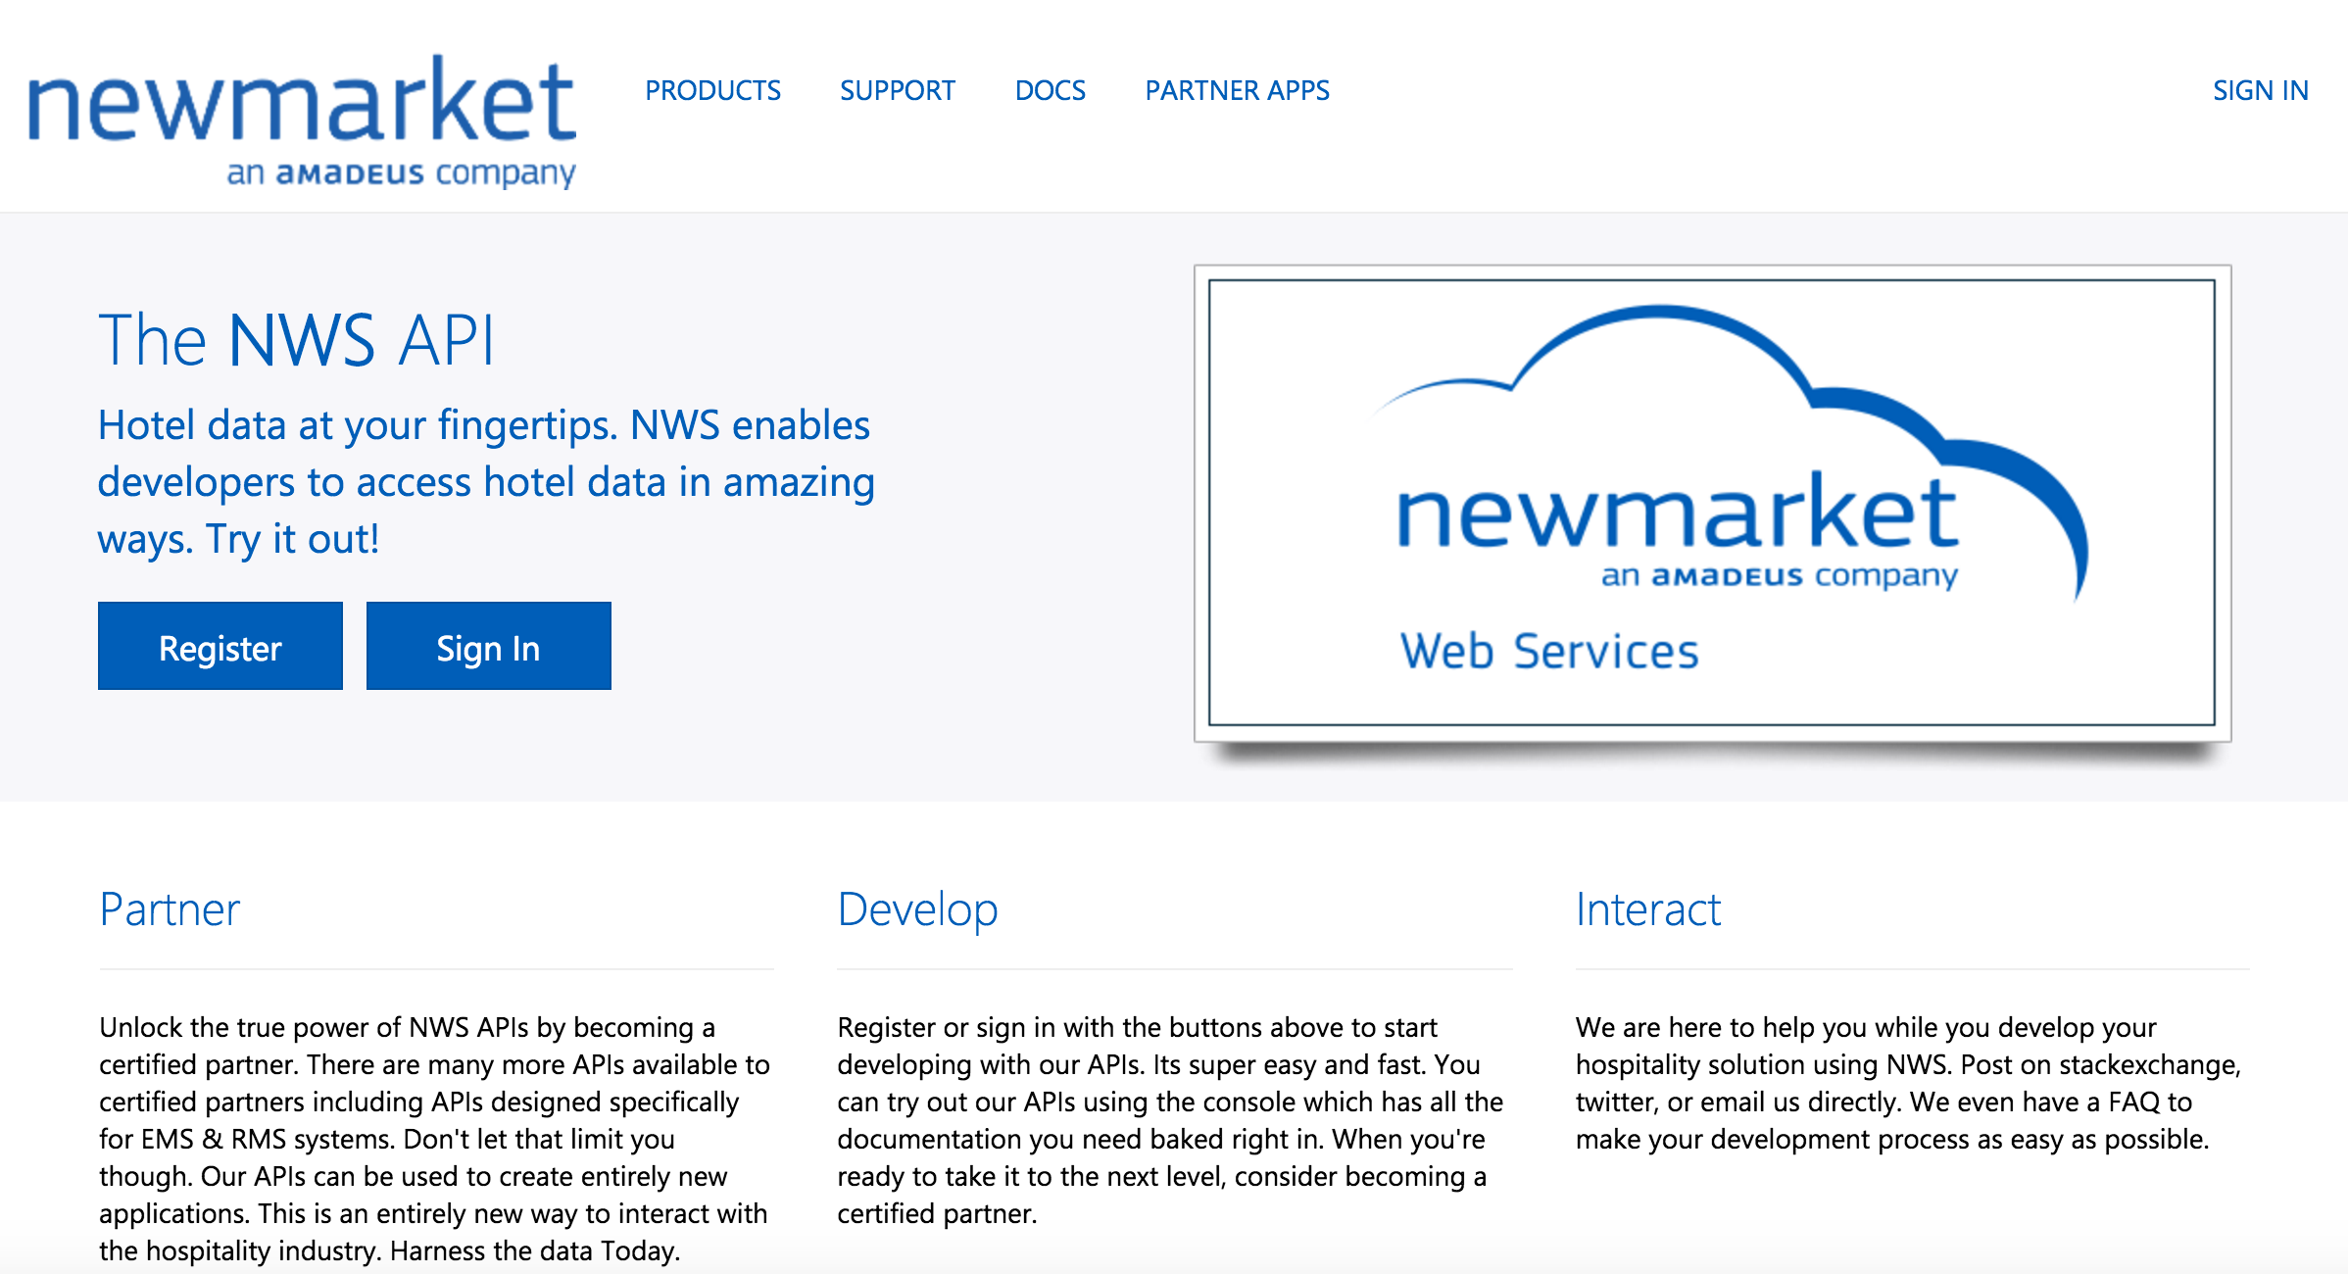
Newmarket
an Amadeus company
Part of the global Amadeus IT Group, Newmarket delivers hospitality solutions across 154 countries to names familiar to many travelers—Hyatt Hotels Corporation, Embassy Suites Hotels, and many more.
Objectives
Create a new business model by offering its application programming interfaces (APIs) as web services. Gain insight into how partners and customers are using its technology and use the data to monetize the APIs and provide better support.
Tactics
Use API Management to deliver APIs providing real-time information to digital displays in hotels connecting disparate systems. Expand API portfolio into areas that include property management and building automation to provide value-added services to more than 40,000 installations and 150,000 users in over 154 countries worldwide.
Results
Published APIs used by the company’s partners to integrate devices like digital screens with software systems. Certified 13 vendors with 15 more on the way.
Notes:
https://customers.microsoft.com/Pages/CustomerStory.aspx?recid=26612

Slide 14
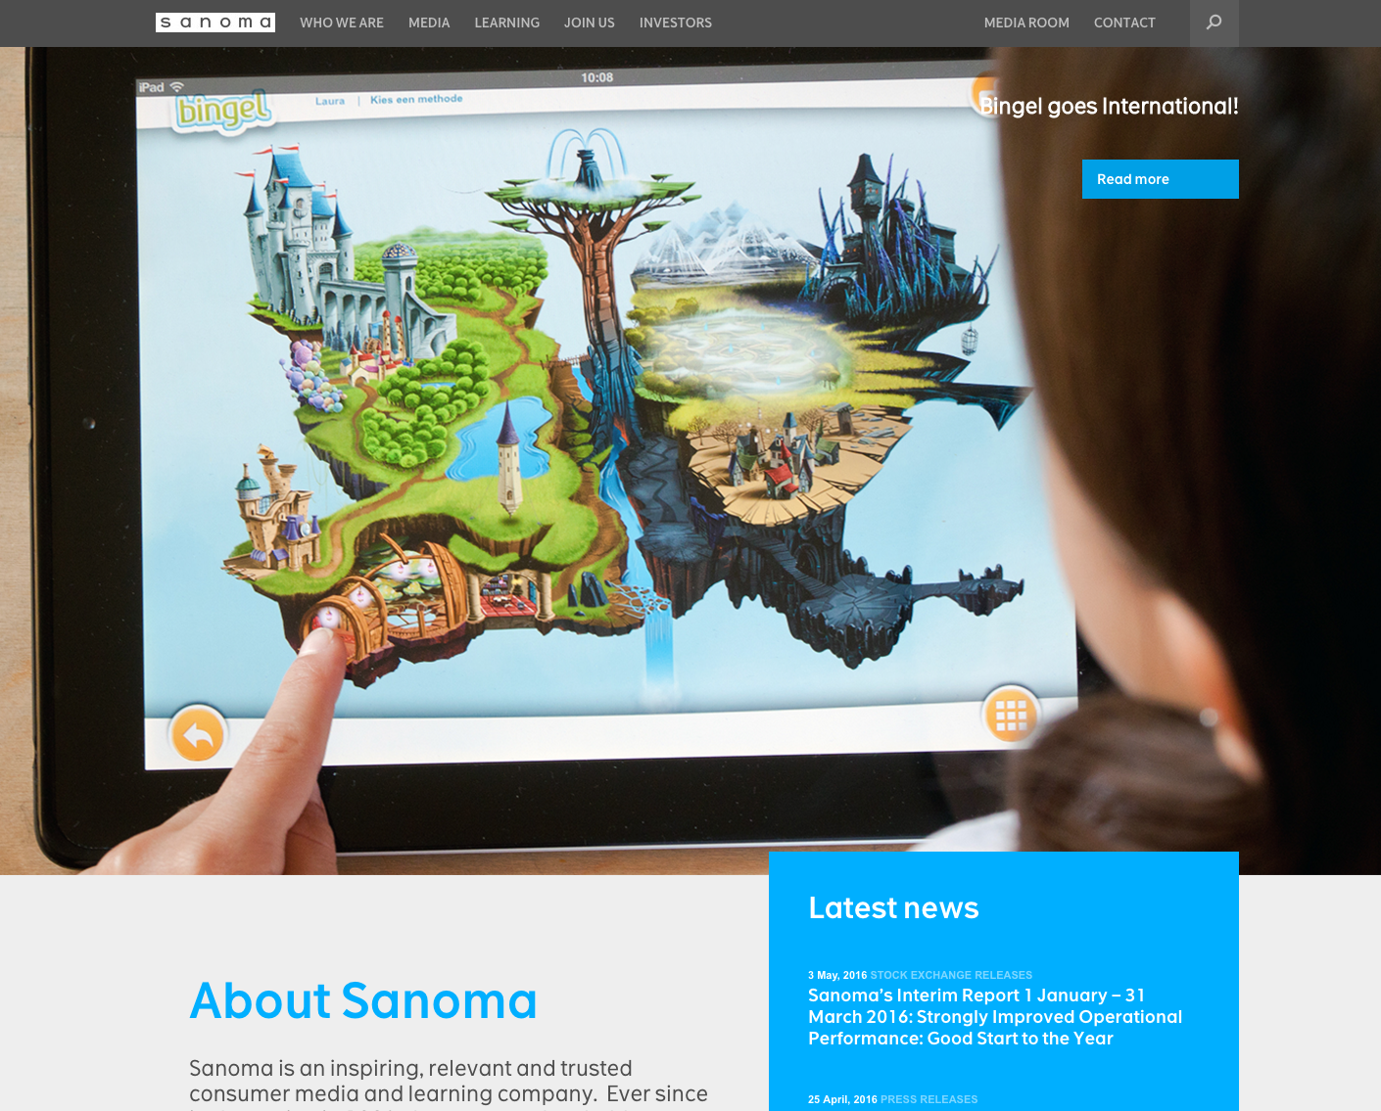


Sanoma Corporation
One of the largest media companies in Europe, Sanoma Corporation has operations in multiple countries and offerings across virtually every type of media, from magazines and newspapers to TV, radio, and games. Among the first to adopt digital media with digital versions of its flagship newspapers since 1996.
Objectives
Simplify the creation of innovative online services for multiple business groups by creating application programming interfaces (APIs) that provide access to data, including consumer profiles and media content.
Tactics
Utilize Azure ExpressRoute to connect API Management to diverse assets hosted in Sanoma datacenters and other environments. Deliver self-serve portal supporting developers working with multiple web and mobile platforms.
Results
Launched API program serving millions of calls per day with peaks driven by media events with no scalability issues.
Notes:
https://customers.microsoft.com/Pages/CustomerStory.aspx?recid=27119

Slide 15
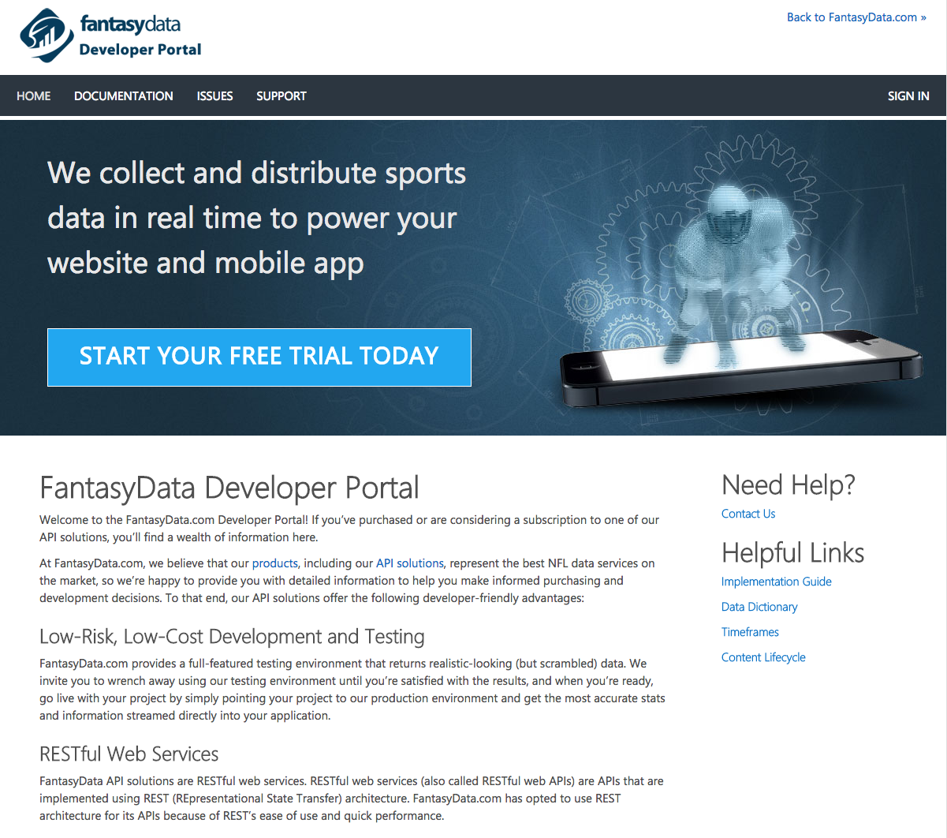
FantasyData
FantasyData is a leading provider of real-time sports content across multiple sports, serving fantasy, media and mobile clients worldwide.
Objectives
Serve real-time data from more than 5000 sporting events from all US regions including football, basketball, baseball, hockey and golf.
Tactics
Using API Management to aggregate data from multiple sources and offer access under multiple pricing tiers starting with free access. Deliver documentation and testing environment helping developers on multiple platforms get started quickly.
Results
Launched API program serving approximately 100 developers building apps for websites, mobile devices, stadium scoreboards and casino kiosks. Leveraging cloud resources to bring down costs and charge less than their competitors.
Notes:
https://customers.microsoft.com/Pages/CustomerStory.aspx?recid=25890

Slide 16

HALO
Exclusively published by Microsoft Studios and developed by 343 Industries, the Halo franchise is an award-winning collection of properties, over $5 billion in worldwide sales to date, that has transcended video games and grown into a global entertainment phenomenon.
Objectives
Expose key HALO APIs including player profiles, statistics and metadata.
Tactics
Using API Management to offer different levels of access for development and production with different rate limits. Using the management interface to get extra usage information for the exposed APIs.
Results
Launched API program serving 1500 users exploring, exploiting and creating incredible apps, tiles, websites and more…
Notes:
Are you connecting to any of your backends via VPN/ExpressRoute? we don’t
Are you doing any data transformation via policies? we used to have static responses that were created via policies before we fully launched, now we only do some minor transformations like removing headers from the response we don’t want developers to see and rewriting the request url.
How many API calls/month and/or customers do you serve? We have over 1000 of subscribers and over 50M calls a month (please don’t use these numbers in any public facing slides though)
Do you plan to offer API access in tiers? By tiers you mean different access levels? We already have two tiers: developers (who get 10 requests/10 seconds) and production (who get 200 requests/10 seconds and need to go through an approval process)
What were the top 3 things that sold you on APIM (or that you liked)? 1. Easily configured policies and rate limits per product 2. They made creating the APIs a pretty easy and straight forwards process 3. I recently discovered the extra power of the APIM REST APIs and was able to get some good information about the usage of our APIs

Slide 17
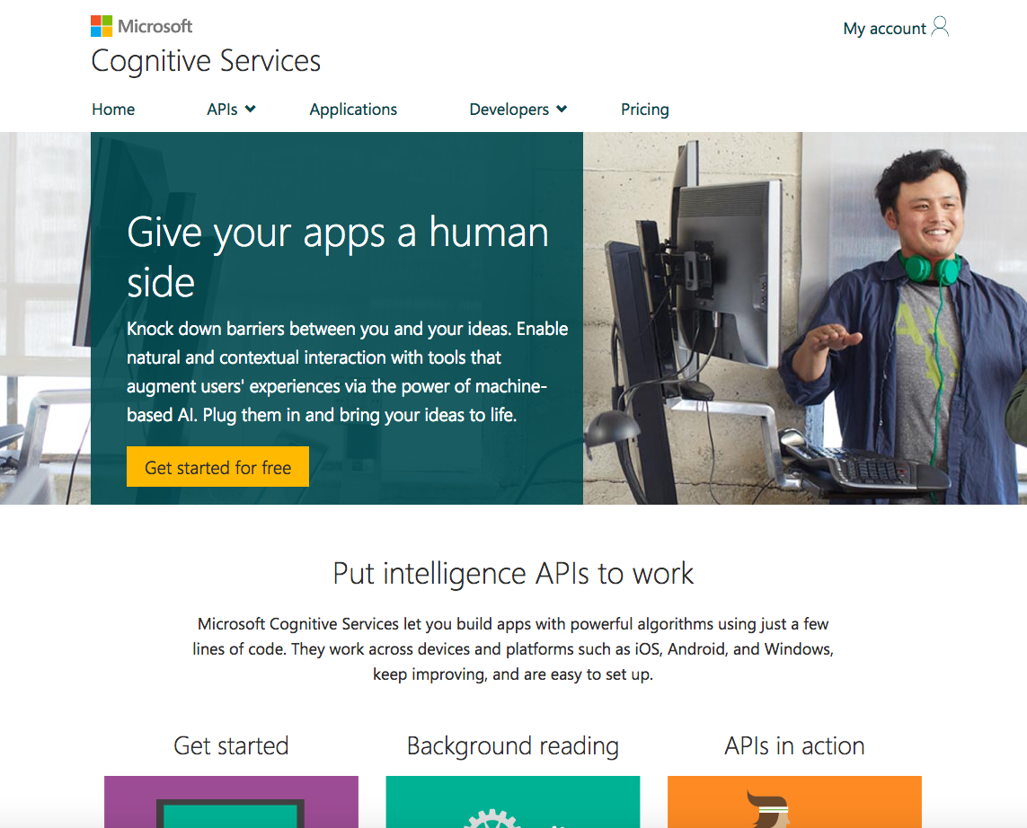
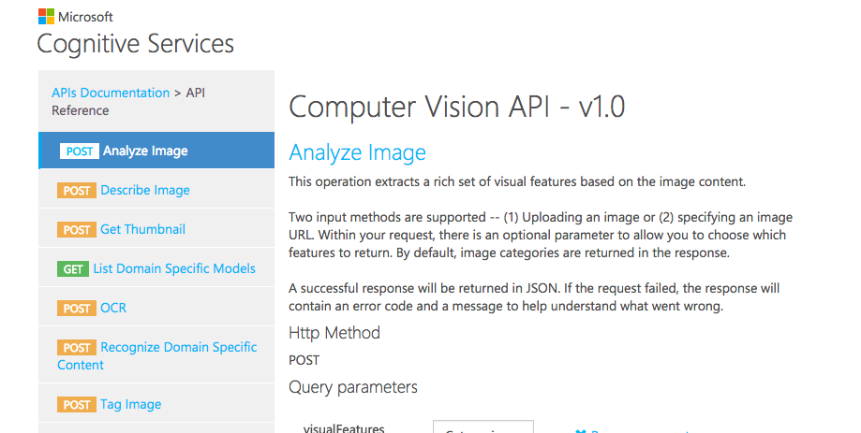
Cognitive Services
Microsoft Cognitive Services has built a broad range of AI-based intelligence capabilities handling vision (e.g. face and emotion recognition), speech (e.g. speaker recognition), language (e.g. linguistic analysis , Bing speller), knowledge (e.g. entity linking , recommendations) and search.
Objectives
Launch a public API program presenting a consistent experience across APIs.
Tactics
Using API Management to consolidate access to multiple backend systems and offer access in tiers with specific metering and rate limiting. Allowing developers to use a Microsoft account to get API credentials.
Results
Launched API program serving more than 21 million unique calls per month for 32,000 unique users.
Notes:
Are you connecting to any of your backends via VPN/ExpressRoute?[Jingmei Li] no
Are you doing any data transformation via policies?[Jingmei Li] Yes, we currently only transform the error responses returned by APIM.
How many API calls/month and/or customers do you serve?[Jingmei Li] As of March 2016, we were serving over 32K unique users or 105k API subscriptions (one user could have more than one API subscriptions). For March 2016, there was 21M API calls. We are still integrating multiple APIM instances since //build release, and for April the numbers should have been a lot higher and I can provide that later.
What were the top 3 things that sold you on APIM (or that you liked)?[Jingmei Li] Powerful policy settings for quota, rate limit, etc, continuous improvement from your team, good support experience.

Slide 18
Takeaways
APIs are the building blocks of modern apps
They need to be managed, protected and measured
Power of APIs is harnessed by developers
API management is a necessity
Buy is better than build¹
¹ This is a hint ☺

Slide 19
I love it! What’s next?
Try API Management on http://aka.ms/apimrocks
Send us your ideas on http://aka.ms/apimwish
Get quick answers on http://aka.ms/apimfaq
Keep up with updates on http://aka.ms/apimdocs
Follow us on @AzureApiMgmt

Slide 20
Thank you!

Slide 21
Notes:
Dark gray background.

