Slide 1

Steef-Jan Wiggers
Integration MVP
End-to-end IoT solution leveraging Microsoft Azure Platform

Slide 2




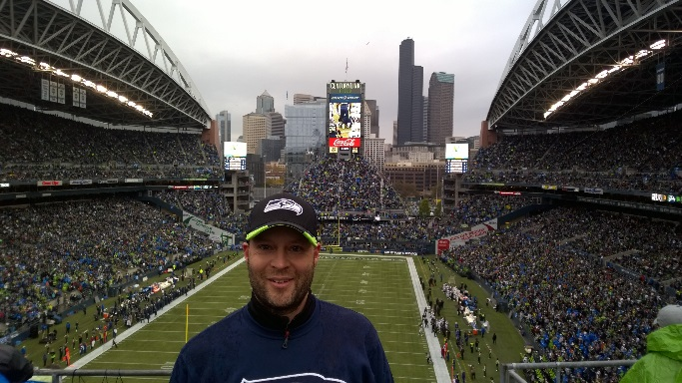

Steef-Jan Wiggers
Microsoft Integration Consultant
Microsoft Integration MVP
Published Author
(Inter)national Speaker
TechNet Wiki Author
Blogger
Forums
Runner
12th Man
DutchWorkz B.V.
Notes:
Speaker intro

Slide 3
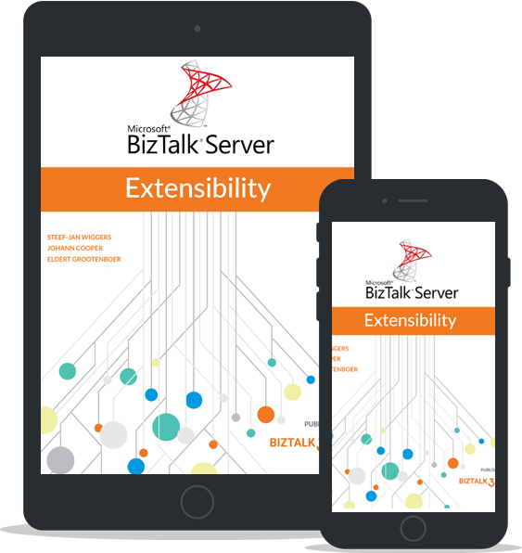
First plug an eBook
Steef-Jan Wiggers
Johann Cooper
Eldert Grootenboer
http://www.biztalk360.com/biztalk-server-extensibility/

Slide 4
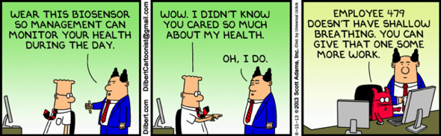
IoT Hype?
Notes:
Today, the Internet of Things (or IoT) is trendy, a lot of buzz and hype around it. However, it has become a reality in our age of digitalization and data. The internet has provided us means to consume data in various ways through devices provided by the smart devices. Connectivity, protocols, velocity and volume of data it all matters in IoT. In this session we dive into an end-to-end IoT solution, discussing the technology and services Azure offers and how solutions look in the real world.

Slide 5
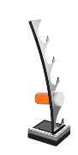
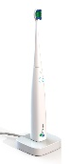

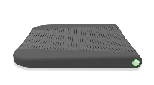




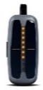

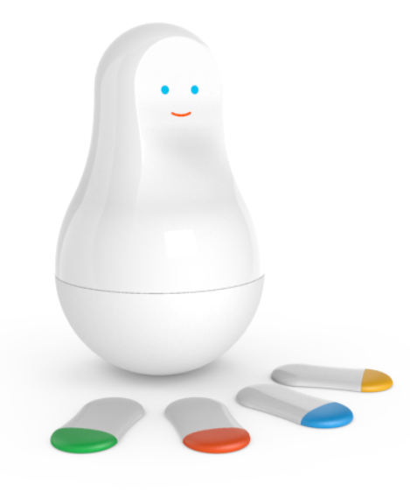
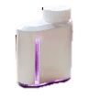

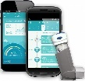


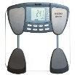

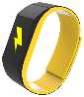
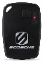


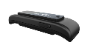



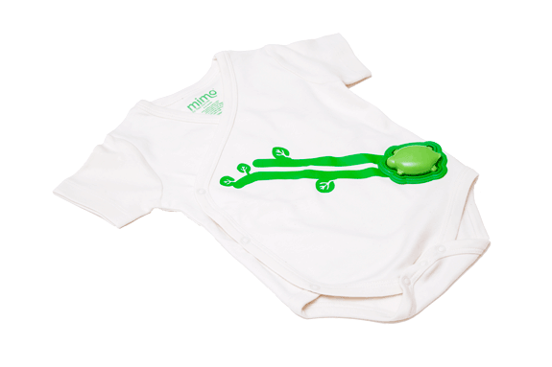
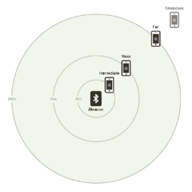
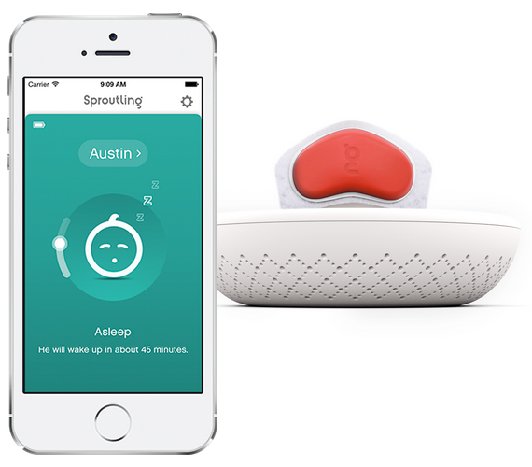

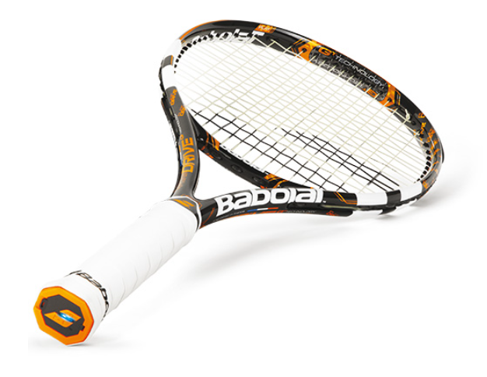

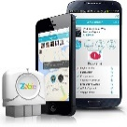









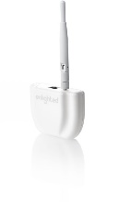

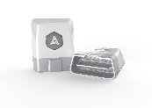
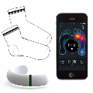
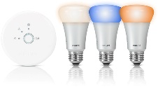



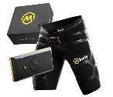
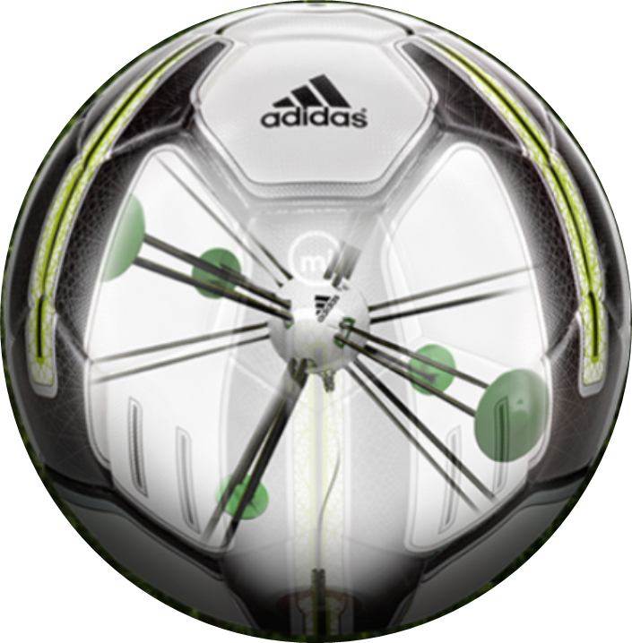



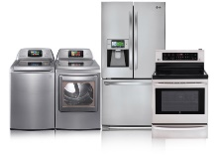
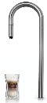
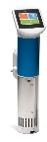
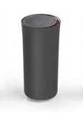

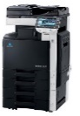
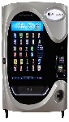
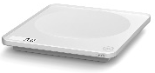

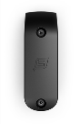
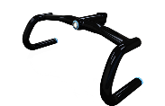
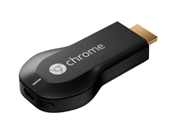


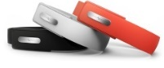

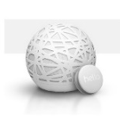
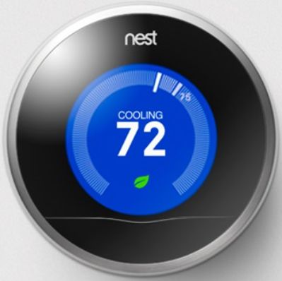
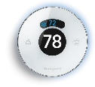
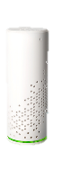

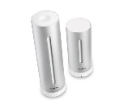


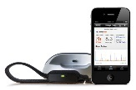



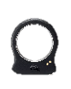



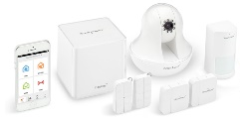
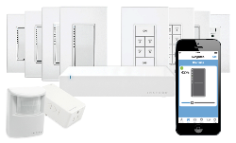
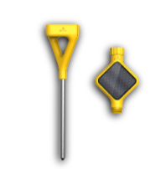
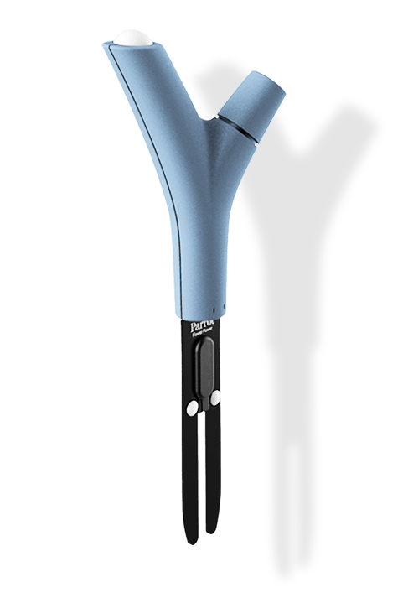

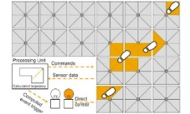
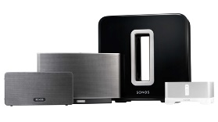




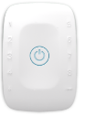




Today!
Medication adherence
Health monitoring
Pet tracking
Behavior modification
Object tracking
Child and elder
monitoring
Sports
and fitness
Indoor
navigation
Trip tracking and car health
Smart lighting
Beacons
and proximity
HOME
WORKPLACE
HOME
Smart appliances
Food and nutrition tracking
Identity
Office equipment
Smart vending machines
Bike ride stats and protection
Air conditioning and temperature control
Sleep tracking
Environmental sensors
Information capture
Control
Home security
Home automation
Leak detection
Garden, lawn and plant care
New devices and sensors
Entertainment systems
Notes:
Anyone that is not connected somehow?

Slide 6
“LEARN ABOUT THE PAST TO PREDICT THE FUTURE”

Slide 7

My experience ….
Wind visualization
Near real time production data
Marketing campaign Wind
Notes:
My experiences so far...

Slide 8



Wind Energy production

Slide 9
IoT Value Chain
Event producers
Collection
Ingestor (broker)
Transformation
Long-term storage
Presentation and action
BizTalk Server
WCF Service
Wind Turbine
Cloud gateways
(web APIs)
Field
gateways
Web/thick client
dashboards
Scada
Notes:
The value chain of the solution you just saw.

Slide 10
Where do we see IoT?
Cities
Buildings
Energy
Healthcare
Mobility
Fire safety
Light
Grid
Patient
Monitor traffic
Pollution
Water
Solar- and wind energy
Monitoring
Traffic reports
Flooding
Implants
Violations
Power
Gas distribution
Tooling
Toll roads
Medical emergency
Climate
Fuel distribution
Surgical equipment
Public transport
Drinking water
Air quality
Power plant
Lab
Taxi
Waste treatment
Lifts and escalators
Nuclear waster
Radiology
Road network
Waste water
Sign posts
Coal Mines
Mobile care
Air traffic control
Public Order
Safety
Oil and gas production
Diabetes
Airports
Notes:
Where else do we see it? Here’s just an example…

Slide 11



IoT Value Chain – Microsoft Azure
Event producers
Collection
Ingestor (broker)
Transformation
Long-term storage
Presentation and action
Stream Analytics
Web/thick client
dashboards
Applications
Service Bus
Event Hubs
Azure DBs
Legacy IOT
(custom protocols)
Devices
IP-capable devices
(Windows/Linux)
Low-power devices (RTOS)
Stream processing
Search and query
Cloud gateways
(web APIs)
Azure storage
Storage
adapters
HDInsight
Data analytics (Excel)
Field
gateways
Devices to take action
Machine Learning
Notes:
Technology --> Azure
Going back to the value chain now filled with Azure Technology this is how it looks.

Slide 12
Azure IoT Reference Architecture
Devices and Data Sources
Data Transport
Device and Event Processing
Presentation
Cloud Gate-way
Data Visualization & Presentation
IP capable devices
Provisioning API
Solution Portal
Device State Store
Agent
Libs
Identity & Registry Stores
Existing IoT devices
Stream Event Processor
Agent
Libs
Gateway
Storage
Analytics/ Machine Learning
Low power devices
Agent
Libs
Control System Worker Role
Notes:
A reference architecture that aligns with that value chain is this reference architecture.

Slide 13




ECO-System
DECISION MAKING
ANALYTICS
OPERATIONAL
UNSTRUCTURED & STRUCTURED DATA
Sensors
Devices
Bots
Crawlers
ERP
CRM
LOB
APPs
Notes:
Multi level value chain, partnering, eco system

Slide 14



Scenario
Greenhouse
Crop Optimization
Energy efficient
Notes:
Setting up a scenario

Slide 15

















































Platform Services
Security & Management
Services Compute
Web and Mobile
Data
Hybrid
Operations
Cloud
Services
Service
Fabric
Web Apps
API Apps
Portal
SQL
Database
Data
Warehouse
DocumentDB
Azure AD
Health Monitoring
Azure Active
Directory
Batch
RemoteApp
AD Privileged
Identity
Management
Mobile
Apps
Logic Apps
Redis
Cache
Azure
Search
Storage
Tables
Azure AD
B2C
Integration
Domain Services
Multi-Factor
Authentication
API
Management
Notification
Hubs
Storage
Queues
BizTalk
Services
Analytics & IoT
Backup
Automation
Hybrid
Connections
Service Bus
Developer Services
HDInsight
Machine
Learning
Stream
Analytics
Data
Lake
Operational
Analytics
Scheduler
Key Vault
Visual Studio
Azure
SDK
Data
Factory
Event
Hubs
Data
Catalog
Import/Export
Media & CDN
Store/
Marketplace
Media
Services
Content
Delivery
Network (CDN)
VS Online
App
Insights
Mobile
Engagement
Azure Site
Recovery
IoT Hub
VM Image Gallery
& VM Depot
StorSimple
Infrastructure Services
OS/Server Compute
Storage
Networking
Virtual Machines
Container
Service
BLOB Storage
Azure
Files
Premium
Storage
Virtual Network
Load Balancer
DNS
Express
Route
Traffic Manager
VPN Gateway
App
Gateway
Datacenter Infrastructure (30 Regions, 22 Online)
Notes:
What do I pick from the big tool box in Azure? Right the services in area from Analytics and IoT.

Slide 16
Azure Services for IoT – Building blocks
Azure IoT Hub
  Connect, secure, communicate, monitor and manage billions of devices
Azure Stream Analytics
  Real time stream processing for billions of IoT devices
Azure Storage
  Blob, SQL, DocumentDB, Data Lake. Storage to meet every need at the scale of IoT
Azure App Service
  Web and mobile apps for any platform on any device
Power BI
  Dashboards and data connectors to visualize any data
Logic Apps
  Powerful workflows to automate business processes
And More…
Notes:
The building blocks

Slide 17


Event Hub
High scale data ingestion via Event Hub.
High scale stream processing via Stream Analytics (or HDInsight /Storm)
Storage for cold-path analytics
Processing for hot-path analytics
Event Hub
Stream Analytics
SQL
Blob
Notes:
IoT Hub, Event Hubs

Slide 18
Event Hubs and Stream Analytics
Event Hub
Cloud-scale telemetry ingestion from websites, apps, and devices
Compatible with more than a million publishers supporting HTTP, AMQP and MQTT
Ingress millions of events per second
SAS based security, with unique token per publisher
Configurable data retention (1-30 days)
Low latency (<10 ms for volatile data)
Pluggable with other cloud services like Stream Analytics
Stream Analytics
Real-time analytics for Internet of Things solutions
Stream millions of events per second
Mission critical reliability, performance and predictable results
Rapid development with familiar SQL-based language
Notes:
Stream Analytics

Slide 19
Azure Storage
Cloud Storage - Anywhere and anytime access
Blobs, Disks, Tables, Queues and Files
Highly Durable, Available and Massively Scalable
Easily build “Internet scale” applications
More than 35 trillion stored objects
3.5+ Million requests/sec on average
Pay only for what you use
Exposed via easy and open REST APIs
Rich Client Libraries and Tools
Blob
Notes:
Storage

Slide 20
Machine Learning
Machine Learning platform in Azure cloud
Pre-process data
Engineer features
Modelling ≣ machine learning ≣ data mining
Run R
Run Python
Experiments (modelling) + Web Services (deployment)
Free
Limited: data size, experiment duration, scalability, speed
Paid
Relatively inexpensive, can be free
Notes:
Machine Learning

Slide 21



PowerBI
Self-service business intelligence and analytics with Excel and the power of the cloud
Analyze in Excel
Collaborate in Power BI for Office 365
Discover
Analyze
Visualize
Share
Question
Mobility
Q&A
Notes:
Power BI
Excel is the most commonly used analytical tool for business users – it truly is accessible to anyone. No other vendor has the ability to reach a billion users through tools they already know and use. Today Excel delivers end-to-end self-service BI functionality through capabilities such as Power Query, Power Pivot, Power View and Power Map. With the accessibility of Excel and proliferation of Office 365, we can lower the barrier of entry for businesses who want to take advantage of the benefits of business intelligence by putting the right analytics tools in everyone’s hands with no friction.
Ease of deployment through Office 365.. Power BI dramatically simplifies and reduces the time it takes for IT to setup and manage the complex infrastructure needed for an enterprise wide BI platform. Power BI enables businesses to balance between the needs of business users working in Excel and an IT department’s requirements for agility, monitoring and governance. IT can also provide business users the ability to search and access IT sanctioned corporate data sources both on premises and in the cloud while monitoring query usage against their data.

Slide 22


Walkthrough
Stream Analytics
Azure Storage
Power BI
Field gateway
Event Hubs
Azure Storage
Analytics (ML, Map Reduce, …)
Notes:
Walkthrough...

Slide 23

Event Hubs - Data

Slide 24

Stream Analytics

Slide 25

Data - Wind
{"turbinenumber":1,"poweroutput":4000,"windspeed":7,"rotorspeed":7.5613199116482033,"generatorspeed":0,"voltage":0,"current":0,"reactivepower":1,"frequency":11.561319911648203,"powerfactor":10,"generatortemp":91.7747483434038,"nacelletemp":0,"outsidetemp":36.70989933736152,"vibration":1,"pitch":0,"brakeactivated":0,"yawactivated":0,"EventProcessedUtcTime":"2016-05-05T09:38:31.9965947Z","PartitionId":1,"EventEnqueuedUtcTime":"2016-05-05T09:38:30.0990000Z"}
{"turbinenumber":3,"poweroutput":4000,"windspeed":7,"rotorspeed":4.5253113436164849,"generatorspeed":0,"voltage":0,"current":0,"reactivepower":1,"frequency":8.5253113436164849,"powerfactor":10,"generatortemp":34.849587692809095,"nacelletemp":0,"outsidetemp":13.939835077123639,"vibration":1,"pitch":0,"brakeactivated":0,"yawactivated":0,"EventProcessedUtcTime":"2016-05-05T09:38:32.7622059Z","PartitionId":3,"EventEnqueuedUtcTime":"2016-05-05T09:38:30.7790000Z"}

Slide 26

Stream Analytics

Slide 27

Data - Greenhouse
{“greenhouse":1,"outsidetemp":36.70989933736152,“humidity":90,"EventProcessedUtcTime":"2016-05-05T09:38:31.9965947Z","PartitionId":1,"EventEnqueuedUtcTime":"2016-05-05T09:38:30.0990000Z"}

Slide 28

Power BI

Slide 29
Microsoft Pre-configured solution
Get started in minutes & customize to meet your needs
Devices
Azure IoT SDK (OSS)
Linux, RTOS, mBed, Windows,
Android, iOS
Business Process
ERP/CRM
Web App
Storage Blobs
DocumentDB
IoT Hub
Stream Analytics
Event Hub
Web Jobs
Logic Apps
Azure
Active Directory
Notes:
Microsoft IoT preconfigured solutions

Slide 30


Custom vs Automation
Notes:
Custom or automated using pre-configured solution/configuration. Flexibility vs Productivity.

Slide 31
IoT, Azure, Exiting
New technology on all fronts
  Front-End
  Integration
  BI
  Embedded
  Cloud
Challenges in speed and agility
More about data than technology!
Notes:
Round up

Slide 32
Contact
Blog: http://soa-thoughts.blogspot.nl/
Twitter: @SteefJan
TechNet Wiki: UserPage
Go see the next two IoT talks:
Kent : Real World Industrial IoT
Mikael : Azure IoT Hub beyond Hello world
Notes:
Round up

Slide 33

Thank You
Notes:
Thank you!

