Slide 1


Sandro Pereira
Integration MVP
A new set of BizTalk Server Tips and Tricks

Slide 2




Sandro Pereira
Senior Software Developer at DevScope
Microsoft Azure MVP since 2011
Member and co-founder of BizTalkCrew – BizTalk Innovation Day Events
Writer of numerous articles for Portuguese eMagazine “Programar”
Author “Sandro Pereira BizTalk Blog” http://sandroaspbiztalkblog.wordpress.com
Member of “BizTalkAdminsblogging.com” and “BizTalk Brasil” community
Member NetPonto community, MSDN BizTalk Forums Moderator
TechNet Wiki author (Wiki Ninja)
TechNet Gallery, Code Gallery and CodePlex contributor
Public speaker
Technical Reviewer PACKT Publishing
  BizTalk Server 2010 Cookbook (April 2012)
Author book: BizTalk Mapping Patterns and Best Practices
Notes:
Good morning…. Nice to see some familiar faces again and plenty of new ones…
It is a pleasure to be here for the third consecutive year and see that this event is bigger and better every year
I will not take too much time presenting myself, I think most of you already know me, if not you will have access soon to this slides.
My name is Sandro Pereira and I’m working as a BizTalk Consultant at DevScope in Portugal an amazing company and I’m a Microsoft Integration MVP since 2011

Slide 3


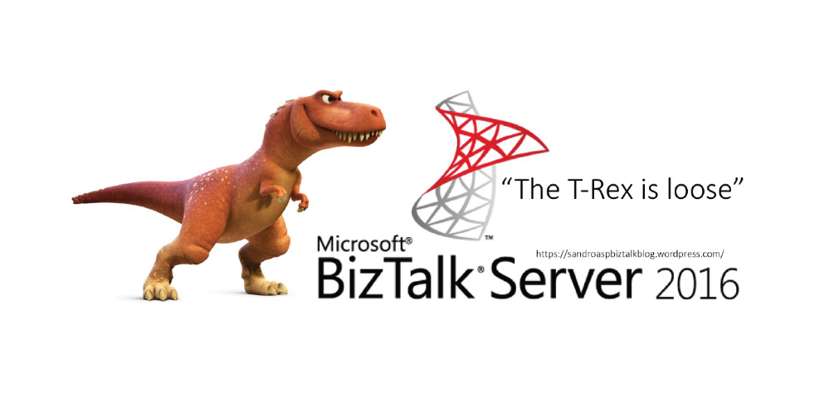
BizTalk Server 2016 stickers
“The T-Rex is loose”

Slide 4
Agenda for this session
  BizTalk Server tips and tricks for Managers or Architects
  BizTalk Server Project Migrations
  BizTalk Server tips and tricks for Administrators
  Maintain the health of BizTalk platforms
BizTalk Server tips and tricks for Developers
  Good tools and techniques to produce eficiente solutions and as quickly as possible
Notes:
It’s critical to use good tools and techniques to produce working solutions as quickly as possible and at the same time, given the increase the requirements and number of applications organizations develop today. But at the same time, it's also critical to maintain the health of the entire platform. In this session, which I'll try to be a very interactive session (so be prepare to participate), I'll address and share some useful BizTalk Server Tips and Tricks (and Workarounds) both for developers and administrators. Covering some topics like RosettaNet, SAP, database maintenance, debatching, out-of-the-box pipelines vs custom pipelines and many more.

Slide 5

What your Manager or
Client wants from you…
Notes:
Make a proper effort estimation

Slide 6
TIP #1 – BizTalk Project Migration
Types of migrations:
AS IS – Without any non-mandatory changes
Analyse and check all the points to improve and then migrate/recreate the integration project will all the improvements or new requirements.
AS IS migration steps required?
Open BizTalk Visual Studio solution
Fix the .NET Version
Fix Strong Name Key
Fix deployment properties…
…. And rebuild
But not always is that so simple!

Slide 7


TIP #1 – BizTalk Project Migration
Custom
Adapters
JUST REBUILD – Open VS, Fix .NET version and deploy
WARNING: Adapters registration ID’s don’t conflict
Custom
Pipelines
JUST REBUILD – Open VS, Fix .NET version and deploy
Custom
Functoids
JUST REBUILD – Open VS, Fix .NET version and deploy
WARNING: Functoid ID’s don’t conflict
Schemas
JUST REBUILD – Open VS, Fix .NET version and deploy
CRITICAL WARNING: SAP Adapter
You may need to rebuild all the schemas, maps and orchestrations

Slide 8

TIP #1 – BizTalk Project Migration
Maps
30% JUST REBUILD – Open VS, Fix .NET version and deploy
CRITICAL WARNING: New Transformation engine “XslCompiledTransform” versus the “XslTransform”
THEY ARE NOW 100% COMPATIBLE
Change in Scripting Functoid Boolean Parameter Behavior (https://support.microsoft.com/en-us/kb/2887564)
Scripting functoid cannot return null out of an inline C# method
Passing Null values around chain functoids in not simple anymore
Helper classes used in maps cannot use overloading
Only public methods may be called from XPath expressions
Passing a node to a helper class as a “XpathNodeIterator” now requires a Node.MoveNext to select the first node
…
SOME OF THEM DON'T GIVE ERRORS WHILE COMPILING

Slide 9
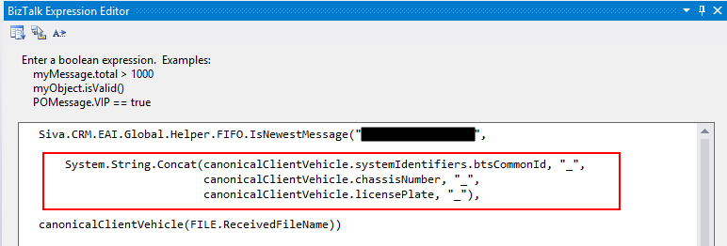
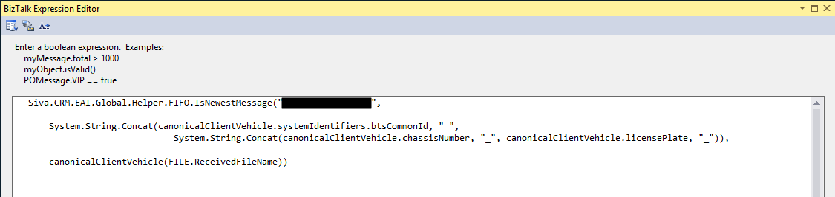
TIP #1 – BizTalk Project Migration
Orchestrations
JUST REBUILD – Open VS, Fix .NET version and deploy
WARNING: String concat behaviors

Slide 10
TIP #2 – Base your decision by…
The number of projects you have to migrate
By the structure of Visual Studio solutions
The number of features you have to migrate
  Cross references databases
  BAM OLAP
  EDI and others…
The adapters that you need to migrate
  The “old” SAP Adapter is forever gone!
  You still have SQL, SOAP Adapter, …
The number of transformations (maps)
that exist in the solutions
EDI, BAM OLAP or Cross References
can provide some challenges!
A good Visual Studio solution structure is really important!
SAP adapter is probably the only adapter that was really discontinuous!
The number of maps you have!

Slide 11
TIP #2 – Base your decision by…
Build 3 Env + 2 Custom adapters + BTS 2006R2 17 Integration Solutions (with SAP) in…
Build 3 Env + 2 Custom adapters + BTS 2006R2 10 Integration Solutions (with BAM OLAP) in…
Build 2 Env + 2 Custom adapters + BTS 2004 5 Integration Solutions (with Cross references and on with 210 projects) – no documentation in…
…less than 40 days
…less than 25 days
…less than 40 days

Slide 12

What about EXTENSIBILITY…
…what’s new?

Slide 13

TIP #3 – Meet Grabby! (Open Source Community project)
Let’s be completely
honest…
There isn't any major revolution since 2004!
2006: BizTalk Administratin Console
2006 R2: Support for WCF Adapters
2009:
2010: New Trading Partner Management
2013: New Map Engine, Support Cloud
2013 R2: JSON
2016: Always On (that’s SQL!)
Until now…
Now you will be able to easily extend your BizTalk Server…
Taking coffee with BizTalk will be possible…
… the limit will be your imagination!
With BizTalk GrabCaster Adapter… you will be able to embedded a microengine (GrabCaster engine) within the BizTalk Server engine extending the internal capabilities and providing a very easy way to solve any complex integration problem… even without code!
Notes:
It is possible to extend the framework by writing your own:
MetaInstruction and Instruction classes in assemblies
which should be deployed to the GAC
Creating vocabulary definitions that correspond to public methods on your MetaInstructions, and then using the AddMetaInstruction vocabulary definition in the BREPipelineFramework vocabulary in InstructionLoaderPolicy BRE Policies which will allow you to use the your custom vocabularies in the ExecutionPolicy.

Slide 14

That st**** Developer….

Slide 15
TIP #4 – Installing Custom Adapters
What the Admin
should do to install them on a 64-bit machine?
A) Double click CustomAdapter.reg
B) Open a 32-bit command prompt:
%windir%\SysWoW64\cmd.exe
<Adapter installation directory>\CustomAdapter.reg
Common problem
Unique ID’s
[HKEY_CLASSES_ROOT\CLSID\{62018D08-281A-415b-A6D3-6172E3762867}]
@="Static DotNetFile Adapter"
"AppID"="{12A6EBAA-CF68-4B58-B36E-A5A19B22C04E}"
https://msdn.microsoft.com/en-us/library/aa560561.aspx
What the Admin
should do?
A) Ensure that you generate new guids
B) Or use the Adapter Registry Wizard
<Installation Path>\SDK\Utilities\AdapterRegistryWizard\
https://msdn.microsoft.com/en-us/library/aa578379.aspx

Slide 16
TIP #5 – The local messaging archive folder
Very common
in integration scenarios: Message archiving
To see messages being archived locally into the hard drive:
either by using a pipeline component
or by simple using the default functionalities in BizTalk like: filters
Common problem we will find with these kind of approach's?
Everyone forgets to create maintenance plans
The most critical → disk full
Many files in a folder can cause performance problems
What the Admin
should do?
You can easily script this type of task since day one by using PowerShell or other tools
And ensure that these folders are properly monitored and cleaned from time to time
https://gallery.technet.microsoft.com/BizTalk-DevOps-manage-d1d512e4

Slide 17
TIP #6 – Use PowerShell to monitor your environment
One of the principal needs for BizTalk Administrators is the ability to monitor the health of BizTalk environments on a regular basis and react promptly to solve any possible issues that may appear in order to keep your BizTalk Server applications accessible to your users/organization.
DevOps
PowerShell Samples to monitor BizTalk environments…
… and you even can have Auto Healing capabilities!
Monitoring Host Instances with Auto-Healing capabilities
https://sandroaspbiztalkblog.wordpress.com/2016/02/16/biztalk-devops-monitor-your-biztalk-environment-using-powershell-monitoring-host-instances-with-auto-healing-capabilities/
Monitoring Ports (Stopped/disabled/unelisted) with Auto-Healing capabilities (https://goo.gl/qBEyLM/)
Monitoring Suspended Service Instances with Auto-Healing capabilities (https://goo.gl/pBvVGF/)
Schedule Message Box Viewer or BizTalk Health Monitor and customize notification alerts with PowerShell (https://goo.gl/rlt76y/)
Monitoring BizTalk SQL Agent Jobs (https://goo.gl/TLo5Az)
Monitoring Disk Space (https://goo.gl/AX0jq8)

Slide 18

I'm a Developer… not a magician!
How can I do that?

Slide 19

TIP #7 – Migrating Maps
XslCompiledTransform is not compatible with my maps!
You can consider configuring the transformations in “the old fashioned way” by adding DWORD UseXslTransform with value 1.
For 64 bit BizTalk host instances: HKLM\SOFTWARE\Microsoft\BizTalk Server\3.0\Configuration
For 32 bit BizTalk host instances and Visual Studio’s Test Map functionality: HKLM\SOFTWARE\Wow6432Node\Microsoft\BizTalk Server\3.0\Configuration
The problem
with this approach is?
Will lose the many performance and memory usage improvements provided by the XSLCompiledTransform class
And the answer is
install BTS 2013R2 CU2!
Backward compatibility option to use XslTransform instead of XslCompileTransform is available at map level
Notes:
It is possible to extend the framework by writing your own:
MetaInstruction and Instruction classes in assemblies
which should be deployed to the GAC
Creating vocabulary definitions that correspond to public methods on your MetaInstructions, and then using the AddMetaInstruction vocabulary definition in the BREPipelineFramework vocabulary in InstructionLoaderPolicy BRE Policies which will allow you to use the your custom vocabularies in the ExecutionPolicy.

Slide 20
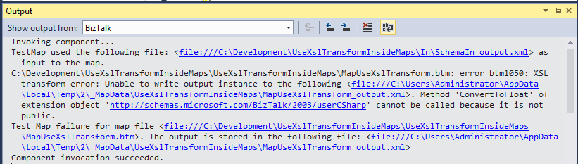
TIP #7 – Migrating Maps
The problem
with this approach is?
You cannot test your maps inside Visual Studio if you use XslTransform compatibility option!
So, WHAT’S THE POINT OF USING IT?
My suggestion
is…
You may loose more time adjusting the maps to the new engine… it will be painful must of the times… but it’s the best way that we have for now.

Slide 21
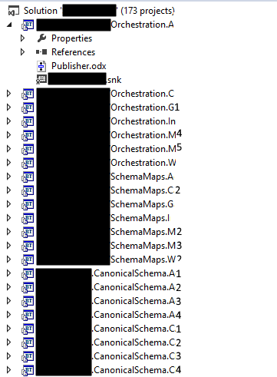
TIP #8 – DevOps: PowerShell is your friend!
What happens when we exaggerate in Visual Studio Structure?
1 Solution containing +170 projects!
Is a developer NIGHTMARE!
Find dependencies, find something!
~30 min to deploy!
What happens when you are migrating this project or a new developer joins?
You need to fix Signing Properties for all BizTalk Project
You need to fix Deployment Properties for all BizTalk Project
How to fix or configure the Deployment Properties of a BizTalk Project with PowerShell (https://goo.gl/7Afo0k)
How to fix or configure the Signing Properties of a BizTalk Project with PowerShell (https://goo.gl/acDzRN)
Notes:
It is possible to extend the framework by writing your own:
MetaInstruction and Instruction classes in assemblies
which should be deployed to the GAC
Creating vocabulary definitions that correspond to public methods on your MetaInstructions, and then using the AddMetaInstruction vocabulary definition in the BREPipelineFramework vocabulary in InstructionLoaderPolicy BRE Policies which will allow you to use the your custom vocabularies in the ExecutionPolicy.

Slide 22

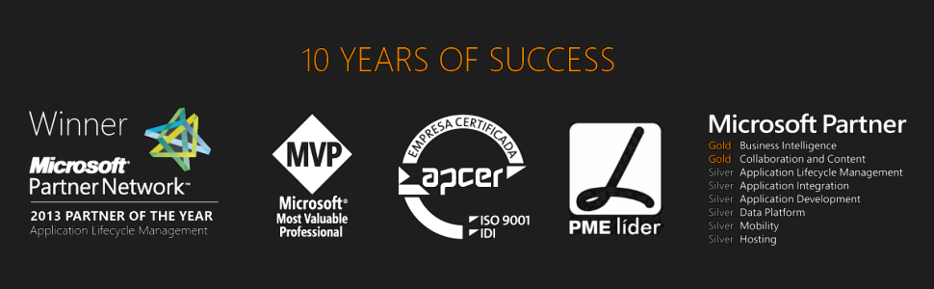



Thanks
  sandro.pereira@devscope.net
  linkedin.com/in/sandropereira
  @sandro_asp
  sandroaspbiztalkblog.wordpress.com
+351 223 751 350
www.devscope.net

Slide 23

Director's cut…

Slide 24
TIP #9 – Using BRE to help you implementing CBR
BizTalk Business Rules Engine Pipeline Framework
The BizTalk BRE Pipeline Framework leverages the Business Rules Engine (BRE) to abstract away logic to be exercised in BizTalk pipelines thus catering for increased development flexibility and agility.
But can we extend
these capabilities?
Extend BizTalk Business Rules Engine Pipeline Framework capabilities?
Extend BRE capabilities, like calling static methods?
And the answer is
YES, we can!
By default, the rule engine requires you to assert an instance of a .NET class to execute a policy that invokes a static member of the .NET class.
You can modify this behavior by changing the value of the “StaticSupport” registry key under:
HKEY_LOCAL_MACHINE\Software\Wow6432Node \Microsoft\BusinessRules\3.0
https://brepipelineframework.codeplex.com/documentation
Notes:
It is possible to extend the framework by writing your own:
MetaInstruction and Instruction classes in assemblies
which should be deployed to the GAC
Creating vocabulary definitions that correspond to public methods on your MetaInstructions, and then using the AddMetaInstruction vocabulary definition in the BREPipelineFramework vocabulary in InstructionLoaderPolicy BRE Policies which will allow you to use the your custom vocabularies in the ExecutionPolicy.

Slide 25
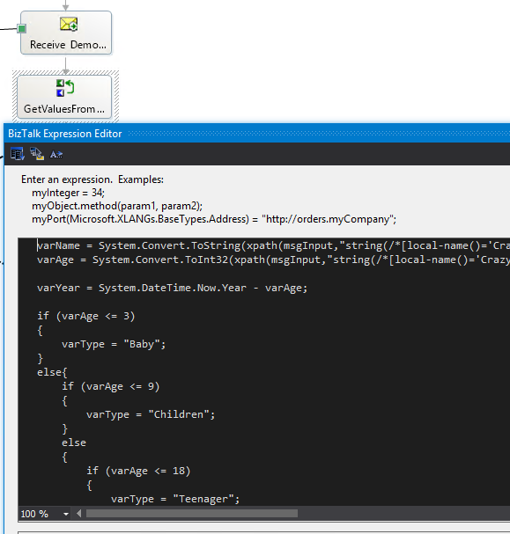
TIP #10 – Debugging orchestrations inside Visual Studio
Have you ever inherited orchestrations full of C# code inside expression shapes?
Something is failing and you really don't know why!
And before you redo it... you need to understand what is happening
Would not be nice, sometimes, to be able to debug this C# code inside Visual Studio?
A tool familiar to all developers
Maps (.btm.cs), Schemas (.xsd.cs), Pipelines (.btp.cs) generate “.cs” files in the source folder
However Orchestration “.cs” files are placed in the
obj\Debug\BizTalk\XLang folder
renamed as File0.cs, File1.cs etc

Slide 26
TIP #11 – Full Backup will only happen 1 time per day
Full Backup
only happen 1 time per day
BizTalk Server databases should be backed up and BizTalk Server will provide out-of-the-box a job for accomplished that: Backup BizTalk Server (BizTalkMgmtDb) job
To Force
a full Backup
We need to use the “sp_ForceFullBackup” stored procedure available in BizTalkMgmtDb DB.
Mark the ForceFull column to 1 in the adm_BackupSettings table
A different
way to Force a Full Backup
Create a new SQL Server jobs that
call the “BizTalkMgmtDb.dbo.sp_ForceFullBackup” stored procedure
call the standard Backup BizTalk Server (BizTalkMgmtDb) job
https://gallery.technet.microsoft.com/Force-Full-Backup-BizTalk-b4431508
https://gallery.technet.microsoft.com/Force-Full-Backup-BizTalk-b4431508

Slide 27
TIP #12 – Validating RosettaNet messages
Extending BTARN
with a New PIP
Add Existing Item dialog box, move to <drive>:\Program Files\Microsoft BizTalk 2009 Accelerator for RosettaNet\SDK\Schemas, select xml.xsd, then click Add.
You need to fix the xml.xsd import in the new PIP Schema with a reference to the previous schema add to the solution
However when you use a Map to transform an incoming message to a PIP message you will get this error while validating inside VS:
Output validation error: Prefix 'ns2' cannot be mapped to namespace name reserved for "xml" or "xmlns". Line 1, position 215.
Workaround
to validate the message against the schema
Set the Validate Testmap Output property of your map has False
Open the result message of the transformation inside visual studio and delete the following namespace from the message:
xmlns:ns2="http://www.w3.org/XML/1998/namespace"
And now validate this message against the PIP Schema
https://msdn.microsoft.com/en-us/library/bb950204%28v=bts.10%29.aspx

Slide 28




TIP #13 – Be confident
Your body language affects how others see us, but it may also change how we see ourselves
Standing in a posture of confidence, even when we don’t feel confident — can affect testosterone and cortisol levels in the brain, and might even have an impact on our chances for success.
http://www.ted.com/talks/amy_cuddy_your_body_language_shapes_who_you_are

Slide 29
Thanks
  sandro.pereira@devscope.net
  linkedin.com/in/sandropereira
  @sandro_asp
  sandroaspbiztalkblog.wordpress.com
+351 223 751 350
www.devscope.net

