Slide 1
Richard Seroter
Integration MVP
The Open Source Messaging Landscape

Slide 2
Richard Seroter
Sr. Director of Product at Pivotal
Lead Cloud Editor for InfoQ.com
9-time Microsoft MVP for Integration
Technical Trainer at Pluralsight
3-time Book Author

Slide 3
A different direction emerging for integration.
@rseroter
Notes:
Source: https://www.flickr.com/photos/seathepicture/14893913398/
Systems integration is more important than ever. More services, more endpoints, more participants. But it feels like the integration space is evolving.
I went looking for materials that described the trends that led to where we are now. Found my own presentation: http://www.slideshare.net/rseroter/the-future-of-application-integration-39516601
I highlighted these trends almost two years ago: cloud IoT, microservices, pre-canned integrations, containers, DevOps, IT budgets outside of IT, OSS, more.
This all leads to a new set of challenges.

Slide 4
Feel like you’re falling behind?
@rseroter
Notes:
Source: https://www.flickr.com/photos/richseattle/5656483022/
Can be overwhelming! Even if you ignore the crazy pace of MSFT development in Azure – Service Bus, Event Hubs, IoT, Flow, Logic Apps, etc – there’s a TON of work happening in open source.

Slide 5
Let’s be aware of the options out there.
@rseroter
Notes:
Source: https://www.flickr.com/photos/56690322@N03/6706739587/
Let’s take a look at what’s out there. Expose you to what’s building in popularity, so that you feel prepared when your boss asks you about it!

Slide 6
#1
#2
#3
Look at modern integration criteria
Review popular OSS integration tools
Compare to the Microsoft portfolio
@rseroter

Slide 7
#1
#2
#3
Look at modern integration criteria
Review popular OSS integration tools
Compare to the Microsoft portfolio
@rseroter
Notes:
This isn’t to say that this criteria represents the NORM. To be sure, I’d bet that the majority of app integration today is still connecting that dusty banking system to another system of record using pipe-delimited files and FTP. BUT, as those systems start to go offline, they’re being modernized or replaced with much of this criteria in mind.

Slide 8
Base messaging patterns
Publish / Subscribe
Queuing
Request / Response
@rseroter
Notes:
Core messaging styles and patterns are timeless. Enterprise Integration Patterns book as relevant as ever.
Just may not need big, complex messaging systems to accomplish it!

Slide 9
high availability and resilience
@rseroter
Notes:
Source: https://www.flickr.com/photos/jslicer1/9073651348/
The idea of a 9-5 app is going away. Systems are accessed at all hours, from all places, with unpredictable usage patterns. Integration solutions are expected to stay online, recover gracefully under load or node failure.
WHY (continual use, handle bursts, not relying solely on HTTP, want brokerage, heartbeat)
WHERE (microservices integration, platform backbones)

Slide 10
significant
throughput
@rseroter
Notes:
Source: https://www.flickr.com/photos/richardbarnett/14738836489/
High throughput
Big data, stream analytics, dozens or hundreds of microservices. All of these lead to significant chatter and need for not just high throughput but LOW LATENCY.
WHY (machine born data, real-time analytics)
WHERE (IoT, log data, click data, telemetry)

Slide 11
programmable and automated
@rseroter
Notes:
Source: https://www.flickr.com/photos/76220901@N03/6878355129/
Companies shouldn’t be using any software that can’t be installed consistently with no human involvement. Need to be able to stand up environments instantly on-prem or in the cloud so that I can experiment with a new version, do load testing, or provide an acceptance test setting for users.

Slide 12
lightweight
@rseroter
Notes:
Source: https://www.flickr.com/photos/farbwahl/8940552738/
Microservices, not chock-full platforms
Messaging backbone between services; business and routing logic is in the service, not the messaging system
In order to support programmable, automated environments, I often need something small! Composable, limited dependencies. May have multiple components involved (edge to center, linking services) and don’t want something that unwieldy.
WHY (IoT, cloud, container friendly)
WHERE (edge computing)

Slide 13
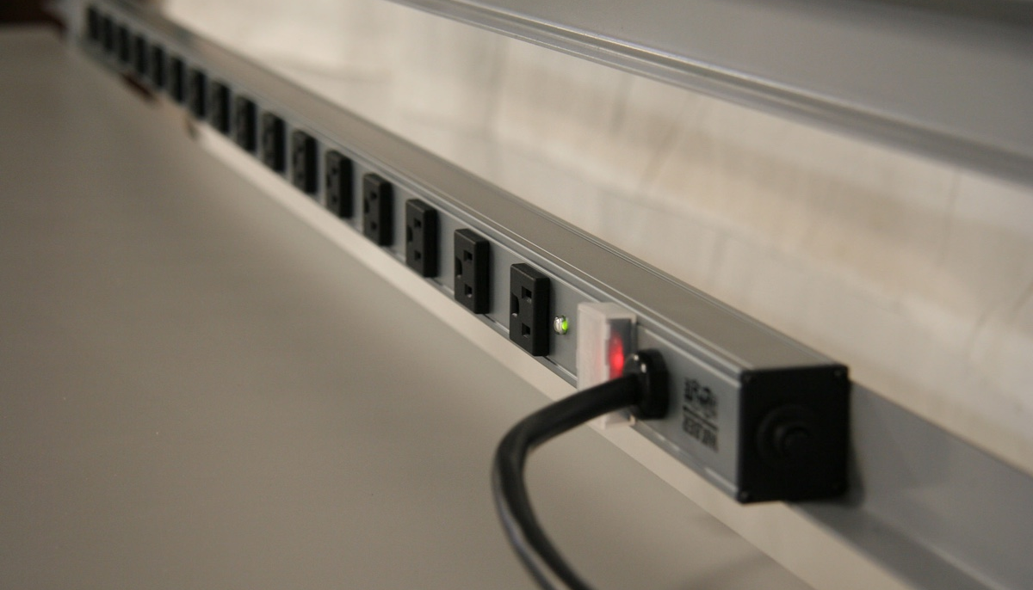
transient
endpoints
@rseroter
Notes:
Source: https://www.flickr.com/photos/formaspace/8315357012/
I may not know who all my subscribers are. From a BizTalk perspective, that feels like blasphemy (minus what ESB Toolkit let you do). But in this modern world, you have ephemeral services, and those that come and go on THEIR schedule.
WHY (more transient, less single point of contact for config)

Slide 14
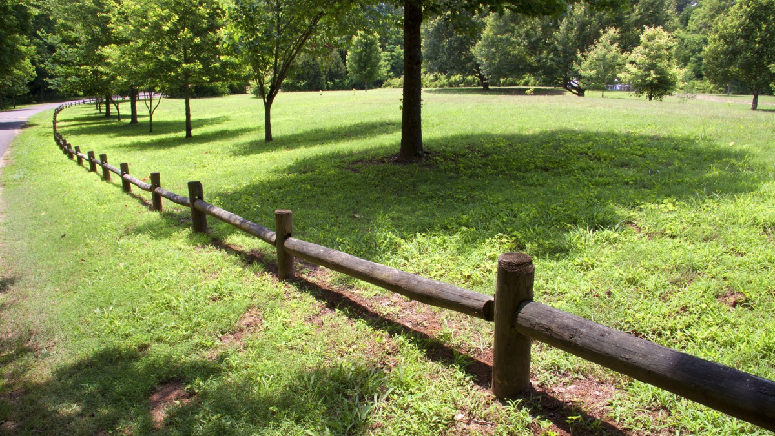
low barrier to entry
@rseroter
Notes:
Source: https://www.flickr.com/photos/blue_wave/7165137785/
Straightforward to use by ANY engineer, not just a shared integration team. Numerous SDKs available, ecosystem is great.

Slide 15
Leave Behind …
Application Adapters
Transformation Engine
Workflow
Rich User Interface
Integration Teams
@rseroter
Notes:
Source: https://www.flickr.com/photos/78164779@N06/9327710998/
Clearly still important, but not as critical as part of a centralized engine …

Slide 16
#1
#2
#3
Look at modern integration criteria
Review popular OSS integration tools
Compare to the Microsoft portfolio
@rseroter

Slide 17
@rseroter

Slide 18
what is it?
“Kafka is a distributed, partitioned, replicated commit log service. It provides the functionality of a messaging system, but with a unique design."
@rseroter

Slide 19
what should I know?
Built by LinkedIn, open sourced in 2011
Binary protocol over TCP, lots of SDKs
Basic pub/sub, queue routing
Designed to persist large amounts of data
Targets real-time and batch consumers
@rseroter

Slide 20
how does it work?
producer
producer
zookeeper
topic 1
(partition 1)
topic 1
(partition 1)
topic 1
(partition 1)
topic 1
(partition 2)
topic 1
(partition 2)
topic 1
(partition 2)
topic 1
(partition 3)
topic 1
(partition 3)
topic 1
(partition 3)
broker
broker
broker
C1 offset: 5
C2 offset: 9
C2 offset: 5
consumer 1
consumer 2
consumer 3
@rseroter

Slide 21
DEMONSTRATION
@rseroter

Slide 22
@rseroter

Slide 23
what is it?
“RabbitMQ is a messaging broker - an intermediary for messaging. It gives your applications a common platform to send and receive messages, and your messages a safe place to live until received."
@rseroter

Slide 24
what should I know?
Implements AMQP standard
Pluggable architecture
Can persist data to disk, or just RAM
Supports multiple routing strategies
Mature ecosystem
@rseroter

Slide 25
how does it work?
producer
producer
exchange
exchange
broker
broker
queue 1
queue 2
queue 3
node
consumer 1
consumer 2
consumer 3
@rseroter

Slide 26
DEMONSTRATION
@rseroter

Slide 27
@rseroter

Slide 28
what is it?
“NATS acts as a central nervous system for distributed systems. Unlike traditional enterprise messaging systems, NATS provides an always on ‘dial-tone’."
@rseroter

Slide 29
what should I know?
Very lightweight engine written in Go
Text protocol over TCP, lots of SDKs
Pub/sub with queue-like options
Auto-prunes slow, lazy client connections
@rseroter

Slide 30
how does it work?
producer
producer
NATS server
NATS server
NATS server
NATS server
consumer 1
consumer 2
consumer 3
@rseroter

Slide 31
DEMONSTRATION
@rseroter

Slide 32
#1
#2
#3
Look at modern integration criteria
Review popular OSS integration tools
Compare to the Microsoft portfolio
@rseroter

Slide 33
Kafka is like …
kind of
Azure Event Hubs
Why?
Ordered sequence of events stored in partitions, read via offset
Not an enterprise message bus, but biased towards velocity
Different protocol support, hosting options, architecture
@rseroter

Slide 34
RabbitMQ is like …
kind of
Azure Service Bus
Why?
AMQP support
Similar pub/sub constructs
Different hosting options, durability choices
@rseroter

Slide 35
NATS is like …
kind of
???
Why?
Unique portability, performance story
Can play the role of one-way/two-way communication hub
@rseroter

Slide 36
#1
#2
#3
Look at modern integration criteria
Review popular OSS integration tools
Compare to the Microsoft portfolio
@rseroter

Slide 37
Thank you!
@rseroter

