Slide 1
Johan Hedberg
Microsoft Azure MVP
BizTalk Server – Behind enemy lines

Slide 2
BizTalk SERVER In Java Land

Slide 3
BizTalk SERVER ALM Real World Example

Slide 4
BizTalk SERVER Modern Development Practices

Slide 5
BizTalk SERVER AGILE Development Practices

Slide 6
BizTalk SERVER DEVOPS Practices

Slide 9
Automated
Agile
Open
Transparent
Blend in!
Maintainable
Familiar

Slide 10
Tracking, Search
& Visualization
Work items
Source Control
Build & Deploy
List in no way complete…

Slide 11
Get Latest
Check-in
MAIN
Source Control

Slide 12
FEATURE-1
FEATURE-1
FEATURE-2
MAIN
Merge
RELEASE

Slide 13
DEV
MAIN
RELEASE

Slide 14
LOCAL REPOSITORY
Commit
MASTER
Clone
Push
Pull
MASTER
CENTRAL REPOSITORY

Slide 15
Pull Request
FEATURE-2
Merge
FEATURE-1
DEVELOP
RELEASE-1.0
HOTFIX
0.1
0.2
MASTER
0.1
1.0

Slide 16
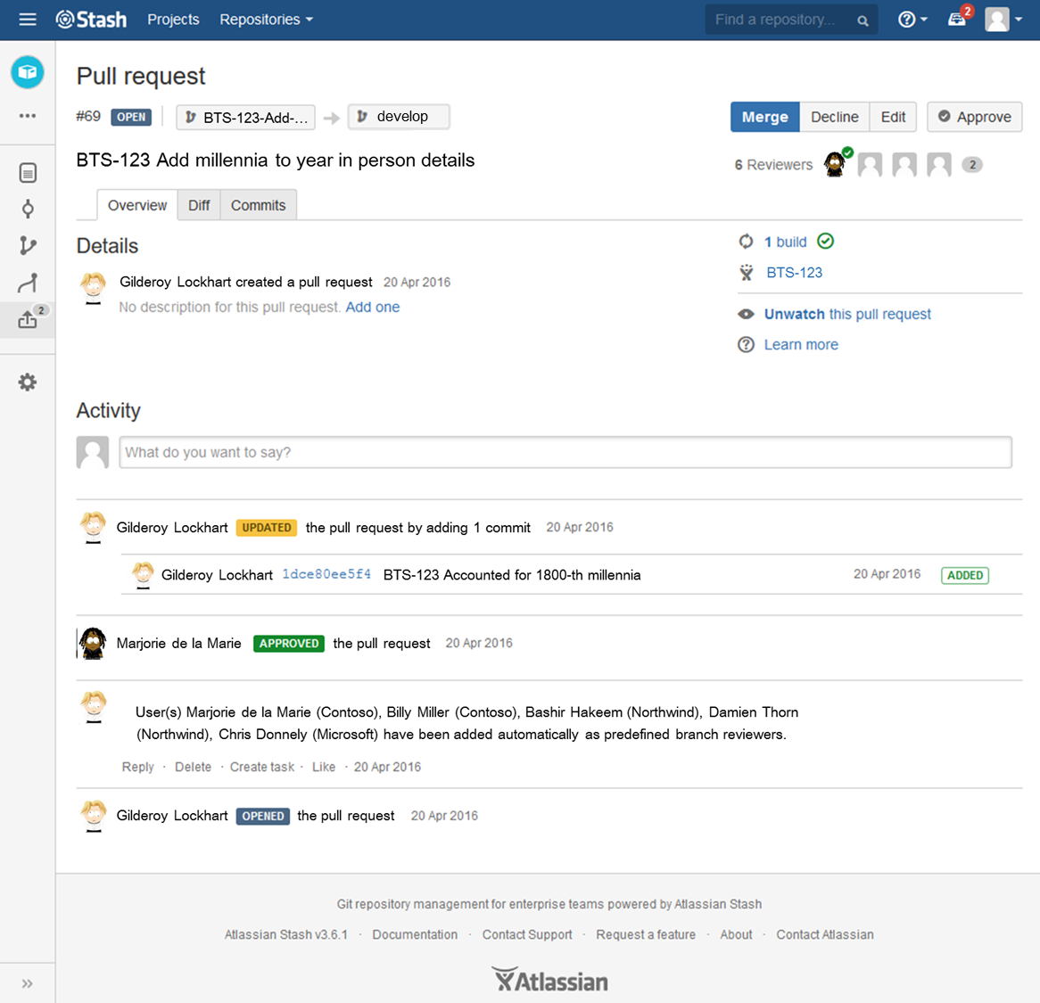
develop

Slide 17
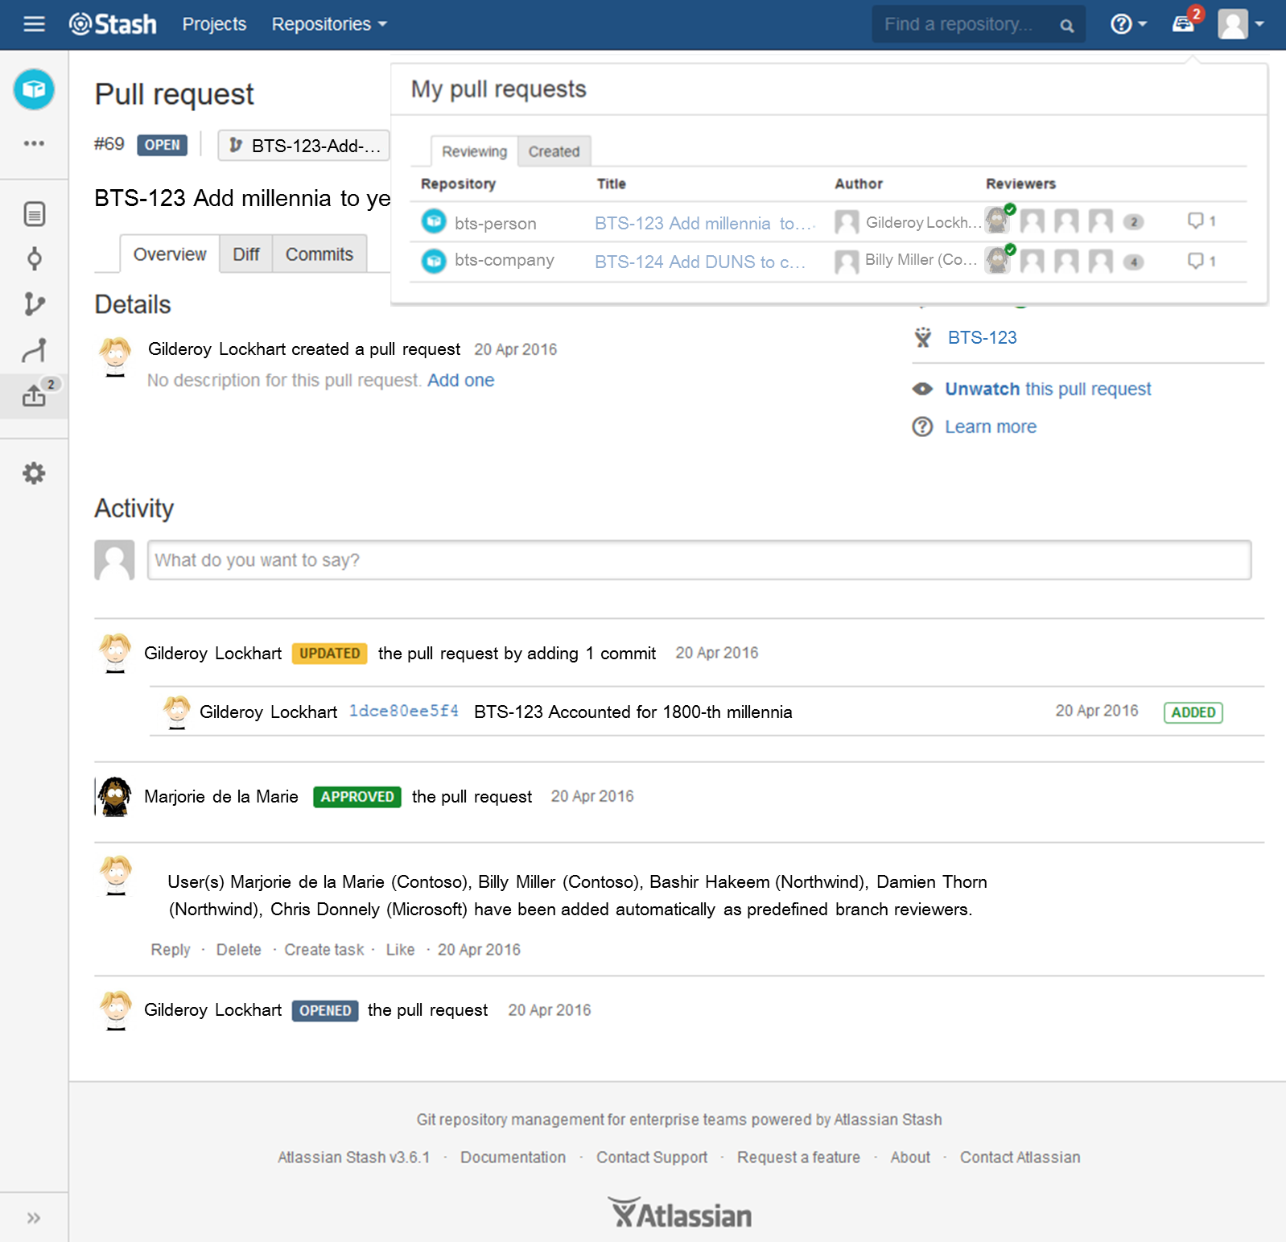

Slide 19
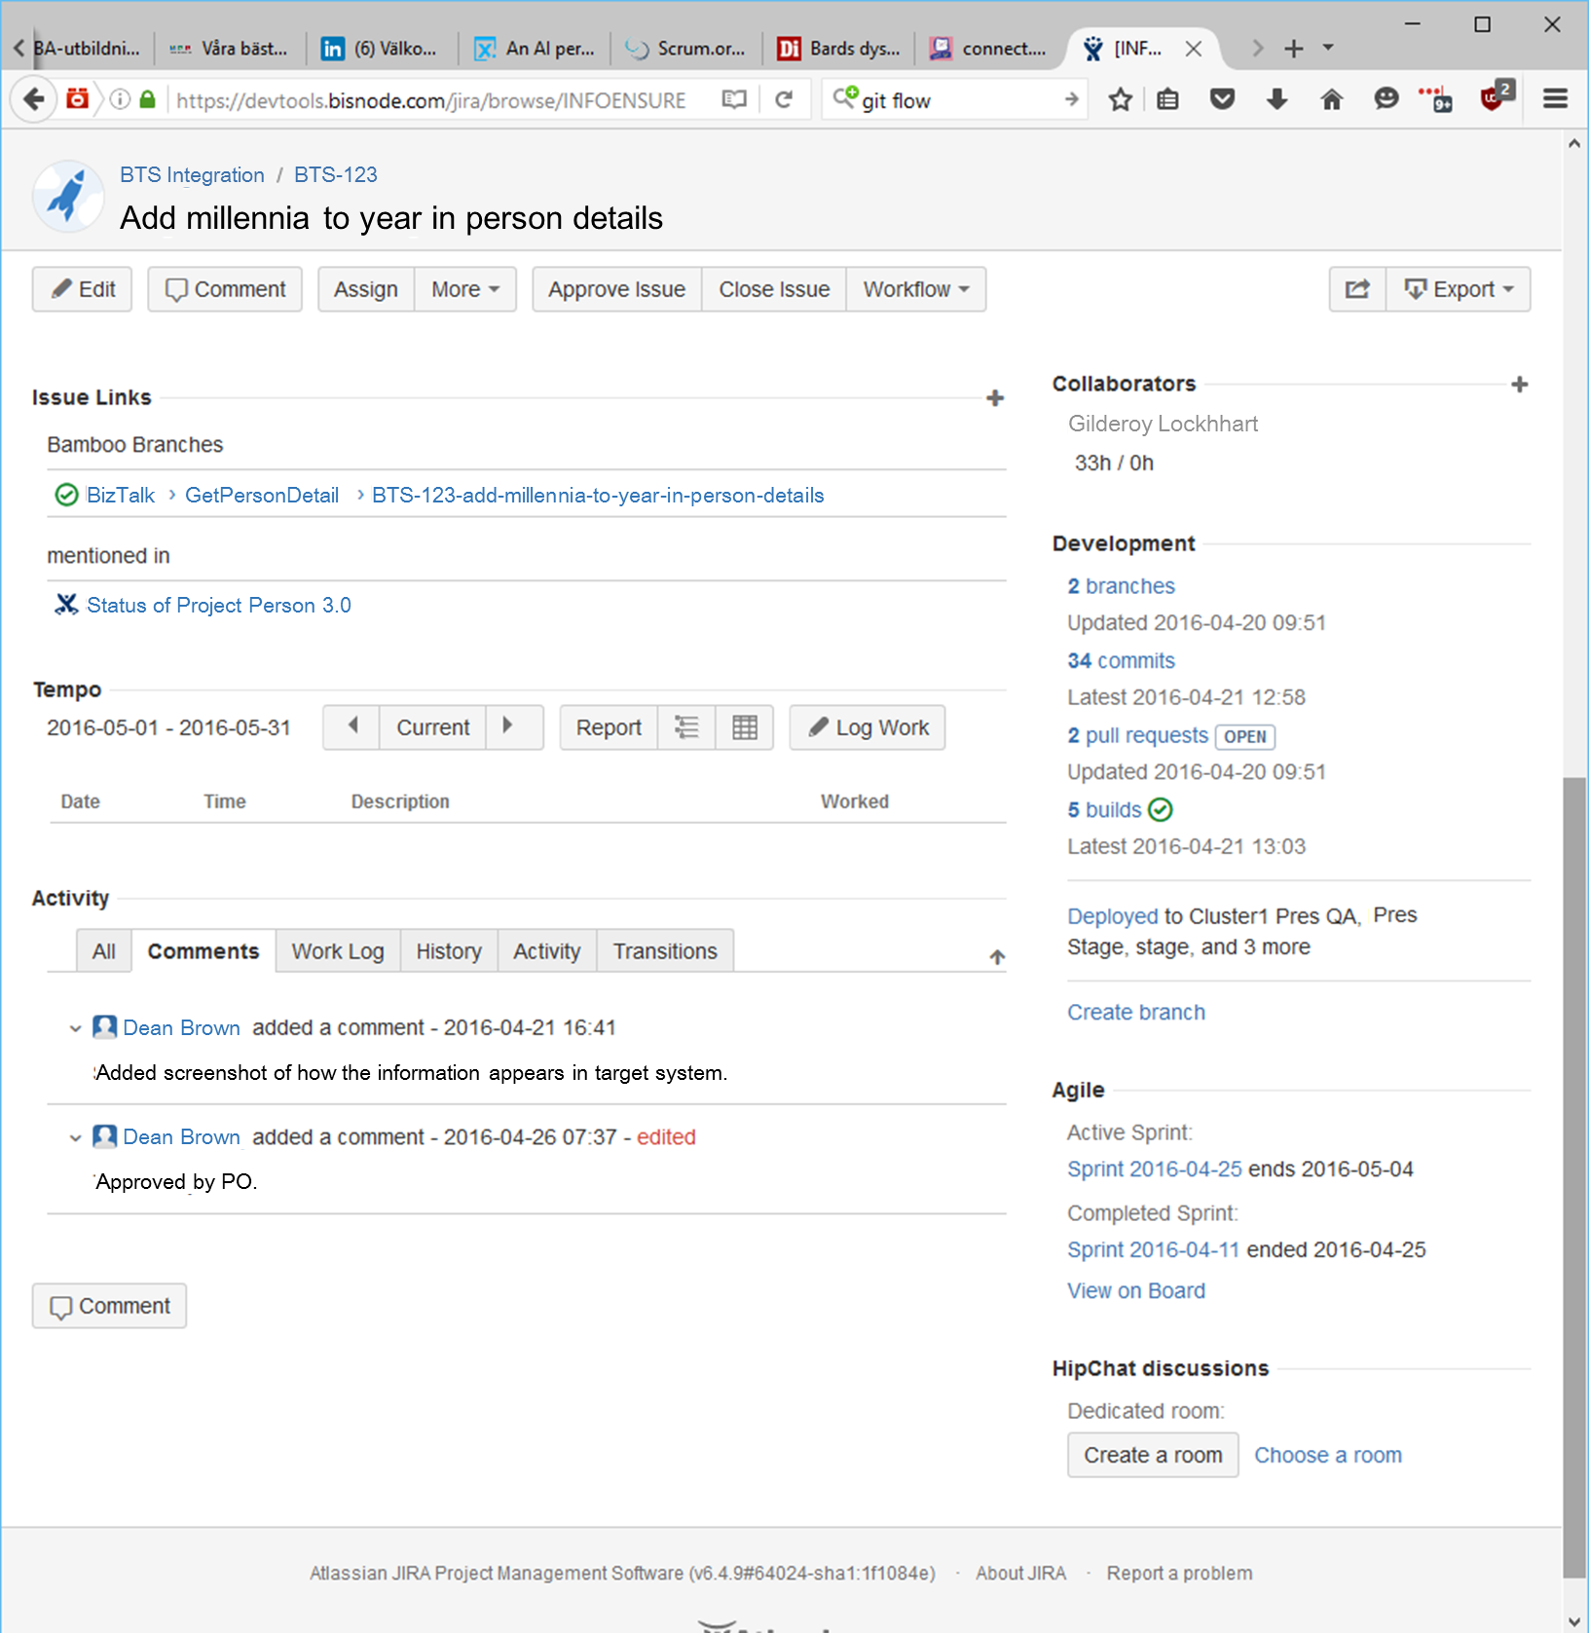

Slide 21
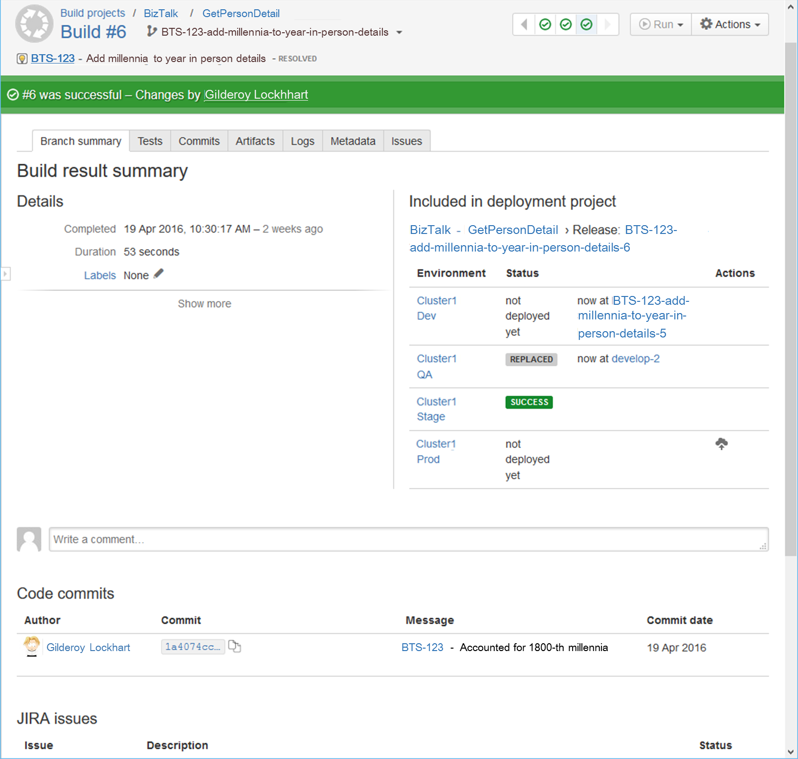
BizTalk
GetPersonDetail

Slide 22
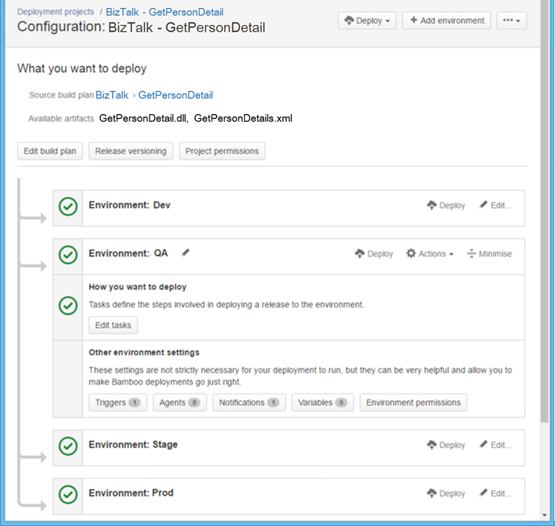

Slide 23
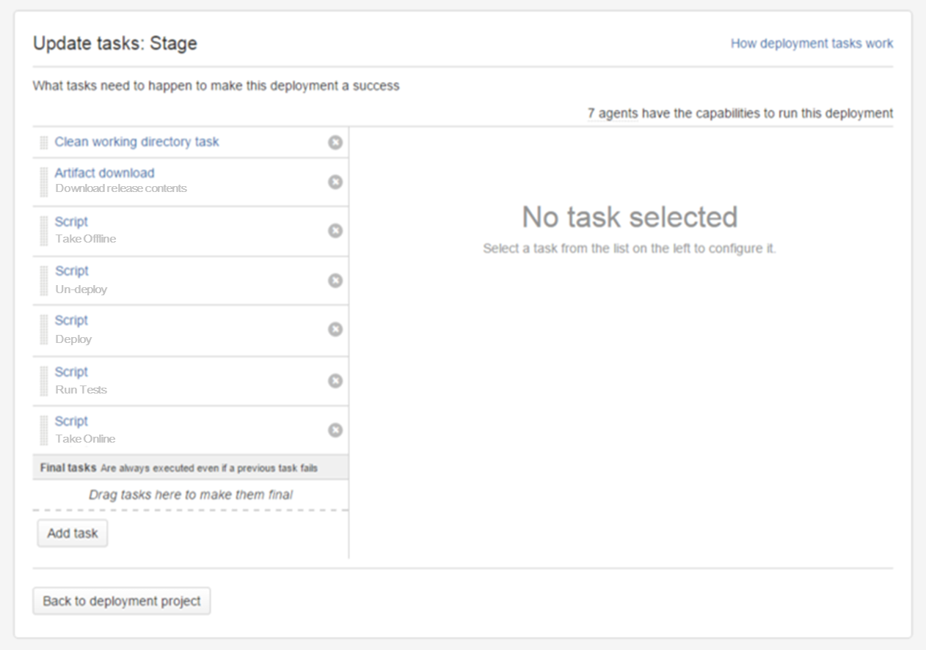
Deploy
Take Offline
Run Tests
Take Online
Un-Deploy
Download release contents
Take Offline
Un-deploy
Deploy
Run Tests
Take Online

Slide 24
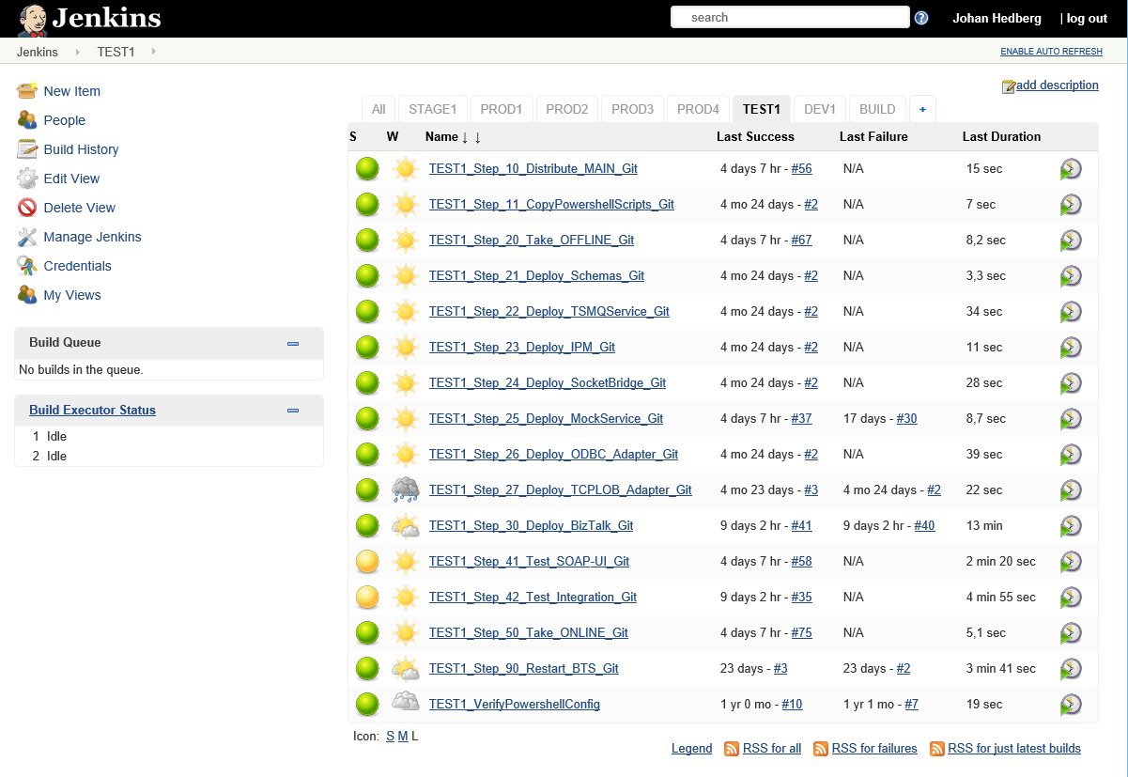
Build
Distribute
Deploy

Slide 25
Build
Distribute
Deploy
Take Offline
Run Tests
Take Online
Un-Deploy

Slide 26
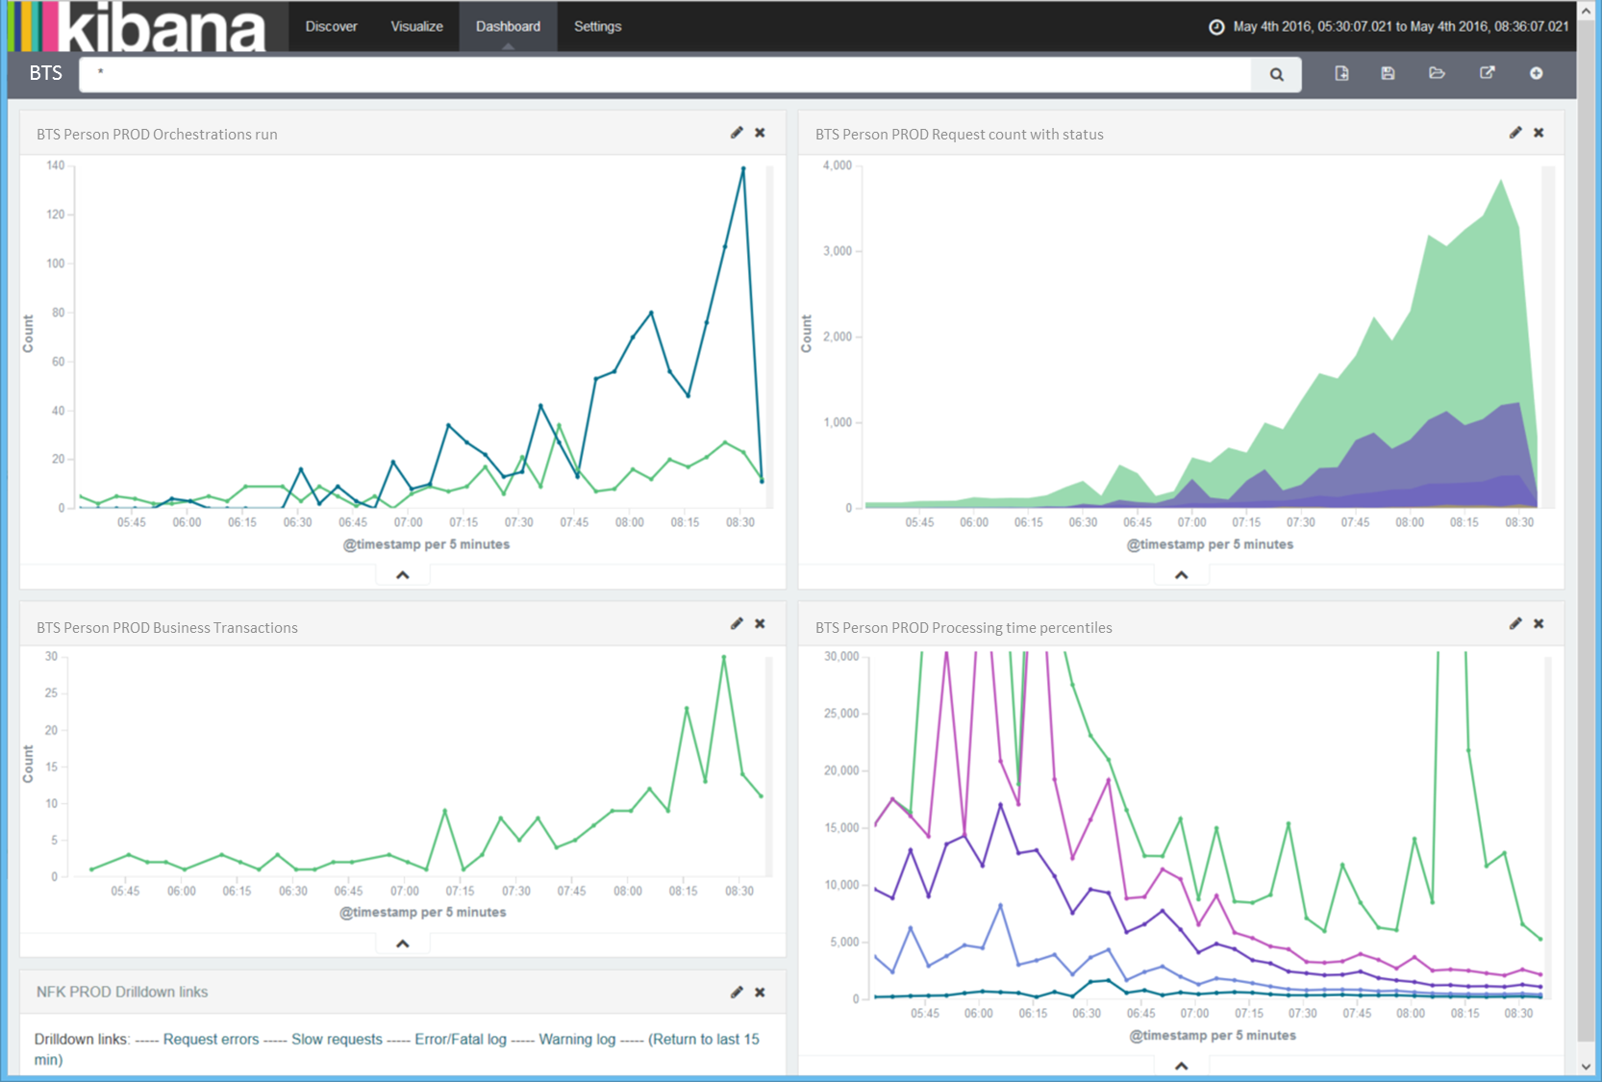

Slide 27
Summary
Going behind enemy lines means blending in
Use (agile) processes and tools that work where you are
Preferably same as everyone else in the organization
Common practices, common vocabulary
Code reviews through pull requests – feeds culture
Visibility to all, of all
Integration, not isolation

Slide 28
Contact AND QUESTIONS
?
Johan Hedberg
Consultant, Architect, Developer @ XLENT in Sweden
Microsoft Azure MVP
johan@jeh.se / johan.hedberg@xlent.se
@johhed
https://www.linkedin.com/in/mvpjohanhedberg
http//blogical.se/blogs/johan

