Slide 1
Jeff Hollan
Program Manager (Azure), Microsoft
Advance Integration Strategies

Slide 2
Agenda
Use Case Highlight
Advanced Patterns and Operations
Creating Deployments
Release Management

Slide 3
Requirements
Synchronization of new and updated Prescriber Records between Prescriber360 (CRMOL) and Salesforce.
Migration from scheduled record processing to Real-time.
Provide for Upsert operations.
Rules based routing.

Slide 4
Salesforce to Prescriber360

Slide 5
Prescriber360 to Salesforce

Slide 6
Prescriber360
100 Menlo Park, Suite 302B
Edison, NJ 08837
Phone: +1 (732) 474-0700
Toll Free: +1 (855) VNB CONS
Email: sales@vnbconsulting.com

Slide 7
These Demos are AWESOME!
What do I do when I leave the “happy path?”
How do I actually manage these resources with the right pipelines and processes?

Slide 8
Extensible Actions and Triggers
Basic Action
Azure API
Azure Function
Nested Workflow
HTTP/HTTP + Swagger
Triggers and Long Running Actions
Polling
202 ACCEPTED
Location: https://-------/checkStatus?id=1
Retry-After: 15
Webhook / HTTP Request
HTTP POST @callbackUrl()

Slide 9
Demo: Custom API and Long Running Actions

Slide 10
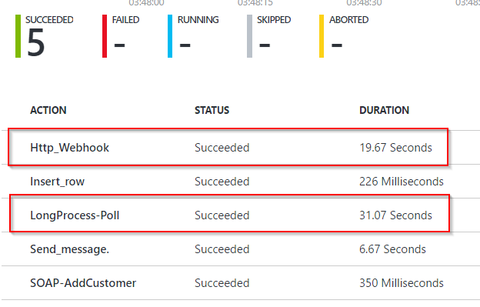
Extensible Actions and Triggers

Slide 11
Management, Deployment, and Release Management

Slide 12
Creating Logic App Templates
{
“parameters”: {},
“resources”: [
“<Azure Resource Definition>”,
“<Azure Resource Definition>”
]
}

Slide 13
Creating Logic App Templates
Azure Resource Manager Templates
Resource Group
Service Plan
Logic App
Connections

Slide 14
Demo: Logic App Deployment and Release Management

Slide 15
Reach Out / Reach In
@logicappsio
Logic Apps GitHub | http://github.com/logicappsio
Logic Apps Blog | http://aka.ms/logicappsblog
Logic App User Voice | http://feedback.azure.com/forums/287593-logic-apps
Logic Apps Live Webcast | http://aka.ms/logicappslive
BizTalk Blog | https://blogs.msdn.microsoft.com/biztalk_server_team_blog
Integration Advisors | (sign-up) http://aka.ms/azureadvisors
Monthly Newsletter | (sign-up) mail to: biztalkintegration@microsoft.com

