Slide 1

Christopher Anderson
Program Manager II, Microsoft
Leveraging Azure Functions & Azure App Service for integration scenarios

Slide 2

Who am I?
Christopher Anderson
Program Manager II
chrande@microsoft.com - @crandycodes
History
SQL Server & Azure SQL DB
Azure Mobile
WebJobs SDK
Azure Functions

Slide 3
Agenda
What is App Service & Functions?
Integration patterns with App Service

Slide 4
What is Azure App Service?

Slide 5
Azure App Service
“PaaS that developers love and businesses can trust”

Slide 6




















































Security & Management
Platform Services
Hybrid Operations
Portal
Compute
App Service
Developer Services
Azure AD
Connect Health
Cloud
Services
Service
Fabric
Web
Apps
API
Apps
API
Management
Azure
Functions
Visual Studio
Azure SDK
Active
Directory
AD Privileged
Identity Mngt
Batch
Remote App
Mobile
Apps
Logic
Apps
Notification
Hubs
Team Project
Application
Insights
Multi-Factor
Authentication
Backup
Integration
Analytics & IoT
Data
Automation
Operational
Insights
Storage
Queues
Biztalk
Services
SQL Data
Warehouse
HDInsight
Machine
Learning
SQL
Database
Key Vault
Hybrid
Connections
Service
Bus
Import/Export
Store /
Marketplace
Data
Factory
Event
Hubs
Redis
Cache
Search
Media & CDN
Site
Recovery
Stream
Analytics
Mobile
Engagement
DocumentDB
Tables
VM Image Gallery
& VM Depot
Media
Services
Content Delivery
Network (CDN)
StorSimple
Infrastructure Services
Compute
Storage
Networking
Windows
Linux
Containers
BLOB Storage
Azure Files
Premium Storage
Virtual Network
Load Balancer
DNS
Express
Route
Traffic Manager
VPN Gateway
Application Gateway
Notes:
I am going to focus on the green box
But it plays nicely with the rest of Azure

Slide 7
>300K
Active customers
>900 K
Apps Hosted
>6Billion
Requests per Day
>200k
Dedicated Cores
2x
Yearly Customer
Growth
4x
Yearly Traffic
Growth
Notes:
Other Numbers to include:
-1.5x yearly customer growth
-3x yearly traffic growth
-3x yearly revenue growth

Slide 8








Apps
eCommerce
Digital Global Presence
Custom Apps
LOB
API / Services / ISV
Logic Apps
APIM
Mobile Apps
Notification Hubs
Azure
Functions
API Apps
Web Apps
Services
App Service
Fully Managed Platform
Enterprise Grade
Developer Experience
Auto scale
OS and Framework patching
Load balancing
Languages and Frameworks
Superior DevOps
Self service supportability
Enterprise grade SLA
Security and Compliance
On-Premise Connectivity
Platform

Slide 9
Digital Global Presence
Custom Apps
Apps
eCommerce
Digital Global Presence
LOB
API / Services / ISV
Logic Apps
APIM
Mobile Apps
Notification Hubs
Azure
Functions
API Apps
Web Apps
Services
App Service
Fully Managed Platform
Enterprise Grade
Developer Experience
Auto scale
OS and Framework patching
Load balancing
Languages and Frameworks
Superior DevOps
Self service supportability
Enterprise grade SLA
Security and Compliance
On-Premise Connectivity
Platform

Slide 10
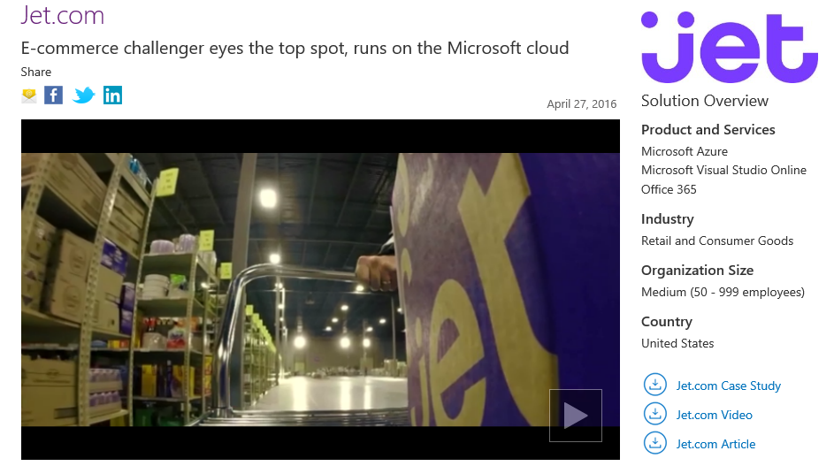

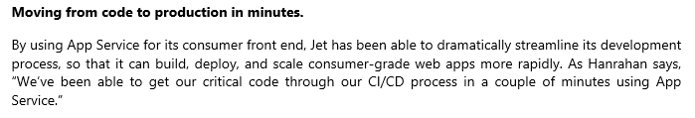
eCommerce
Iberia Express
Objectives
Scalable e-commerce website to sell flights, both through travel agencies and directly to consumers
Tactics
Built Azure App Service web app using Umbraco and SQL on Azure
Used VNET to connect data from on-premises
Results
Scalable Website with integration for Flight booking and Check In systems

Slide 11




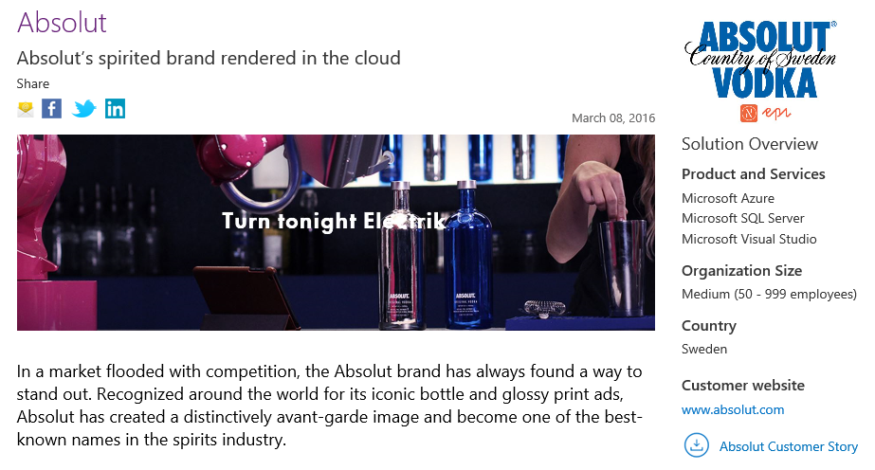
NASCAR
Digital Global Presence
Objective
Support live video with live timing and scoring. Custom (per manufacture) experience. Support any device at large scale
Tactics
Using Azure Web App (running PHP) as frontend utilizing many Azure services such as Storage, SQL, Notification Hub, and Cache. Incorporating Azure DevOps
Results
Highly scalable Web and Mobile solution support any device for streaming and live scoring. Engaging customers to interact with the application reaching millions of users.

Slide 12
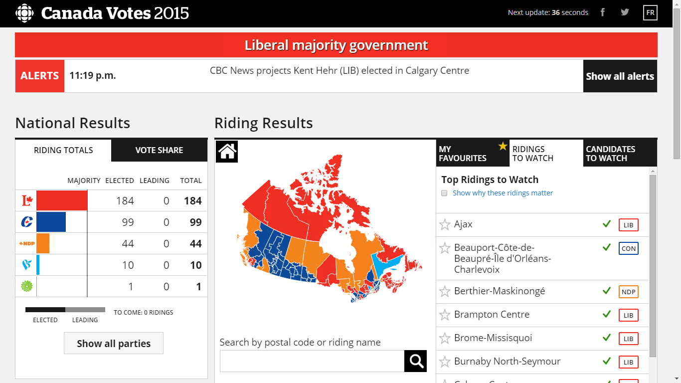
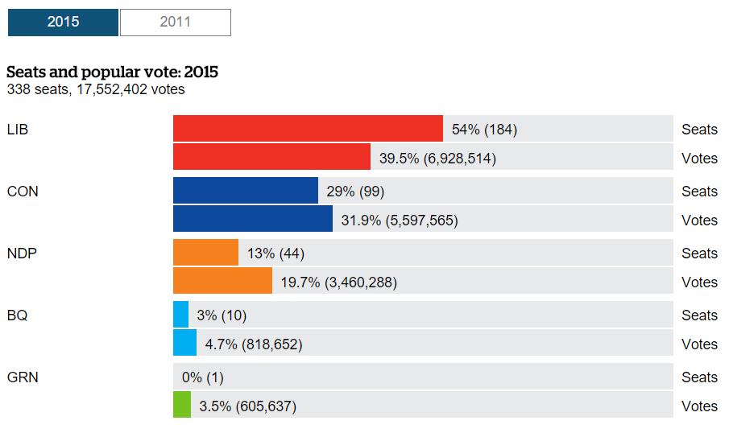
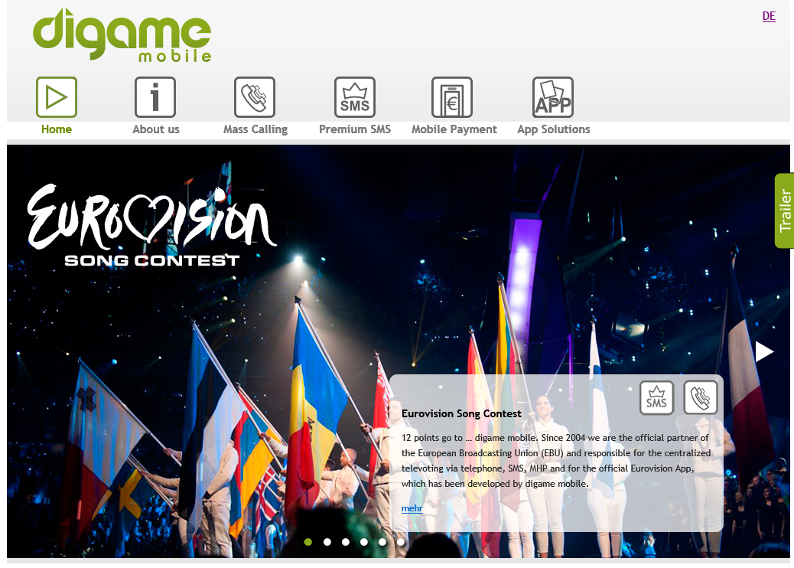
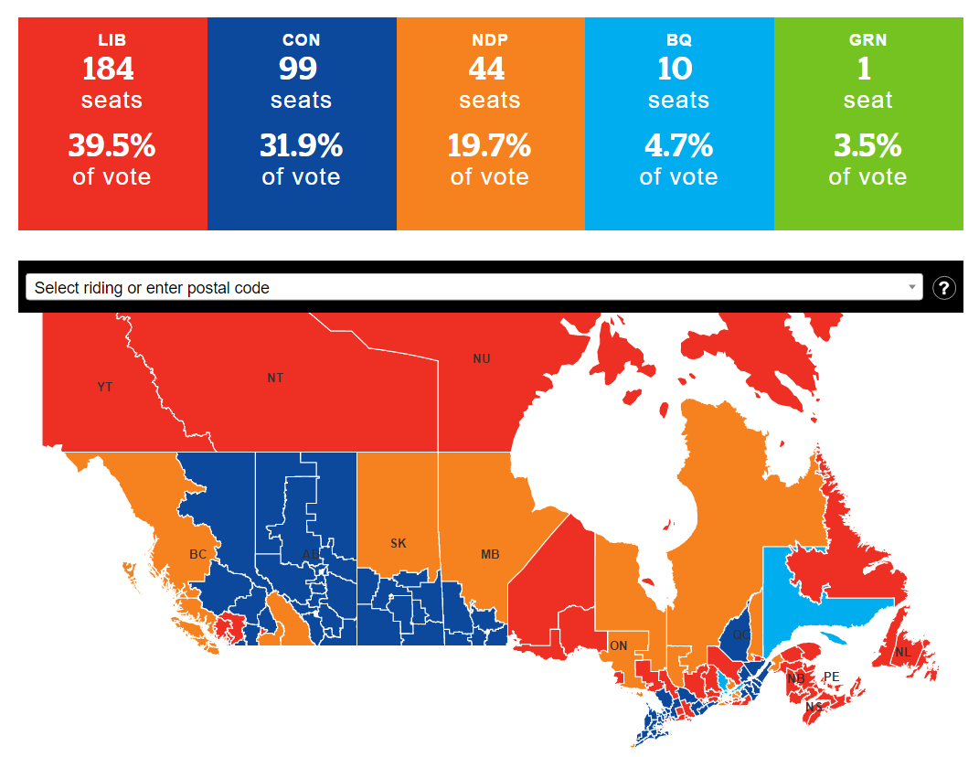
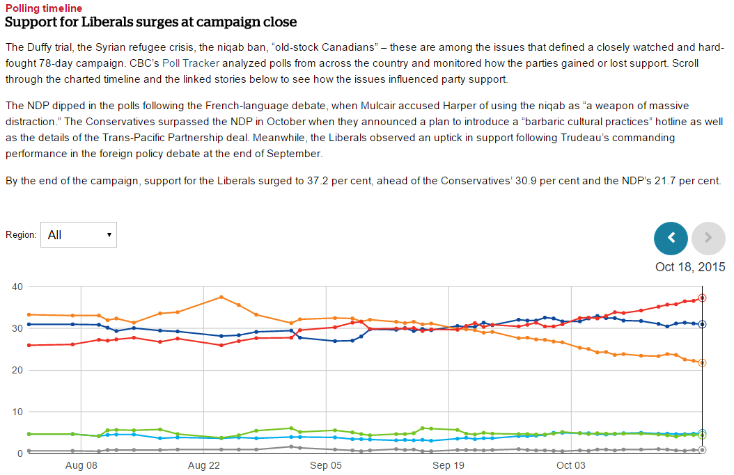
Canadian Broadcasting
Custom Apps
Objectives
Provide real-time results of Canadian election at very high scale (nationwide). While keeping the experience for mobile and desktop devices responsive and impressive
Tactics
Using App Service Environment to (auto) scale across 3 different geo-regions and utilize (peak time) close to 1300 cores. Used App Service apps to provide API, Web and Mobile experiences
Results
Successfully served 3.6 billion requests over six hours, at a peak of 800K RPS.
Digame
Mobile
Objectives
Support Live TV with online voting
Provide rich experience, allowing customers to vote, purchase songs, view standing via Mobile and Web
Tactics
Cloud-based web and mobile apps running on App Service, connecting to backend production systems
Auto-scale for peak times
Results
Scalable solution supporting very large number of voters
Added real-time feedback to production

Slide 13

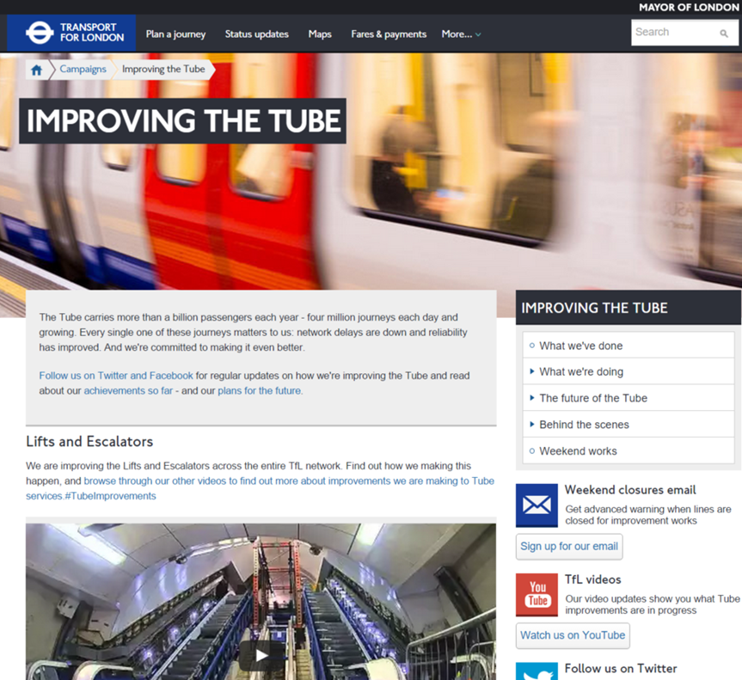
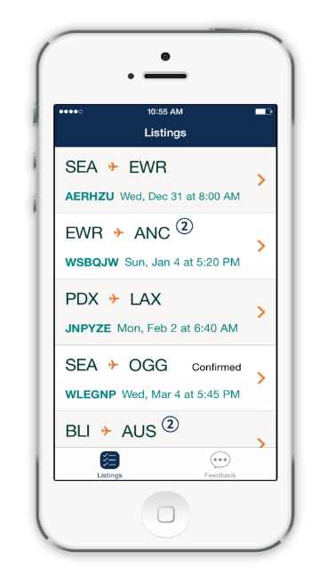


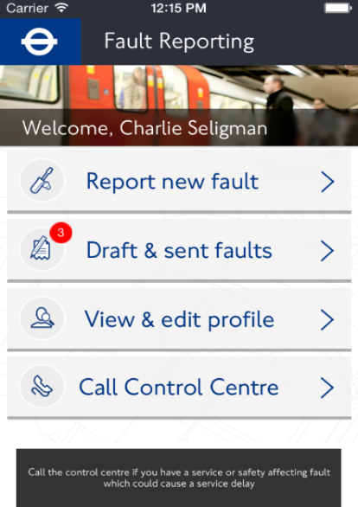
Alaska Airlines
Objective
Provide responsive and productive ‘same day flight’ experience for Alaska personal, using employees’ devices connecting to on-premises systems
Tactics
Using cross platform native apps (Xamarin) to deliver a mobile app with mobile backend running on Azure App Service, securely connected to On-Premises systems using VPN.
Results
Employees to securely login, via Azure Active Directory, and hop on a flights.
LOB
Transport for London
Objectives
Allow employees to report on assets needing repairs, using employees’ devices underground (little to no network / WiFi). Work offline and sync while connecting to on-premises systems
Tactics
Using App Service Environment to host TFL application. Using App Service Environment secure VPN to connect to variety of On-Premises systems and data sources. Secure employees login via Azure Active Directory. Support offline data sync
Results
Scalable, secure, reliable mobile LOB solution supporting thousands of TfL employees on the go, in busiest times, no matter where they are, without having to change any of the On-Premise legacy software

Slide 14
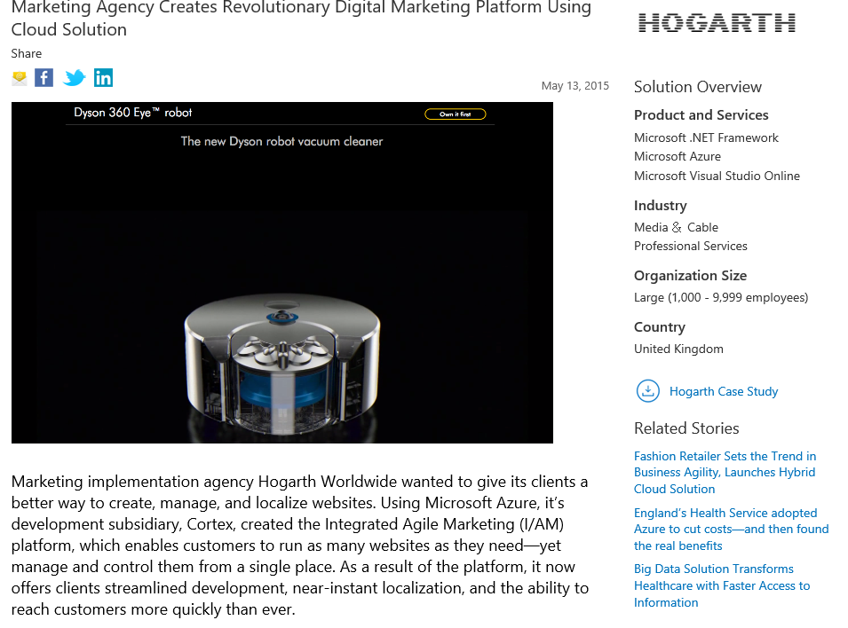
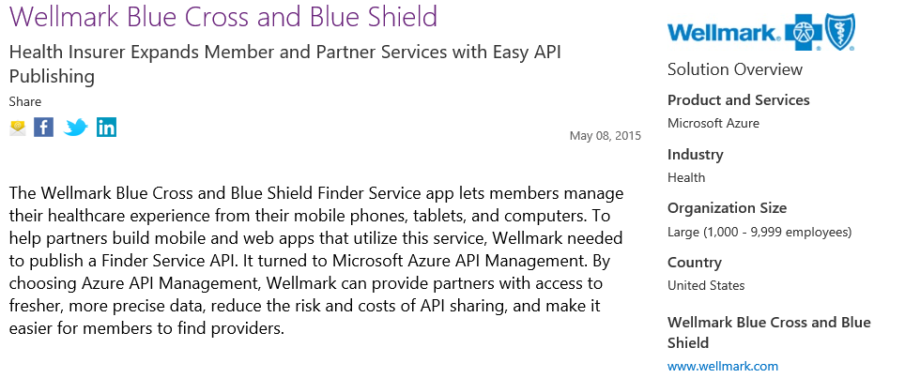
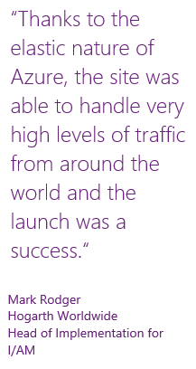
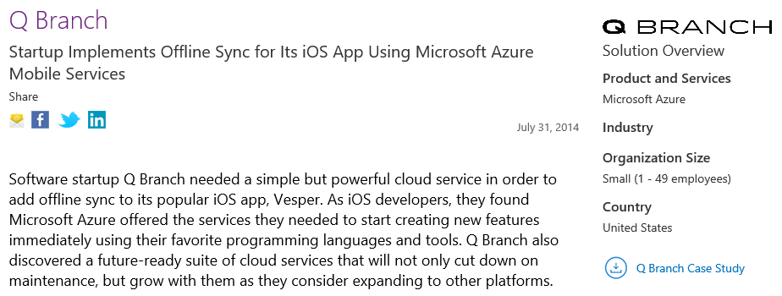
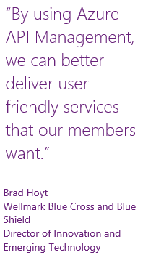
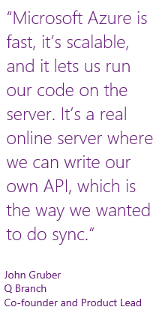
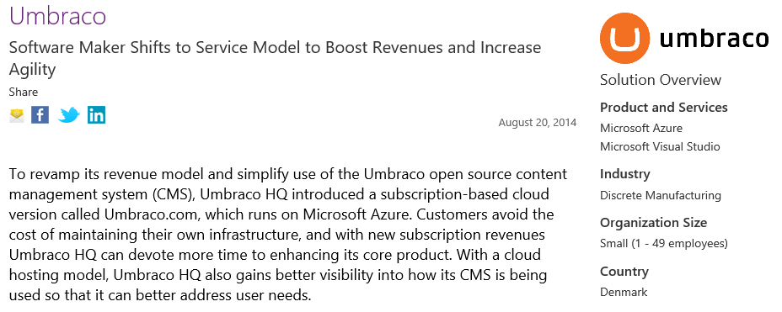
API / Services / ISV

Slide 15
Digital Global Presence
Custom Apps
Apps
eCommerce
Digital Global Presence
LOB
API / Services / ISV
Logic Apps
APIM
Mobile Apps
Notification Hubs
Azure
Functions
API Apps
Web Apps
Services
App Service
Fully Managed Platform
Enterprise Grade
Developer Experience
Auto scale
OS and Framework patching
Load balancing
Languages and Frameworks
Superior DevOps
Self service supportability
Enterprise grade SLA
Security and Compliance
On-Premise Connectivity
Platform

Slide 16

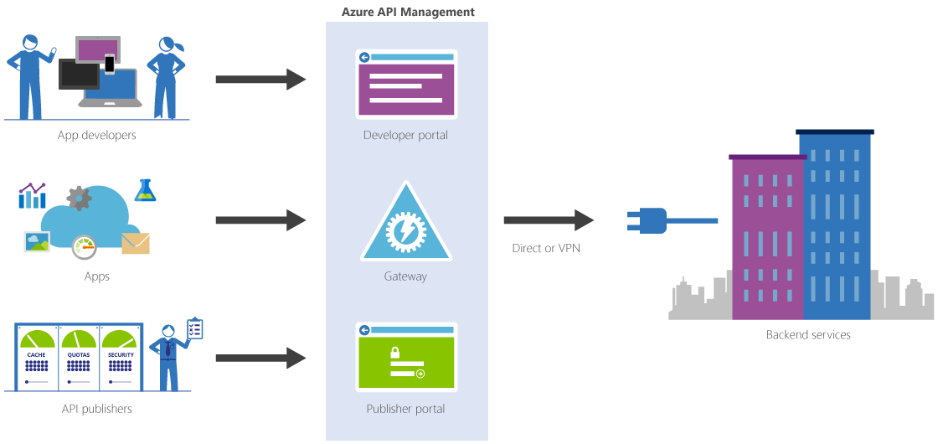
APIM
API Apps & API Management
API Apps
Quickly build APIs in the cloud using the language of your choice. Publish, manage, secure, and analyze your APIs in minutes.
Secure APIs with Active Directory, single sign-on, and OAuth
Generate client proxies or APIs in your language of choice
Mashup existing enterprise APIs
Integrate with API Management and Logic Apps

Slide 17

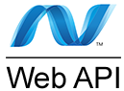



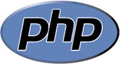



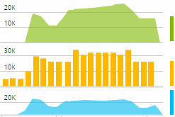
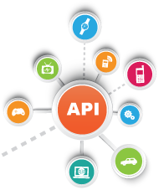
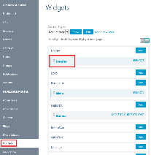
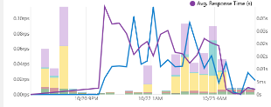
APIM
API Apps
1) API design
2) Generate clients
3) Implement Logic
4) Compose
Swagger
Azure
Mobile Engagement
Developer
Portal
8) Measure
7) Control
5) Publish
6) Share

Slide 18
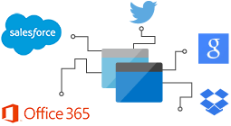
Logic Apps
Logic Apps
Develop and deliver powerful integration solutions with ease
Create business processes and workflows visually
Deliver integration capabilities in web, mobile, and API apps
Integrate with your SaaS and enterprise applications
Automate EAI, B2B, and business processes
Connect to on-premises data

Slide 19
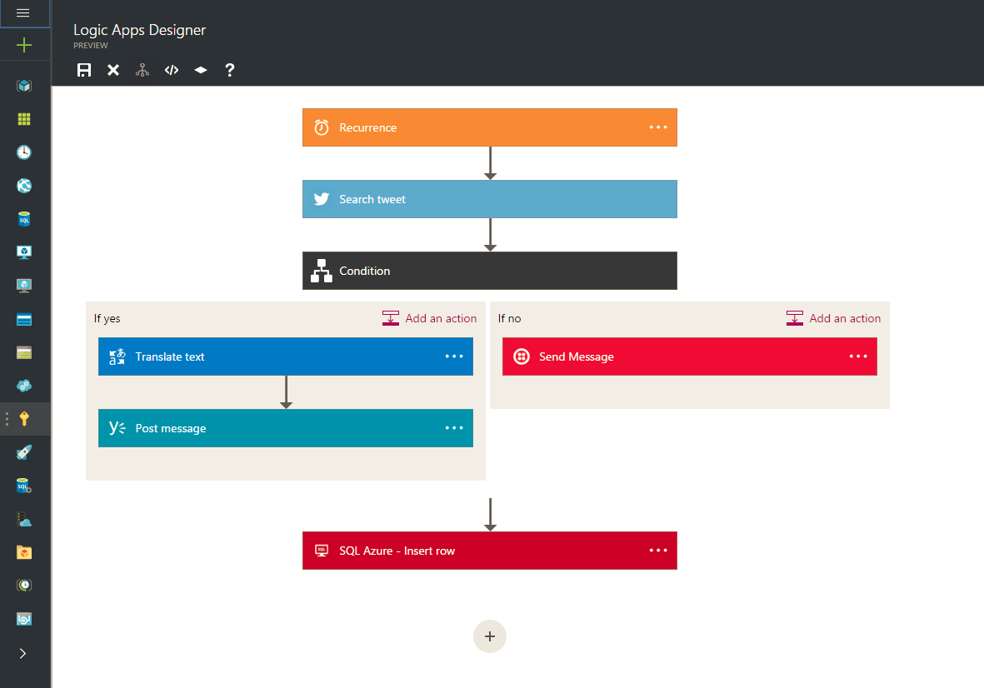
Logic Apps
The grow-up story for Microsoft Flow visual designer based on declarative language stock library of SaaS and format connectors leverage Azure Functions as custom steps invoke with a timer and Web hooks scalable runtime.

Slide 20
Web Apps
Web Apps
Create and deploy mission-critical web apps that scale with your business.
Supports .NET, Java, PHP, Node.js, and Python
Built-in auto-scale and load balancing
High availability with auto-patching
Continuous deployment with Git, TFS, GitHub, and Visual Studio Team Services
Supports WordPress, Umbraco, Joomla, and Drupal

Slide 21

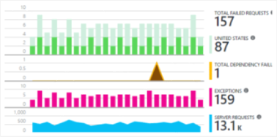


Web Apps
2) Code Repository
3) Build
4) Deploy to stage
5) Validate
6) Publish
1) Develop
8) Monitor and Improve
7) Deploy to Cloud
Notes:
This is the whole (top level) Dev Ops story where Dev build wounderful apps, using CI they mange their code, builds, and releases. Connecting to a repository, they can deploy to Azure Websites, build in the cloud, deploy to a slot to test and validate, swap into production, deployed across the globe as needed, monitor and get feedback, on which devs can make updates. Rinse and repeat

Slide 22

Mobile Apps
Mobile & Push
Notification Hubs
Build engaging iOS, Android, and Windows apps. Develop with Xamarin or local SDKs.
Broadcast push with customer segmentation
Enterprise single sign-on with Active Directory
Autoscale to support millions of devices
Apps can work offline and sync
Social integration with Facebook, Twitter, Google
Leverage HockyApp or Azure Mobile Engagement to learn and improve

Slide 23
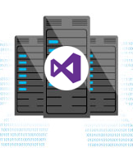
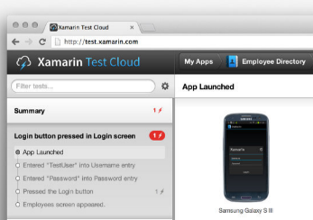
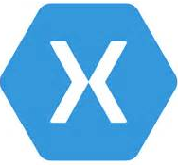



Notification Hubs
Mobile Apps
1) Develop
2) Build
3) Test
Xamarin Test
Cloud
Xamarin
TFS
Auth
Notifications
Data Sync
Azure
Mobile Engagement
Your App
6) Measure
4) Deploy
5) Extend

Slide 24
Demo: Deploying an app to App Service

Slide 25



Azure
Functions
Azure Functions
Code
Azure Functions
Events + data
Process events with Serverless code.
BAM!!!
Make composing Cloud Apps insanely easy
Develop Functions in C#, Node.js, Python, PHP, Batch and more
Easily schedule event-driven tasks across services
Expose Functions as HTTP API endpoints
Scale Functions based on customer demand
Easily integrate with Logic Apps

Slide 26

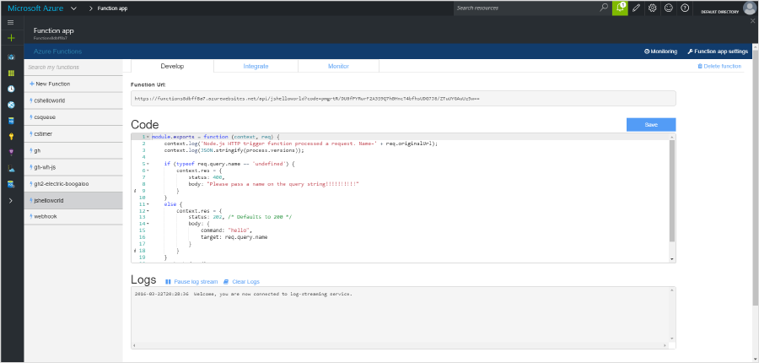

Azure
Functions
1) Trigger
2) Input Binding
3) Develop
4) Execute
5) Output Binding
Web
Hooks
App Services
Hosting Plans
Azure Services
Azure Services
Azure Services
7) Develop Locally
6) Monitor and Improve
Notes:
This is the whole (top level) Dev Ops story where Dev build wounderful apps, using CI they mange their code, builds, and releases. Connecting to a repository, they can deploy to Azure Websites, build in the cloud, deploy to a slot to test and validate, swap into production, deployed across the globe as needed, monitor and get feedback, on which devs can make updates. Rinse and repeat

Slide 27
Demo: hello world with Azure Functions

Slide 28
Integration patterns with
Azure App Service

Slide 29
Integration Patterns
A
B
UNION
A
A`
XFORM
A1
A2
FLOW

Slide 30
Example: Invoice processing
Upload Invoice as File
Convert to JSON
Grab raw file
Store record
Unified API
Fetch Invoice

Slide 31
UNION with App Service
API Management
Upload Invoice as File
Convert to JSON
Grab raw file
Store record
Unified API
Fetch Invoice

Slide 32
XFORM with App Service
API Management
Function
Upload Invoice as File
Convert to JSON
Grab raw file
Store record
Unified API
Fetch Invoice

Slide 33
FLOW with App Service
API Management
Logic App + Connectors
Function
Upload Invoice as File
Convert to JSON
Grab raw file
Store record
Unified API
Fetch Invoice

Slide 34
What can that Fetch Invoice API be?
API Management
Logic App + Connectors
Function
Upload Invoice as File
Convert to JSON
Grab raw file
Store record
Unified API
Fetch Invoice

Slide 35
API Management can help you talk to it all!
API Management can talk to…
API on-prem (optionally with VPN/Express Route)
API on other clouds (optionally with VPN)
API hosted on an API App
API hosted on Azure Functions

Slide 36
What can that Fetch Invoice API be?
API Management
Logic App + Connectors
Function
Upload Invoice as File
Convert to JSON
Grab raw file
Store record
Unified API
Dealer’s Choice
Fetch Invoice

Slide 37
Wrap Up

Slide 38
Get started and reach out!
Try Functions – https://functions.azure.com
Try App Service – https://tryappservice.azure.com
Contact me
chrande@microsoft.com
@crandycodes
@AzureFunctions

Slide 39
Questions?

Slide 40
Thanks!

