Slide 1
INTEGRATE 2014
Azure API Management
Josh Twist
Microsoft

Slide 2
The Rise of APIs
Continued robust growth in APIs
Fueled by mobile, cloud, open & big data, IoT
Public APIs are just the “tip of the iceberg”
APIs are a core component for many startups
APIs are drivers of innovation in the enterprises

Slide 3
So you want an API program?
How do you engage with developers?
How do you reduce TTFSC?
How do you enforce your business policies?
How do you make your legacy API modern?
How do you understand their behavior?
How do you protect your core business systems?
API Management

Slide 4
WINDOWS AZURE API
DEVELOPER PORTAL
DEVELOPERS
PROXY
API
APPS
API
PUBLISHER
PORTAL
Can be hosted anywhere and authored in any language on any platform.
PUBLISHER / ADMIN
AZURE API
MANAGEMENT

Slide 5
Recent Updates
GA
Static IP
OAuth 2.0 support
Backup / Restore
Certificate auth
Root APIs
HTTP support
Subscription per app
Significant performance improvements in the developer portal
Now in 13 Azure regions, including Australia!
Delegation
Improved Caching
Custom Sub Keys
Compression Support
Google Analytics Support
HTTP support
Subscription per app
API Search

Slide 6
DEMO
AZURE API MANAGEMENT

Slide 8
Preferred text layout, 2-color (no bullets)
Main topic 1: size 40pt
Size 20pt for the subtopics
Size 20pt for the subtopics
Main topic 2: size 40pt
Size 20pt for the subtopics
Size 20pt for the subtopics
Main topic 3: size 40pt
Size 20pt for the subtopics
Size 20pt for the subtopics

Slide 9
Adjusting list levels
Main topic 1: size 40pt
Size 20pt for the subtopics
Size 20pt for the subtopics
Main topic 2: size 40pt
Size 20pt for the subtopics
Size 20pt for the subtopics
Main topic 3: size 40pt
Size 20pt for the subtopics
Size 20pt for the subtopics
Use the “Decrease List Level” and “Increase List Level” tools on the Home Menu to change text levels.
Try this:
Place your cursor in any row of text to the left that says “Size 20pt for subtopics”
Next click the Home tab, and then on the “Decrease List level” tool. Notice how the line moves up one level.
Now try placing your cursor in one of the “Main topic…” lines of text. Click the “Increase List Level” tool and see how the text is pushed in one level
Use these 2 tools to adjust your text levels as you work

Slide 10
Bullet points layout with subhead
Example of a bulleted slide with a subhead
Set the slide title to “Sentence case”
Set subheads to “Sentence case”
In “bulleted” slide layouts, level 2 text is 24pt
Level 3 text is 24 pt
Level 4 text is 20pt
Level 5 text is 20pt
Hyperlink style
www.microsoft.com

Slide 11
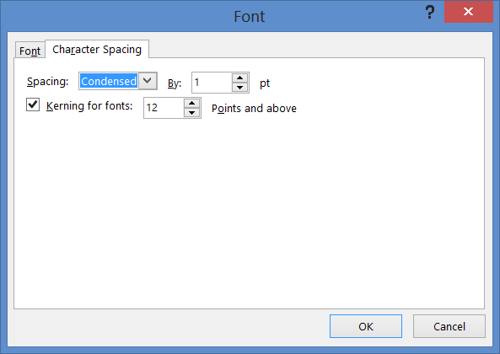
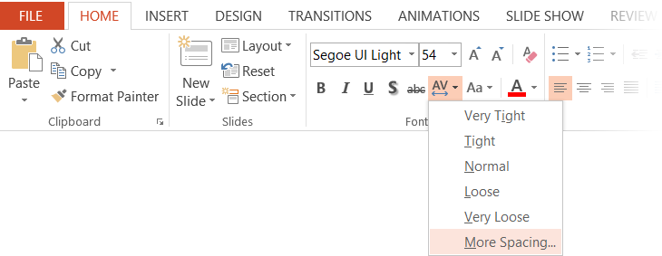
Character spacing
Type that is size 54pt and larger should be condensed by 1pt
Type that is smaller than 54pt should be normal

Slide 12
Software code slide
This slide layout uses Consolas, a monotype font which is ideal for showing software code.

Slide 13
Section title

Slide 14
Section title

Slide 15
Section title

Slide 16
Section title

Slide 17
Demo
Name

Slide 18
Video

Slide 19
Segoe is our typeface
The simplest executions of Segoe are often the most beautiful. Let’s make our words engaging and our ideas clear by adopting a less-is-more approach to typography. Limit type to no more than three sizes in a layout. Set all copy in sentence case, limit the use of lowercase, and keep paragraphs flush left.

Slide 20
Font info
Font, size, and color for text have been formatted for you in the Slide Master
This template uses Segoe UI and Segoe UI Light, standard fonts included in Windows 7/8
If you are running Windows 7 or 8, no fonts are needed. If you are running Windows Vista or earlier, you will need to install Segoe UI Light.
When connected to CorpNet, you can find Segoe UI here: \\showsrus\images\Corporate_Fonts\PC\Segoe UI\Segoe_UI_Font_family
Copy the .ttf fonts into your C:\Windows\Fonts folder

Slide 21
Presentation fonts/typography
What are the font choices and sizes?
Any font size 28pt or larger should use Segoe UI Light
Any type that is less than 28pt should use Segoe UI
On one slide, try to use a maximum of 3 font sizes
Where to start
Control focus by using scale versus bullets
Use color to draw focus when necessary
Start with main topic at 40pt and subtopics at 20pt
Title/sentence casing and periods
Title text should be “sentence case”
All supporting slide text should be sentence case except for names and products

Slide 22
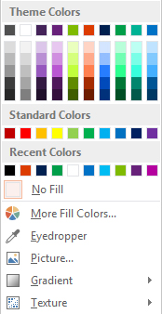
Slide palette info
The PowerPoint palette for this template has been built for you and is shown below. Avoid using too many colors in your presentation.
Select the 4th color from the left for subheads and 1st level non-bulleted text color, or wherever “color” text is preferred over the default black/white text
Accent colors 1-6 – (6 Theme Colors to the far right)
Text
Light 2
Accent 1
Accent 2
Accent 3
Accent 4
Accent 5
Accent 6
Use Accent 1 as the main accent color. Use Accent 2 and Accent 3 when additional colors are needed.
Use Accents 4-6 sparingly – only when more colors are necessary.

Slide 23
Lots of data? Minimalize and plan
Gray is used to de-emphasize data that is less important. Use cool gray 3 or cool gray 7. See slide 7 for color formulas.
All elements have the same interior margins as text blocks.
When a chart or graphic, has more elements than can easily be aligned to the grid, align the outer edges of the group, top, bottom, left and right edges to the grid.
It is preferable to keep the group aligned to the left border.
130M
140M
125M
Other
Other
Other
Other
Other
Other

Slide 24
Pie chart 1

Slide 25
Pie chart 2

Slide 26
Horizontal bar chart
Label 1
Label 2
Label 3
Label 4
Label 5

Slide 27
Line chart
Label 1
Label 2
Label 3

Slide 28
Chart Example

Slide 29
3 column table Tables are easy to modify
Table header | Table header | Table header
To modify table, first click anywhere in table, so the Table Tools menu is highlighted at top | Layout > To add rows, click into cell and choose, Insert Above or Insert Below | Layout > Shrink or expand column widths by adjusting the Cell Size, or set them to same size with Distribute
To modify the table layout, click Table Tools > Layout To modify the table style, click Table Tools > Design | Layout > To add columns, click into cell and choose Insert Left or Insert Right | Layout > Use Alignment settings to adjust text alignment and cell margins
 |  | Tip: To quickly add a row, place cursor in this last cell and hit Tab key

Slide 30
4 column table Tables are easy to modify
Table header | Table header | Table header | Table Header
To modify table, first click anywhere in table, so the Table Tools menu is highlighted at top | Layout > To add rows, click into cell and choose, Insert Above or Insert Below | Layout > Shrink or expand column widths by adjusting the Cell Size, or set them to same size with Distribute
To modify the table layout, click Table Tools > Layout To modify the table style, click Table Tools > Design | Layout > To add columns, click into cell and choose Insert Left or Insert Right | Layout > Use Alignment settings to adjust text alignment and cell margins | Tip: To quickly add a row, place cursor in this last cell and hit Tab key

Slide 31
Special content slide layouts

Slide 32
Section title
Speaker Name

Slide 33
There are over 1 million words in the English language.

Slide 34
“ Add a quote here. Design is easier than it looks, and more important than it seems.”
Author’s Name

