Slide 1

INTEGRATE 2014
BizTalk Roadmap
Bill Staples
Application Platform, Microsoft

Slide 2
Integration in a mobile-first, cloud-first world

Slide 3
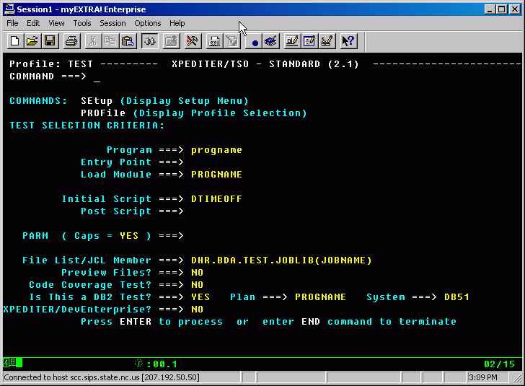
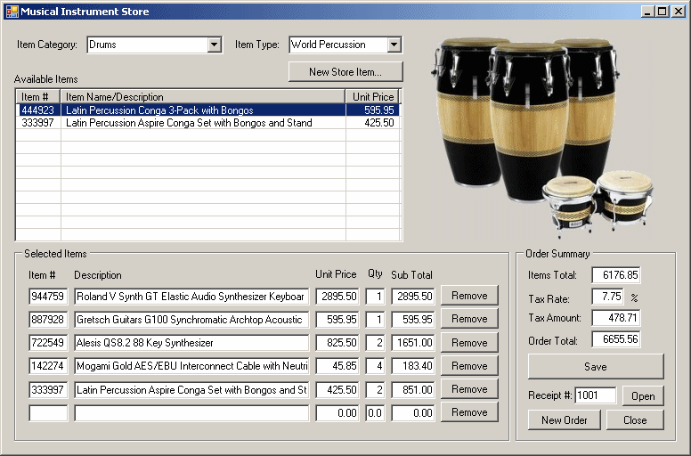
Apps of the past

Slide 4

Users of today

Slide 5
Shift how we think about apps.
To
From
You go to work
Runs on PC/Web
Keyboard/Mouse
Data from users and customers
Transacted local workflow
Run in one data center
Work comes to you
Runs on mobile device
Touch, voice and sensors
Data from people, devices & systems
Orchestrated global services
Hybrid cloud reality

Slide 6
Traditional app integration
Enterprise apps installed in a local datacenter
Specialized BizTalk server integrated common enterprise apps
Few touch points with tight coupling

Slide 7
Contoso
Modern app integration
Tailspin Air
→ Enterprise apps on-premises and in cloud
→ Many touch points with loose coupling
→ Integration is no longer a vertical solution,
we believe it is core to the app platform

Slide 8
Traditional trading partnerships
BizTalk server
Fixed set of B2B protocols/schemas
Lengthy partner onboarding
Crossing enterprise boundaries through firewalls
Hard to do resource planning to adjust for seasonal demands

Slide 9
Partnering in the cloud era
New ‘cloud friendly’ protocols using XML/JSON & HTTP
Leveraging partners across the globe
Quick and simple partner onboarding
Leverage on-demand scaling to better utilize resources

Slide 10
Fundamentals of our integrated approach
Integrated app services
Secure, hybrid cloud
SaaS connectivity
Business user friendly
Ecosystem driven
Enterprise grade
Cloud Scale
Open

Slide 11
Today’s Azure App Platform
Azure Websites
Mobile Services
Media Services
BizTalk Services
API Management
→ Standalone services with distinct hosting environment, extensibility point and management experiences
→ You stitch them together to build a ‘solution’

Slide 12
A refactored App Platform with integration at the core
Web and Mobile Services
Build modern Web and Mobile apps:
A common app container and cross-platform extensibility model
Out of box SaaS connectivity
Integrated API management
Built-in hybrid connectivity
Available in public and private cloud
Cloud Orchestration Engine
Microservices Ecosystem
BizTalk Microservices
API Management
App Containers and Hosting Environment

Slide 13
Demo
Integrated App Platform

Slide 14
Enterprise Travel Scenario
Mobile App
Workflow
Web App
SAP
Sendgrid
ACME

Slide 15
A Lap Around the Stack
A refactored app Platform with integration at the core

Slide 16
>400k
300k
App Containers and Hosting
Apps Hosted
Unique Customers
120%
Building on a solid foundation
Proven cloud scale
Hybrid connectivity built-in
Open platform
Available on premises today with Windows Azure pack
Yearly Paid Subscription Growth
>500%
~2Billion
Yearly Traffic Growth
Transactions daily

Slide 17
Governance
Access Control
Built-in API Management
Hybrid connectivity
Throttle, rate limit and quota callers
Modern formats to existing APIs
Authentication + key management
Built-in analytics
Partner APIs
APIs for
On-Premises and SaaS

Slide 18
Microservice runtime and development
Cross platform
Auto update
Deep logging diagnostics
Rich ecosystem with partner monetization opportunities

Slide 19
AS400
Zuora
Websphere MQ
Twitter
Chatter
SalesForce
HTTP, HTTPS (REST)
SAP
File
Office 365
Sugar CRM
Out-of-box Microservices
BOX
Microsoft Dynamics CRM Online
Siebel
IBM DB2
Standard Protocols
Common Enterprise Apps
Most Popular consumer and Enterprise SaaS
Available through the marketplace
Facebook
Informix
Microsoft Dynamics AX
SFTP
SMTP
Twilio
Twitter
OneDrive
Coupa
SQL Azure
FTP/FTPS
Marketo
Zoho
Microsoft SQL Server
Workday
Oracle Database
SuccessFactors
Azure HDInsight
MongoDB
Web Services
(SOAP+WCF)
Quickbooks
Microsoft SharePoint
Microsoft Yammer
Salesforce
Microsoft Dynamics AX
Azure Services
(Service Bus)
Azure Services
(Mobile + Others)
Azure Services
(Storage Blob +Table)

Slide 20
BizTalk features as Microservices
Validation
Batching/Debatching
Format Conversion (XML, JSON, FlatFile)
Extract
Transform
Mediation Patterns (Request Response, One Way etc)
Business Rules
Trading Partner Management
AS2/X12/EDIFACT

Slide 21
Workflow engine and Web-based process designer
JSON based workflow definition
Orchestrates API execution
Supports long running processes and control flows
Provides rich logging, diagnostics
Enables developers and business users to easily define and track business process

Slide 22
Complete web + mobile experiences
Rich PaaS offer with cross-platform for .NET, Java, node.js, PHP…
Built-in autoscale and load balance
High availability and auto-patching
Continuous integration and DevOps

Slide 23
Frequently Asked Questions
→ Will you support migration from BizTalk server/services?
→ Will I be able to acquire/use just the BizTalk features?
Will you ship the integrated platform with Azure Pack?

Slide 24
Roadmap Summary
→ BizTalk server update coming in 2015
→ Azure BizTalk services continuing under SLA
→ Integrated platform preview coming Q1 2015

