Slide 1








BizTalk Summit 2015 – London
ExCeL London | April 13th & 14th
Karandeep Anand
Partner Director of Program Management at Microsoft
Keynote
t
Sponsors

Slide 2
Azure Integration Briefing
Karandeep Anand
Partner Director PM
Azure AppPlat

Slide 3
March ‘15
Feb ‘15
>1000s
Azure App Service
Launch
API Management GA
Community Newsletter Subscribers
@ WPC
>100s
July ‘14
App Integration Partner Award Nominations
Blog Posts driving adoption & engagement
BizTalk 2013 R2 GA

Slide 4
Some background…

Slide 5


Apps using Microsoft Azure
Hyper-scale
Agility
Insight
Notes:
Azure is Microsoft’s cloud computing platform, and enables developers to move faster and do more.
With Azure we deliver an application platform that enables you to build applications that can scale from a few to tens of millions of concurrent users
Our services enable incredibly agile development workflows, and the ability to continuously deploy improvements to your solutions with zero friction.
And we provides a rich set of capabilities that enable you to integrate your applications with any data and unlock insights for your business

Slide 6
Azure Websites
Mobile Services
BizTalk Services
Key app services in Azure today
Notes:
Some of the key services used by Azure customers to build these solutions today include our Websites offering, our Mobile Services offering, and our BizTalk Services offering.
These are separate offerings today – and provide all of the capabilities I previously mentioned.
Today we are releasing some major new enhancements that make them even better. And I’d like to invite Bill Staples on stage to talk about them.

Slide 7
Key Learnings
  Easy to get started & grow up as needed
  Rich ecosystem of templates, apps & tools
  Cost effective yet highly scalable
  Auto-load balance, auto-scale, GEO DR
  Needs deeper integration with business logic
  One of the largest Azure service!
Azure Websites

Slide 8
Key Learnings
  Validated the brand & cloud design patterns
  Hybrid is critical & a differentiator
  Feature & capability gaps:
    Out of box sources & destinations
    Pipeline templates, custom code support
    Long running workflows, parallel execution
  Needs a lot more investment!
BizTalk Services

Slide 9

HACK ZONE
Learning Effort
Complexity of problem

Slide 10
Vision
Democratize
Integration
iPaaS
Leader
Rich
Ecosystem
Notes:
Azure is Microsoft’s cloud computing platform, and enables developers to move faster and do more.
With Azure we deliver an application platform that enables you to build applications that can scale from a few to tens of millions of concurrent users
Our services enable incredibly agile development workflows, and the ability to continuously deploy improvements to your solutions with zero friction.
And we provides a rich set of capabilities that enable you to integrate your applications with any data and unlock insights for your business

Slide 11
Your
Business
Empower
your employees
Transform
your business
Engage
your customers
Your
Business
Your
Customers
Your
Customers
Power BI
Power BI
Notes:
It is an incredibly exciting time in the technology space right now. The opportunities to transform how we all do business have never been greater.
Every organization is looking for ways to engage their customers better, empower their employees more, and ultimately transform the value they deliver.

Slide 12
Your
Business
Empower
your employees
Transform
your business
Engage
your customers
Your
Customers
APPS
Power BI
insight
agility
internet scale
to any device
Power BI
Notes:
Developers - and the applications and solutions they build - play an integral role in enabling this.
In fact - it is increasingly digital apps and technology that enable businesses to delight their customers and differentiate from one another.
It has never been a better time to be a developer.

Slide 13

Introducing Azure App Service
Unique integrated offering
Build rich, engaging & intelligent apps
Scale as your business grows
Azure Websites
Mobile Services
BizTalk Services
Key app services in Azure today
Notes:
Today we are announcing App Service, a new service in Azure, which brings together the functionality of Azure Websites, Azure Mobile Services, and Azure Biztalk Services into a single development experience.

Slide 14

One integrated offering
Web Apps
Mobile Apps
Web apps that scale with your business
Build Mobile apps for any device
LOGIC Apps
Api Apps
Automate business process across SaaS and on-premises
Easily build and consume APIs in the cloud
Notes:
App Service has everything you need to build apps that target both web and mobile clients from a single app back-end.
Using API Apps, you can connect your app to dozens of popular services like Office 365 and salesforce.com in minutes, and integrate your own APIs so they can be used within any app.
And finally with Logic Apps, you can automate business processes using a simple no-code experience.

Slide 15
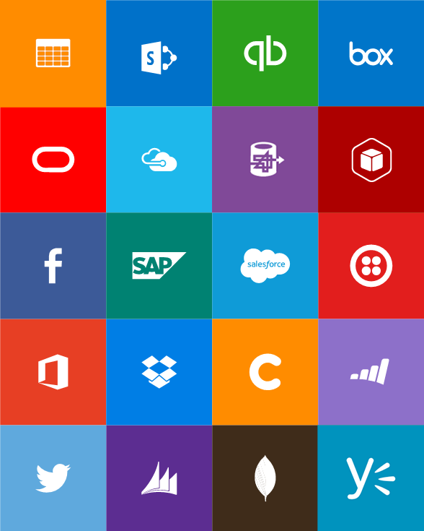

Notes:
App Service has everything you need to build apps that target both web and mobile clients from a single app back-end.
Using API Apps, you can connect your app to dozens of popular services like Office 365 and salesforce.com in minutes, and integrate your own APIs so they can be used within any app.
And finally with Logic Apps, you can automate business processes using a simple no-code experience.

Slide 16
One low price
Notes:
App Service has everything you need to build apps that target both web and mobile clients from a single app back-end.
Using API Apps, you can connect your app to dozens of popular services like Office 365 and salesforce.com in minutes, and integrate your own APIs so they can be used within any app.
And finally with Logic Apps, you can automate business processes using a simple no-code experience.

Slide 17
Full capability set available including:
  .NET, Node.js, Java, PHP, and Python
  WebJobs for long running tasks
  Integrated VS publish, remote debug…
  CI with GitHub, BitBucket, VSO
  Auto-load balance, Autoscale, Geo DR
  Virtual networking and hybrid connections
  Site slots for staged deployments
Web Apps
Web apps run as-is
no changes required

Slide 18
New capabilities for Mobile apps:
  Webjobs for long running tasks
  CI with GitHub, BitBucket, VSO
  Auto-load balance, Autoscale, Geo DR
  Virtual networking and hybrid connections
  Site slots for staged deployments
Mobile Apps
Mobile services plus
a whole lot more

Slide 19
New Logic Apps for easy automation
  No code designer for rapid creation
  Dozens of pre-built templates to get started
  Out of box support for popular SaaS and on-premises apps
  Use with custom API apps of your own
  Biztalk APIs for expert integration scenarios
LOGIC Apps
Automate SaaS and
on-premises systems

Slide 20
Easily use cloud or custom APIs:
  Dozens of built-in APIs for popular SaaS
  An ecosystem of APIs for any need
  Create and publish custom, reusable APIs
  Visual Studio tooling with one click publish and remote debugging
  Automatic client SDK generation for many languages
Api Apps
Create, consume and
host APIs more easily

Slide 21
Built-in API Connectors
Connectors
Box
Chatter
Delay
Dropbox
Azure HD Insight
Marketo
Azure Media Services
OneDrive
SharePoint
SQL Server
Office 365
Oracle
QuickBooks
SalesForce
Sugar CRM
SAP
Azure Service Bus
Azure Storage
Timer / Recurrence
Twilio
Twitter
IBM DB2
Informix
Websphere MQ
Azure Web Jobs
Yammer
Dynamics CRM
Dynamics AX
Hybrid Connectivity
Protocols
BizTalk Services
HTTP, HTTPS
File
Flat File
FTP, SFTP
POP3/IMAP
SMTP
SOAP + WCF
Batching / Debatching
Validate
Extract (XPath)
Transform (+Mapper)
Convert (XML-JSON)
Convert (XML-FF)
X12
EDIFACT
AS2
TPMOM
Rules Engine
Notes:
All the connectivity and tools you need to automate your modern business – with over 40 connectors and growing all the time with the ability for any 3rd party to contribute to our gallery.

Slide 22
Demo
Introducing Azure Logic Apps

Slide 23

Hybrid Integration
Notes:
The ability to easily connect Azure Applications with existing systems – whether they are hosted in the cloud, or on-premises behind a firewall – enables you to deliver even more value within your application and connect with systems and investments you already have.

Slide 24
Guru V
Demo: Next Generation BizTalk Services

Slide 25
Demo: EAI on Azure App Service
Order Processing
Receive order on HTTP
Discount computation Rule
XML with final price
Transform
XML for SQL connector insert
Insert order in SQL
XPATH Extractor
Check value; Send mail

Slide 26
App Service
Web Apps
Mobile Apps
Web apps that scale with your business
Build Mobile apps for any device
LOGIC Apps
Api Apps
Automate business process across SaaS and on-premises
Easily build and consume APIs in the cloud
Notes:
App Service has everything you need to build apps that target both web and mobile clients from a single app back-end.
Using API Apps, you can connect your app to dozens of popular services like Office 365 and salesforce.com in minutes, and integrate your own APIs so they can be used within any app.
And finally with Logic Apps, you can automate business processes using a simple no-code experience.

Slide 27
Get Started w/ App Service!
Logic & API Apps in preview
Build & submit your API Apps (connectors)
Get started for free @ azure.com

Slide 28
Roadmap
Investments
Feedback & data-driven development
Ship Azure App Service on-premises
Ship major version of BizTalk Server in 2016
Grow the Ecosystem & Community

Slide 29
Resources
PMs, MVPs & community @ summit
https://tryappservice.azure.com
Twitter: @_karandeep, #BizTalkSummit2015
www.biztalk360.com/biztalk-summit-2015-london

Slide 30
Thank you!

Slide 31
EAI Features | v1 | v2
XML Transformation
Validation
Content Based Routing
Request Response
AD Auth
OAuth
Flat File
JSON
XML
Connector Extensibility
Custom Code
B2B Features | v1 | v2
AS2 / X12 / EDIFACT
Agreement Decoupling
Batching / De-batching
Archiving
Transform
Trading Partner Management (API & Portal)
Vertical Extensibility
Tracking
Custom Code
Workflow Features | v1 | v2
Long Running
Browser Designer
Control Flow
Instance Management
Tracking
Large Messages (1GB)
Config Support
Expressions
Other Features | v1 | v2
OOB Connectors
Marketplace
Hybrid Connectivity
Custom Code Isolation
Unified Portal
Auto Update with Opt Out
Rules Features | v1 | v2
Vocabulary
Policy
Sources (XML only today)
Test Policy
Browser Rule Editing
V1 = BizTalk Services
V2 = App Service (BizTalk + Logic + API)

