Slide 1

Saravana Kumar
Integration MVP
Evolution of Integration Space

Slide 2
Saravana Kumar
MVP – BizTalk, Integration, Azure (since 2007)
Founder of BizTalk360
http://blogs.biztalk360.com
twitter: saravanamv

Slide 3
Agenda
Integration Evolution
  Business Changes
  Role Changes
  Technology Changes

Slide 4
Role of Integration is evolving day-by-day

Slide 5
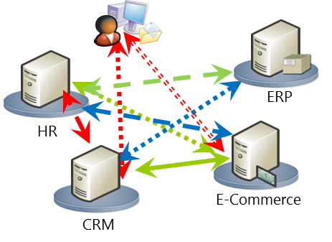
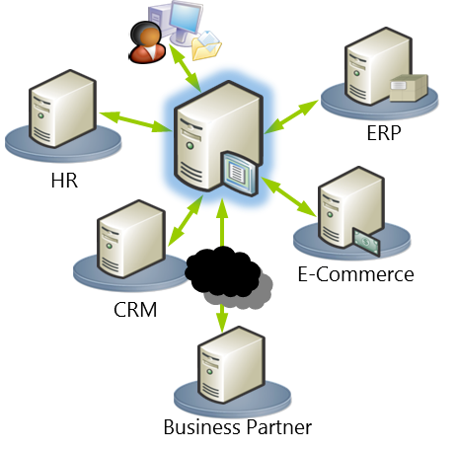
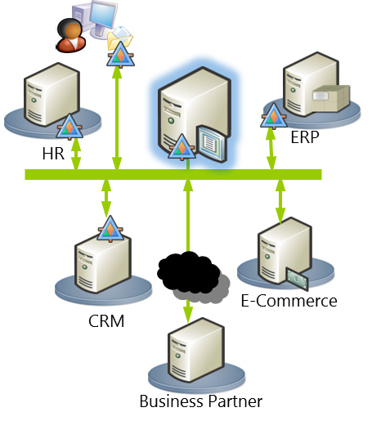
Evolution of Integration solutions

Slide 6
Point-to-Point
Challenges
  Complex Interface
  Redundant Logic
  Doesn’t Scale
  Lacks Visibility
Business Impact
  Delays Response to changing business needs

Slide 7
ESB Architecture
Service Consumer
Service Consumer
Service Consumer
Location & Version
Transparency
Transport Protocol
Conversion
Data
Format Transformation
Enterprise Service Bus
Invocation &
Orchestration
Error Handling
& Repair
Message Interactions
Support
Service Provider
Service Provider
Service Provider

Slide 8
Acceptance of Integration terms
SOA was accepted
EAI/ESB terms started to evolve
EAI patterns started evolving

Slide 9
Integration evolution due to changing Business needs

Slide 10
Industry is evolving
Digital transformation
2 speed IT
Faster time to market
Agility

Slide 11



























Microsoft Tech Stack
Security
Application Platform
Application Performance Management
Azure Active Directory
App Service
Container Service
Redis Cache
Function App
SQL Database
Batch
Web Apps
Application Insights
Azure AD – B2C / B2B
Storage
Document DB
Service Fabric
Operations Insights
Management & Governance
Integration
Development
Security Centre
Cortana Analytics Suite
Stream Analytics
Dev Test Labs
Automation
Cognitive Services
Data Lake Analytics
Visual Studio Team
Services
Backup Vaults
Data Lake Storage
Resource Groups
Data Catalog
Dev Machine
Templates
Machine Learning
Power BI
Notes:
Using Azure and Microsoft, the big strength is the relationships between the features on Azure and the ability to use them to support your integration
For other vendors every time you want to do something custom or use something in the expanded platform it requires a vendor selection process

Slide 12
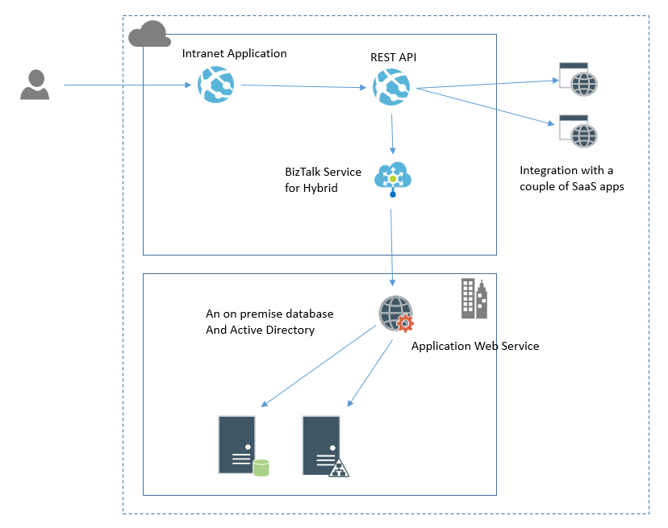
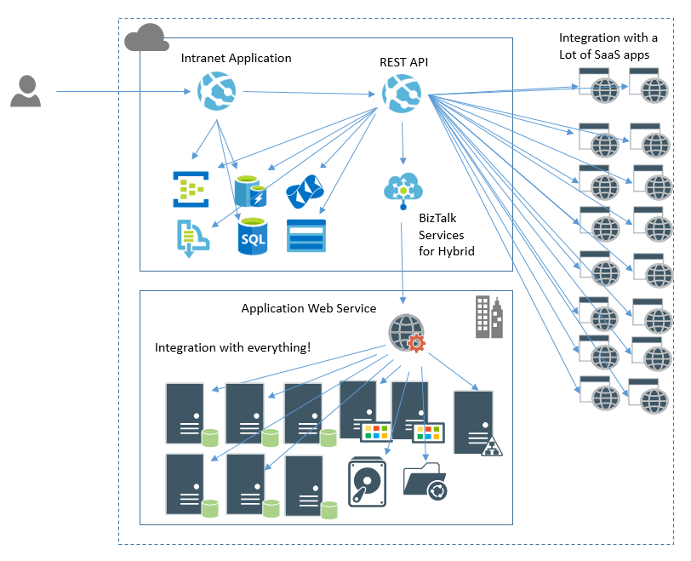
The Evolving Architecture Paradox (today)
Start of Project
End of Project
Notes:
The challenge for architecture in an agile environment is managing change
Agile teams are driven by features and delivery of stories. They look to just get the job done.
This is made worse when the cloud empowers them to provision new stuff with out the checks and balances to manage it
As an architect the challenge is how do I govern the architecture without being seen to be a blocker for the project
The key thing is the identification of “Architecturally significant changes”

Slide 13
Integration evolution raises lot of questions

Slide 14
How do I integrate my back-end systems and services with multi-tenant SaaS applications?
How do I create composite services that are orchestrated services provided by multiple SaaS applications?
Should I use integration middleware in the cloud (PaaS) to integrate my on premise applications?
What does hybrid integration architecture look like and how to I manage such an environment?

Slide 15
Role of Integration Consultants is also evolving day-by-day

Slide 16
Modern Integration Roles
Integration Specialist | Ad-Hoc Integrator | Citizen Integrator
Coaching Supporting Escalation Governing Defining Approaches Defining Standards Implementation on hard projects Pair programming | Traditional developer who also does some integration Doing bulk of implementation Working within Integration Constraints Working on other non integration features | Business User who is tech savvy Integration Analysis Light weight integration Low risk integration
Hard core Integration Consultant
Traditional Developer
Business Users

Slide 17



Pre-2008 - Tech Savvy Business User
I can solve that problem with a macro in excel
Benefits
  Business got the job done
  Low cost
Challenges
  000’s of Access/Excel solutions across Org
  Security and Data Vulnerabilities
  Solutions been around for decades in some org
  Complex business logic lost in macros

Slide 18



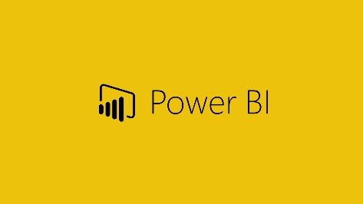


Cloud/SaaS Era
Benefits
  SaaS/Cloud enabled app platforms
  Market place add ons
  More complex solutions
  Scalable to more users
Challenges
  Super Charged Stealth IT
  Silo applications limits functionality
  Often identity challenges
  Integration often required

Slide 19


API/IPaaS Era - Citizen Integrator
I can connect the API to Salesforce
Benefits
  API simplifies integration
  Business users can call API
  Integrated solutions
Challenges
  Not every org asset is API capable
  What technical debt is being created under the radar?

Slide 20
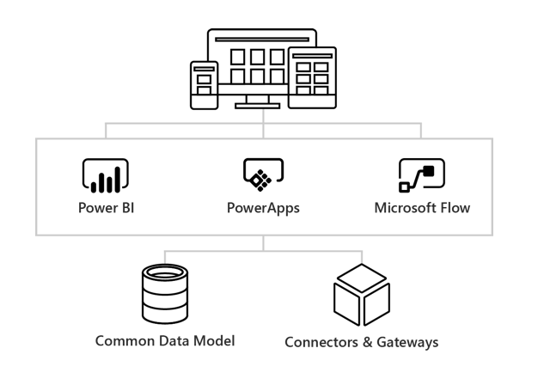
Microsoft Integration story for citizen integrators

Slide 21
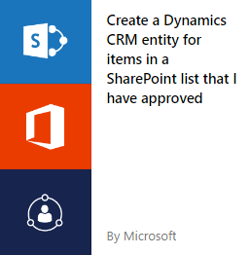
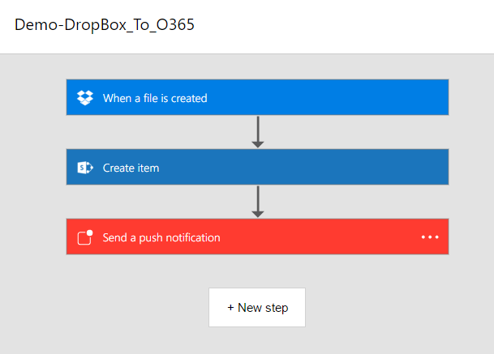
Flow Overview
Automate my day
Automate my team
Online Designer
Flow Templates
Flow Mobile App
  Push Notifications
  Activity
Develop from SharePoint Online

Slide 22
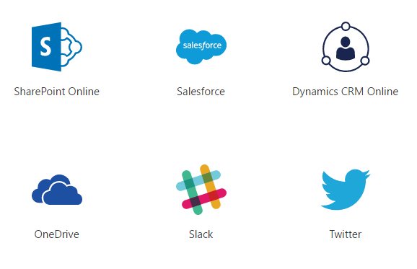
Power Apps Overview
Connect to what you have
  SaaS Apps
  API’s
  Hybrid
  On-Premise Data Gateway
No Code Applications
  Build in browser
  Build from data
  Build in Power Apps Studio
Publish to Web and Mobile
  Windows Store
  Apple App Store
  Google Play

Slide 23
Integration tools and technologies are also evolving

Slide 24
Microsoft Integration Suite (2004)
BizTalk Server
SSIS
MSMQ
WCF (web services)

Slide 25











Microsoft Integration Suite (today)
EAI/ETL
Messaging
Orchestration
IoT
Azure BizTalk
BizTalk Server
BizTalk Server
Service Bus
Messaging
Logic Apps
BizTalk Server
Event Hubs
IoT Hubs
Data Factory
SSIS
Event Hubs
API
Hybrid Connectivity
BAM/Analytics
Citizen Integrator
Azure BizTalk
Service Bus
Relay
API Apps
API Management
Power BI
Stream Analytics
Power Apps
Flows
VPN
Express Route
Event Hubs
Notes:
If we follow a model

Slide 26
Adoption of REST over SOAP
WSDL Metadata
Client
SOAP Envelope
Service
Wraps messages in standardized, extensible envelope.
Provides strongly-typed interfaces
SOAP
+
WDSL
Service URL
SOAP Action
Payload
Response
Extensions (WS-*)
Metadata (optional)
REST
over
HTTP
Client
GET
HEAD
PUT
POST
PATCH
DELETE
OPTIONS
Service
Resource
URI
“Supports software engineering
on the scale of decades”
Hypermedia
Roy Fielding
HATEOAS

Slide 27
Accept: Things are moving fast

Slide 28
The 2 Modes of IT
Marathon Runner – Mode 1
Sprinter – Mode 2
Mission Critical Systems
Conventional Approaches
Stability
Reliability
Low Risk
Slow & Safe
Systems of Record
Take Risks / Safe Enough
Agility & embrace change
Remove bureaucracy
Deliver Value Fast
Fail Fast
Aggressive customer focus
Systems of Engagement

Slide 29
Delivery ‘vs’ Architecture
Need to Deliver Business Value
BUT
  Technology changes so rapidly
  Projects change so rapidly
  Flexibility is king
  The best way to solve a problem today might be different tomorrow
SO
  Think of architecture as a journey rather than a destination
  Go into detail on transitional architectures
  Use common blueprints/patterns
  Just in time architecture
Effective Architecture
Technical Debt
Delivery
Make the customer happy
Hit deadlines
Deliver the project
Architecture
“It is not the strongest of the species that survive,
nor the most intelligent, but the one most responsive to change” - Darwin

Slide 30




Monetization of Integration
Azure LogicApps

