Slide 1
Matt Farmer & Kevin Lam
Senior Program Manager / Principal Program Manager — Microsoft
Logic Apps Deep Dive

Slide 2
Logic Apps Deeep Dive
Kevin Lam
Matt Farmer

Slide 3
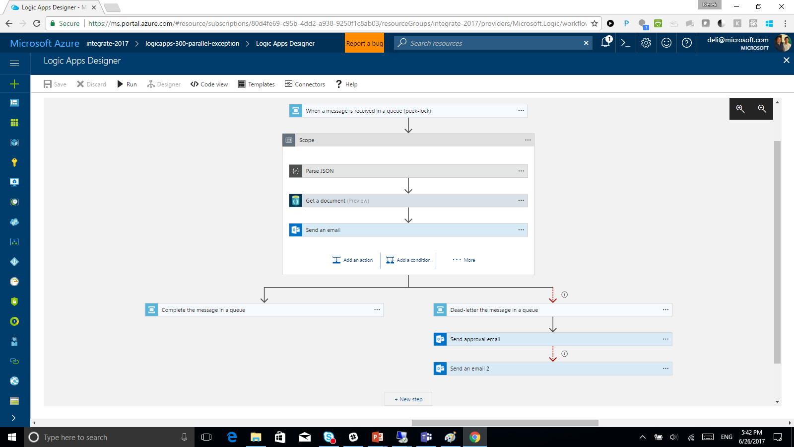
Logic Apps Designer

Slide 4
TypeScript/React app
Uses OpenAPI (Swagger) to render inputs & outputs
Generates workflow definition (JSON)

Slide 5
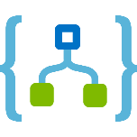
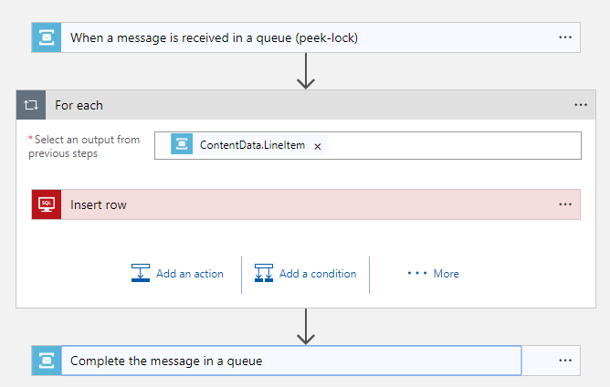
Logic App Workflow Engine
Logic Apps is a job scheduler with a JSON-based DSL describing a dependency graph of actions
Highly parallelized concurrent job execution engine
Notes:
Domain Specific Language

Slide 6
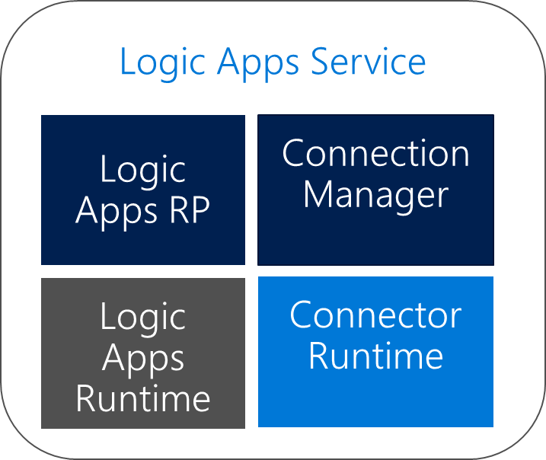
Component Architecture
Logic Apps RP Reads the workflow definition and breaks down into a composition of tasks with dependencies
Logic Apps Runtime Distributed compute/workers are coordinated to complete tasks on-demand
Connection Manager Manages connection configuration, credentials and token refreshment
Connector Runtime API abstraction via Open API descriptions

Slide 7
Workflow Definition
Service Bus
Trigger Task
Run
Save
ForEach
On new message
SQL Insert
Workflow Orchestrator
Complete Message
Workflow Complete

Slide 8
Task Resiliency
No active thread management – tasks and runs can exist in parallel and at massive scale
At least once guaranteed execution
Transient failures invoke retry-policies (DNS issues, throttles, or 5xx responses)
If the task doesn’t respond, workflow orchestrator will assign a new task (at least once guarantee)

Slide 9
Integration Service Environments

Slide 10
Integration Service Environments
VNET connectivity
Private static outbound IPs
Dedicated compute
Isolated storage
Flat cost
Custom inbound domain names

Slide 11
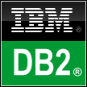
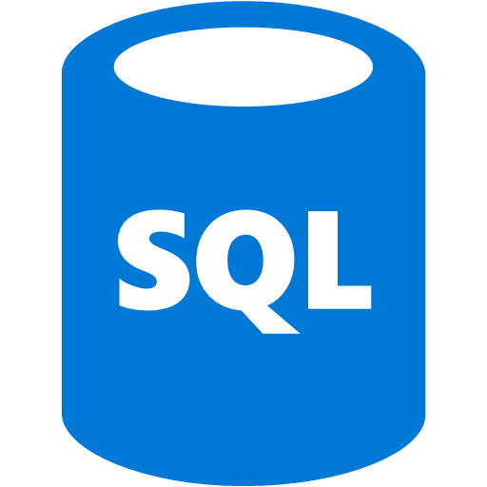
ISE Architecture
Region
Logic Apps Service
Integration Service Envs
Integration Service Env
Logic Apps RP
Connection
Manager
Integration Service Env
Logic Apps Runtime
Connector Runtime
Logic Apps Runtime
Connector Runtime
Express Route
VNET
SFTP Server

Slide 12
Deployment Model
Base Unit:
50 M action executions / month
1 standard integration account
1 enterprise connector
Includes unlimited connections
VNET connectivity
Each additional processing unit:
Additional 50M executions / month

Slide 13
ISE ISE Baby

Slide 14
Custom Connectors

Slide 15
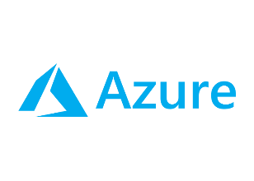
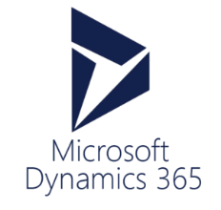
Connected with over 200 connectors
Cloud APIs and platform functionality
Over 200 out of box connectors
SaaS, on-prem, protocols, B2B and message manipulation
Hybrid connectivity
Hosted and managed within the platform
Scales to meet your needs
First class designer experience
API connections
Authenticate once and reuse
Differentiate connection configuration
Simple to deploy
Portal experience for managing API Connections
Custom Connectors
Access any REST/SOAP API
Cloud or on-premises
Simple creation wizard
Connections and managed secrets
First class designer experience

Slide 16
SaaS
Logic Apps is Connected
10to8
Act!
Adobe Creative Cloud
Adobe Sign
appFigures
Amazon Redshift
Asana
AWeber
Azure Active Directory
Azure API Management
Azure App Services
Azure Application Insights
Azure Automation
Azure Cognitive Services
Content Moderator
Custom Vision
Face API
LUIS
QnA Maker
Text Analytics
Video Indexer
Vision API
Azure Data Lake Store
Azure Document DB
Azure Event Grid
Azure Event Grid Publish
Azure Event Hubs
Azure Files
Azure Functions
Azure Log Analytics
Azure Log Analytics Data Collection
Azure Machine Learning
Azure Resource Manager
Azure Service Bus
Azure SQL
Azure SQL Data Warehouse
Azure Storage Blob
Azure Storage Queues
Azure Storage Tables
Basecamp2&3
Benchmark Email
Bing Maps
Bing Search
BitBucket
Bitly
Bizzy
Blogger
Box
Buffer
Calendly
Campfire
CapsuleCRM
Chatter
Cognito Forms
Common Data Service
Disqus
DocFusion365
DocParser
DocuSign
Dropbox
Dynamics CRM Online
Dynamics CRM Service Bus
Dynamics for Financials
Dynamics for Operations
Dynamics NAV
Easy Redmine
Elastic Forms
Enadoc
Eventbrite
Facebook
FlowForma
FreshBooks
Freshdesk
FreshService
GitHub
Gmail
Google Calendar
Google Contacts
Google Drive
Google Sheets
Google Tasks
GoTo Meeting
GoTo Training
GoTo Webinar
Harvest
HelloSign
HipChat
Impala
Infusionsoft
Inoreader
Insightly
Instagram
Instapaper
Intercom
JIRA
JotForm
LeanKit
LinkedIn
LiveChat
MailChimp
Mandrill
Microsoft Forms
Microsoft Kaizala
Microsoft StaffHub
Microsoft Teams
Microsoft Translator
Medium
MSN Weather
Muhimbi PDF
Nexmo
Office 365 Groups
Office 365 Outlook
Office 365 Users
Office 365 Video
OneDrive
OneDrive for Business
OneNote
Outlook.com
Outlook Customer Manager
Outlook Tasks
Paylocity
PagerDuty
Parserr
Pinterest
Pipedrive
Pitney Bowes Data Validation
Pivotal Tracker
Planner
Plivo
Power BI
Project Online
Redmine
SafetyCulture
Salesforce
Salesforce Chatter
SendGrid
ServiceNow
SharePoint Online
Skype for Business
Slack
SmartSheet
SparkPost
StaffHub
Stripe
Survey Monkey
Teamwork
Teradata
Todoist
Toodledo
Trello
Twilio
Twitter
Typeform
UserVoice
Vimeo
VS Team Services
Webmerge
Wordpress
Workday HCM
Wunderlist
Yammer
YouTube
Zendesk
Cloud APIs and platform functionality
Nearly 200 out of box connectors
Hosted and managed within the platform
Scales to meet your needs
First class designer experience
Rapid development
API connections
Authenticate once and reuse
Differentiate connection configuration
Simple to deploy
Portal experience for managing API Connections
XML & EDI
Protocols/Native
Hybrid
XML Validation
Transform XML (+Mapper)
Flat File Encode
Flat File Decode
X12
EDIFACT
AS2
Int Account Artifact Lookup
HTTP, HTTPS
HTTP Webhook
FTP, SFTP
SMTP
RSS
Compose, Parse JSON
Query, Join, Table, Select
Schedule, Wait
Variables
Terminate
Workflow
BizTalk Server
File System
IBM DB2
Informix
Oracle DB
MySQL
PostgreSQL
SharePoint Server
SQL Server
SAP
Teradata
Websphere MQ
Notes:
Call out that we now support SQL Triggers

Slide 17
Custom Connectors
Access any REST API
Simple creation wizard
Designer experience
Managed secrets
ARM Resource
Subscription/Region scope

Slide 18
But – I want to connect to my own stuff!

Slide 19
Custom Connectors
Reuse your common enterprise systems
Surface only the operations you wish
Package business logic as a custom API (Functions, API Apps) and expose for easy reuse
ISV? Let’s take it one step further…

Slide 20
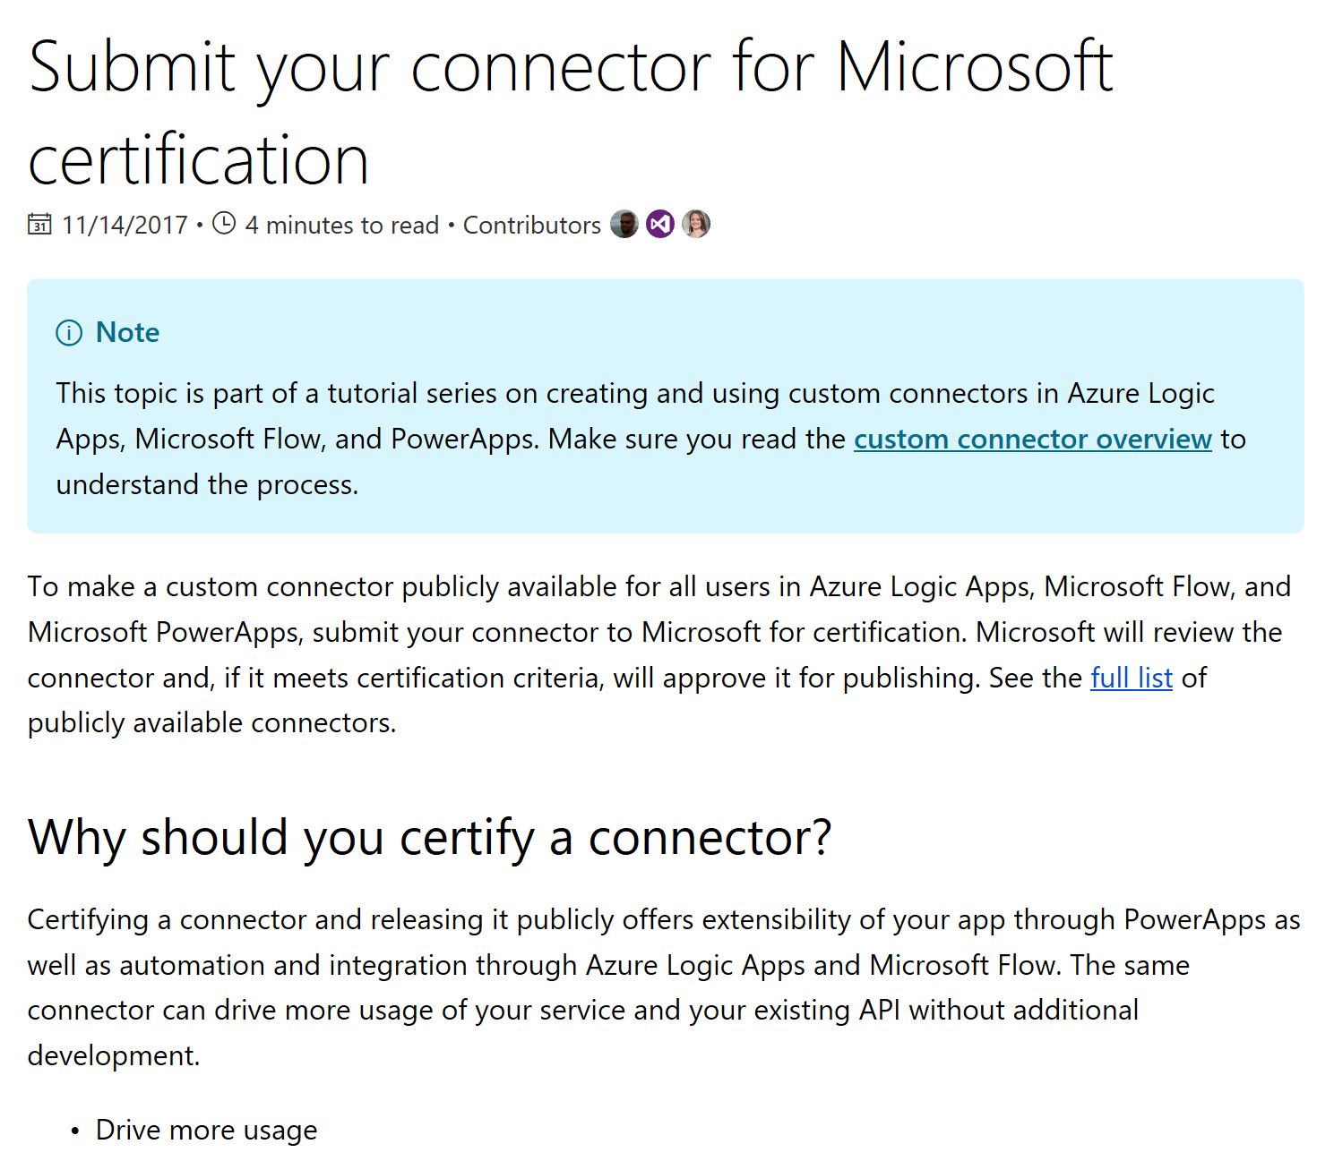
Connector Certification

