Slide 1


Kevin Lam & Derek Li
Principal Program Manager / Program Manager — Microsoft
Introduction To Logic Apps

Slide 2
Be an Integration Hero with Logic Apps
Kevin Lam
Derek Li

Slide 3
The Integration Hero
noun | ˈt͟hē ˌin-tə-ˈgrā-shən ˈhir-(ˌ)ō
A person who is admired or idealized for outstanding achievement.
  The chief character in IT, who is typically identified with good qualities, and with whom the CTO is expected to sympathize.
  In IT, a person of superhuman qualities and often semidivine origin, in particular one of those whose exploits and dealings with the (ancient on-prem systems) were in the subject of myths and legends.
North American: another term for submarine sandwich

Slide 4



















Logic Apps
Connect to on-premises, hybrid, and cloud applications
Run mission critical, complex integration scenarios with ease
Build smart integrations leveraging machine learning, cognitive services
Azure Functions
Service Bus
Cognitive Services
Logic Apps
Machine Learning
Azure API Management
On-premises data gateway
BizTalk
Server
Notes:
Logic Apps is Azure’s Workflow as a Service that is the heart of Azure’s iPaaS offering providing the connective tissue across the services you use. It allows you to integrate disparate services hosted both in the cloud and on-premises. Today companies use a number of SaaS providers and IT is challenged with stitching those together to build the applications that companies need.
Logic Apps provides you the ability to utilize these variant services to run mission critical

Slide 5
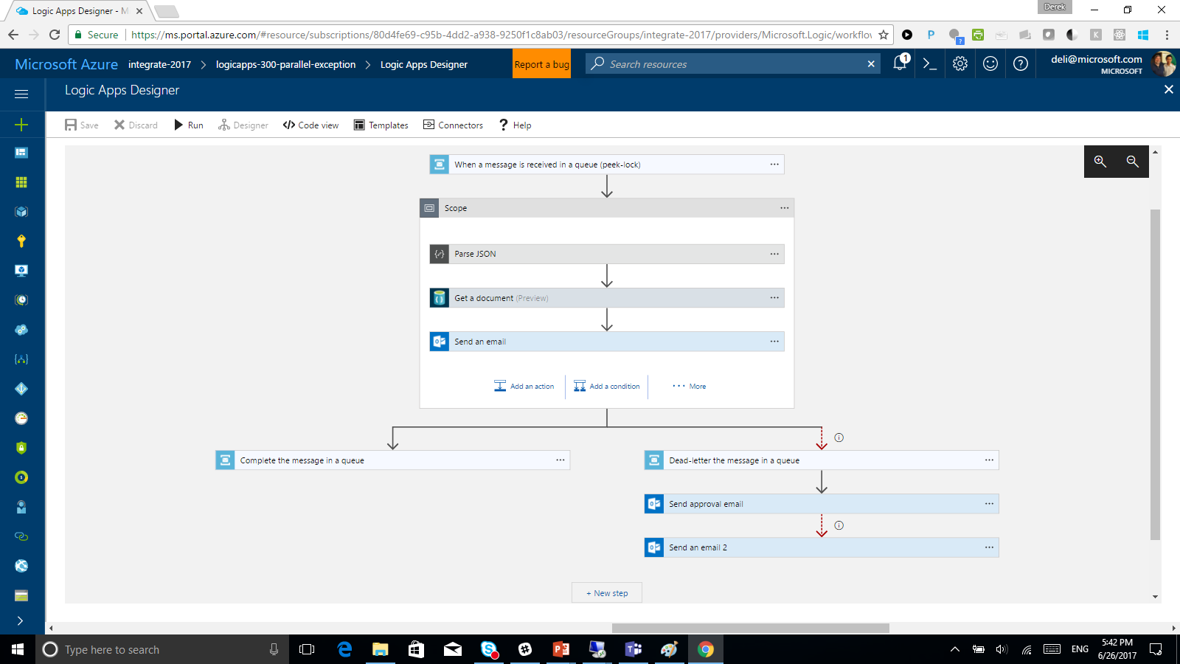
Powerful Integration
Faster integration using a smart visual designer
Easy workflow creation with triggers and actions
Mashup applications, data and services
Built for mission critical Enterprise Integration
Create, deploy, manage and monitor

Slide 6








Connected with over 200 connectors
Cloud APIs and
platform functionality
  Over 200 out of box connectors
    SaaS, on-prem, protocols, B2B and message manipulation
  Hybrid connectivity
  Hosted and managed within the platform
  Scales to meet your needs
  First class designer experience
API connections
  Authenticate once and reuse
  Differentiate connection configuration
  Simple to deploy
  Portal experience for managing API Connections
Custom Connectors
  Access any REST/SOAP API
  Cloud or on-premises
  Simple creation wizard
  Connections and managed secrets
  First class designer experience

Slide 7
Incredible Platform Versatility
Messaging
Data Wrangling
B2B & EDI
(hybrid) EAI
Smart SaaS
Process Automation
Event-driven scale
Abstraction of servers
Micro-billing
Serverless
MICROSOFT CONFIDENTIAL

Slide 8
How?

Slide 9
Recurrence/advanced scheduling
Polling
Webhook
Request
Triggers
Create new instances of Logic Apps

Slide 10
Actions
Flow control
Scope
Condition
Switch-case
For each
Do-until

Slide 11
Actions
Workflow steps
Call APIs
Invoke code
Control behavior
Message handling
Expressions & operators

Slide 12
From “Hello Word” To Integration Hero
In 5 Minutes
Demo

Slide 13
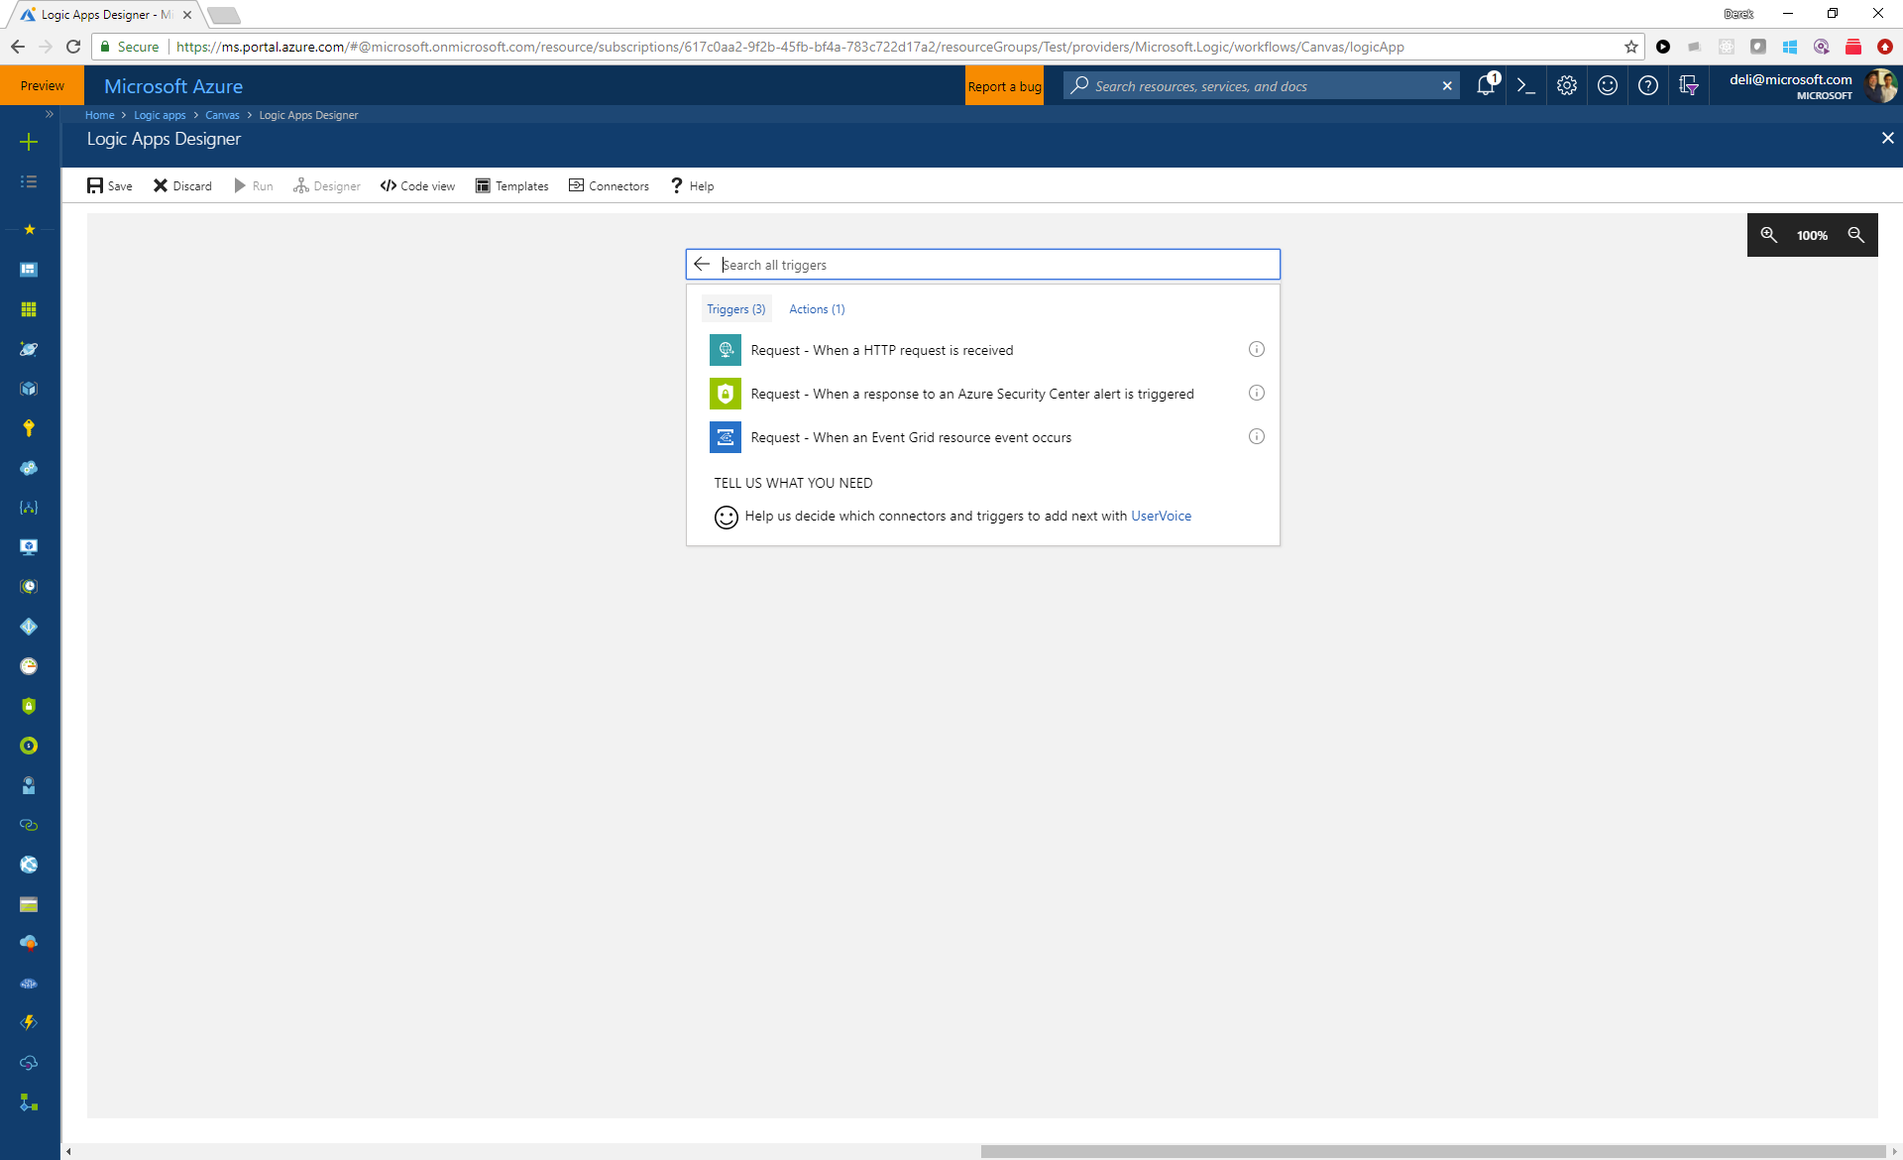

Slide 14
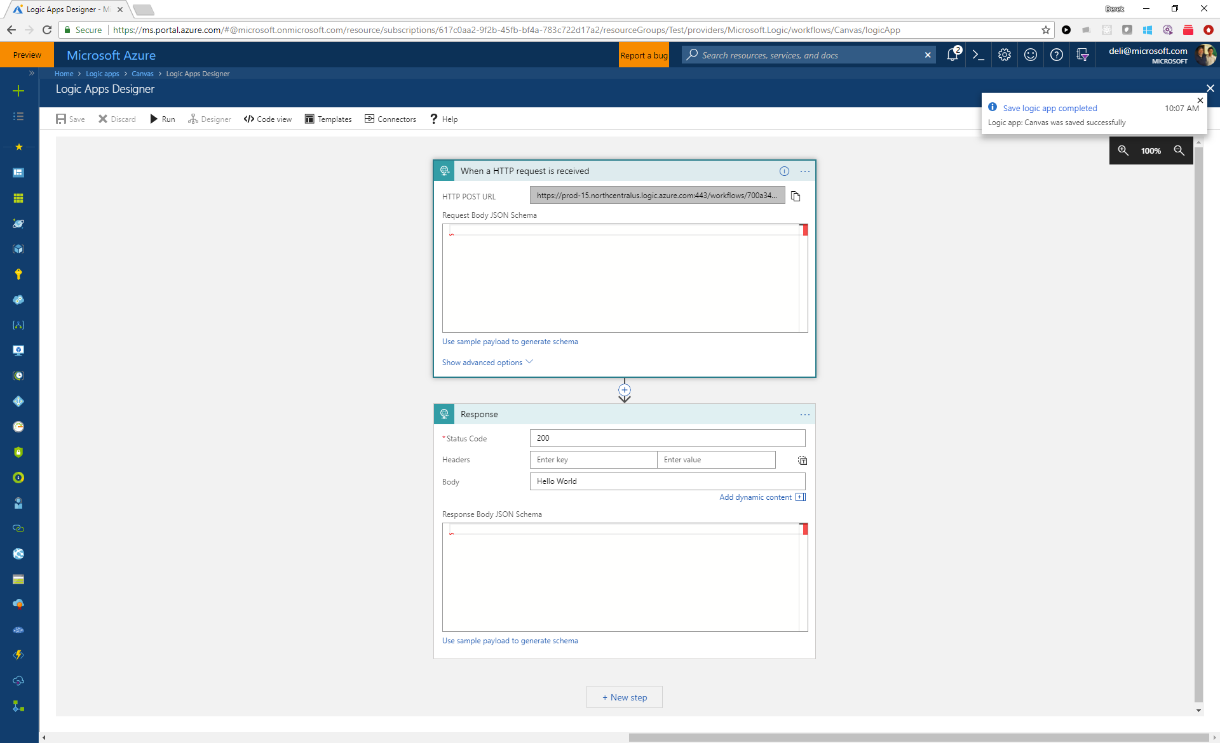

Slide 15
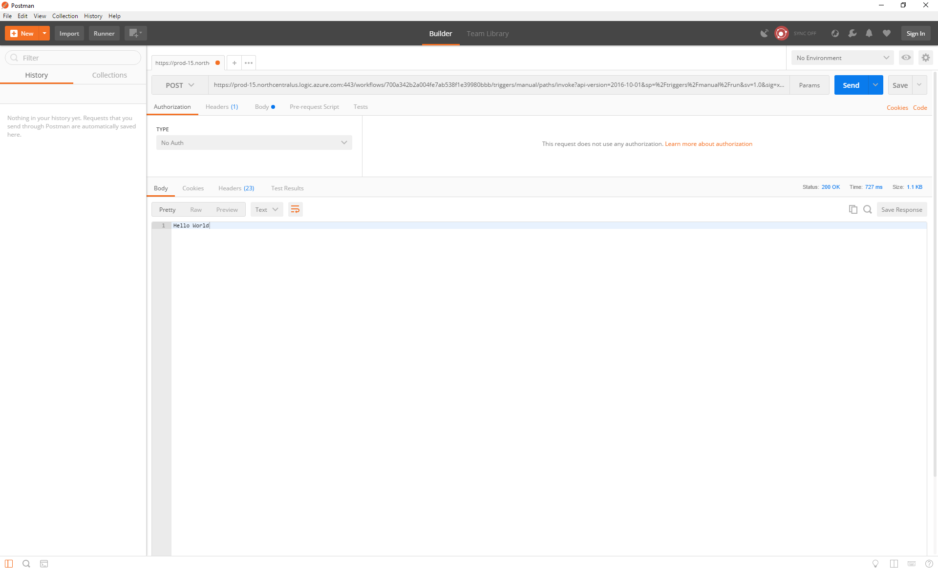

Slide 16
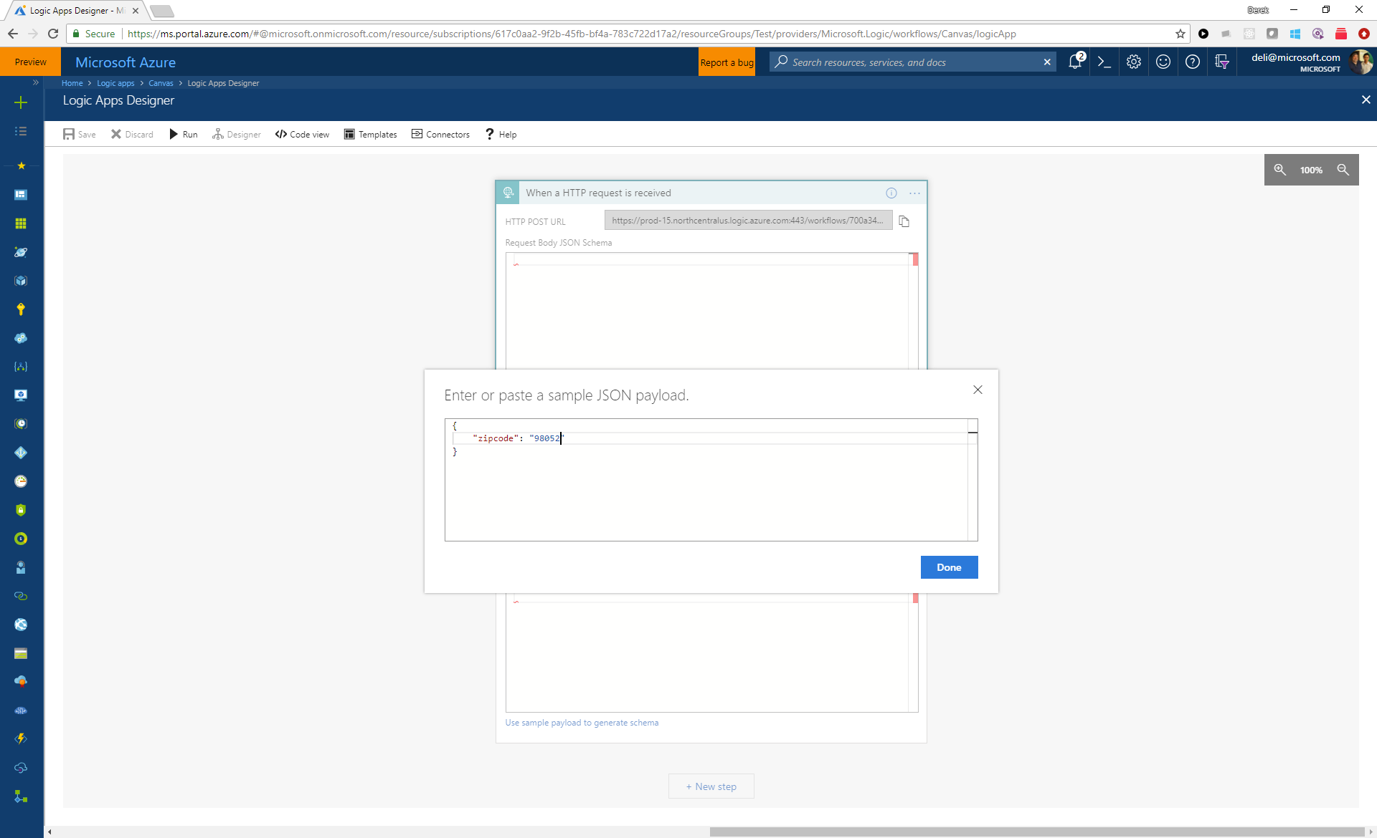

Slide 17
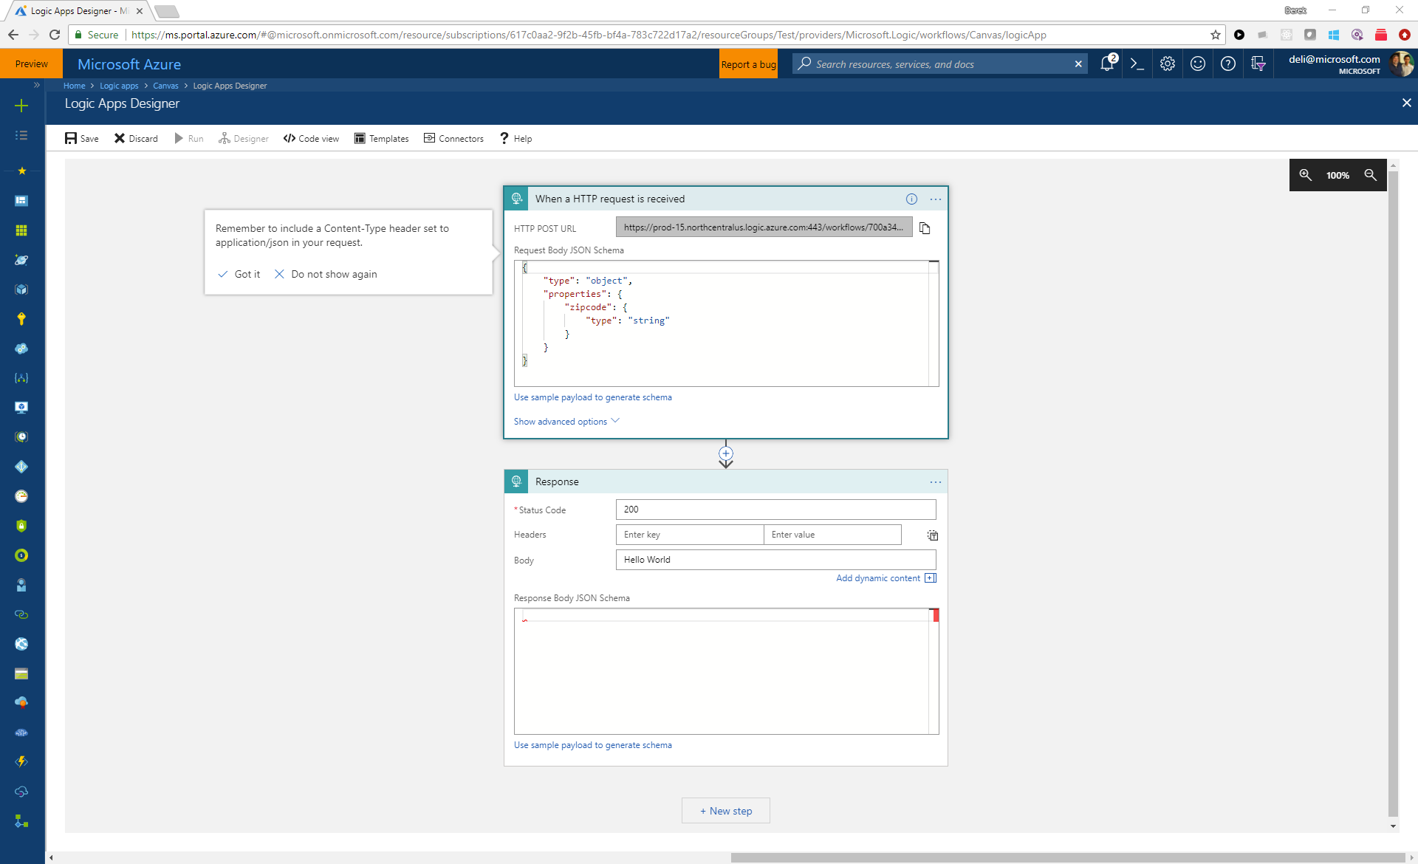

Slide 18
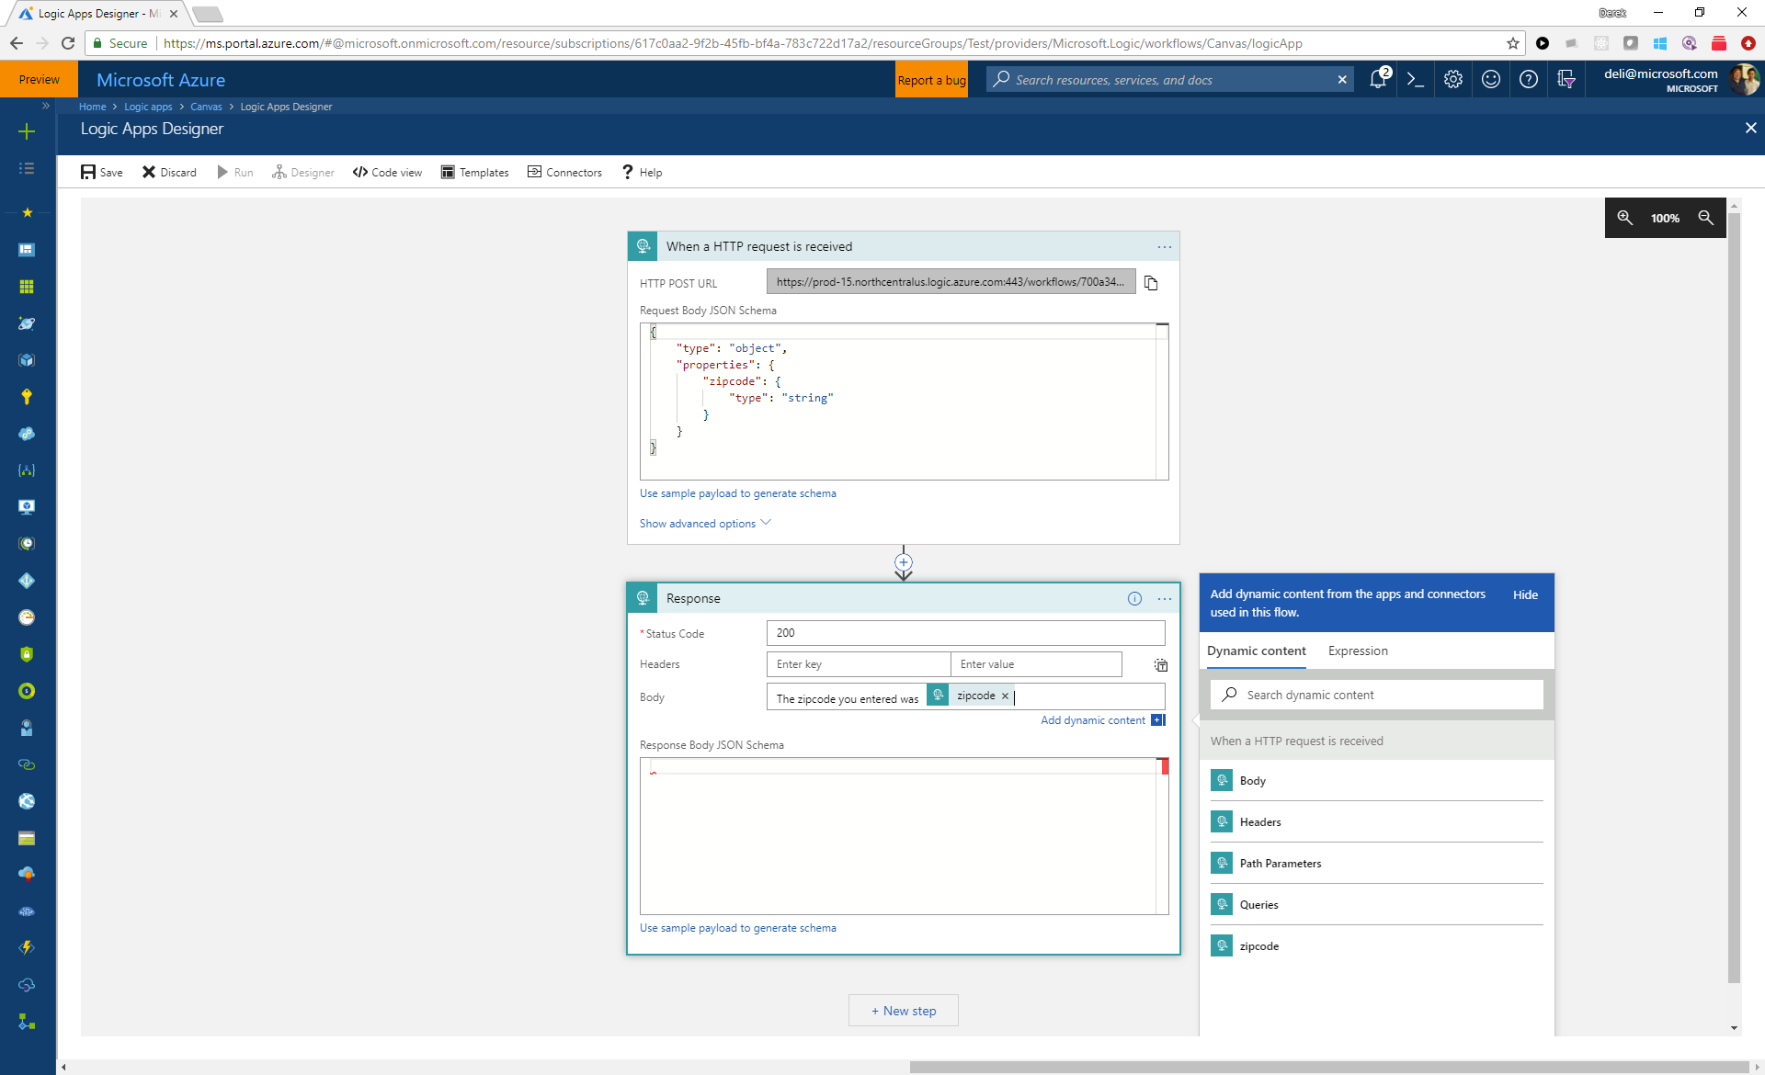

Slide 19
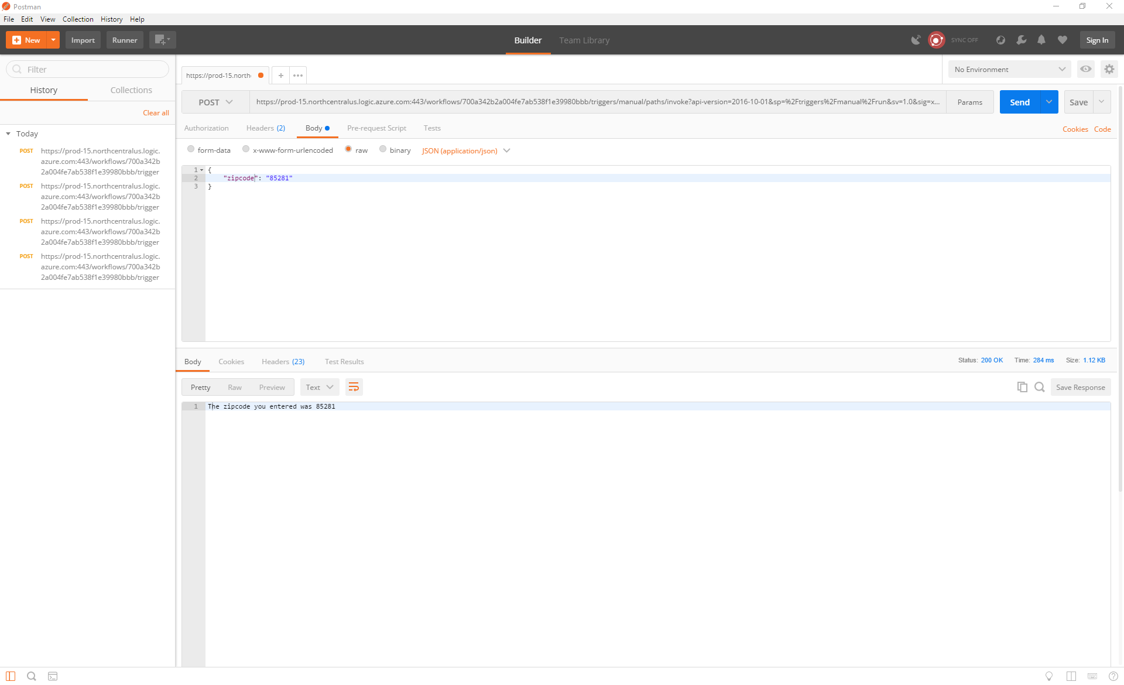

Slide 20
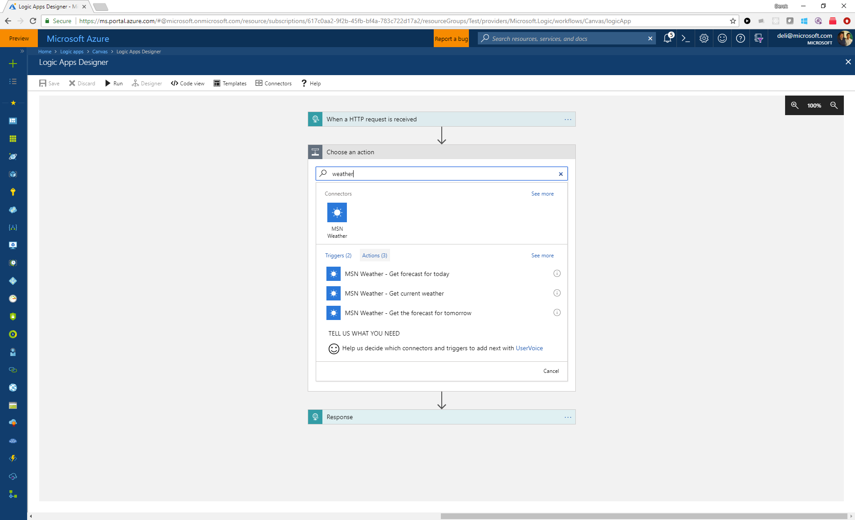

Slide 21
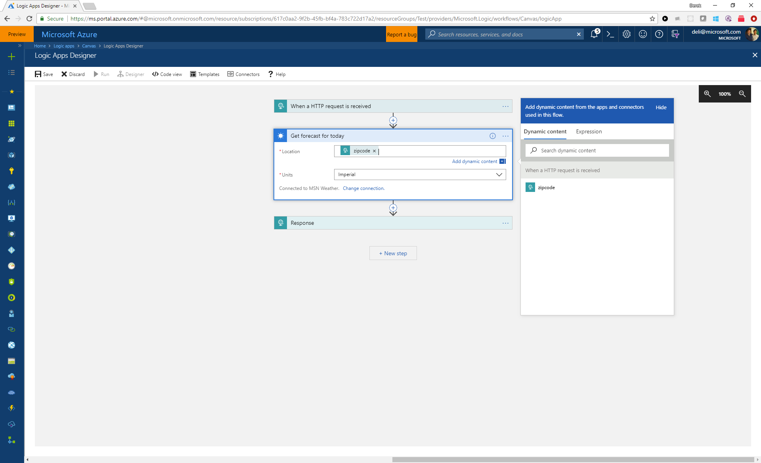

Slide 22
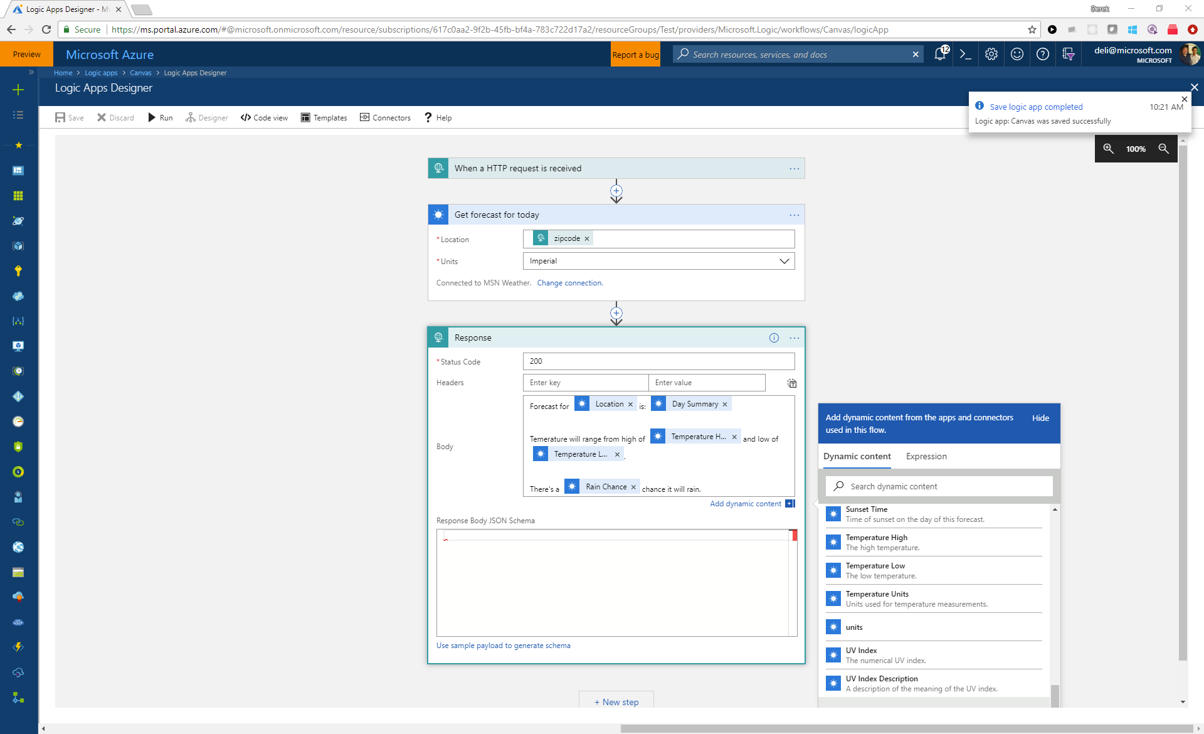

Slide 23
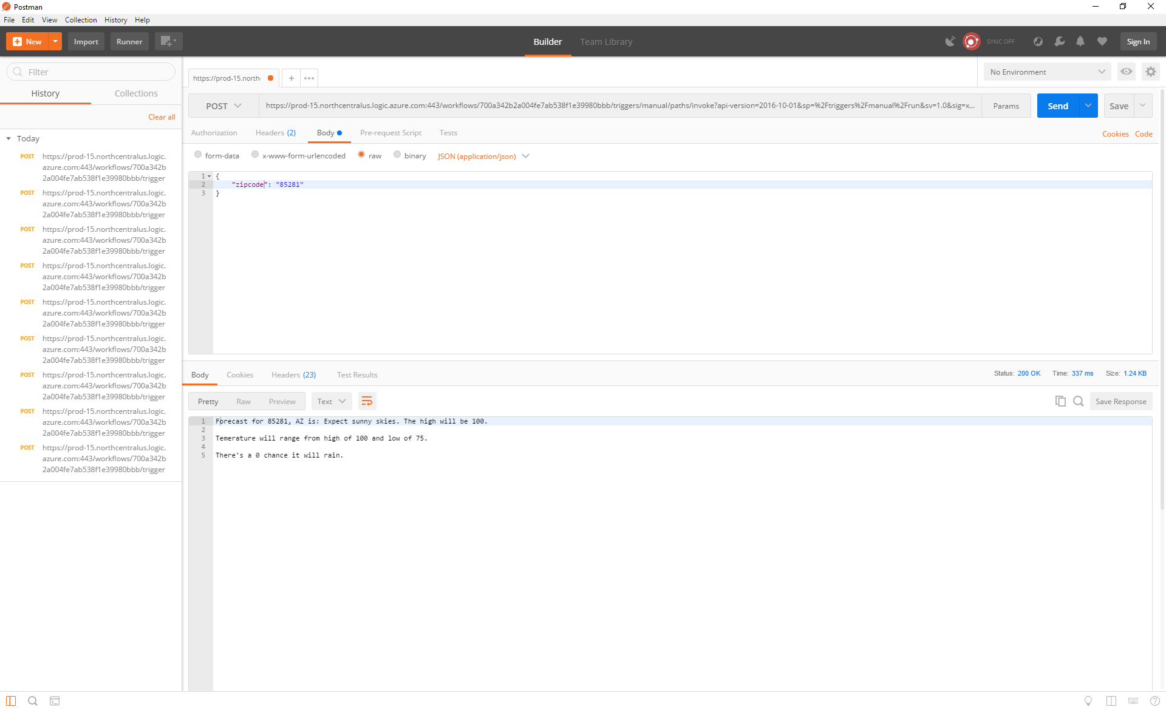

Slide 24
What else can it do?

Slide 25
Manageable
Trigger & run history
Monitoring view
Version history & Rollback
Diagnostics & Alerts
Operations Management Suite

Slide 26
Developer Tools
Visual Studio
Resource Group Project
ARM Template
Deploy
Source Control
CI/CD
Edit in Designer
Cloud Explorer
Browse Azure
Edit in Designer
Manage
Execute & Monitor
Download

Slide 27
B2B Enterprise Messaging
Liquid Transforms
XML & Flat File Handling
EDI
Trading Partners
Integration Account
Business Tracking

Slide 28
Secure
RBAC
Auditing
Static IPs
IP Constraints
Reg. Access Keys
Encrypted at rest

Slide 29
Superhero Order Processing
Demo

Slide 30
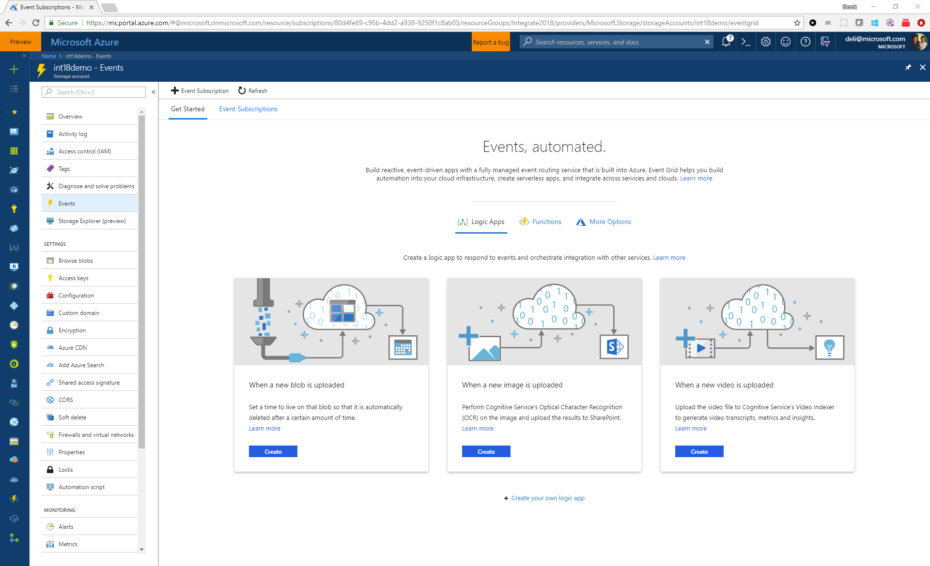

Slide 31
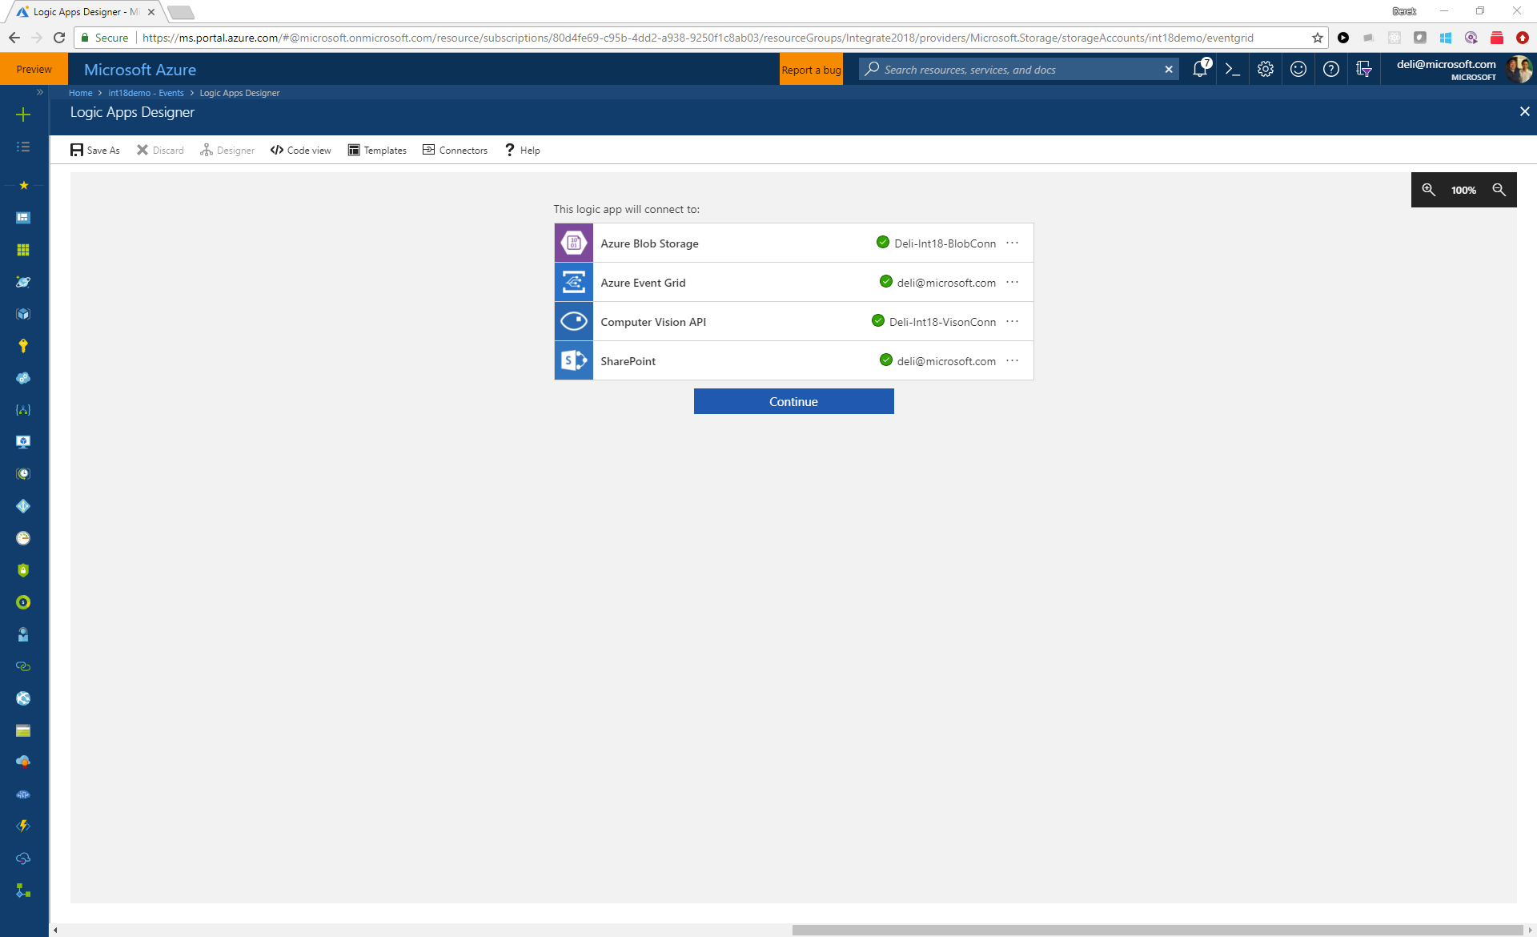

Slide 32
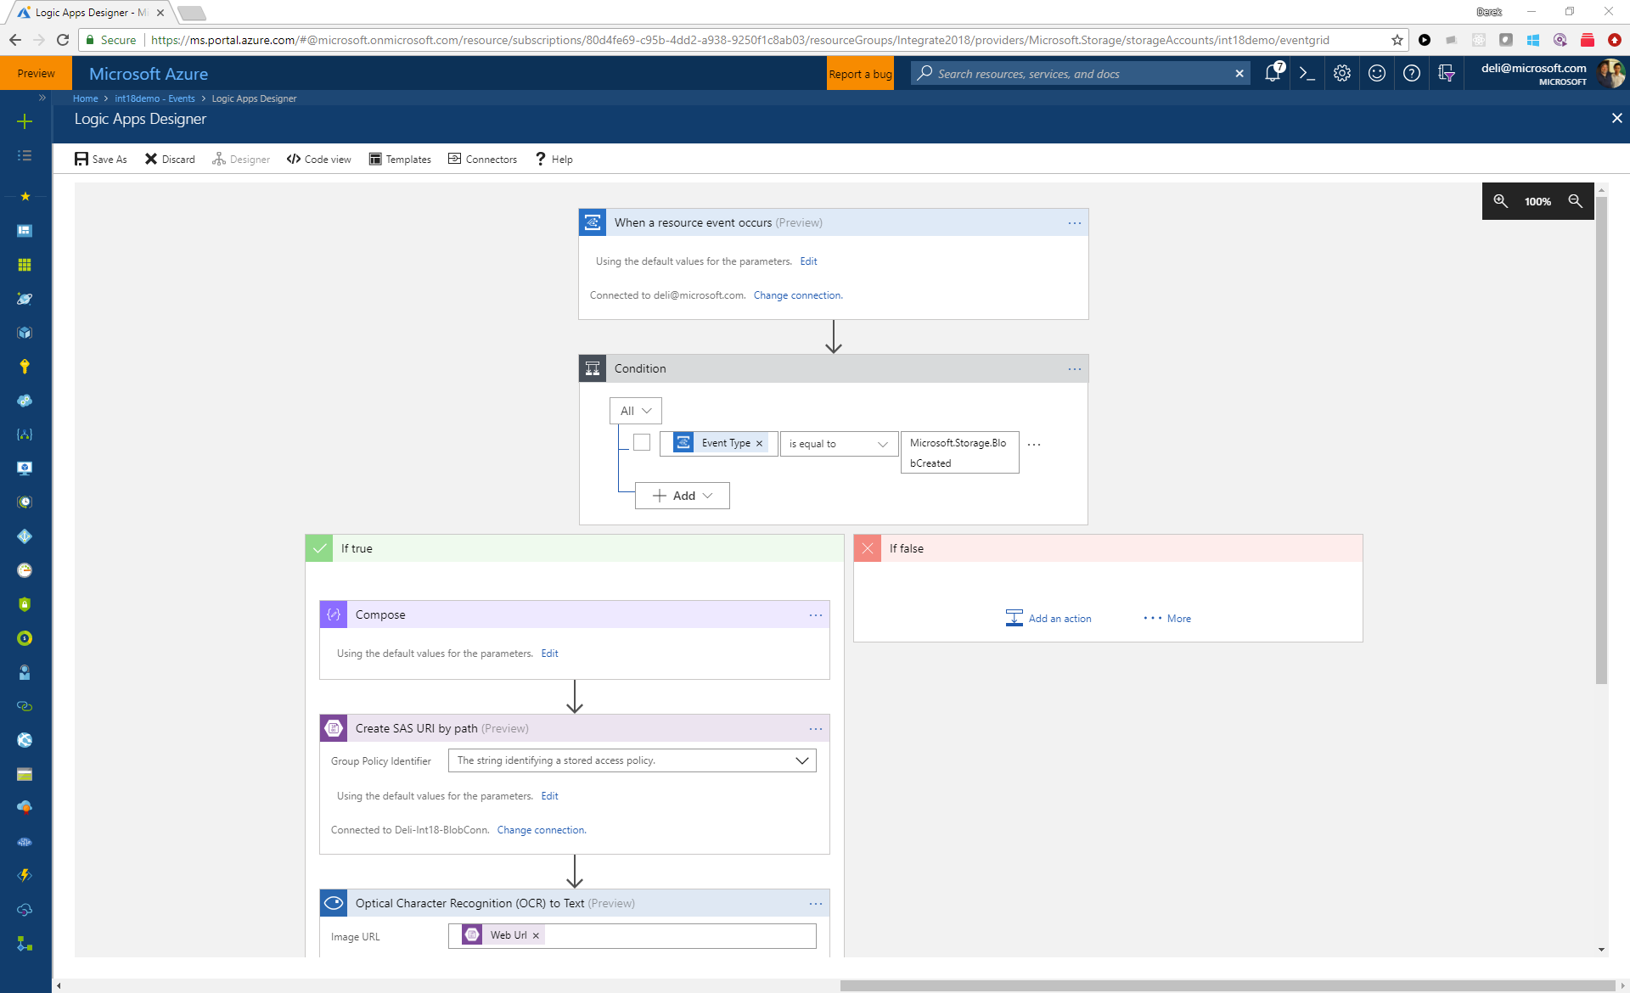

Slide 33
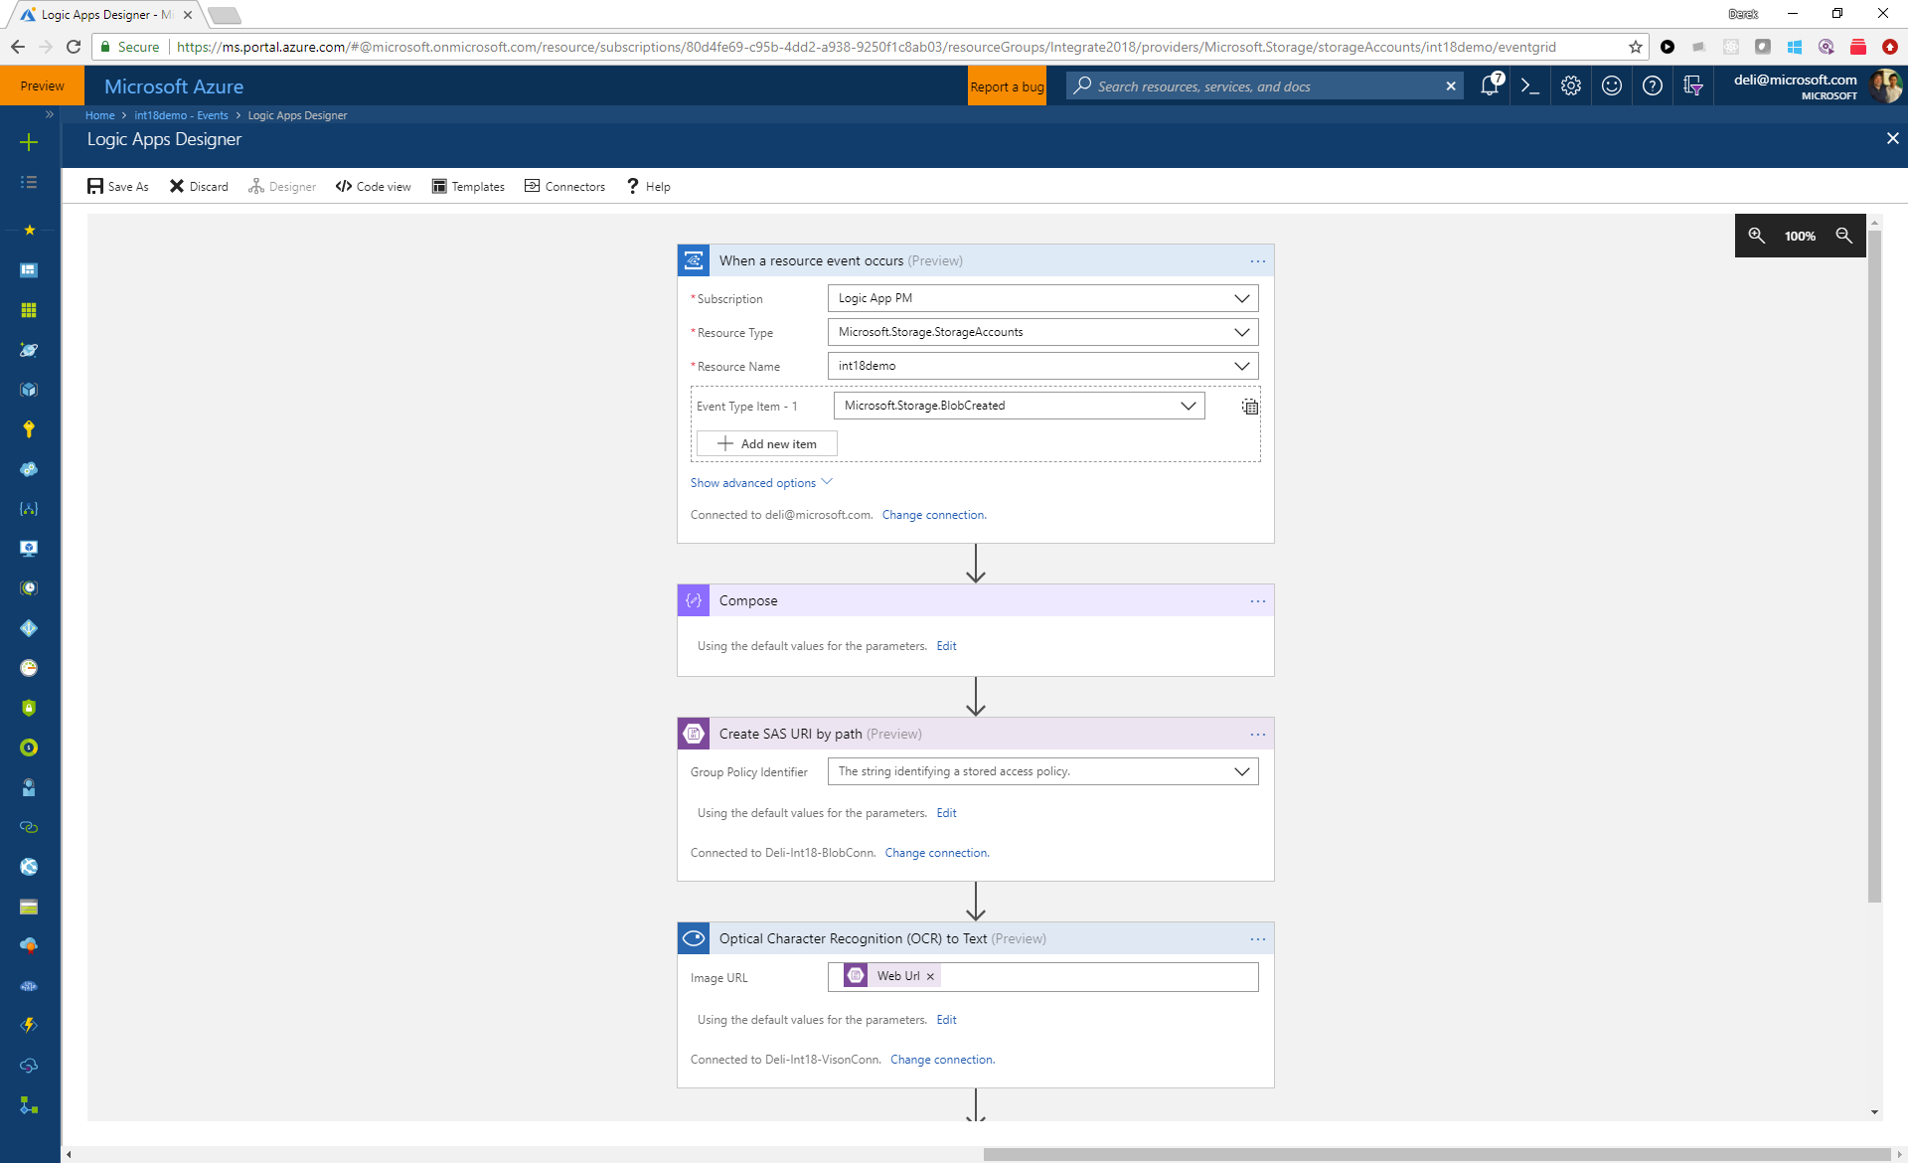

Slide 34
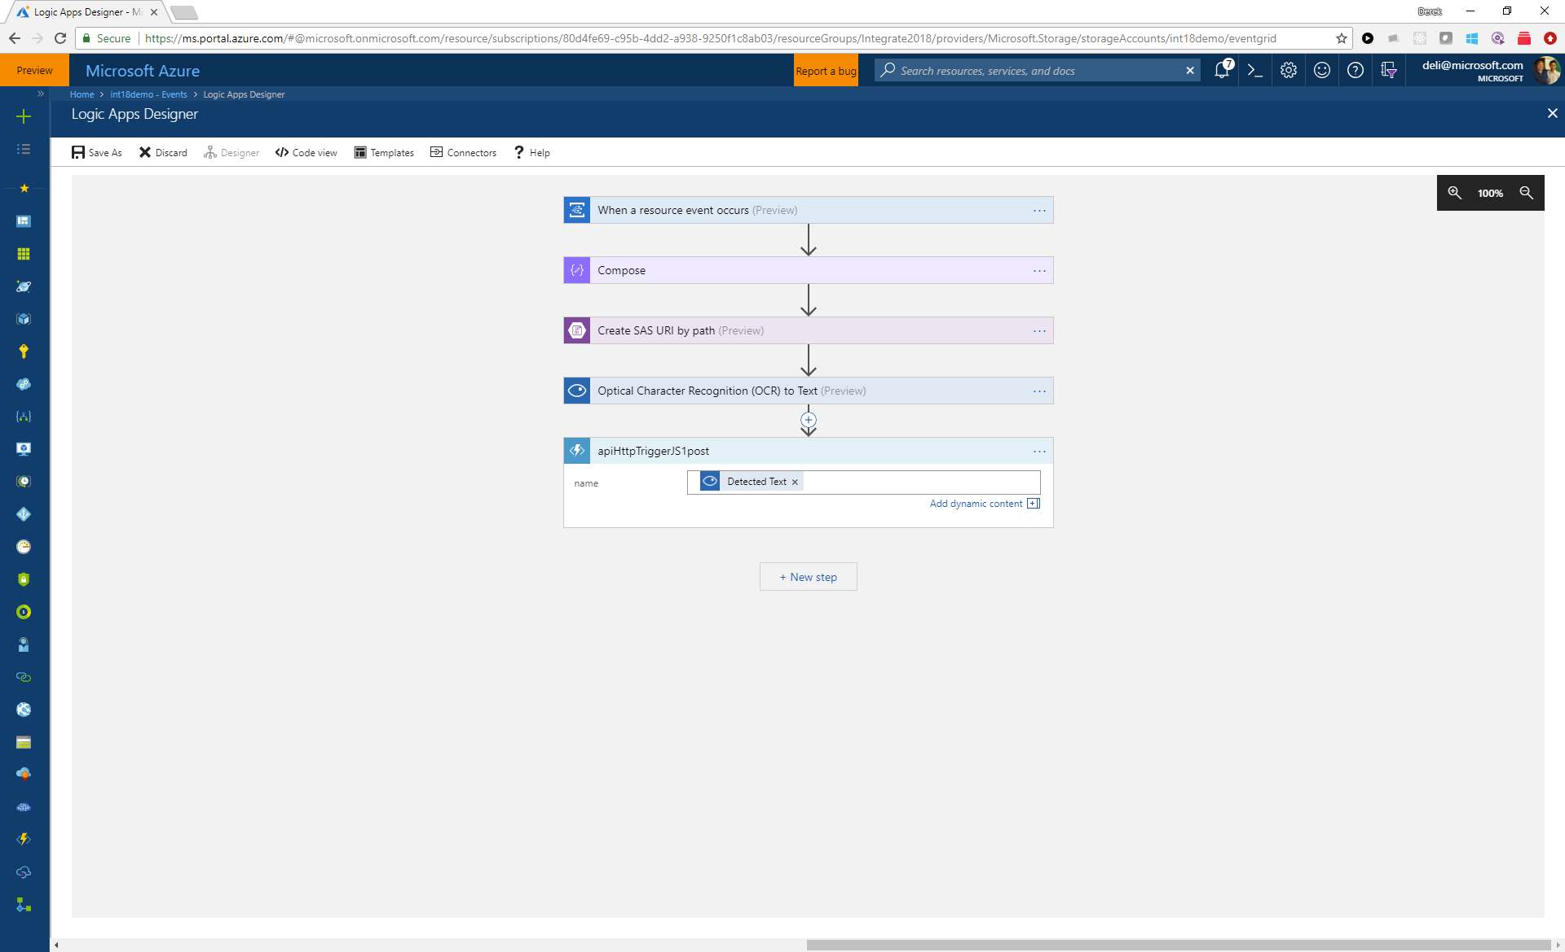

Slide 35
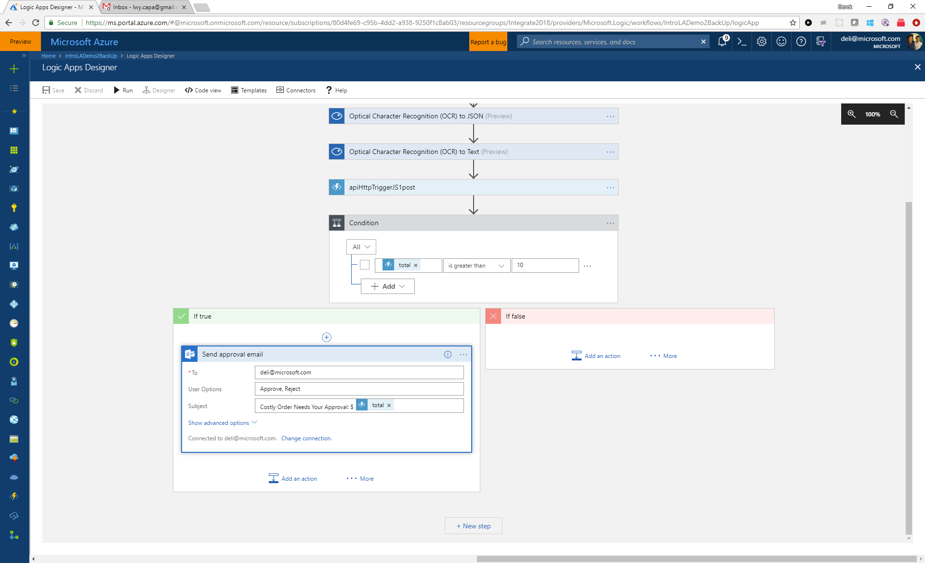

Slide 36
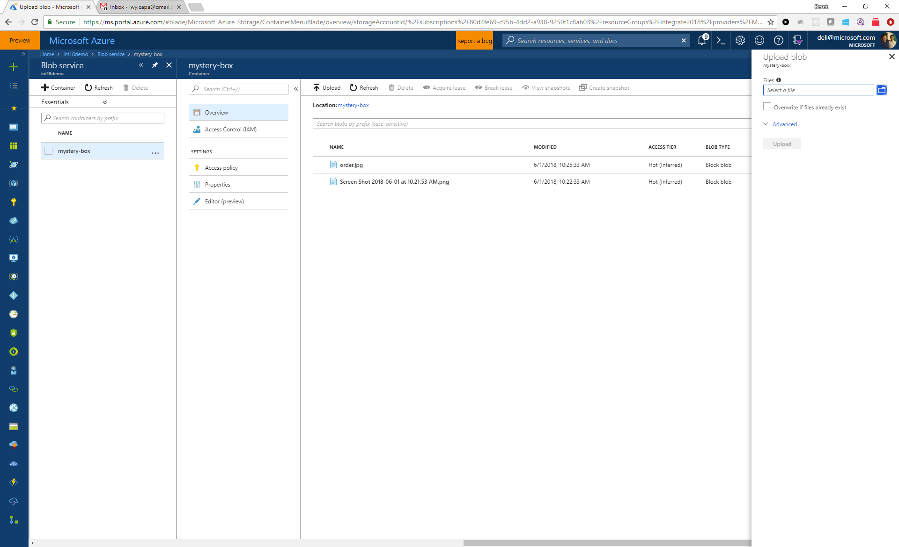

Slide 37
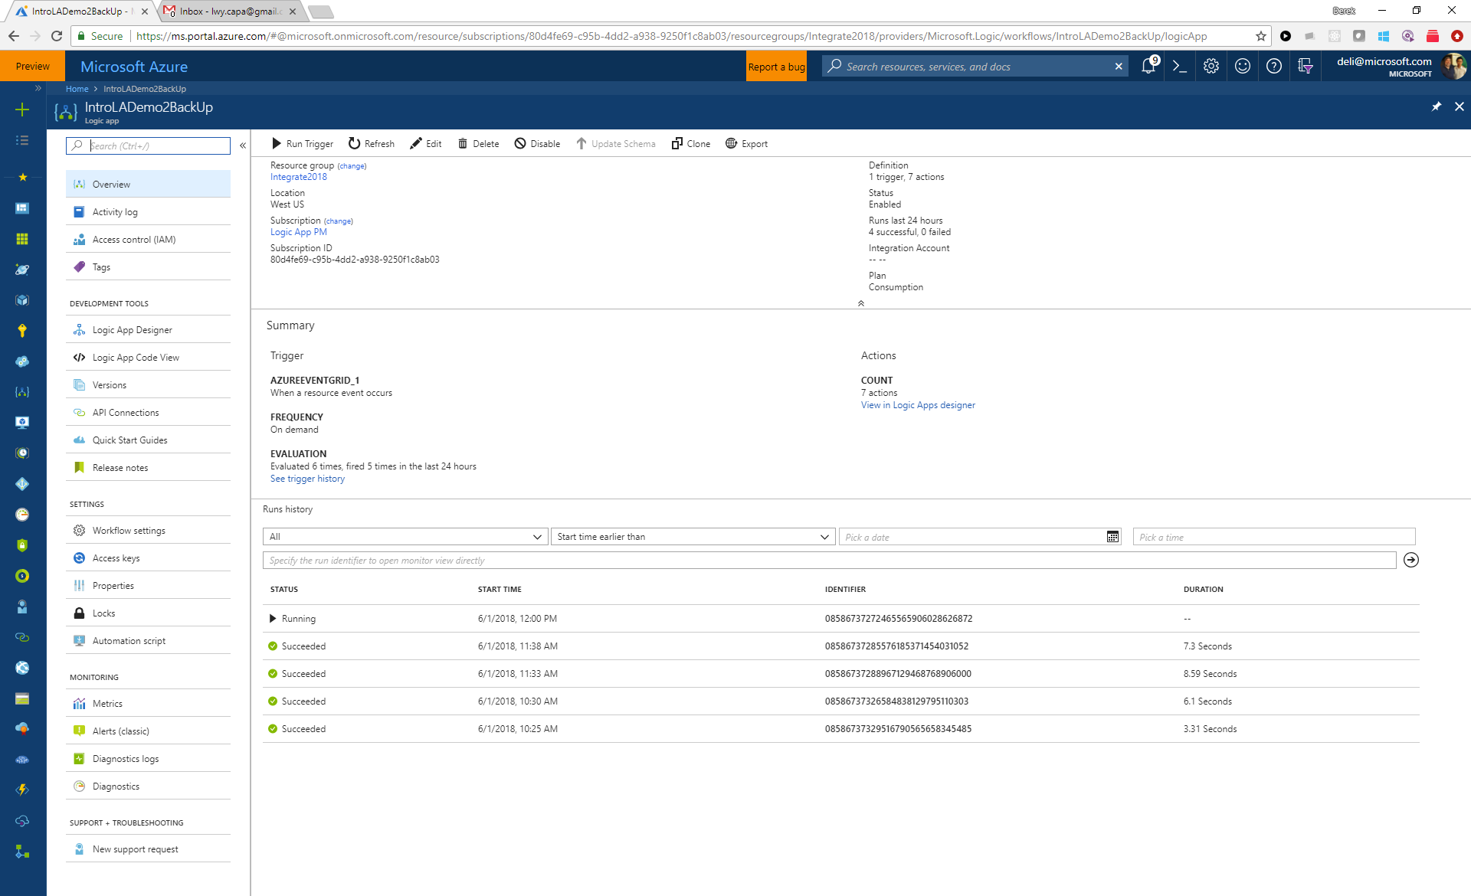

Slide 38
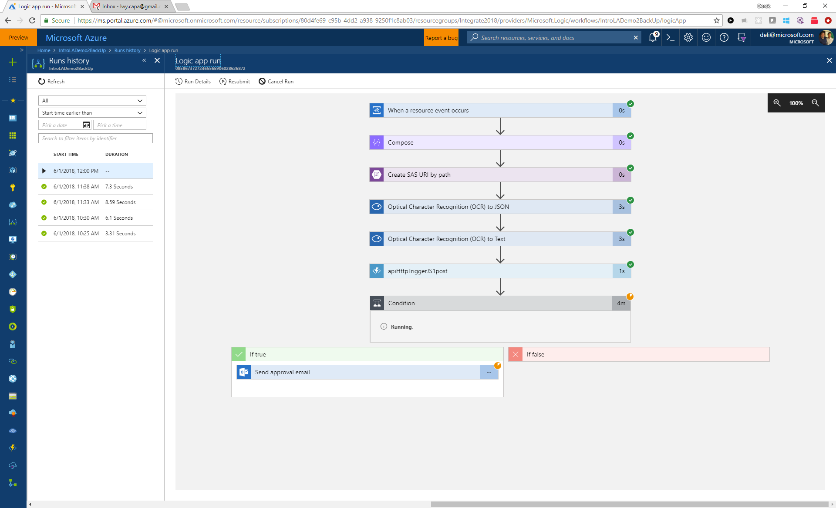

Slide 39
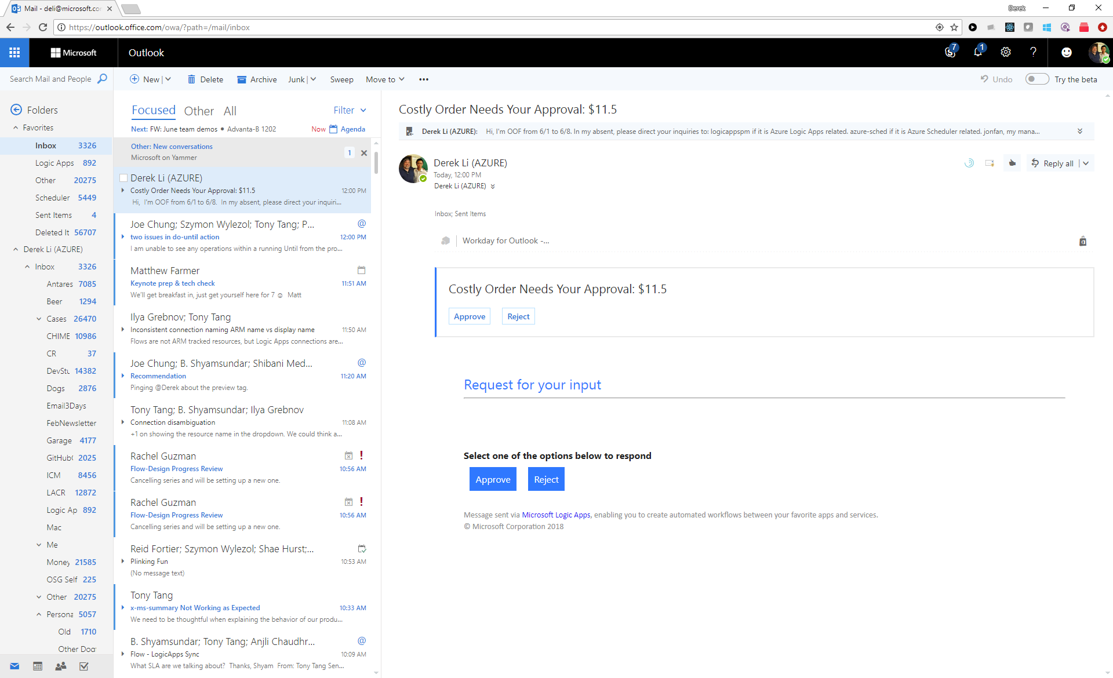

Slide 40
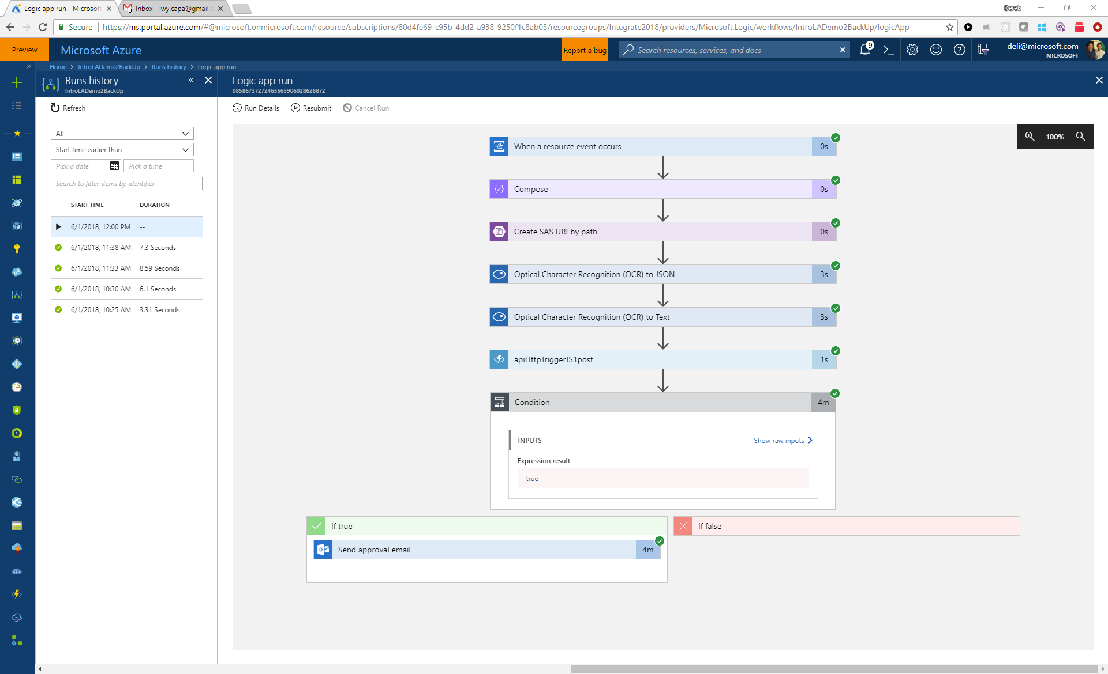

Slide 41
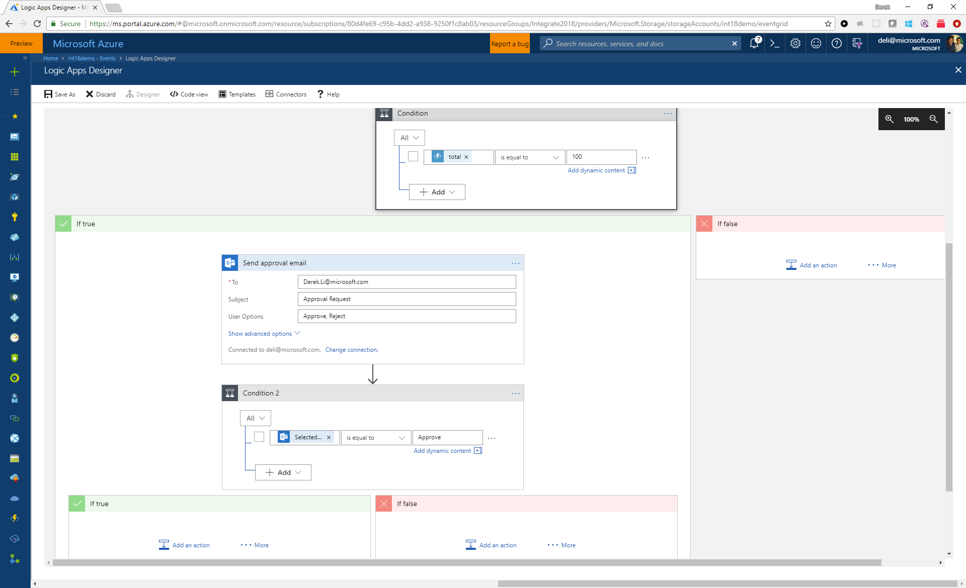

Slide 42
What’s coming?
Smart designer
Dedicated and connected
On-prem
China Cloud
Testability
Managed Service Identity
Key Vault
OAuth request trigger
Output property obfuscation
Notes:
What else

