Slide 1


Jon Fancey & Divya Swarnkar
Principal Program Manager / Program Manager — Microsoft
Enterprise Integration using Logic Apps

Slide 2

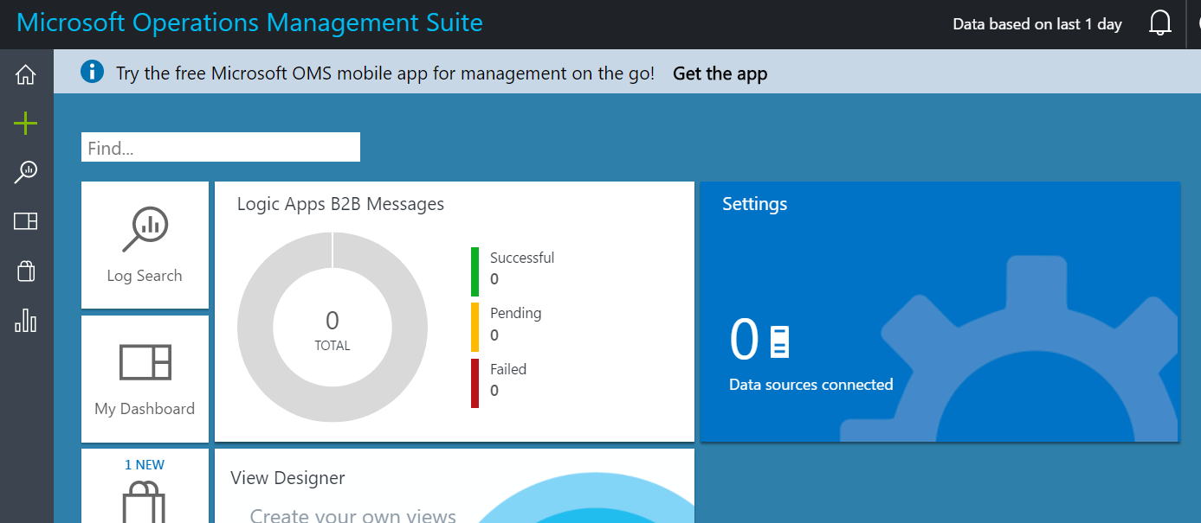




Level-Set: Integration Account
Core to our XML and B2B capabilities
Provides partner creation and management
Provides for XML validation, mapping, flatfile conversion
Provides tracking

Slide 3
Enterprise messaging
Validate
Extract
Transform
Enrich
Route
XML Validation
@xpath
XSL Transform
Compose
Send message to topic
VETER Pipeline
Reference schema in Integration Account
Select literals, single nodes or node-sets
BizTalk mapper compatibility
Parameter support (enrich)
Construct a new message

Slide 4
Message Handling
Flexibility in content types
Flexible content, binary, JSON, XML, primitives
Schema support for JSON schema and XSD
Mapping
XSLT-based – use existing assets – 1.0/2.0
JSON-based – XSLT 3.0 and Liquid
Visual Studio mapper to create xslt-based maps
Parameters support
Data Operations
Compose
CSV/HTML tables
Filter, Join, Select array
Flatfile
Convert to/from flatfile – csv, delimited, positional
Built-in type conversion json<>xml<>base64
Validation
Check for errors in selected Xml and Json schema
EDI
  Outbound encoders, X12, EDIFACT will make use of batching for B2B
  Out of box X12 and EDIFACT schema
  Leverage batching capabilities

Slide 5
Batching
Grouping and Processing messages
Sender and receiver logic apps
‘batcher’ (sender) aware of batching logic app
Batching logic app not aware of batcher(s) – n:1
Supports batch partitioning (grouping)
Batch release criteria: count, time, size, count
Event
Send to Batch
Partition within batch
Batch
Trigger

Slide 6
Disaster recovery with B2B
Many organizations have stringent RTOs
  Feature allows you to be in control
Integration Account holds stateful data e.g. EDI control numbers
Primary and Secondary Integration Accounts
  Created in different regions
  Can have multiple secondaries
Logic Apps replicates integration account state
  Triggers from changes in primary
AS2 quickstart– Just click deploy the template
https://github.com/Azure/azure-quickstart-templates/pull/3302

Slide 7
Tracking
Operations Management Suite
Full Logic App, EDI and custom tracking
Integration
Account
Events for sending & receiving as well as acknowledgement tracking
Turn on Azure Monitor
Push to storage, EventHub, Log Analytics
Tracking API for custom events
OOB Solutions for easy management
Automatically associates data
Use TrackedProperties in your Logic Apps for custom data items
Rich schema for correlation
Create practice alerts
Download messages

Slide 8
What’s new in enterprise Connectors
SAP
Trigger
SFTP
Large message support
Schema Generation
SOAP
Passthrough
On-premise
EDIFACT
Batching
B2B connector improvements
AS2 large message support
EDI overrides – delimiter, preserve interchange

Slide 9

Demo: SAP ECC Connector
SAP R/3 systems
SAP S/4 HANA systems

Slide 10
Pre-requisites
Data Gateway
Same network as SAP system
SAP NCo libraries
On data gateway, from SAP marketplace
Access
Whitelist gateway

Slide 11





How it works
1
2
LA with SAP trigger
RFC server registration/renew
Logic app webhook registration/renew
2
Gateway Cloud Service
2
Service Bus Relay
1
2
RFC server at gateway receives message from SAP
Logic App receives message via webhook callback
1
On-premise data gateway
+
RFC Listener
1
On-Premise
SAP system

Slide 12

Customer Highlight
At Evoqua we have been using the SAP Connector for Logic Apps to automate business processes between SAP and our Microsoft Dynamics CRM system, along with many other systems. For CRM we are able to get new Customers and Materials from SAP over to our CRM system 95% faster by using Logic Apps and the SAP Connector.
In addition our development time for new integrations involving SAP is cut by 50% or more using Logic Apps and the SAP Connector.”
– Susan Swanger, Senior Integration Architect, Evoqua Water Technologies.

Slide 13
What’s new in Mapping
XML transform
XSLT 2.0/3.0
Liquid
JSON to JSON/XML/Text mapping
Loops, conditionals, variables etc.
Custom assemblies and Functoids

Slide 14
XSLT 3.0
Recommendation as of July 2017
MUCH easier to do a bunch of things:
JSON > XML > JSON mapping
Dynamic evaluation: xsl:evaluate
Text value templates: value-of > {}
More built-in functions: date, math etc

Slide 15
Liquid
Great for text-based mapping
{% if user %}
Hello {{ user.name }}!
{% endif %}
Full programming constructs
Looping
Variables
Conditionals

Slide 16
SOAP support
Create first-class SOAP connectors by importing WSDL
Use On-premises Data Gateway to access services behind firewall
Ability to create passthru connector

Slide 17
Demo: SOAP

Slide 18
What’s new in Monitoring and Tracking
New(ish) Logic Apps Log Analytics (OMS) Solution
Rich Query - Same Syntax as Application Insights
Now in Azure Portal
Bulk Resubmit
Advanced Filtering
Bulk Download (coming soon)
Resubmitted run (coming soon)
Add Tracked Properties from designer

Slide 19
Logic Apps Monitoring via OMS
Demo

Slide 20
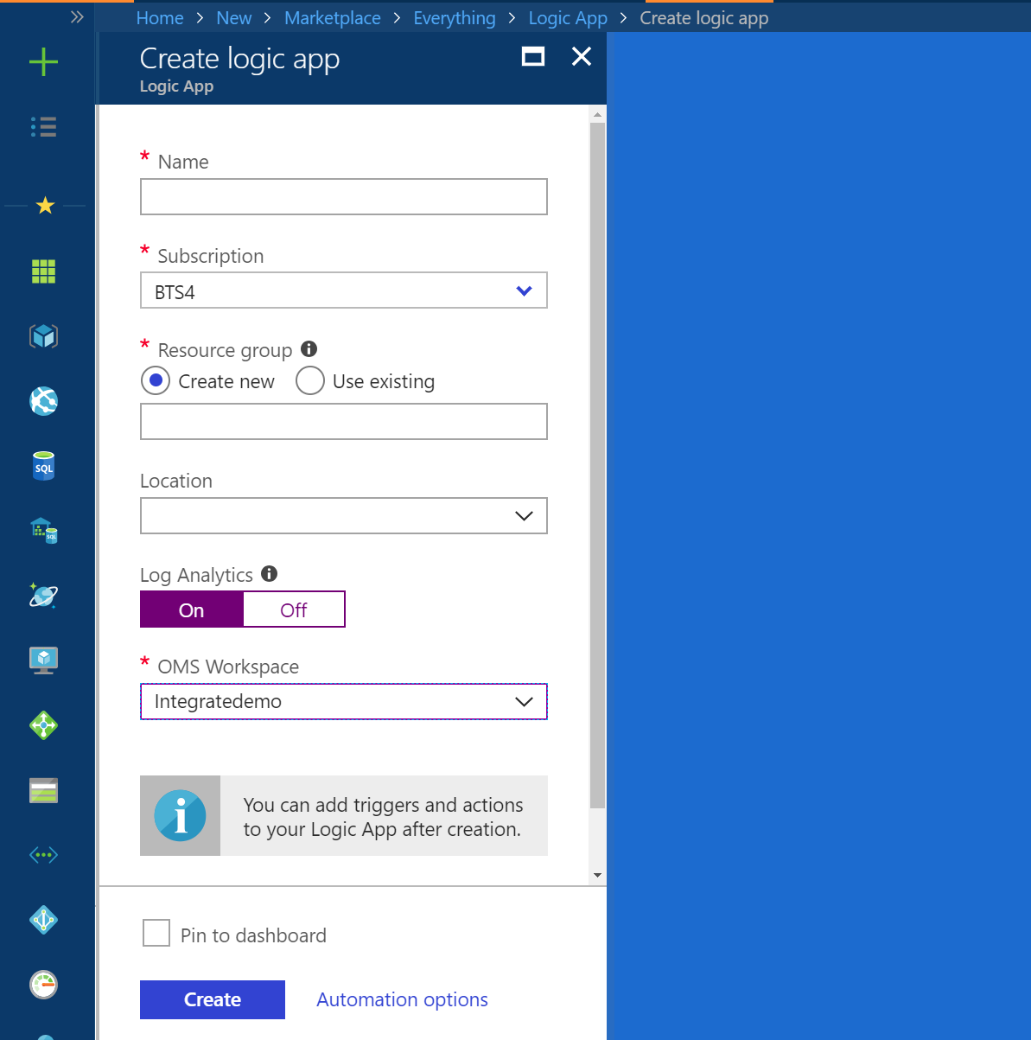
Enable diagnostics at Logic App creation !

Slide 21
SAP Connector – What's Next
GA (August)
Secure Network Communications (H2)
BAPI Commit, Enqueue/Dequeue (H2)
SAP Certification
SAP for ISE aka VNET support (H2)
Outbound batch (H2)
Increase timeout
SAP native schema support

Slide 22
Whats Next in Enterprise Integration
Enterprise Connectors
Oracle EBS
Newsuite
Integration Account
Consumption Based
Higher limits for artifacts
Biztalk parity
Rules engine
Rosettanet
Concur
Successfactors
Pipelines
HL7
SWIFT
Adapters – Peoplesoft, TIBCO, etc.
Management
Group, sort, search, version, etc.

Slide 23
Recap
SAP connector (Sign up for Private Preview !!)
Trigger to receive messages from SAP
Generate schemas from SAP
Mapping capabilities
Liquid
XSLT 3.0/2.0
Custom assemblies and functoids from XML maps
SOAP services
Passthrough
On-premise
Monitoring
Monitor your production system with Log Analytics with our OOB solutions and customize as you wish

Slide 24
Q/A

