Slide 1


Divya Swarnkar & Amit Kumar Dua
Program Manager — Microsoft
Microsoft IT (CSE) use of Logic Apps for Enterprise Integration

Slide 2





Microsoft Integration & Business Portfolios
Enterprise Integration Provides
Partner Integration (B2B)
System to System integration (A2A)
Security, Tracking and Monitoring
Data compatibility translation services and multi-interface transport options
24x7 Support
Microsoft External
Partners Transactions
Microsoft Internal Transactions
Order to Cash, Supply Chain Management, Contract Mgmt
50 Billion+ in Transactions
Licensing, Sales and Contracts, Distribution Svcs
Enterprise Integration
Vendor payments, treasury, etc.,
Global Banks (Euro, US, Latin AM)
Employee Payroll, Benefits
1 Billion+ in deposits per month
Human Resources, Benefits, Legal
Accounts Payable, Bank Transfers
Happy Employees, Families, Health Care
3 Billion$$ a month impacted
Travel, AMEX transactions, Bank Statement Processing and Rebates
Ship status, order confirmation, electronic invoicing
Finance, Marketing
Human Resources
Happy Suppliers, Distributors, Retailers and End Customers Globally
In all Enterprise Integration processes over 30 Million Transactions per Month and billions of dollars in Revenue, Payroll and Cash Management allocations, supporting over 200 business critical applications and 1000+ partner configurations.

Slide 3
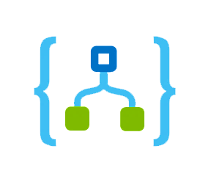

Integration landscape
1000+
Partners Config
175+
BizTalk Servers
200+
LOB systems
Logic Apps
30M+
Transactions/month
Message Standards
X12, XML, EDIFACT, Rosettanet, SWIFT & more
1300+
Transforms
Biztalk Server 2016
Notes:
Write next to icons

Slide 4
Vision
Integrate at the speed of Business
Simplify
Share
Accelerate
Reduce time to market
Simplify business, platform, support
Accelerate with right automation to build, test service, partner onboardings.
Leverage a product that reduces time to take code to production, reduces devops
Share with partner ecosystem – and learn from them too !

Slide 5
Integration patterns
Trading
Partner
Gateway
Exchange
Protocol
Document
Protocol
Business
Process /
Orchestration
Line of
Business
Integration
On-premises
Connectivity
LOB
Application
EDI X12
EDIFACT
OAGIS
RosettaNet
BTF
Custom message processing
Transforms
Business Property Promotion
Flat file encoding
LOB specific enhancement
ExpressRoute
BizTalk
Data Gateway
MTPB/HTTPS
SFTP
AS2
RNIF
BTF
Trading
Partner
Gateway
Exchange
Protocol
Document
Protocol
Business
Process /
Orchestration
Line of
Business
Integration
On-premises
Connectivity
LOB
Application
EDI X12
EDIFACT
OAGIS
RosettaNet
BTF
Custom message processing
Transforms
Business Property Promotion
Flat file decoding
LOB specific enhancement
ExpressRoute
BizTalk
Data Gateway
APIM/HTTPS
SFTP
AS2
RNIF
BTF

Slide 6

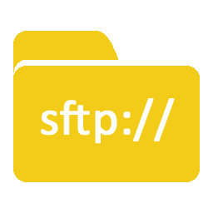



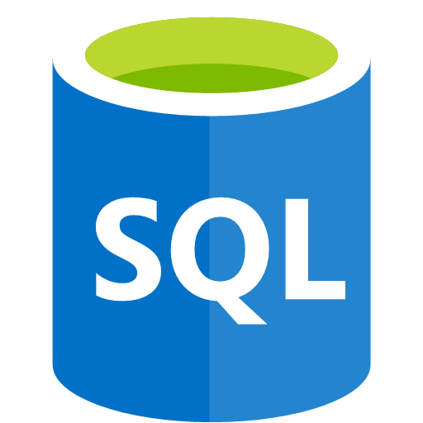

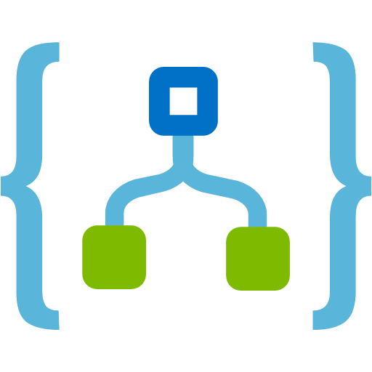

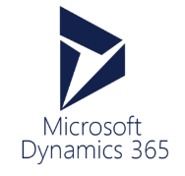
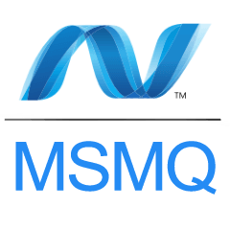

Partner
Partner
(External/Internal)
Store
Gateway
APIM
Publisher/s
Applications/Services
Pub/Sub/Store
Biztalk Server
Integration Workflows
Applications/Services
On-premise
Gateway
Subscriber/s
Pub/Sub/Store

Slide 7
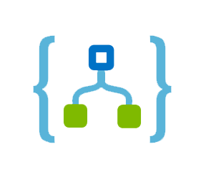
Integration patterns with Logic Apps
Transform flow
LIQUID
SFTP
Passthrough flow
SFTP
APIM
HTTP
EDIFACT
XML
PROMOTION
MSMQ
AS2
X12
TRANSFORM
FF ENCODE
SAP
Policy/Route
Processing
LOB Adapter

Slide 8
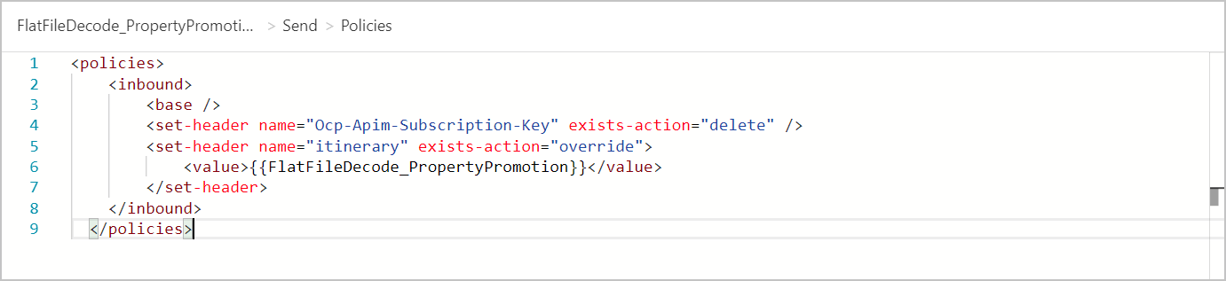
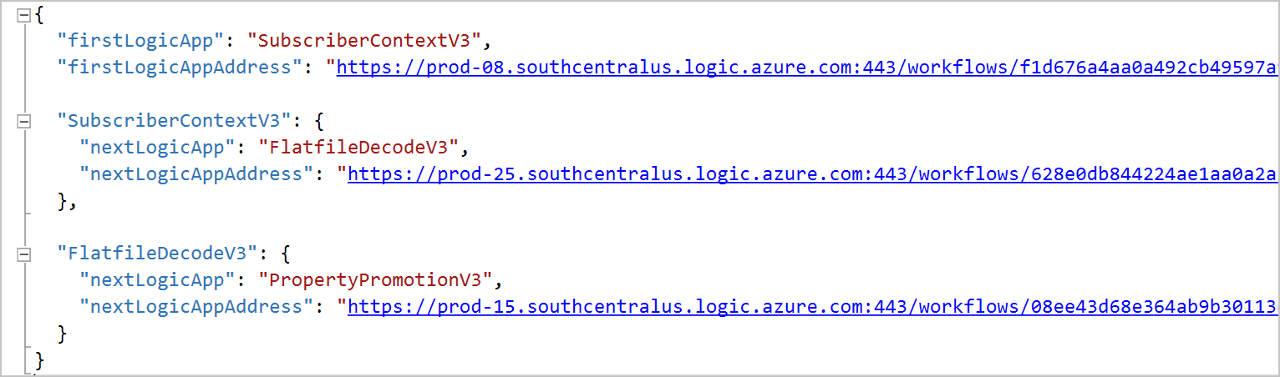
APIM policy sample to drive itinerary
Notes:
Version – use the default itinerary for latest version in production
APIM creates abstraction between conceptual workflow and actual version of Logic apps being executed.

Slide 9
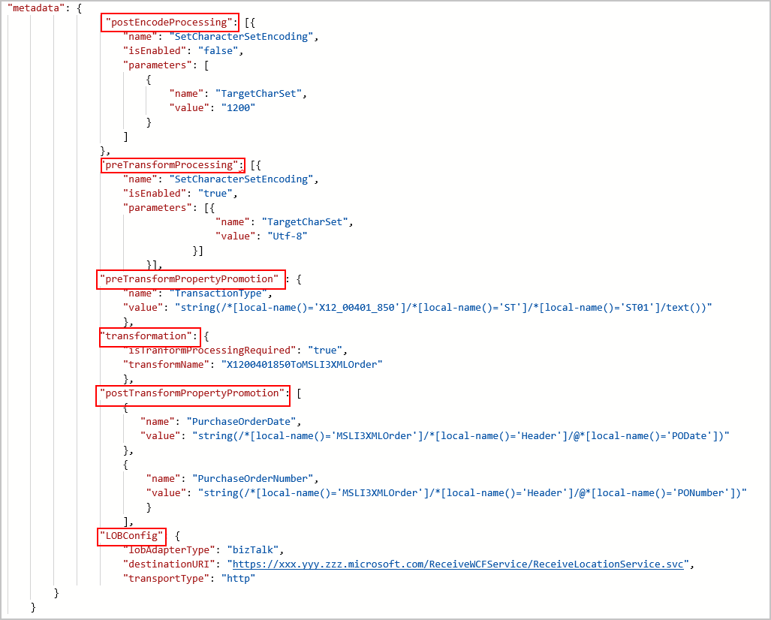
Metadata Example

Slide 10
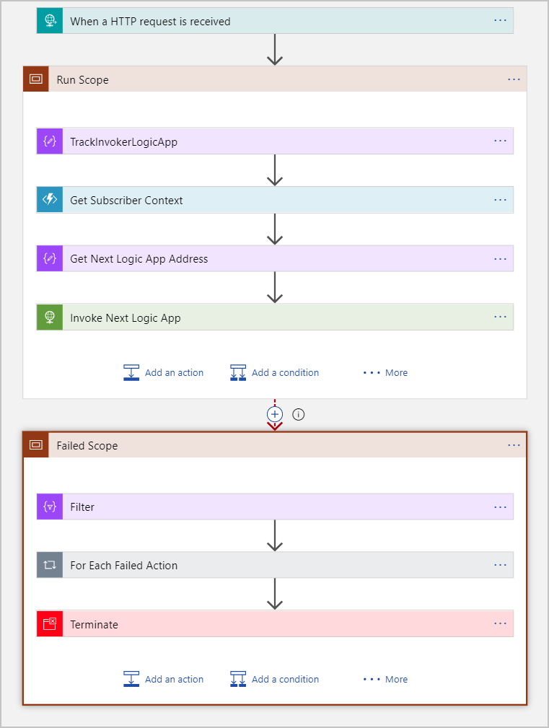
Exception Handling

Slide 11


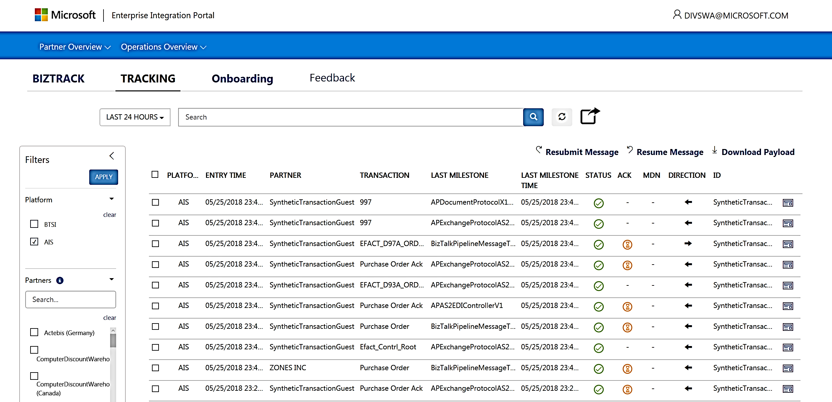
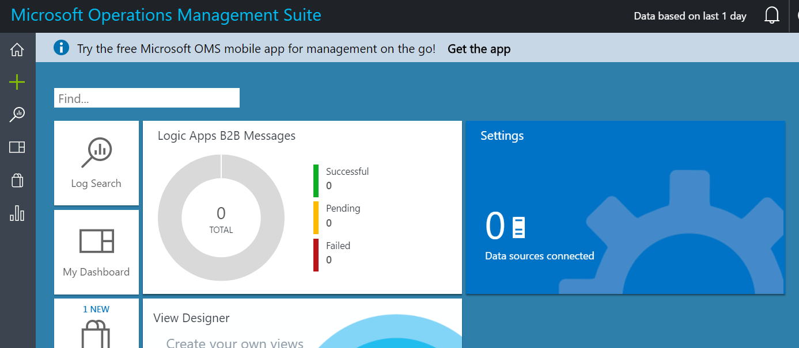

Service Management/Tracking
All services in integration
Warm path
Hot path
Business failures
Azure
Function
Event
Hub
Log Analytics
Business as subscribers
Business Tracking
Monitoring (OMS)
Incident/Ticket Mgmt (IcM)

Slide 12
Business on Logic Apps
FY18 Q1
8 Partners
FY19
30+ Partners
FY19 Q1 and beyond
150+ Partners
100K TPM
250K TPM
3M TPM
100% CUSDEC , VL
VL, Finance
100% VL, 100% SC Retail, Finance
Enterprise Integration Pack, diagnostics, metadata, etc..
Batching, Disaster Recovery, business tracking, service management
Concurrency control, Isolated environment, etc..

Slide 13
Future considerations
Integration Account
Single or per business
Isolation
High value and time critical businesses
Stringent SLAs
Logic Apps as Isolated
Migration strategy ready if needed
LA team plans to improve limits in future
Logic Apps has partners, BTS has partner configurations
Control on updates to avoid busy times

Slide 14

Simplify and Accelerate
Planning
Designing
Artifacts Development
Artifacts Testing
End-End Testing
Move to Logic Apps
Continuous Onboarding
TPM Setup
Itinerary Setup
Map Development
Custom Components Development
Unit Testing
AB Testing
End-End Testing
New Partners Onboarding
Testing with the Partners
Migration Process
Onboarding Process
Migration Tools
TPM Migration tool
AB Testing Tool
Self-Serve Onboarding
Accelerate EDI Integration
Simplify Partner Onboarding
Simplify End-End Testing

Slide 15
Biztalk to Logic Apps Migration tool
Demo

Slide 16
Self-Serve Onboarding Tool
Brief Look

Slide 17
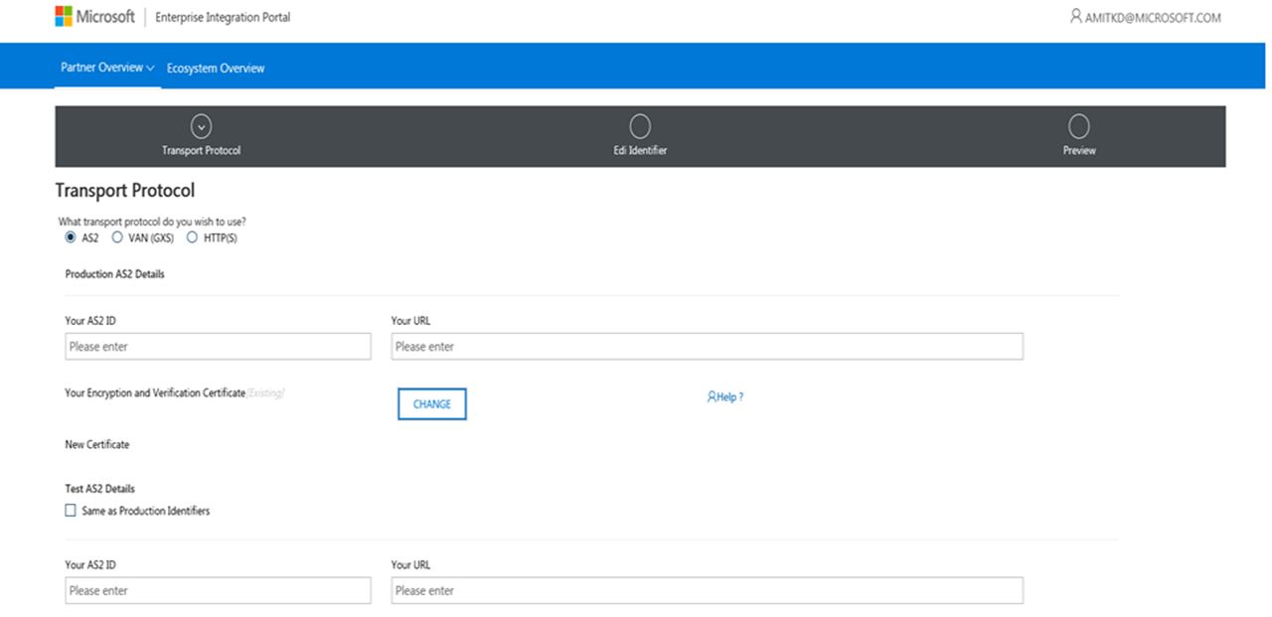
Self-Serve Onboarding Tool

Slide 18
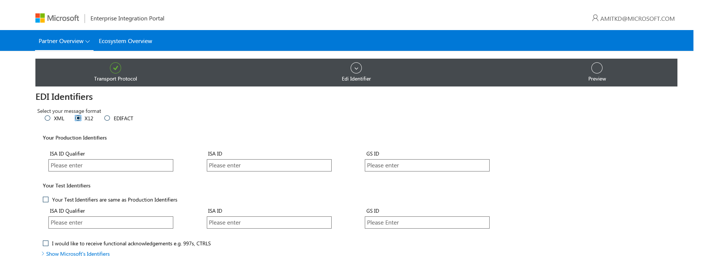
Self-Serve Onboarding Tool

Slide 19
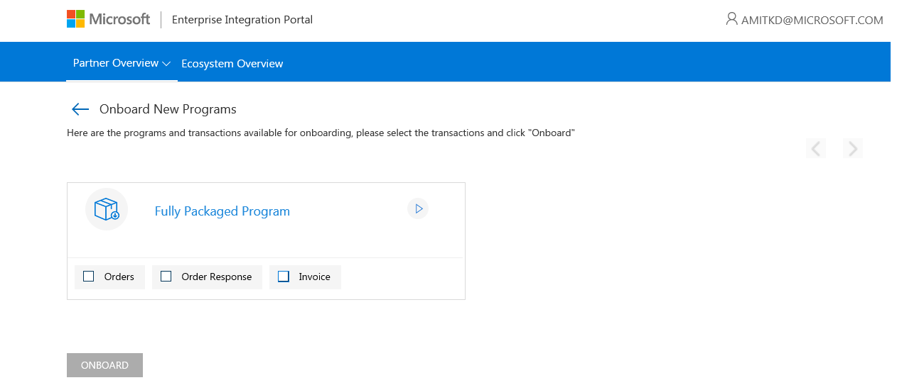
Self-Serve Onboarding Tool

Slide 20
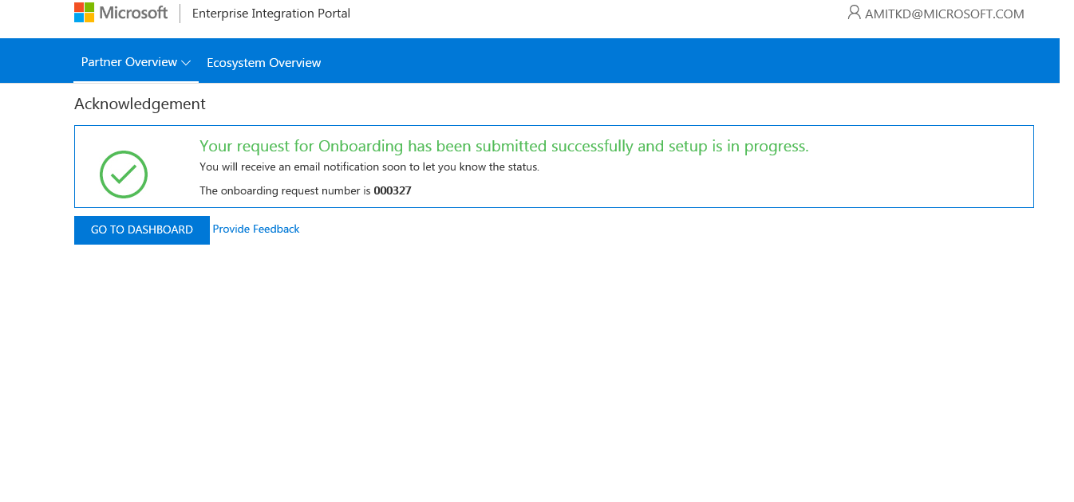
Self-Serve Onboarding Tool

Slide 21
Learnings
There are published limits for Logic Apps; understand what they are.
Consider the nature of flows you will create – high throughput or long running workflows.
Leverage the platform as much as possible to control concurrency (split-on, for-each).
Understand the structure and behavior of your data (batched v/s non-batched).
When batching items, understand limits and batch sizes to determine release criteria
Versioned endpoints for extensible, test-in-production mindset
In Logic App, your delivery options are – ‘at least once’ or ‘at most once’ (not ‘only once’).
Notes:
- # of actions in a workflow, actions executed in 5 min for a LA, # of calls to external services
- Webhooks/Http calls for long running processes, workflow action to make LA calls - quick response, no backward compatibility
- For each will add to the count of actions, while spliton wont. Do you need all 20 items in a row to be processed in parallel ?
- Consider LAs that are called down the flow after de-batching – use the above tow points i.e limits and required parallelism to design those LAs. Process batch with split on. Release a controlled, constant flow into the decoding process without overrunning
- If considering t-in-p scenarios, then think about how to enable versioning and SxS story for your workflows. SxS strategy and ability to fall to a LKG state
- LA execution model is atleast once delivery, with fire and forget you can get atmost once deliveries. Exactly once semantic is not possible in distributed systems

Slide 22
Thank You !!
Artifact migration tool : https://aka.ms/tpmigration
Whitepaper: https://aka.ms/logicappitcasestudy

