Slide 1
Saravana Kumar
Founder – BizTalk360/ServiceBus360
Welcome to INTEGRATE 2017

Slide 2
Welcome to INTEGRATE 2017

Slide 3
#integrate2017

Slide 4
Thanks to our Sponsors
TITANIUM
GOLD
SILVER
PLATINUM

Slide 5
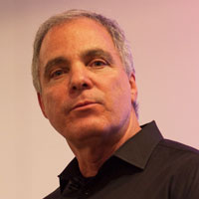
Thanks to
Jim Harrer
Principal Group Program Manager

Slide 6
Thanks to all our Speaker

Slide 7
Integration User Group

Slide 8
INTEGRATE 2017 USA Microsoft HQ, Redmond (Oct 25,26,27)

Slide 9
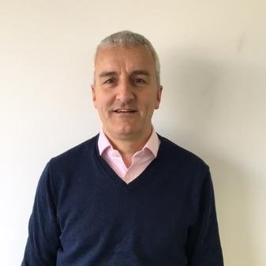
Duncan Barker
Business Development Manager – BizTalk360
BizTalk360 – Company Developments

Slide 10
One Platform.
Operations, Monitoring and Analytics Software
for Microsoft BizTalk Server
for Azure Service Bus
Get started with a 14-day Free Trial
Get started with a free account
www.biztalk360.com
www.servicebus360.com

Slide 11
Company Growth
August 2011
December 2011
December 2012
First BizTalk360 Customer
5 customers
65 customers
December 2013
145 customers
December 2014
December 2015
v7.8 in use
December 2016
v8.2 (major revamp)
v5.0 in use
v2.5 in use
v7.0 in use (migration from Silverlight to HTML5)
255 customers
450+ customers
370 customers
Start of India operations
New UK & India Offices
ServiceBus360 launched
June 2017
500+ customers
v8.4 released (May 2017)
ServiceBus360 (~10 releases , early customers)
v7.10 in use
Saravana + 2 part time staff
UK Team - 5
India Team - 2
UK Team - 6
India Team - 14
UK Team - 8
India Team - 24
UK Team - 10
India Team - 32
UK Team - 11
India Team - 32
Trusted by over 500+ businesses in 26+ countries, Protecting over 1500+ BizTalk environments

Slide 12
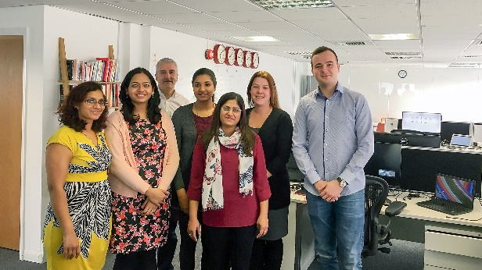
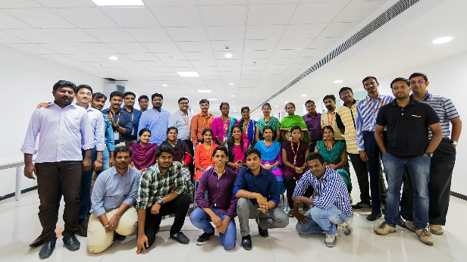
BizTalk360 Team
50+ Member strong team spread across two locations – London (UK) and Coimbatore (India)

Slide 13
Operational Teams
R & D, Product Engineering
Quality Assurance & Documentation
Customer Support
Customer Happiness
Licensing, Accounts & HR
Sales & Marketing

