Slide 1
Saffieldin Ali
Senior Premier Field Engineer - Microsoft
BizTalk Health Check – What and How?
Notes:
I am Saffieldin, or Saffi for Short, Sr.PFE at EMEA Integration Team in Microsoft Services
PFE? We’re the Proactive Consultants
we’ve 3 areas to help our premier customers: Assess, Educate, Operate
Sometimes we’re involved in reactive cases

Slide 2
About Me
My Name is Saffi Ali
Senior Premier Field Engineer, Enterprise Integration
MCSE: Cloud and Infrastructure
Before Microsoft:
Integration Solutions Developer/Consultant
Used different integration technologies
Web/Cross Platform/IoT Application Developer

Slide 3
Why
Compulsory test for safety and exhaust emissions of motor vehicles
Ambulances and taxis each year 1
** http://www.monnington-motors.co.uk/mot-assessment/
Notes:
Intruduce MOT Analogy:
Generally, You need to take care of your car, otherwise, you cannot predict how nasty It’s going to be, Unless you’ve got a Tesla
(Lights, tyres, brakes, seat belts, airbags, safety equipment?)
Ambulances and taxis each year 1

Slide 4
Why
Identify symptoms and/or potential problems before it affects production
Review critical processes to achieve minimum downtime due to disaster recovery
Identify any warnings/red flags that may be adversely affecting users
Understanding of common mistakes made by administrators and developers
Understanding supportability best practices
Notes:
BizTalk is a distributed system composed of Services, DBs, etc on different location
You have to take care of it

Slide 5
BizTalk Health Check Process
Interviewing
Operations Interview
Knowledge Transfer
Collecting
Run collection tools
Collect informal information
Analysis and Reporting
Run and examine analysis tools results
Write and Present the Final Conclusion

Slide 6
Interviewing Red Signals
“We have our own procedures for database backups”
“We didn't test the disaster recovery site”
“How big are these databases going to get, it’s causing issues with our backups?”
“Can you send us a word document telling us how to install BizTalk?”
Notes:
Fast

Slide 7
BizTalk Health Check Areas
Platform Configuration for BizTalk Server
OS Service Pack Level and Critical Updates
Disk and Network Health
BizTalk Server Configuration
Latest BizTalk Server Critical Hotfixes
Host Separation Policy and Dedicated Tracking Host
Runtime Adjustments (Tracking, Polling Intervals, etc)
Performance
Perf. Analysis of Both BizTalk & SQL Servers
Host throttling Analysis
Notes:
8 Sections, 40 Checks Total, 200+ Rules

Slide 8
BizTalk Health Check Areas
Resilience
High availability for SQL Server databases
Redundancy of the Master Secret Server (ENTSSO) Service
Redundant Host Instances
Load Balancing of HTTP, SOAP, etc
SQL Server Configuration for BizTalk Server
Latest Service Pack and Critical Hotfixes
SQL Agent Service and BizTalk Jobs
Database files placement, Memory Config, etc
Disaster Recovery
Disaster Recovery of the BizTalk Databases and Master Secret Key

Slide 9
BizTalk Health Check Areas
Security
Host Separation for Security
MSDTC Security Configuration
Certificate Management
BizTalk Application Management and Monitoring
Monitoring Solutions for BizTalk
Monitoring BizTalk Message Flow
Event Log Analysis

Slide 10
BizTalk Health Check Key Tools
Microsoft Baseline Security Analyser (MBSA)
BizTalk Best Practices Analyser
BizTalk Health Monitor (BHM)
Perf. Analysis of Logs (PAL)

Slide 11
Platform Configuration

Slide 12
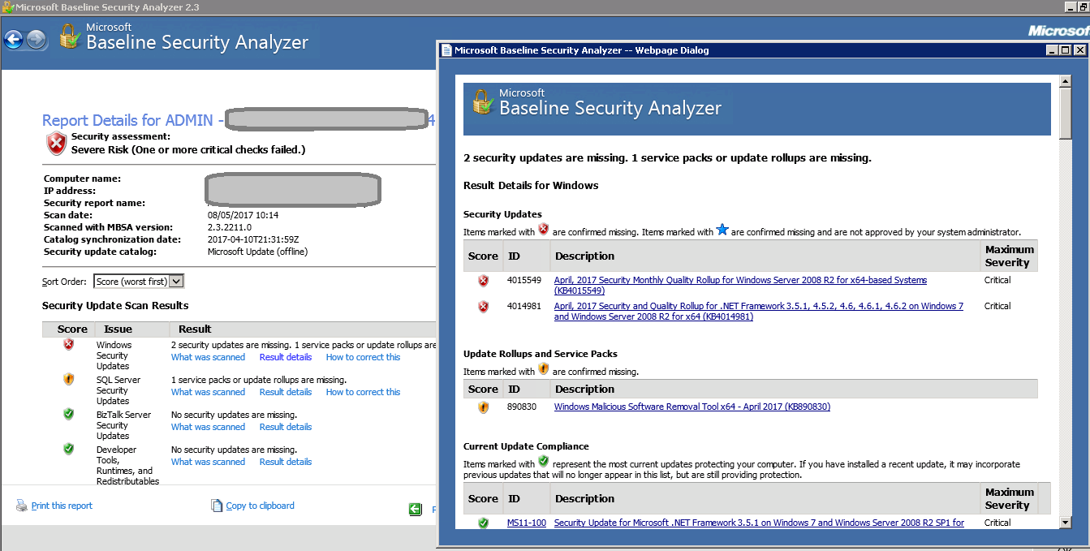
Baseline Security Analyser
Notes:
Execuse: I didn’t have any security issues
Ok let’s wait until you got aransomware Problem

Slide 13
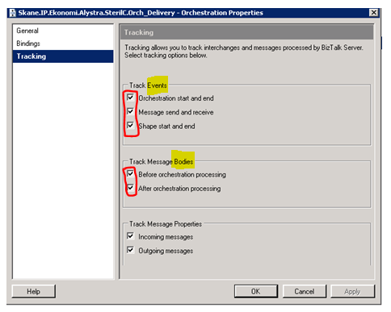
Default tracking
Be careful to decide level of tracking !
Notes:
80% of Developers forgot this on production, without the need to do so

Slide 14
Polling intervals
Look out for climbing CPU on SQL Server !
Notes:
The Polling Interval is the maximum amount of time each host instance will wait between dequeue requests.
Best practice is to not adjust this value from the default of 500 milliseconds unless the system has specific low latency requirements. It is important to bear in mind that reducing the Polling Interval value may have an impact on the CPU usage on the SQL server that does the BizTalkMsgboxDb database.

Slide 15
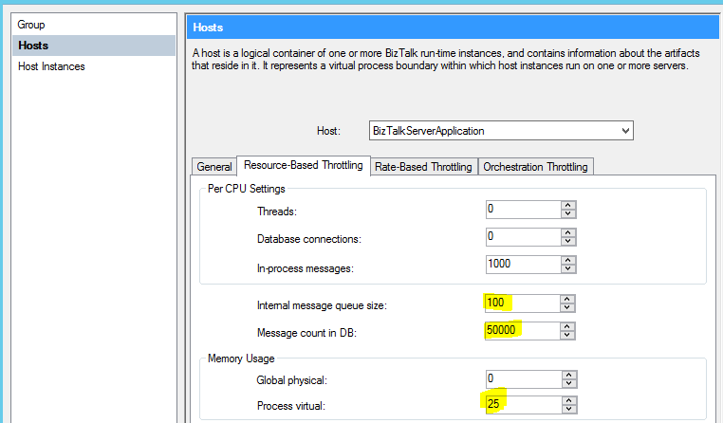
Host resources
Stretch according to load and memory

Slide 16
BizTalk Monitoring
Notes:
ACTIVE Monitor is matter, you may have all of the monitoring tools, but you don’t use them correctly, or act upon them
- It might sounds odd, but I’ve seen it several time
Any monitoring tool Should Cover Both Infra Parts and App Part (BizTalk Specific Checks)

Slide 17
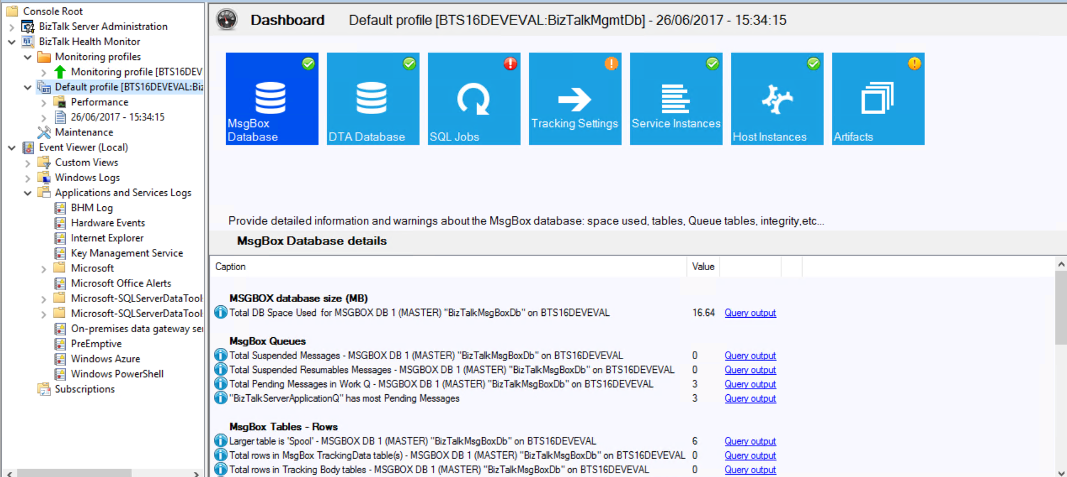
BizTalk Health Monitor (BHM)
Notes:
This BHM, Fast to the next slide

Slide 18
BHM
What ?
MMC Snap-In built on top of known MBV framework
Very rich Query\Rules and Maintenance repositories
Built to monitor and maintain multiple BizTalk environment/s.
Easily integrated with BizTalk Admin Console.
Released and Supported for BizTalk Server 2010\2013\2013R2..and now 2016 !
Query
Rules
Warnings

Slide 19
BHM
Why ?
BHM reports requested by Microsoft support
Run 200 queries and evaluate more than 500 rules produced by MS Support
Continuous update of queries, rules and repair scripts
Single tool : Analyze, warn, fix multiple BizTalk environment/s
Schedule report collection and send notifications.
Customizable
custom queries and rules
dashboard

Slide 20
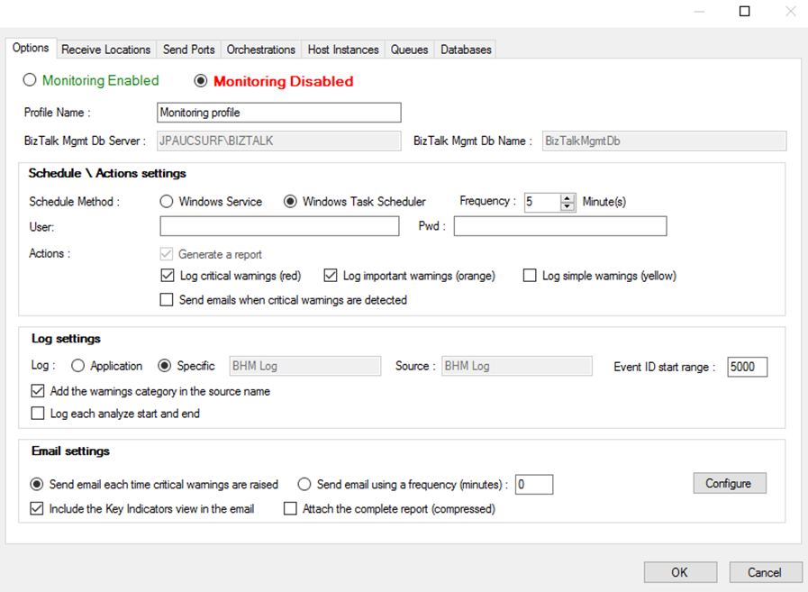
BHM
Continuous Monitoring
Configuration
Notes:
A monitoring profile will execute continuously the BHM collector to gather very quickly all important data from a given BizTalk group and will report all critical and important warnings detected in a specific BHM log (it can be the Application log); the restricted selection of queries make the BHM collector completed in few seconds.
Any generic Monitoring application “à la” SCOM can then be used to parse the BHM log of the server executing the BHM collect agent (Windows Service or Windows Task) to identify all BHM warnings raised and send emails or any other types of alerts.
Monitoring profile configuration
When a new Monitoring profile is created, a new specific configuration dialog box is displayed to configure easily this profile and select quickly the items to monitor. The Options tab of this dialog box allows very quickly to configure the current Monitoring state, its schedule period and method, the type of actions to trigger after a collect, the configuration of the log to raise the warnings to, and the email settings (it is more recommended to configure emails or other kind of alerts in your generic Monitoring application parsing the BHM log. Such monitoring applications provide usually powerful features in term of alerts configuration):

Slide 21
BHM Uses cases
Continuous monitoring
Periodic health checks with email notifications
Quick collection of reports for Microsoft Support
Validation of new BizTalk installations and configurations
Easier group changes detection - comparing collected reports
Run periodically CleanUp Scripts using Maintenance node
Pre-Loaded Perfmon counters for various scenarios

Slide 22
Performance Analysis

Slide 23
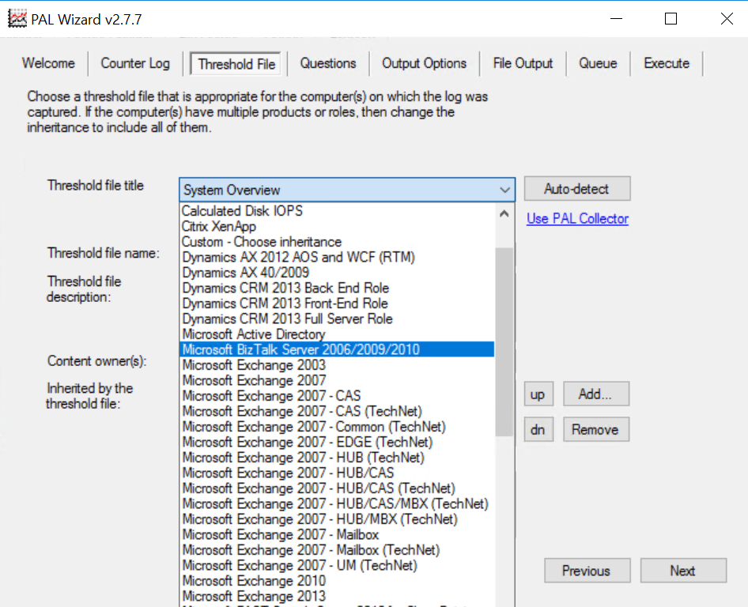
PAL Wizard
Answer each option carefully as it will impact the output report
Choose the correct Threshold Option
Use the ThresholdFile tab to create a perfmon counter template file to easily collect the data
Notes:
Fast

Slide 24
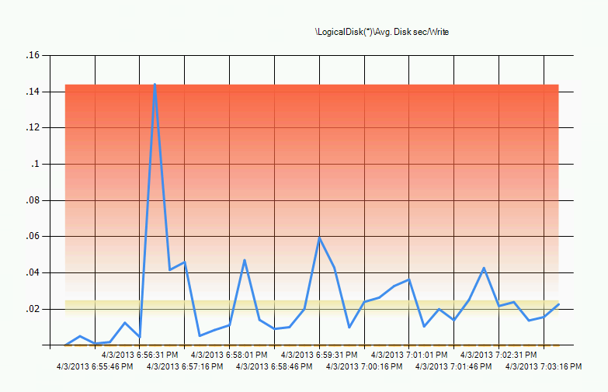
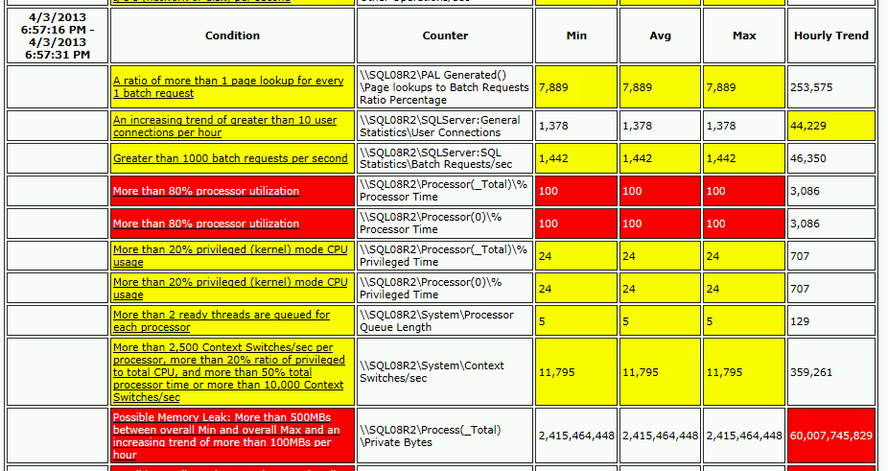
PAL Output
Alerts summarized in time slices
Graphs show thresholds
Notes:
Fast

Slide 25
Demo
Notes:
BHM and PAL

Slide 26
Resilience and DR

Slide 27
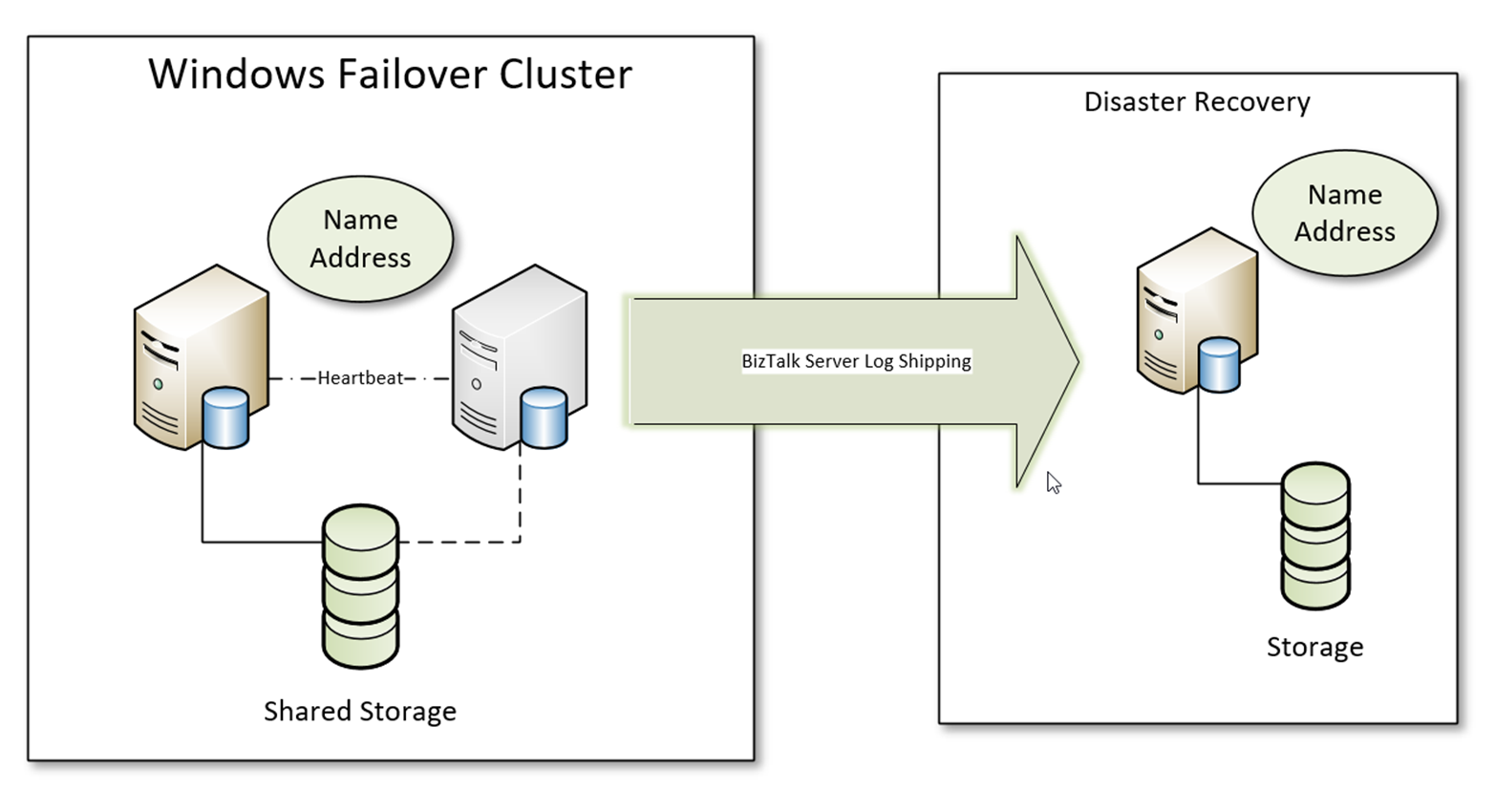
Resilience
Traditional High availability for SQL Server databases

Slide 28
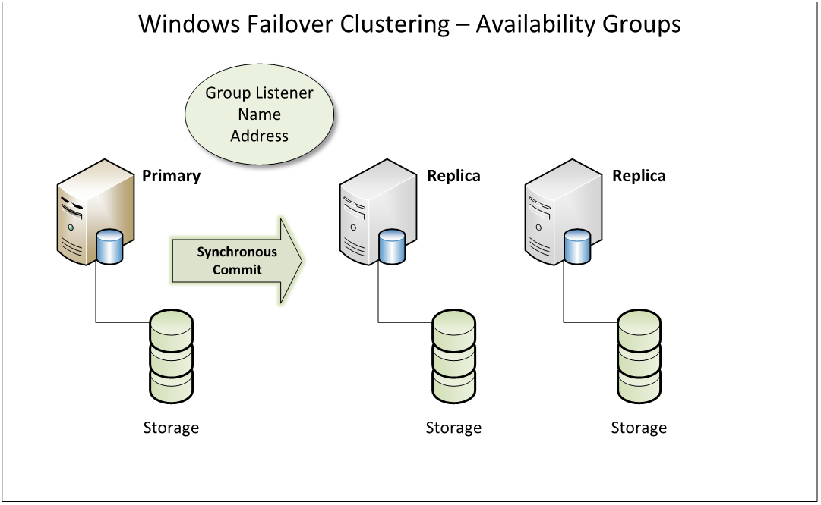
Resilience
High availability + DR with AOAG

Slide 29
Disaster Recovery
Backup is only half the story, if you can’t restore “Disaster Recovery” becomes “Disaster”
Enabling the BizTalk Backup job is easy, restoring BizTalk databases is not
Consider using BizTalk Log Shipping
Consider using SAN systems
Practice Disaster recovery procedures

Slide 30
Useful Links
BizTalk Health Check Checklist
BizTalk Health Monitor (BHM)
Microsoft Baseline Security Analyser (MBSA)
Perf. Analysis of Logs (PAL)
Notes:
https://msdn.microsoft.com/en-us/library/hh510230.aspx#TermsAndDefinitions

Slide 31
Last but not least
“Microsoft Integration Community is awesome”
Notes:
I believe that this community is one of the key differentiator compared to MS competitor,
Level of maturity and supportability is simply superb
Thanks to BizTalk360 to all the community members for the amazing work you do.
Thank You

