Slide 1
Johan Hedberg
Microsoft Azure MVP
Logic App continuous integration and deployment with Visual Studio Team Services

Slide 2
Setting the stage

Slide 3
Some things a common pipeline needs to address
Development standards
Process standards
Security standards
Deployment standards
Team communication and culture…
…and more…

Slide 4
Core architecture principles and guidelines
An integration
is a resource group
has a unique name
is self contained and self reliant (mostly)
uses (but does not contain) infrastructure components
consists of Logic Apps, Functions, Schemas and Maps, API Connections, and other supporting components like storage, app service plans etc.
Photo by Simon & His camera

Slide 5
Core architecture principles and scope
Subscription
Integration Resource Group(s)
(
)
XSL
XSD
Infrastructure Resource Group

Slide 7
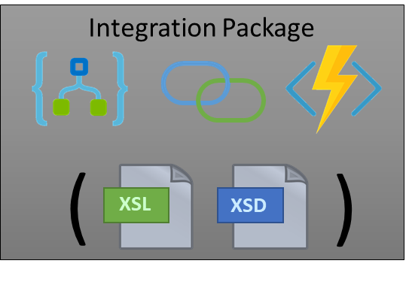
x 5
x 50
x 500+

Slide 8
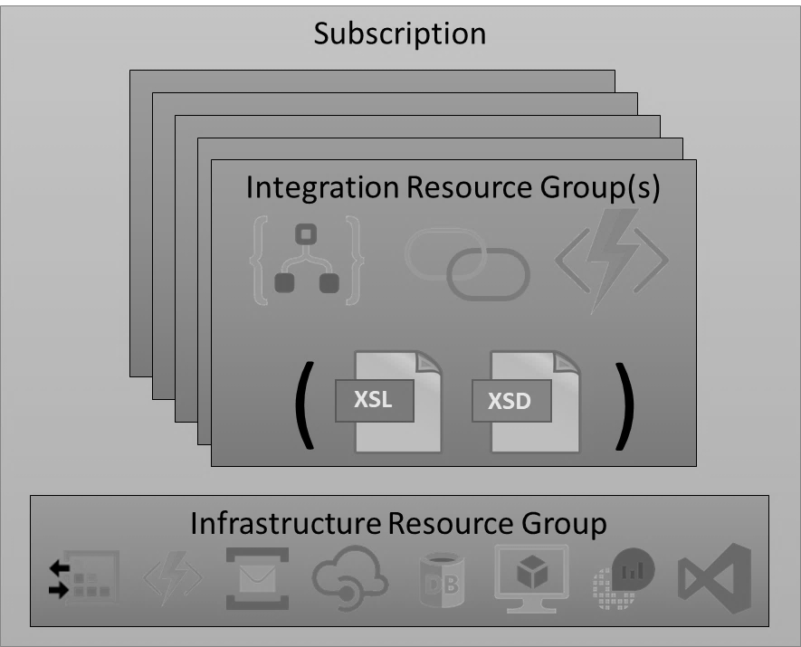
TEST
PROD

Slide 9
TEST
PROD

Slide 10
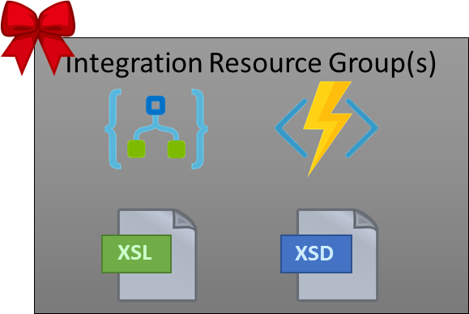
TEST
PROD
Azure Portal
Developer initiated, or CI/CD
Gated
Deploy
Deploy
Build
Release
The same Release
Release
A release is ready to be deployed. Approve?
Approve!

Slide 11
Walkthrough

Slide 12
Summary
Shared development standards and an automated process can help teams succeed
We have options; multiple ways to create one
Options are great, since there is no one size fits all
VSTS build and release management is one option for a complete build and deployment process for cloud based integration

Slide 13
Thank you!
Questions and/or follow ups?
Johan Hedberg
johan@jeh.se
https://www.linkedin.com/in/mvpjohanhedberg

