Slide 1
Jeff Hollan
Program Manager - Microsoft
Azure Functions – Serverless compute in the cloud

Slide 2
The evolution of application platforms
On-Premises
IaaS
PaaS
Serverless

Slide 3
What is Serverless?
$
Abstraction of servers
Event-driven/ instant scale
Micro-billing
Notes:
Abstraction of servers, infrastructure and configuration of operating system
Event-driven scale
Sub-second billing
Stateless
Serverless compute is a fully managed service. Some refer to it as Functions as a Service
OS and Framework patching is performed for you
There is zero administrative tasks and no need to manage any infrastructure
You just deploy your code (function) and it runs
Your code runs within seconds and for very short period of time
Serverless compute scales quickly (almost instantly) and vastly
Automatically scales within seconds
No scale configuration is required (there is no way to configure scale or limits)
Scales to match any given workload. Scales from zero to handle tens of thousands concurrent functions invocations within seconds
Pay only for the time your code is running
Serverless compute reacts to events
React, in near real-time, to events and triggers
Triggered by virtually any event from Azure service or 3rd party services
Setup time, provisioning is long & costly

Slide 4
Benefits of Serverless
Reduced DevOps
Focus on business logic
Faster time to market
Notes:
“Pinnacle of PaaS compute”
Not just hardware “servers”, but software servers are also managed for you
Focus on business logic, not solving technical problems not core to business
Lower effort to get started makes it easier to experiment (bots, etc.)
Benefits of “Serverless”

Slide 5
Serverless application platform components
Development
Platform
IDE support
Functions
Logic apps
Developer tooling
Bindings and triggers
Open source
Visual designer
100+ connectors
Functions orchestration
Visual debug history
Local development
Data/storage
Messaging
Gateway Connectors
Intelligence
Bots
Verbose debugging
Notes:
TIME MARKER (COMPLETE SLIDE): 10:10 A.M.
Talking Points: (Updated on 4/3/17)
Lets talk about what really makes up MSFT’s Serverless platform: At the center of the Serverless platform, is our compute offerings: Azure Functions and Azure Logic Apps. Azure Functions is an event based Serverless compute experience that helps you accelerate your development. Run time is open. Function code can be executed in vm or somewhere else, on prem or in clould. Logic Apps is a powerful orchestration tool. It enables building a Serverless app in minutes – by orchestrating multiple functions using a visual workflow tool.
Say you have your apps up and running using Serverless. Congratulations! You now need to collect intelligence from different apps across platforms to take actions upon. There are a few essential components which we think are core to building Serverless applications are:
Data/ Storage –Functions has triggers and bindings with Azure document DB and Azure Blob storage
** Triggers: Triggers are event responses used to trigger your custom code. They allow you to respond to events across the Azure platform or on premise.
** Bindings: Bindings represent the necessary meta data used to connect your code to the desired trigger or associated input or output data.
Messaging such as queues and topics using Azure Service Bus and Azure Event Hubs
Integration – that includes core LOB apps and SaaS apps integration via Azure Logic Apps.
Intelligence on data and sentiment/ predictive analysis using Cognitive services and Machine learning
Conversation as a service – how do we equip developers to build apps that offer an end-to-end experience for their end users – Azure Bot Service offers a Serverless interactive bot experience.
More, developers are spending more time writing code that allows them to add huge business impact with Serverless. MSFT offers numerous development tools such as IDE Support for Visual Studio in functions and Logic Apps, enables local development (vs web browser coding environment), visual debugging capability, all with your tools of choice.
Lastly, I also want to highlight top scenarios and use cases for Serverless:
Real-time Stream analytics: Customers can use Functions to feed real-time streams of data from application tracking into structured data and store it in SQL online.
SaaS event processing: Customers can use Functions and Logic Apps to analyze data from an excel file in Onedrive and perform validation, filtration, sorting and convert data into consumable business charts
Web app architecture: Used a lot in creating targeted marketing collaterals – when a customer clicks on a webpage, it triggers a webhook, that uses a function to create an ad that matches the customer profile and displays a completed webpage.
Real-time bot messaging: When customers send a message to a chatbox, Functions calls Cortana analytics to generate appropriate answers and sends a response back.
//from before: Customers have different paths to build a Serverless app – start by building the distributed application components using functions by leveraging the numerous templates and declarative bindings Or
Start with the workflow and orchestration of Serverless application using Azure Logic Apps. The visual designer enables developers to quickly and easily author, edit and visualize orchestration of multiple functions and workflow.

Slide 6
Introducing Functions
Code
Azure Functions
Events + data

Slide 7
Use bindings in your code
run.csx
function.json
public static void Run(byte[] image, string filename,
Stream outputBlob, TraceWriter log)
{
log.Info($"Processing image: {filename}");
var imageBuilder = ImageResizer.ImageBuilder.Current;
imageBuilder.Build(
image, outputBlob,
new ResizeSettings(640, 400, FitMode.Max, null), false);
}
{
"bindings": [
{
"name": "image",
"type": "blobTrigger",
"direction": "in",
"path": "card-input/{filename}.jpg",
"connection": "AzureWebJobsStorage"
},
{
"type": "blob",
"name": "outputBlob",
"path": "card-output/{filename}.jpg",
"connection": "AzureWebJobsStorage",
"direction": "out"
}
]
}

Slide 8
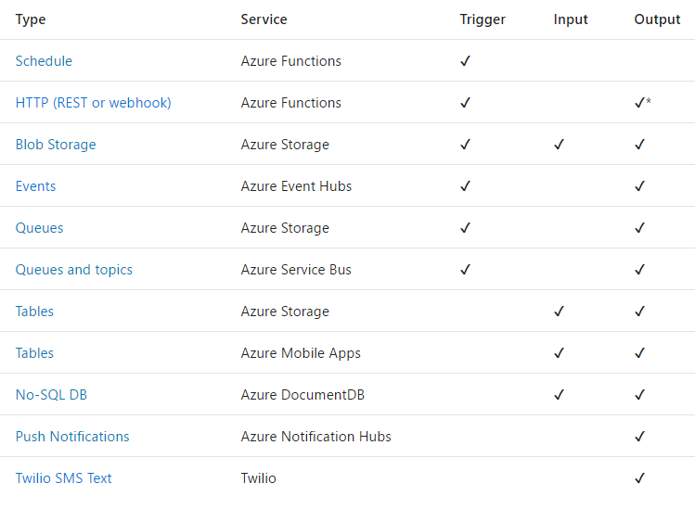
Triggers and Bindings

Slide 9
Demo – Azure Functions

Slide 10
Azure Functions Runtime
Made up of the Management Role (portal experience) and Worker Role (execution)
Runs on the IoT Edge
Data has gravity – allows you to process data on the device
Same runtime as the local debugger, GitHub code, and Azure

