Slide 1
Saravana Kumar
Founder / CTO – BizTalk360
TOP 10 FEATURES OF BIZTALK360

Slide 2
Top 10 features highlights

Slide 3
Why BizTalk360?
PAIN POINTS WITH MICROSOFT BIZTALK SERVER
1
2
3
BizTalk server support requires skilled BizTalk resources
Lack of security and audit measures
Lack of Productivity Tools
4
5
Monitoring & Notification
Analytics & Reporting

Slide 4
WHAT IS BizTalk360?
HOW BIZTALK360 HELPS YOUR BUSINESS
OPERATIONS
MONITORING
ANALYTICS

Slide 5
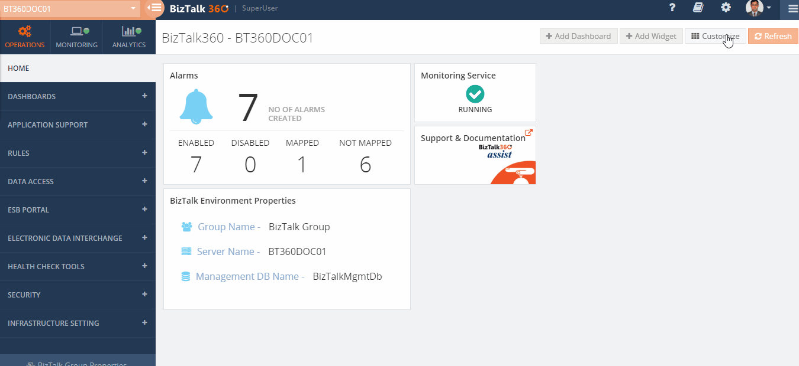
01. Rich Operational dashboards

Slide 6
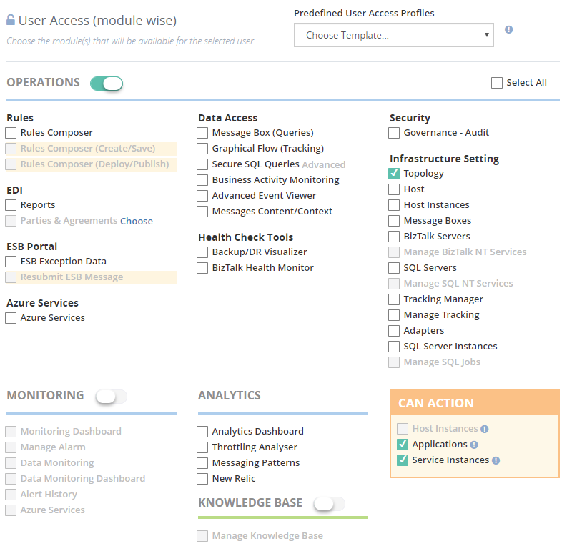
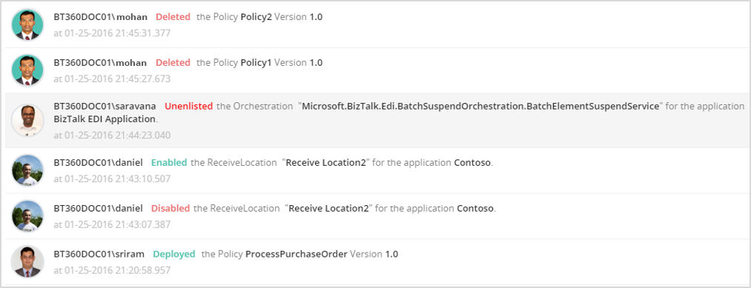
02. Fine grain security and auditing
1
2
3

Slide 7
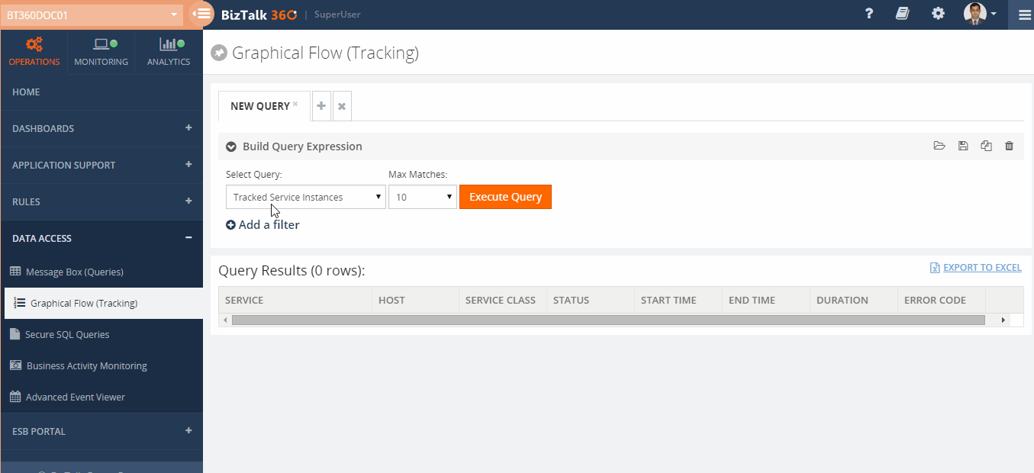
03. Graphical Message Flow

Slide 8
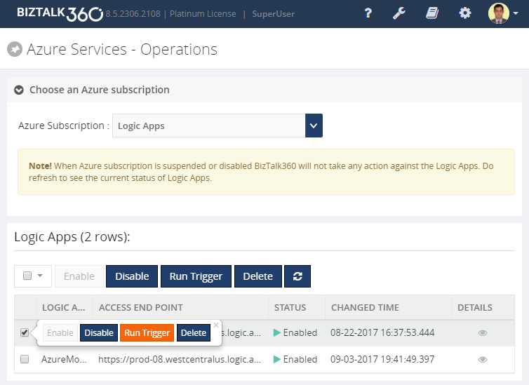
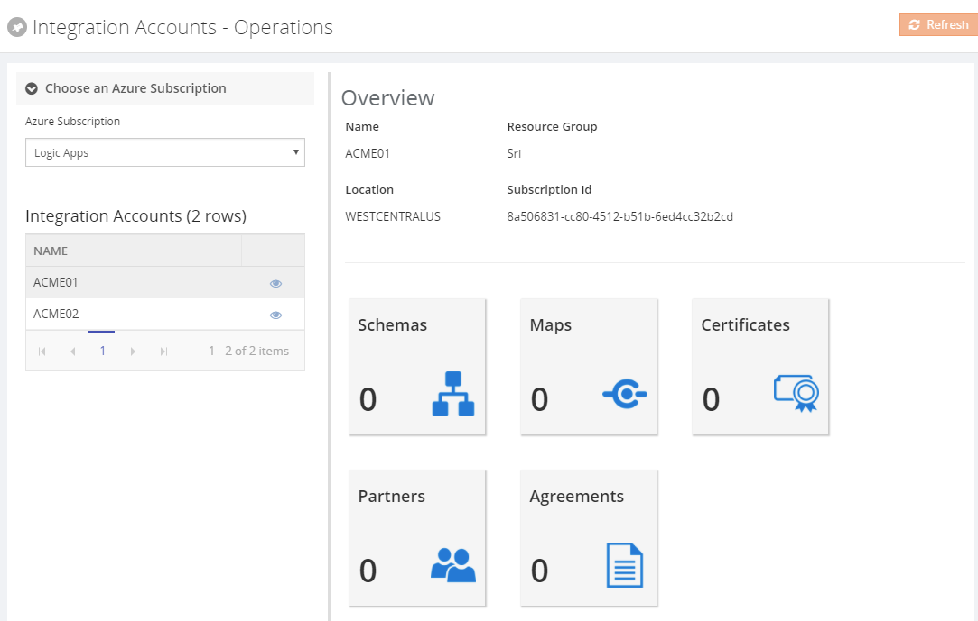
04. Azure + BizTalk Server (single management tool)
Azure Logic apps
Azure integration account

Slide 9
05. Monitoring – complete coverage
Wide coverage for pretty much every aspect of BizTalk Server Monitoring
BizTalk Environment
Receive Locations
Send Ports
Orchestrations
Host Instances
Host Throttling
BizTalk Health Monitor
SQL Instances
SQL Jobs
REST/SOAP Endpoints
Azure
App Services,
Service Bus Queues,
Logic Apps
BizTalk/SQL Server
CPU, Memory
NT Services
Event Logs
Queues
IBM MQ
MSMQ
Service Bus Queues
Folder Locations
File
FTP/FTPs
SFTP
Database
SQL Queries
NOTIFICATION CHANNELS
Email
SMS
Event Viewer
Slack
Microsoft Teams
Service Now
HP Operations Manager
Custom Channel

Slide 10
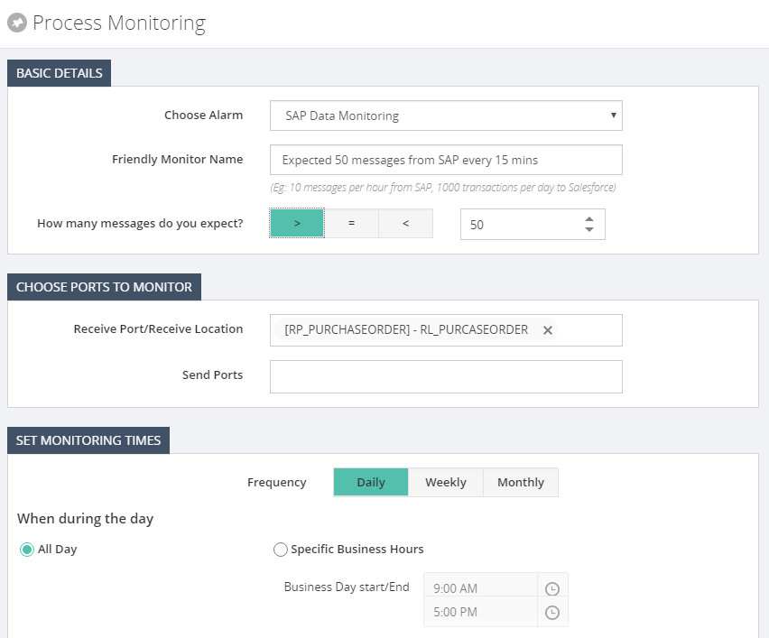
06. Data (NO EVENTs) monitoring
DATA POINTS
Ports, Message Box
Tracking Data, BAM
EDI, ESB
NON-EVENTS MONITORING

Slide 11
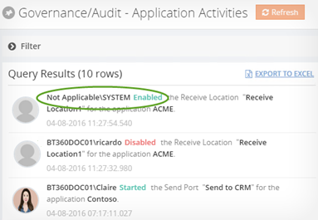
07. Auto healing – from failures
Automatically heal threshold violations on “state-based” artifacts
ELIGIBLE ARTIFACTS
Receive Locations
Send Ports
Orchestrations
NT Services
SQL Jobs
Host Instances
Logic Apps

Slide 12
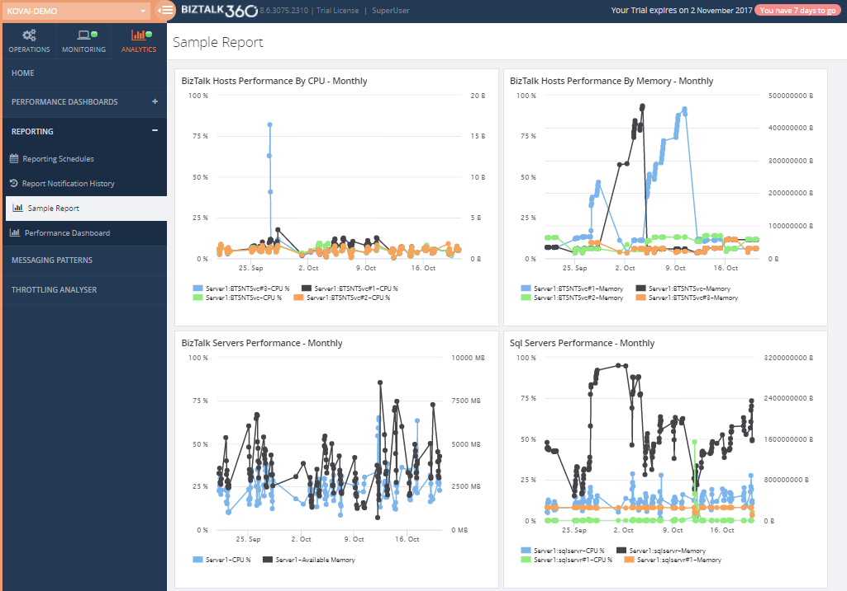
08. Scheduled reporting
SCHEDULED REPORTS
Daily, Weekly, Monthly
PDF download
Out of Box widgets
BizTalk Hosts
BizTalk Server
IIS
SQL Server
BizTalk Messages
Database Size
BizTalk Server
Event Log

Slide 13
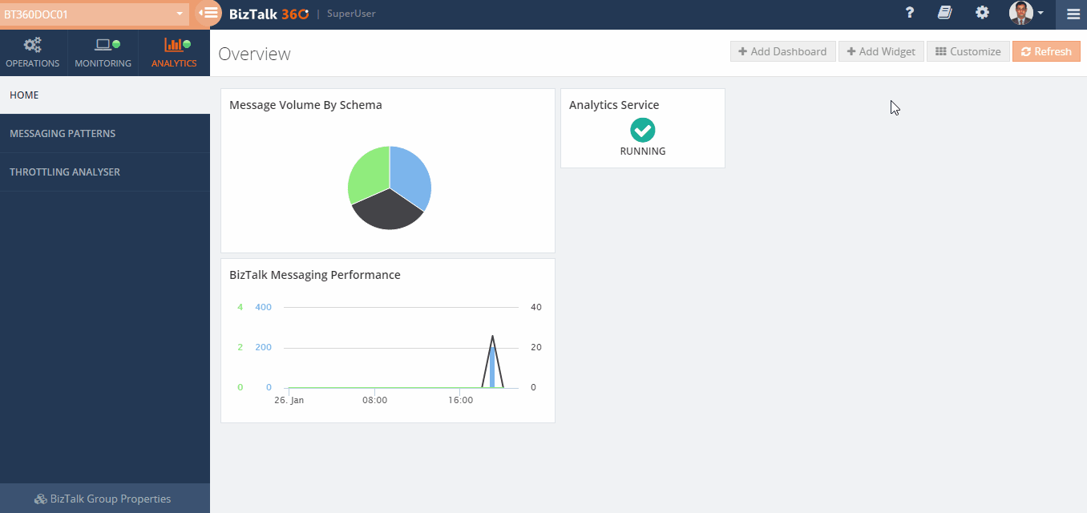
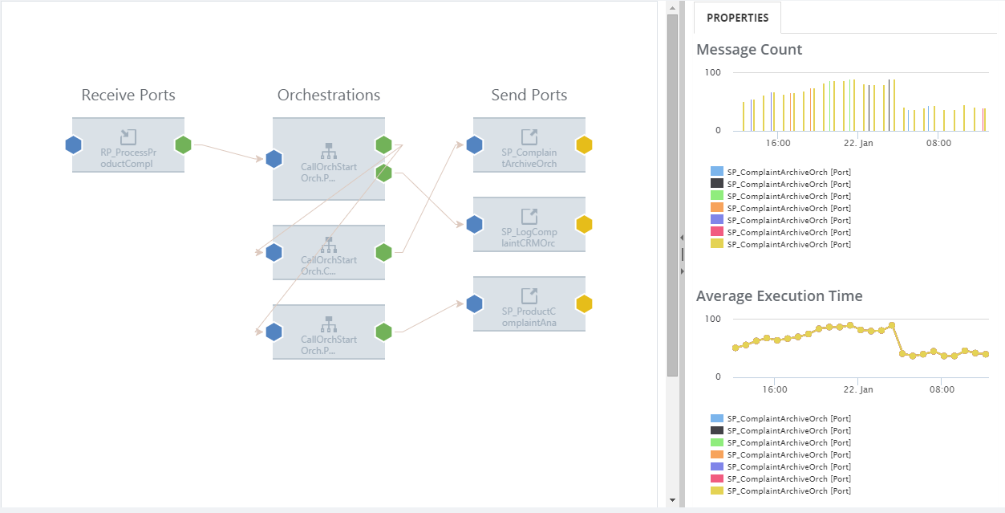
09. Analytics & messaging patterns

Slide 14
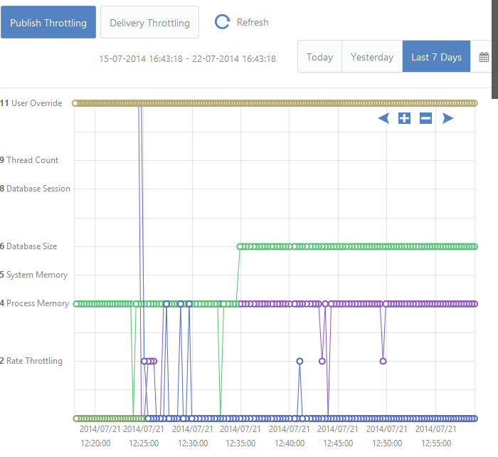
10. Throttling analyser
Understand your environment throttling conditions seamlessly

Slide 15
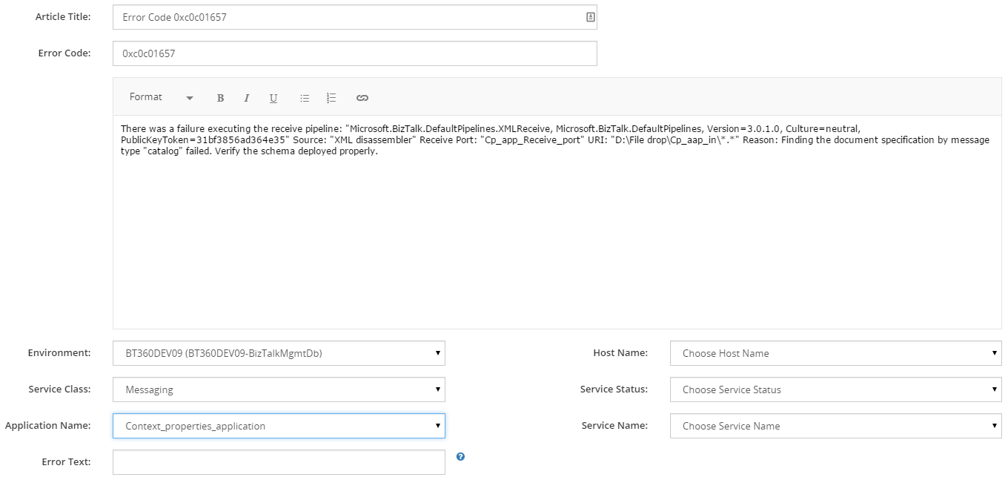
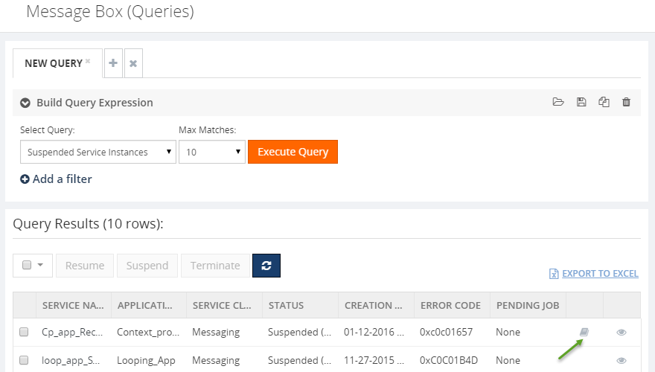
11. Team knowledgebase

Slide 16
summary
01. Rich Operational dashboards
02. Fine grain security and auditing
03. Graphical Message Flow
04. Azure + BizTalk Server (single management tool)
05. Monitoring – industry best
06. Data or transaction monitoring
07. Auto healing – from failures
08. Scheduled reporting
09. Analytics & messaging patterns
10. Throttling analyser

Slide 17
What you have seen is ONLY about 20% of BizTalk360

Slide 18
Some of the other key features
OPERATIONS
EDI Dashboards & Reports
ESB Exception Management Portal
Backup & DR Visualizer
Advanced Tracking Manager
Advanced Event Viewer
Secured SQL Queries
Team Knowledge base
Real Time Operations Feed
Search Artifacts (schemas, maps etc)
Full blown BizTalk Administration
BizTalk Health Monitor Integration
Business Rules Composer/Viewer
Topology diagram
BizTalk Server Licensing Widget
BizTalk Server Dashboard
Manage SQL Jobs, NT Services
MONITORING
Monitoring Dashboards
Data Monitoring Dashboards
Import/Export Configuration
Alert History
Email Templates
Operations Automation
Daily Health Checks
Maintenance Windows
GENERAL
NewRelic Integration
Full API Access
Azure Marketplace
Azure Easy Installer
Chrome Extension

Slide 19
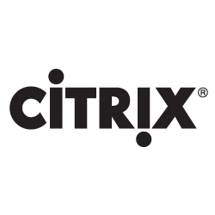
Some of OUR key customers
Trusted by 500+ Customers across 30+ countries
Technology companies
automobile
banks

Slide 20
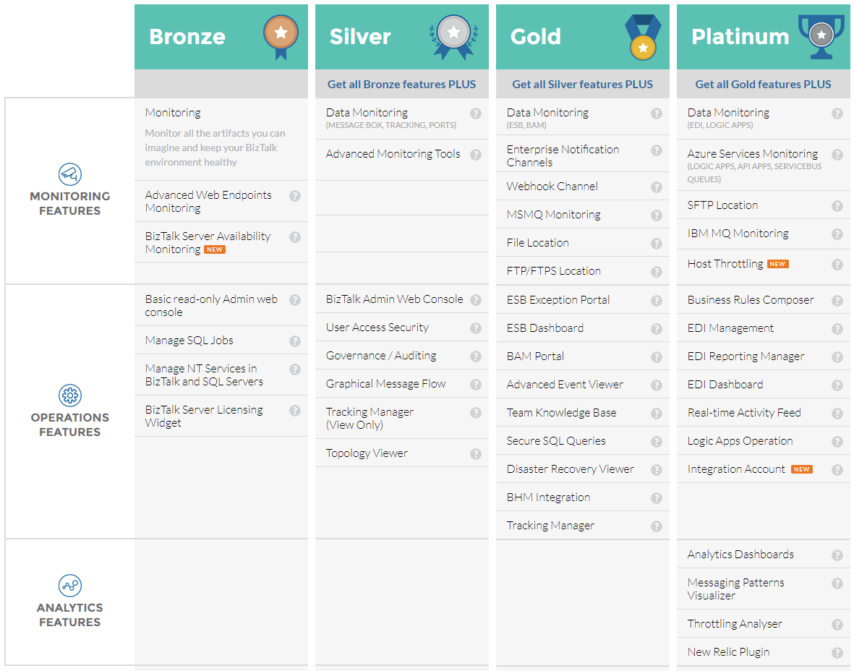
BizTalk360 pricing

Slide 21
Try BizTalk360 for 30 days free
https://www.biztalk360.com/free-trial/
You can reach me on : saravana@biztalk360.com

