Slide 2
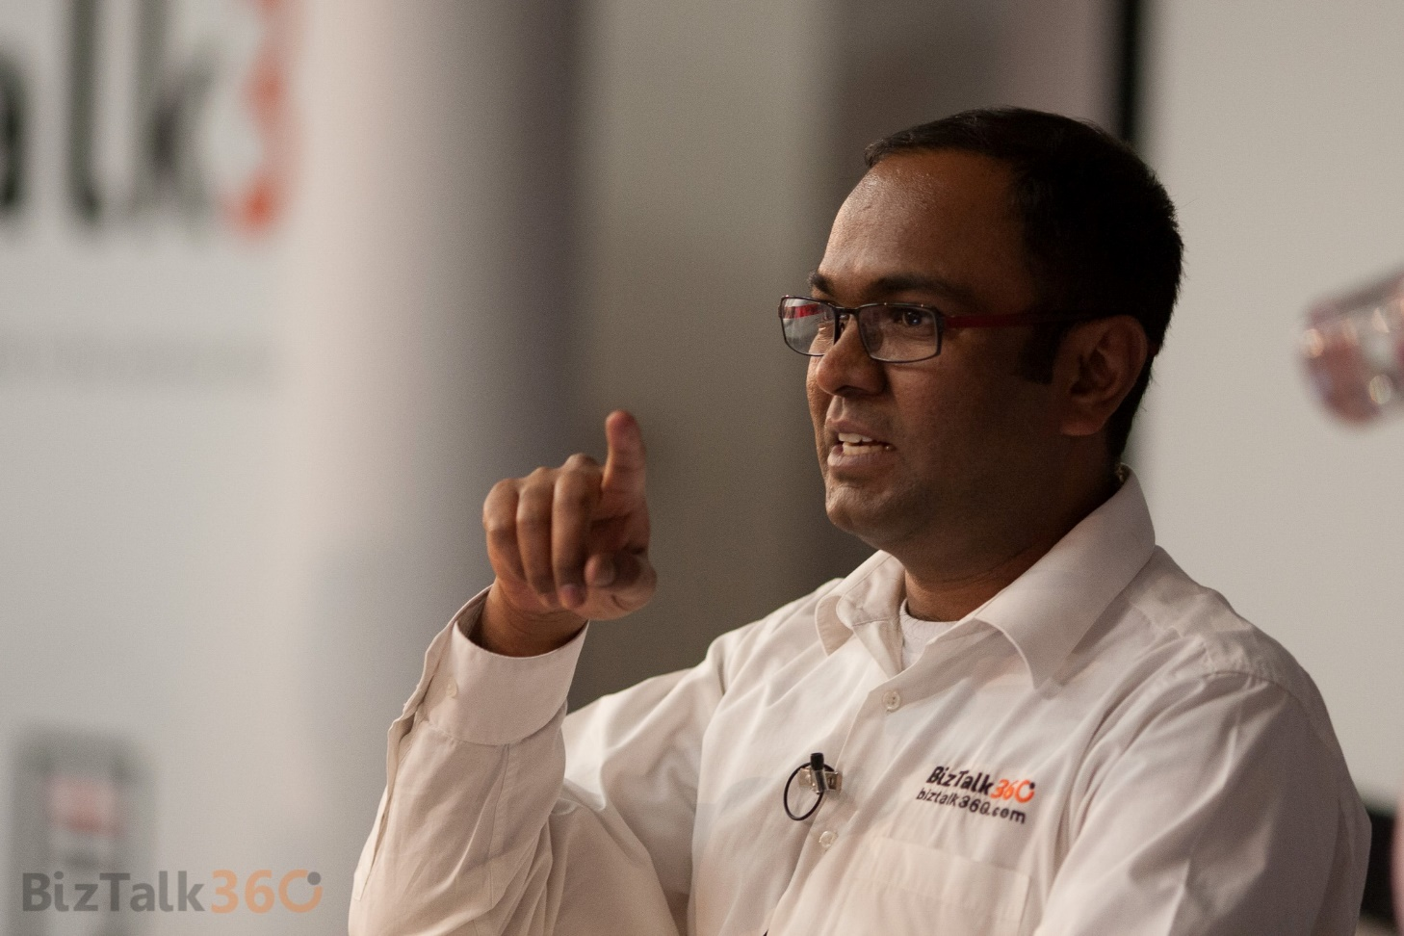
Saravana Kumar
Founder – BizTalk360
9-time Microsoft MVP for Integration
@saravanamv

Slide 3
INTEGRATE 2016 in numbers
380+ attendees from 22 countries representing 187 companies, 60+ live audience

Slide 4
Thank You
* Attendees
* Sponsors
* MVP’s
* Microsoft
* Our team

Slide 5
Agenda
http://bizta.lk/integrate-2016-agenda

Slide 6
Event Hashtag
#integrate2016

Slide 7
Our Goal with INTEGRATE

Slide 8
Integration has became more important and complex

Slide 9
Announcement
BizTalk Mapping Patter book
http://shop.biztalk360.com

Slide 10
Keynote
Jim Harrer

Slide 11
Let’s begin INTEGRATE 2016

