Slide 1

Sam Vanhoutte
CTO Codit, Integration MVP
Azure Service Fabric: notes from the field

Slide 2



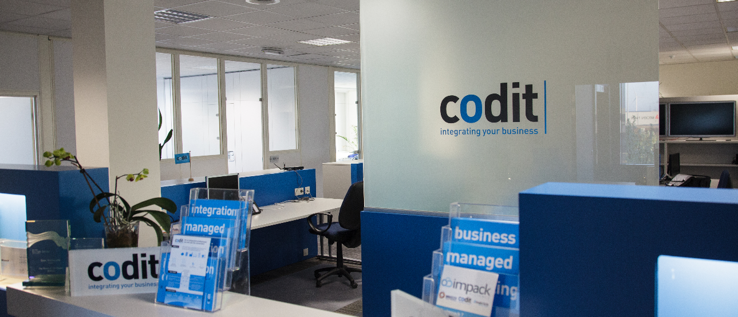




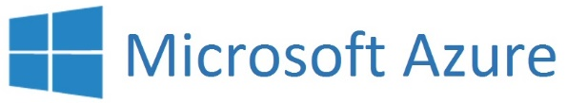
Hello world
2000 Belgium
2004 France
2013 Portugal
2016 Switzerland
2016 U.K.
+ 100 Active customers
Integration
International Focus
Azure
IoT
API mgmt
e-news + SoMe
Close collaboration with Microsoft
+70 employees
Focused on integration solutions
@SamVanhoutte
Integration MVP
CTO

Slide 3
Agenda
Introduction
Positioning
Architecture
Concepts
Scenarios

Slide 4
Services built with Service Fabric
Services built with Service Fabric
Skype for Business
Hybrid Ops
Azure Document DB
billions transactions/week
Intune
800k devices
Azure Core Infrastructure
thousands of machines
Event Hubs
20bn events/day
Bing Cortana
500m evals/sec
Azure SQL Database
1.4 million databases
Power BI
IoT Suite

Slide 5









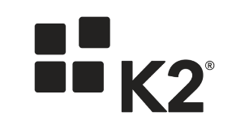



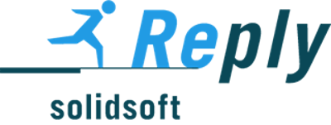


























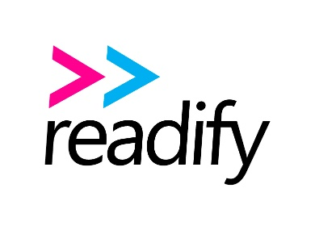












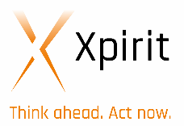










300+ Service Fabric Preview Customers

Slide 6
Positioning µ-services

Slide 7

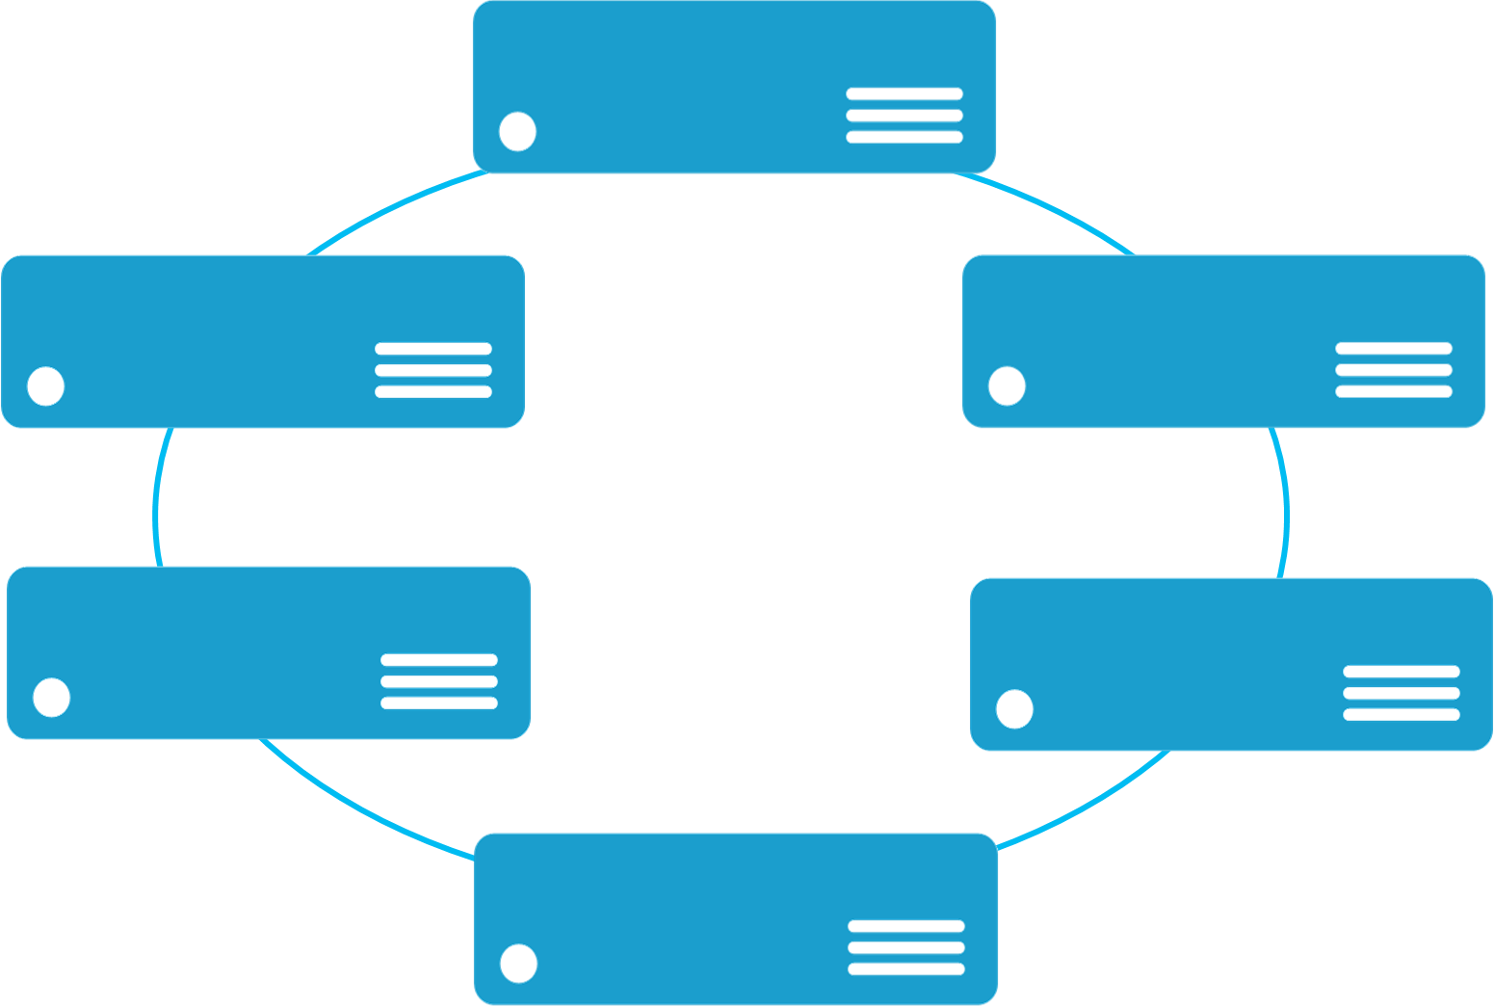

Monolithic application approach
Microservices application approach
A monolith app contains domain specific functionality and is normally divided by functional layers such as web, business and data
App 1
App 1
App 2
A microservice application separates functionality into separate smaller services.
Scales by cloning the app on multiple servers/VMs/Containers
Scales out by deploying each service independently creating instances of these services across servers/VMs/containers

Slide 8
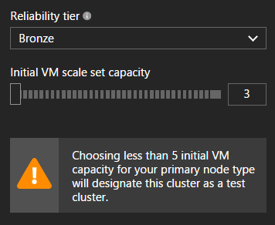
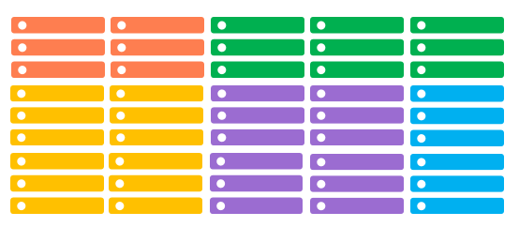
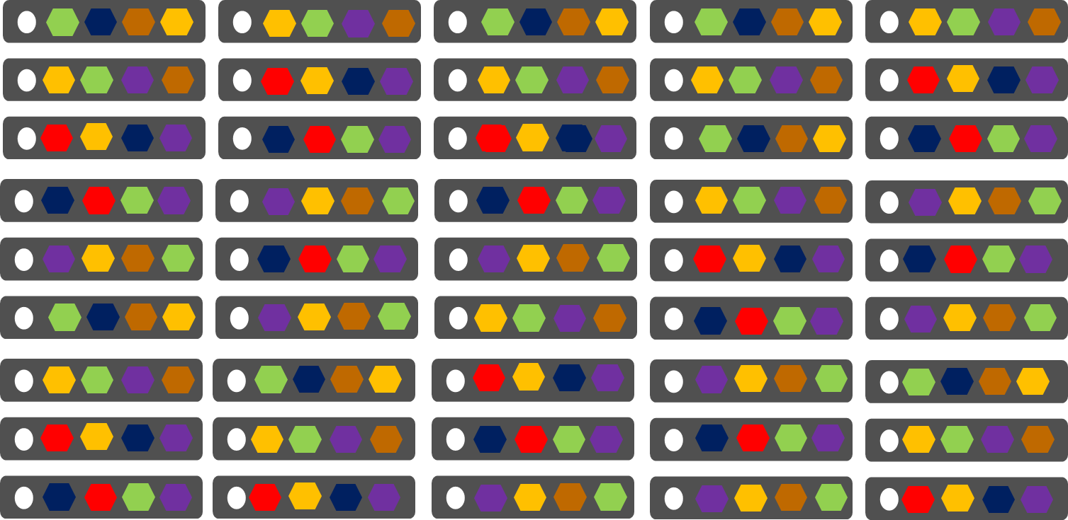
Cloud Services vs. Service Fabric
Node types !
Azure Cloud Services
(Web and Worker Roles)
Azure Service Fabric
(Stateless, stateful or Actor services)
  1 role instance per VM
  Uneven utilization
  Low density
  Slow deployment & upgrade (bound to VM)
  Slow scaling and failure recovery
  Limited fault tolerance
  Many microservices per VM
  Even Utilization (by default, customizable)
  High density (customizable)
  Fast deployment & upgrade
  Fast scaling of independent microservices
  Tunable fast fault tolerance

Slide 9
Architecture resilient against failure

Slide 10
Microsoft Azure Service Fabric
Develop once
deploy everywhere
A platform for reliable, hyperscale, microservice-based applications
Microservices
High Availability
Data Partitioning
Service Fabric
Health Monitoring
Container Orchestration & lifecycle management
Hybrid Operations
Self-healing
Simple programming models
High Density
Rolling Upgrades
Low Latency
Placement Constraints
Replication & Failover
Stateful services
Fast startup & shutdown
Load balancing
Hyper-Scale
Automated Rollback
Windows
Server
Linux
Windows
Server
Linux
Azure
Hosted Clouds
Windows
Server
Linux
Private Clouds

Slide 11
Service Fabric Microservices
App1
App2
App Type Packages
Service Fabric Cluster VMs

Slide 12
Handling Machine Failures
#FAIL
App1
App2
App Type Packages
Service Fabric Cluster VMs

Slide 13
Concepts µ-services

Slide 14
Programming models
Stateless
Stateful
State is external or non existing
Multi-instance (parallel execution)
Load balancing (singleton partition)
Activation & Background work
State is stored with the service
Reliable secondaries exist on other nodes
Ranged or named partitioning
Concurrent transactional state changes
Reliable collections
Activation & Background work
Guest executables
Services
State is external or non existing
Multi-instance (parallel execution)
Load balancing (singleton partition)
Simplified programming model
Single threaded execution
Turn based communication
[StatePersistence(StatePersistence.None)]
State is stored with the service
Reliable secondaries exist on other nodes
Ranged or named partitioning
Simplified programming model
Single threaded execution
Turn based communication
[StatePersistence(StatePersistence.Persisted)]
Actors

Slide 15
Programming models
Keep it simple to start
Stateless
Stateful
State is external or non existing
Multi-instance (parallel execution)
Load balancing (singleton partition)
Activation & Background work
Web API’s
Web Frontend
Protocol Gateway
Background Workers
State is stored with the service
Reliable secondaries exist on other nodes
Ranged or named partitioning
Concurrent transactional state changes
Reliable collections
Activation & Background work
Services, containing partitioned data
Stateful receivers (locking, cursors)
Simple queuing workers
Caching scenarios
Services
Often state still requires sync to external data source
State is external or non existing
Multi-instance (parallel execution)
Load balancing (singleton partition)
Simplified programming model
Single threaded execution
Turn based communication
[StatePersistence(StatePersistence.None)]
Short Lived actions
Fire & Forget
State is stored with the service
Reliable secondaries exist on other nodes
Ranged or named partitioning
Simplified programming model
Single threaded execution
Turn based communication
[StatePersistence(StatePersistence.Persisted)]
Longer running workflows
Related to functional entities:
Shopping Basket, Conversations, Users, Sensors
Actors

Slide 16
Service type
Services types are composed of code/config/data packages
  Code packages define an entry point (dll or exe)
  Config packages define service specific config information
  Data packages define static resources (eg. images)
Packages can be independently versioned
<ServiceManifest Name="QueueService" Version="1.0">
<ServiceTypes>
<StatefulServiceType ServiceTypeName="QueueServiceType" HasPersistedState="true" />
</ServiceTypes>
<CodePackage Name="Code" Version="1.0">
<EntryPoint>
<ExeHost>
<Program>ServiceHost.exe</Program>
</ExeHost>
</EntryPoint>
</CodePackage>
<ConfigPackage Name="Config" Version="1.0" />
<DataPackage Name="Data" Version="1.0" />
</ServiceManifest>
Service Type 1
Code
Config
Data

Slide 17
Application type
Declarative template for creating an application
Based on a set of service types
Used for packaging, deployment, and versioning
Application Type A
Service Type 1
Service Type 2
Service Type 3
Code
Config
Data
Code
Config
Data
Code
Config
Data

Slide 18
Service Partitioning
Services can be partitioned for scale-out.
You can choose your own partitioning scheme.
Service partitions are striped across machines in the cluster.
Replicas automatically scale out & in on cluster changes
Node 1
Node 2
Node 3
Node 4
Node 5
Node 6
S
P2
P1
S
S
S
S
P3
P4
S
S
S

Slide 19
Scenarios

Slide 20
Connected Building
Enable state machine behavior for buildings, rooms, devices
Scenario
  Physical events are ingested (Codit IoT field gateway)
  Event routing
    Events are routed to the right device Actor
    Related infrastructure actors can observe events from their devices
    (Meeting room 1 wants to get events from Motion sensor 01)
Stateful workflows (state machines)

Slide 21
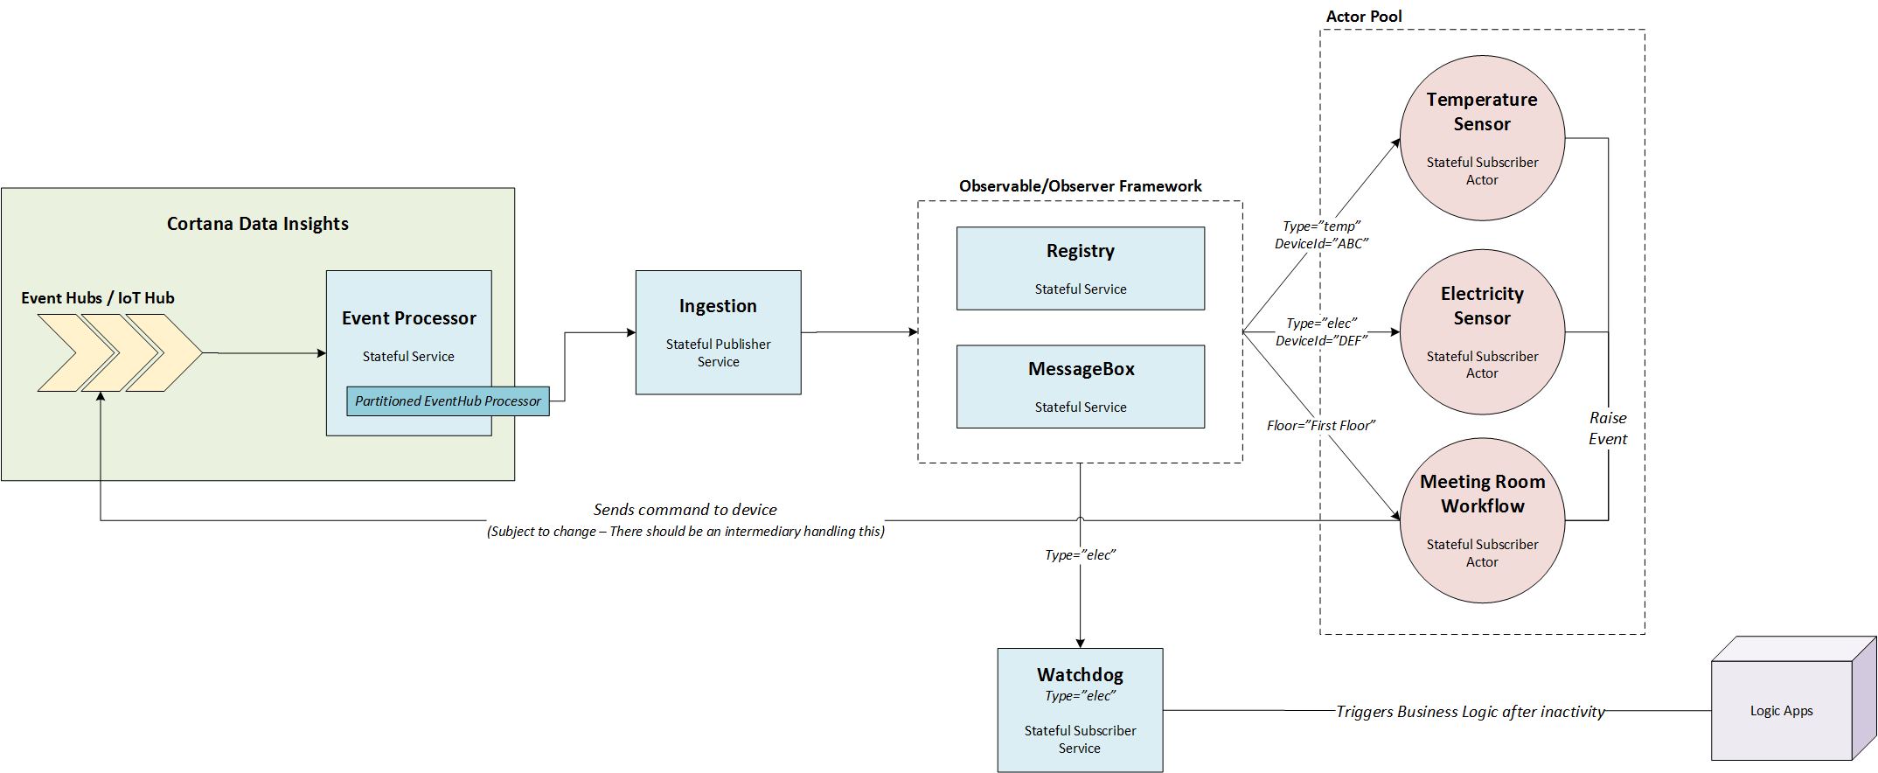
Connected building
Open Sourced Observer framework:
https://github.com/paolosalvatori/servicefabricobserver
Diagram: Tom Kerkhove

Slide 22
Talk2Fans – a startup for sport clubs
Social (few writes, lot’s of reads)
  Talkies per club
  Talkies per game
  Push notifications
Advertising
  Targetted advertising with telemetry
Reporting needs

Slide 23
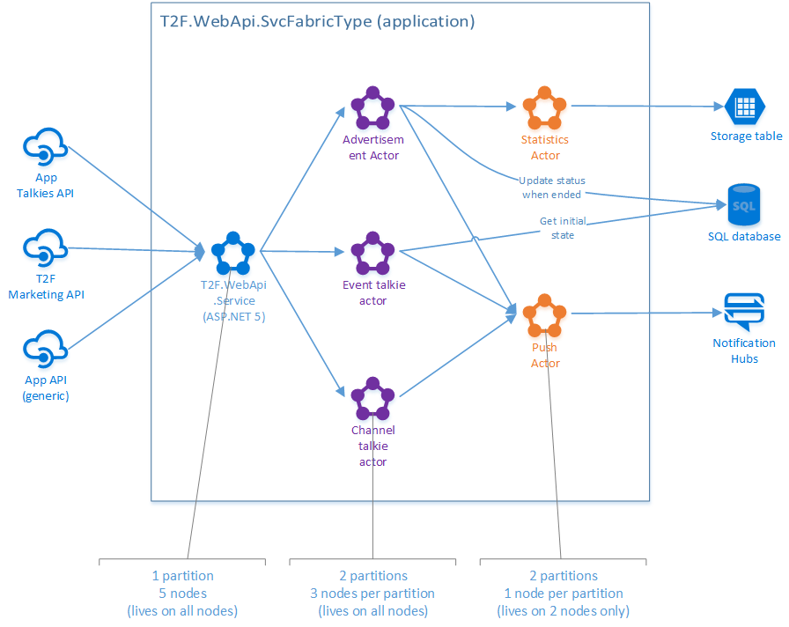
Talk2Fans – a startup for sport clubs
Diagram: Thomas Houtekier

Slide 24
City camp reservation systems
Registering kids for holiday-camps (sports, leisure, language…)
  Big peak of requests (ticketing system) on predefined timestamps
  Per camp, first X registered persons are allowed
Ticket dispenser service needed to distribute tickets to allow further registration.

Slide 25
City camp reservation system
Stateless svc (OWIN)
Stateful svc (ReliableQueue)
Stateful actors
Communication
Ticket dispenser
Registration process per user
Node 01
REST API
Latin
Music
Dev
Jim
Ann
Tom
Node 02
REST API
Sport
Music
Math
Tom
Ann
Node 03
REST API
Sport
Latin
Music
Jim
Josh
Node 04
REST API
Dev
Math
Sport
Ann
Josh
Jim
Node 05
REST API
Music
Dev
Math
Tom
Josh

Slide 26
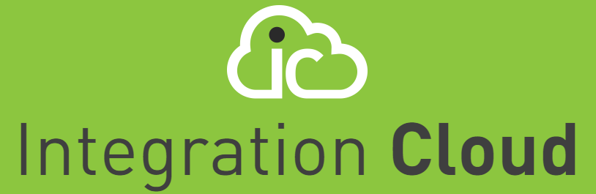
Integration Cloud
Started 6 years ago on Cloud Services. Challenges:
  Complex task & thread management
  Deployment and versioning
  Multi-tenancy
Migration to Service Fabric
  Reliable services for adapters
  Stateful actors for tracking logic
  High density / multi tenancy
  Side by side versioning
www.integrationcloud.eu

Slide 27
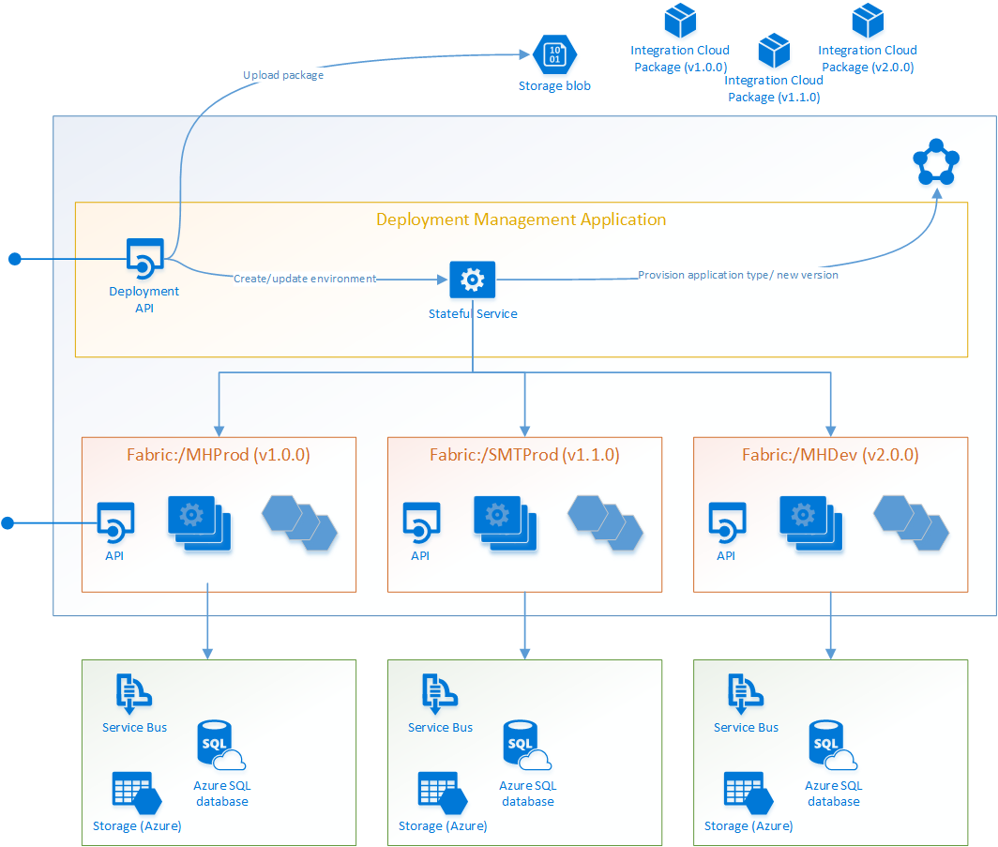
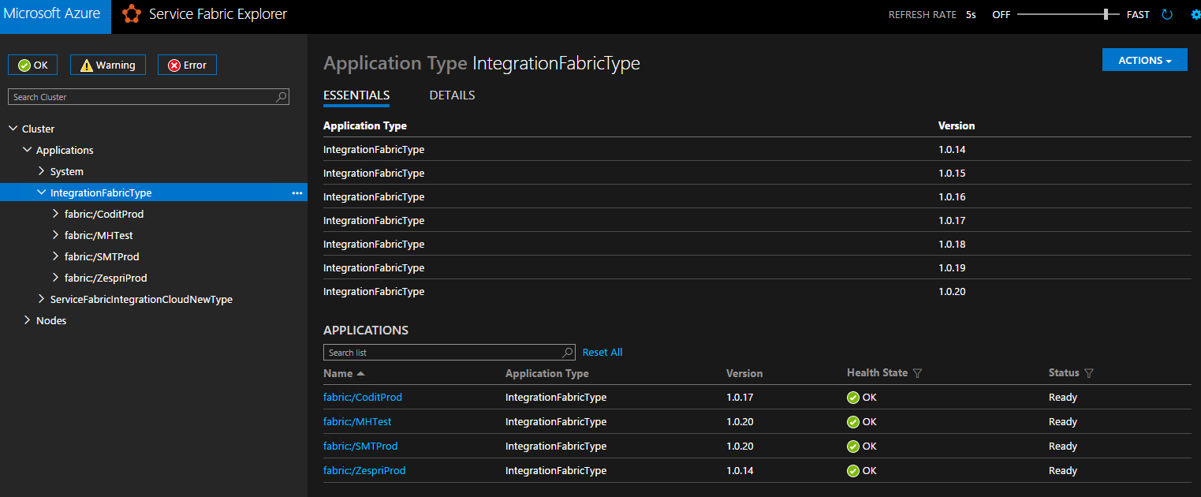
Integration Cloud – multi tenancy
Diagram: Wouter Seye

Slide 28






Thank you!
Keep in touch!
Call or mail us. Ask questions. Happy to help.
Stay tuned
LinkedIn
Twitter
blog
.codit.eu
codit.eu
Newsletter
Pay us
a visit

