Slide 1
Nick Hauenstein
Integration MVP
API Apps 101 for BizTalk Developers

Slide 2
Nick Hauenstein
twitter: @nickhauenstein
Principal Software Development Engineer
Microsoft Azure MVP
Visual Studio ALM Ranger

Slide 3
TOOLS VS FOOD
Cravings
+
Ingredients
Utensils

Slide 4
Priorities
Lunch
Integration
Cravings + Ingredients
Proven Recipes
Tools
Business Challenges + Constraints
Proven Patterns
Tools

Slide 5
Business Challenges + Constraints

Slide 6
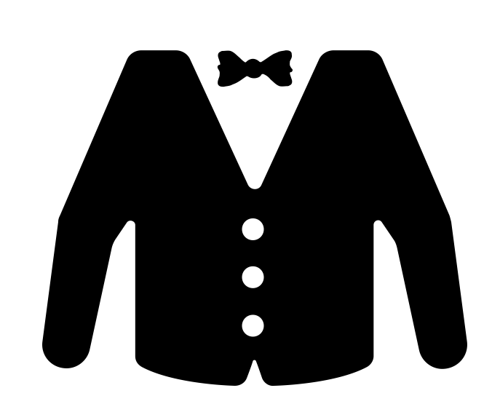
Imagine that we make custom bobbleheads

Slide 7
How It Works
Customer
Uploads 3D model of their face
Selects pre-built body from gallery
We
3D print their face
Attach it to the chosen body

Slide 8
What happens behind the scenes right now that we cannot escape?
QuickLearn Bobble Maker
http://bobbledemo.azurewebsites.net
<?xml...>
<?xml...>

Slide 9
Proven Patterns

Slide 10
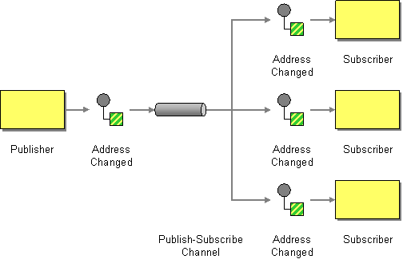
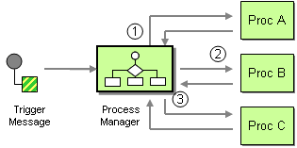
Sketching It Out
Likely at this point, we would sketch this out in terms of integration patterns…
Notes:
So maybe we add a publish/subscribe pattern in there, instead of directly calling the endpoint.
If we’re publishing a single message, we need to transform it, and potentially translate it to reach each destination system appropriately, and probably do the same thing on the way back. So we can do that, and if there is further processing needed we can do it in a pipes and filters style pattern.

Slide 11
Which Patterns?
Adapter
Pipes + Filters
Publish Subscribe
Relying on promotion of data from the content to routable properties
Process Manager + Content-based Correlation
Something that starts to look like sequential convoy?

Slide 12
Tools

Slide 13
So How Do I Build That with BizTalk Server?
Translation / Transformation / Adaptation?
All of these things happen within a BizTalk Port
Notes:
How do we typically approach these things with tools like BizTalk server?
We have established mappings built up in our brains based off of years of experience with the tool. If I want to do a process manager style pattern, I can get that mostly for free with orchestrations – which are inherently suited for the job.
I get publish/subscribe for free – even if I don’t want to do publish/subscribe. The entire messaging engine of BizTalk Server was built around that.
Within a BizTalk port, we see quite a few patterns at work as well.

Slide 14
You Can Use API Apps
As adapters
Similar to BizTalk Server adapters
Notes:
API apps within Logic apps can act like adapters, they can act like pipeline components, or like directly callable services.
Visually they look like orchestration shapes, and in a way provide a vehicle for similar functionality. We’ll investigate that in the demo.

Slide 15
You Could Also Use Logic Apps
As pipes in pipes/filters
Similar to pipelines
Notes:
Moving to the world of Logic Apps and API Apps, we don’t see those patterns go away. We have a lot of the same needs.
Logic Apps themselves can work well as process managers. I have the state (full inputs and outputs) of every single step within the flow – whether or not I want it. It’s an inference engine, so I get that for free.
I could build a Logic App that is essentially implementing a pipes/filters pattern like pipelines.

Slide 16
You Can Use API Apps
As filters in a pipes/filters pattern
Similar to pipeline components
Notes:
API apps within Logic apps can act like adapters, they can act like pipeline components, or like directly callable services.
Visually they look like orchestration shapes, and in a way provide a vehicle for similar functionality. We’ll investigate that in the demo.

Slide 17
So How Do I Build That with BizTalk Server?
Publish/Subscribe?
BizTalk gives that to us for free – whether or not we’ve asked for it
Notes:
How do we typically approach these things with tools like BizTalk server?
We have established mappings built up in our brains based off of years of experience with the tool. If I want to do a process manager style pattern, I can get that mostly for free with orchestrations – which are inherently suited for the job.
I get publish/subscribe for free – even if I don’t want to do publish/subscribe. The entire messaging engine of BizTalk Server was built around that.
Within a BizTalk port, we see quite a few patterns at work as well.

Slide 18
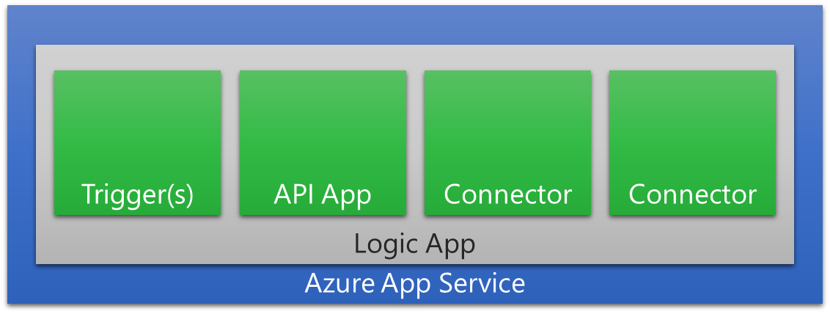
What About Publish/Subscribe For Logic Apps?
Notes:
So far we’ve only seen BizTalk Server giving us publish/subscribe. That said, we still have publish/subscribe over in Azure as well.

Slide 19
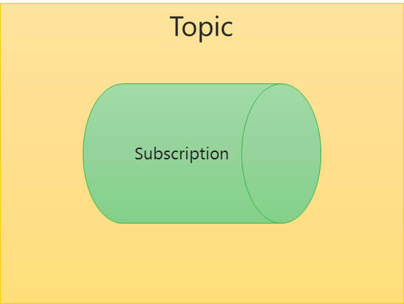
Use Azure Service Bus and Logic Apps Together
Notes:
Azure Service Bus gives us publish/subscribe, and you can imagine a Service Bus Topic as serving a similar purpose to that of the BizTalk MessageBox database.

Slide 20
So How Do I Build That with BizTalk Server?
Process Manager?
We’d have to use an orchestration to implement that
Notes:
How do we typically approach these things with tools like BizTalk server?
We have established mappings built up in our brains based off of years of experience with the tool. If I want to do a process manager style pattern, I can get that mostly for free with orchestrations – which are inherently suited for the job.
I get publish/subscribe for free – even if I don’t want to do publish/subscribe. The entire messaging engine of BizTalk Server was built around that.
Within a BizTalk port, we see quite a few patterns at work as well.

Slide 21
You Could Also Use Logic Apps
As process managers
Similar to orchestrations
I get message state for free – whether or not I ask for it
Notes:
Moving to the world of Logic Apps and API Apps, we don’t see those patterns go away. We have a lot of the same needs.
Logic Apps themselves can work well as process managers. I have the state (full inputs and outputs) of every single step within the flow – whether or not I want it. It’s an inference engine, so I get that for free.
I could build a Logic App that is essentially implementing a pipes/filters pattern like pipelines.

Slide 22
You Can Use API Apps
As directly callable service endpoints
May provide application implementation processing logic directly
Notes:
API apps within Logic apps can act like adapters, they can act like pipeline components, or like directly callable services.
Visually they look like orchestration shapes, and in a way provide a vehicle for similar functionality. We’ll investigate that in the demo.

Slide 23
BizTalk Server Architecture
Orchestration
Receive Port
Send Port
Adapter
Receive Location(s)
Adapter
Subscribe
Publish
Receive Pipeline
Send Pipeline
Map(s)
Publish
MessageBox (BizTalkMsgBoxDb)
Subscribe
Map(s)
Tracking BizTalkDTADb
Configuration BizTalkMgmtDb
Notes:
Really, it’s starting to look like BizTalk Server, but only because we’ve taken and applied many of the same patterns. Logic Apps doesn’t force us to use specific patterns or practices.
Azure and Logic Apps gives us a buffet, and we need to bring an appropriate appetite along with a purposeful and discriminating palate.

Slide 24
What if we did Logic Apps like this?
Operate
VETR
VETR
Notes:
In fact, if you build around that, you might have Logic Apps that start to look a lot like your BizTalk Server ports and orchestrations – with some Logic Apps performing adapter + pipeline-like functionality and then publishing to a topic, while other Logic Apps do the actual operations – potentially calling out to Azure functions in the process or custom APIs in the process.

Slide 25
Use Azure Service Bus and Logic Apps Together
Notes:
Azure Service Bus gives us publish/subscribe, and you can imagine a Service Bus Topic as serving a similar purpose to that of the BizTalk MessageBox database.

Slide 27
Demo
Live demo site is at http://bobbledemo.azurewebsites.net/

Slide 28
End to End Message Flow

Slide 29
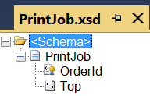
First Message

Slide 30
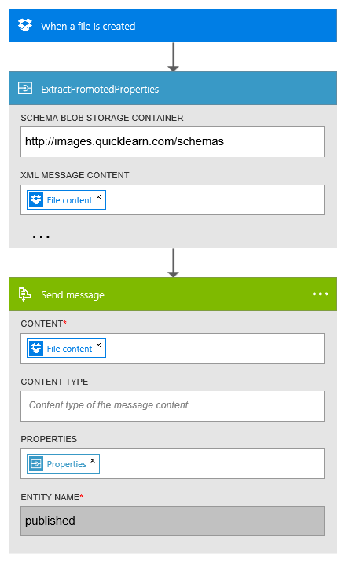
Logic App: XmlIn-FILE
Acts like BizTalk Port
Starts with “Adapter”
Uses custom API to “promote” properties
Schema store is blob storage container
Publishes to topic using OOTB connector

Slide 31
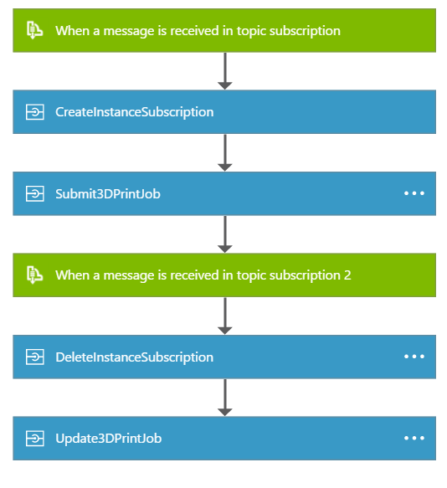
Logic App: PrintProcess
Acts like BizTalk Orchestration
OOTB connector subscribes to message type

Slide 32
Logic App: PrintProcess
Custom API App creates instance subscription for messages with same order id

Slide 33
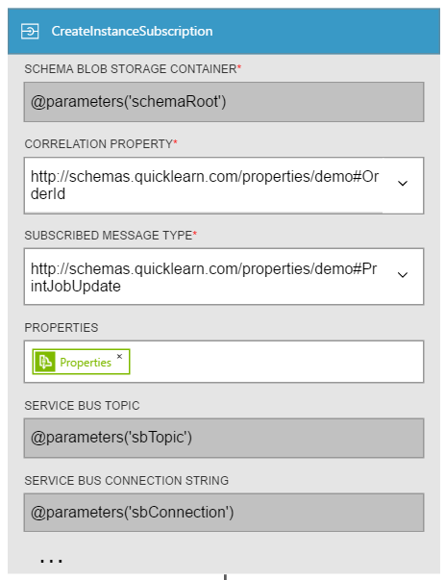

Slide 34
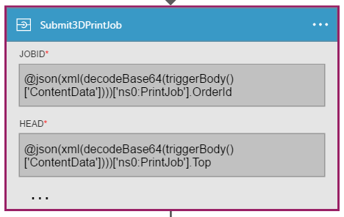
Logic App: PrintProcess
Custom API App receives first bit of information from the message
Though for more realism this would be the final step at the end (with all other information collected)

Slide 35
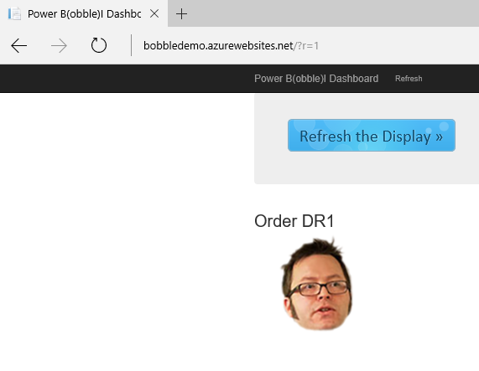

Slide 36
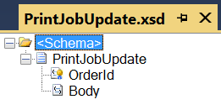
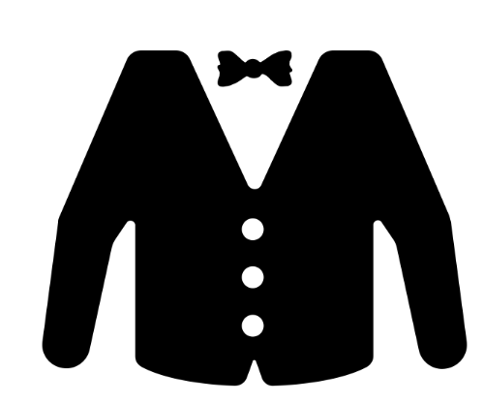
Second Message

Slide 37
Logic App: XmlIn-FILE
Since it was dropped in the same place, it is picked up once again by the Logic App acting like a BizTalk Server port

Slide 38
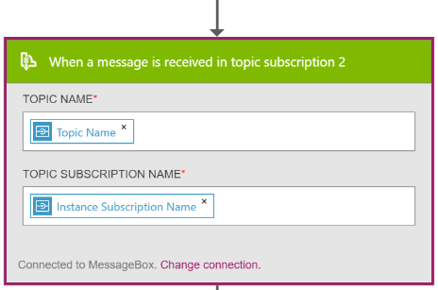
Logic App: PrintProcess
OOTB connector subscribes to previously created instance subscription

Slide 39
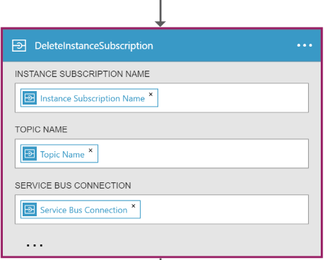
Logic App: PrintProcess
Custom API deletes the instance subscription previously created

Slide 40
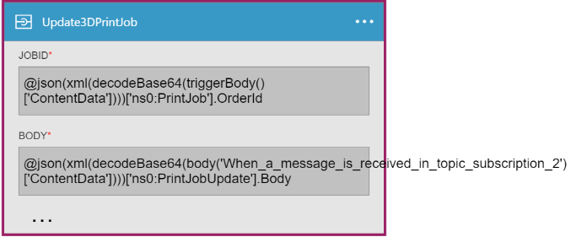
Logic App: PrintProcess
Custom API App receives second bit of information from the second message

Slide 41
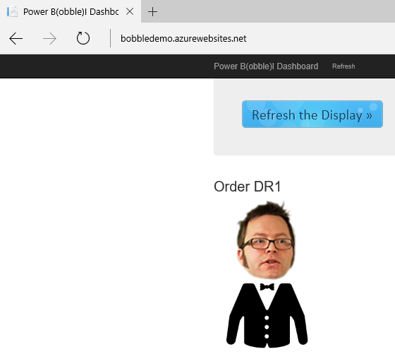

Slide 42
Call to Action

Slide 43
We Needed Custom Components
Custom API Apps
Service Bus “Instance Subscription” Management
Acts like an orchestration shape
Property Extraction / “Promotion”
Acts like a pipeline component

Slide 44
A Golden Opportunity
Build API Apps for the Azure marketplace
Adapters
e.g., Database systems, SaaS providers, industry-specific networks, etc…
Pipeline components
e.g., Encrypt, decrypt, compress, decompress, etc…
Patterns
e.g., Content-based correlation
Notes:
All of that being said, we’re at a point in time where there is a golden opportunity – an opportunity to fill the Azure Marketplace with adapters, pipeline components, and even APIs that provide complex pattern implementations that are otherwise missing.
However, it’s not going to be a 1:1 port of what was there before.

Slide 45
What Now?
There’s a high likelihood that we’ll need these things
http://bit.ly/CustomAdapters
http://bit.ly/CustomPipelineComponents
http://bit.ly/CustomFunctoids
If you build any of those, you should share it
http://bit.ly/ShareMyAPI
If you want to learn more, see our class offerings
http://www.quicklearn.com/

Slide 46
Get the Slides/Code
Includes everything you need to get started building custom APIs including a sample module from QuickLearn Training’s course: Cloud-based Integration Using Azure App Service

