Slide 1
Mikael Hakansson
Microsoft Azure MVP
Azure IoT Hub beyond Hello World

Slide 2
Agenda
Reference architecture
Getting started
Challenges
Demos

Slide 3
Marketing
Use cases
Customer Insights
Flexible Billing and Pricing
New Value Added Services
Benefits
Increased market share & growth
Increased upsell revenue
Increased service revenue
Improved customer satisfaction
Reduced cost of sales
Improved service contract renewal

Slide 4
Product Development
Use cases
Connected Product Usage Analysis
Connected Product Quality Analysis
Connected Software Management
Benefits
Shortened time to market
Improved product failure rate
Reduced number of recalls & warnings
Reduced product development costs
Improved product quality
Improved equipment up-time

Slide 5
Service and Support
Use cases
Monitoring and Diagnostics
Remote Service
Automated Service Execution
Warranty Cost Management
Benefits
Reduced service costs
Improve mean time to repair
Service contract renewal rate
Reduced warranty costs
Reduce service events
Improve first time fix rate
Improve SLA compliance

Slide 6
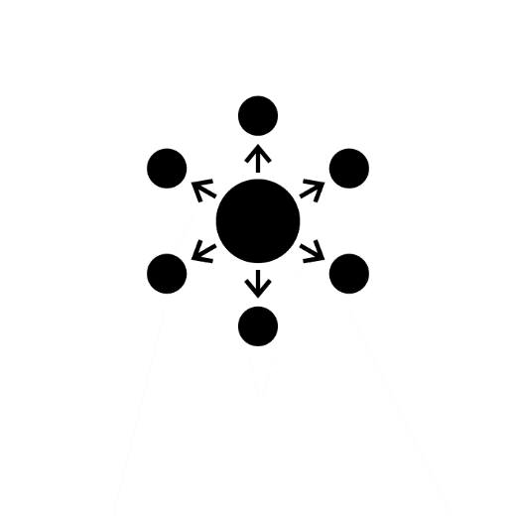
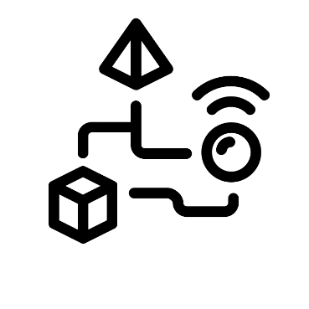
Information distribution
Data collection
Integration
Configuration data
Reference data
Collect on-demand
Commands
Telemetry data
Big data
Point-of-sale
Alerts
LOB systems
Workflows
Routing
Databases & Queues
Security & Scale

Slide 7
Reference architecture (High level)
DEVICE
TRANSPORT
SECURITY
RULES & ROUTING
REPORTS
SDK
DATA
DEVICE
GATEWAY
DEVICE MGMT
SDK
LOB

Slide 8
Reference architecture (High level)
AGENT
TRANSPORT
SECURITY
RULES & ROUTING
REPORTS
SDK
DATA
AGENT
GATEWAY
DEVICE MGMT
SDK
LOB
Device vendor
Cloud
vendor

Slide 9
Reference architecture (High level)
AGENT
TRANSPORT
SECURITY
RULES & ROUTING
REPORTS
SDK
DATA
AGENT
GATEWAY
DEVICE MGMT
SDK
LOB

Slide 10
Device Vendor
Cloud Vendor

Slide 11
Reference architecture – Cloud vendor
AGENT
TRANSPORT
SECURITY
RULES & ROUTING
REPORTS
SDK
DATA
AGENT
GATEWAY
DEVICE MGMT
SDK
LOB

Slide 12
Reference architecture – Device vendor
AGENT
TRANSPORT
SECURITY
RULES & ROUTING
REPORTS
SDK
DATA
AGENT
GATEWAY
DEVICE MGMT
SDK
LOB

Slide 13
How to build and manage device applications?

Slide 14
Reference architecture – AZURE IoT
AGENT
Azure IoT Hub
Stream Analytics
Power BI
SDK
DATA
AGENT
GATEWAY
SDK
LOB
Azure IoT Suite

Slide 15
Develop device applications using node.js and C/C++

Slide 16
Challenges?

Slide 17
Onboarding new devices
SAS Token

Slide 18
Onboarding new devices
1. Register
3. Sign in
2. SAS Token

Slide 19
Onboarding new devices
2. Register
1. Configure
4. Sign in
Register
3. SAS Token

Slide 20
Manage updates
CORE
SDK
OTHER

Slide 21
Manage updates
Challenge
node.js
C# / Java
C / C++

Slide 22
DevOps vs Device developer
“We (DevOps) require the hardware to support our software.”
“Device developers adapt their software to support their hardware.”

Slide 23
00101001
00101001
00101001
00101001
1024 Kb Flash memory
main()
AGENT
SDK

Slide 24
00101001
00101001
00101001
00101001
1024 Kb Flash memory
main()
BOOTLOADER
AGENT
SDK

Slide 25
Manage device applications using node.js and C/C++

Slide 26
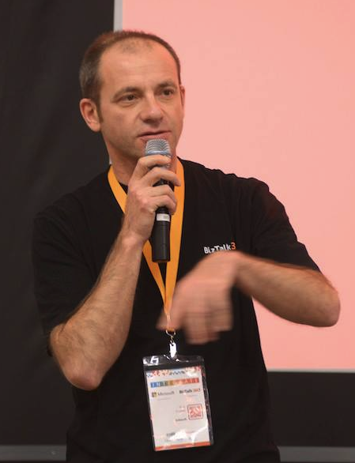
Face recognition

Slide 27
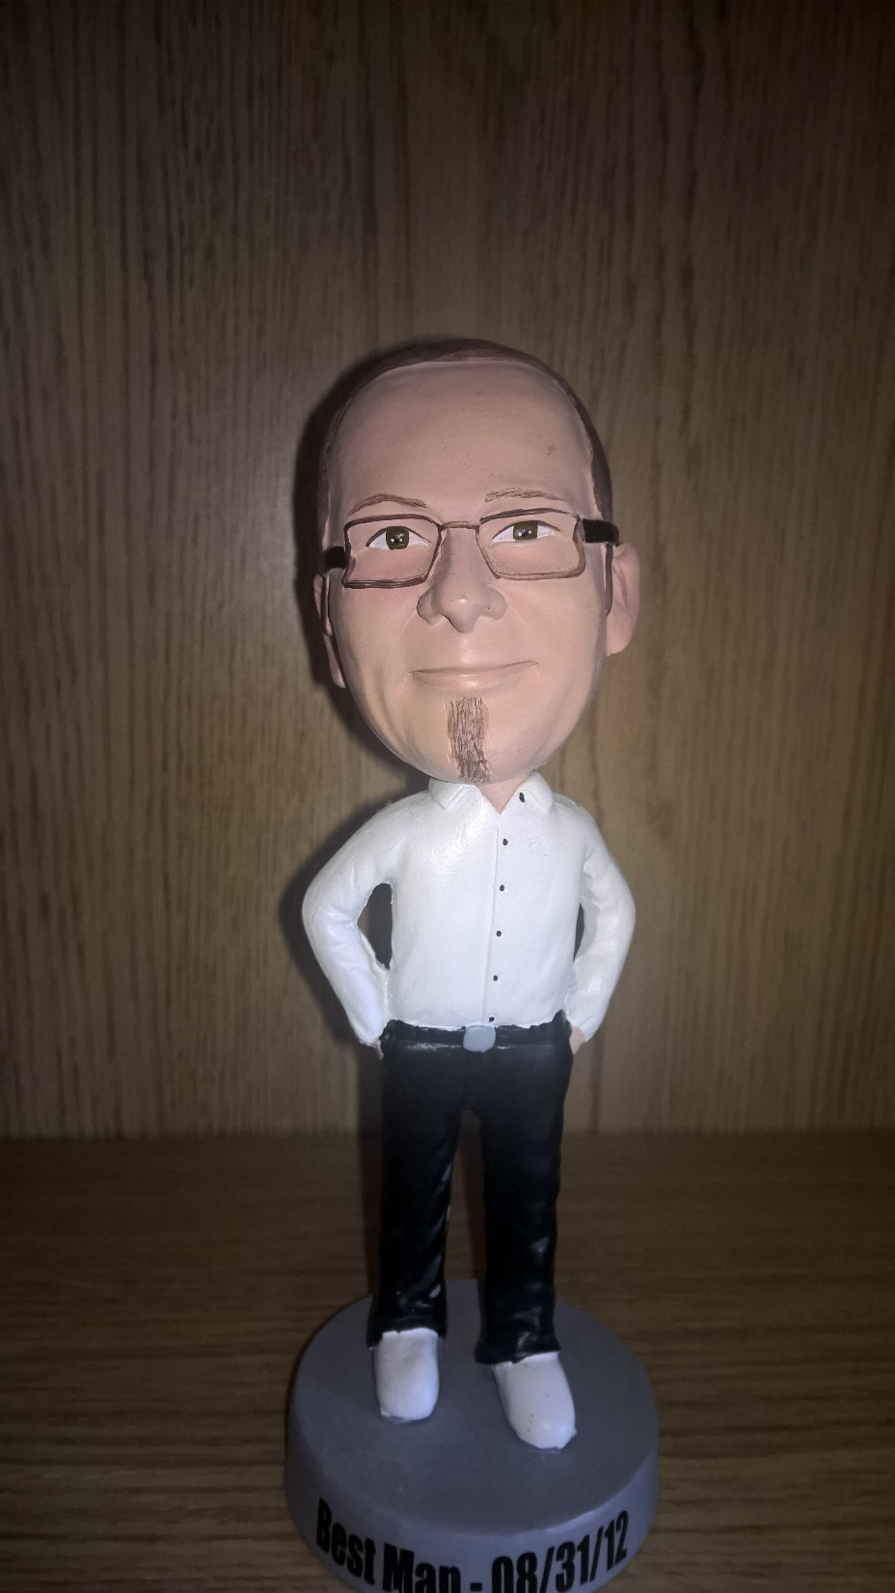

Slide 28
Special thanks to Erik Olieman (NXP)
Sign up for free at microServiceBus.com
Mikael Håkansson
Twitter: @wmmihaa
Github: wmmihaa

