Slide 1
Jon Fancey
Principal Program Manager, Microsoft
BizTalk 2016 Server: What’s new

Slide 2
Who am I?

Slide 3
Where are we?
2016 is the 10th release of BizTalk Server
16 years of leading the industry
Released CTP1 end of March
CTP2 is coming in summer
Focus
HA improvements
Platform refresh
Addressing customer asks and painpoints
Cloud connectivity

Slide 4
What’s new for CTP1
SQL Server 2016 AlwaysOn Support
Provides supported multi-node BizTalk deployment in Azure
Modern, consistent HA/DR capabilities
No more log shipping or active/passive clustering as HA solution
Platform Refresh
SQL 2016
Windows 2016
Office 2016
Visual Studio 2015

Slide 5
Customer-driven Improvements
SHA2 Support
SAP NcO Support
Shared Access Signature Support for Service Bus
basicHttpRelay, netTcpRelay, basicHttp, webHttp
Admin Console
Seach/Filter on artifact name
Change settings for multiple hosts
Suspended messages - Multi-select on “Save To
File”
Mapping
Resizable window for schema selection dialog
Map-level config for xslCompiledTransform vs
xslTransform
Ordered Delivery on Dynamic Send Ports
HL7 Accelerator
Proactive MLLP adapter connection
Binding import/export improvements
Granular party-level for selected parties
Include/exclude tracking settings
Symmetric CLI commands
Improved SFTP adapter
Greater compatibility – now using WinSCP
SYST support not enforced
Better trace and error info
new ciphers – DES, Blowfish, ArcFour
File adapter – overwrite temp files on retry
Batching orchestration performance improvements
Admin console and engine perf improvements

Slide 6
What’s new for CTP2 and RTM
BizTalk Logic Apps Adapter
Easily consume Logic Apps and > 30 connectors
Logic Apps BizTalk Connector and actions
Easily connect to and consume BizTalk functionality
Seamless integration from Logic Apps to BizTalk
Repaint
Modern, consistent look and feel

Slide 7
BizTalk to Logic Apps
SalesForce
4. Create in SalesForce
5. Reply with customer ID
Logic App
2. Store order
Orders Database
BizTalk Server 2016
6. Create
Customer
3. Look up
customer
Order
1. Receive a new order

Slide 8
Demo
BizTalk-initiated processing

Slide 9
Logic Apps to BizTalk
Trigger
Sales
Force
Logic App
Account Changed?
Database
BizTalk Server 2016
Update Account

Slide 10
Demo
Logic App-initiated processing

Slide 11
New Possibilities
Patterns
Solicit/response / request/response / Fire-forget
New capabilities added
Polling http endpoints
Run on schedule
Consume BizTalk capabilities
Call into and augment existing BizTalk processes
Use BizTalk capabilities e.g. Rules

Slide 12
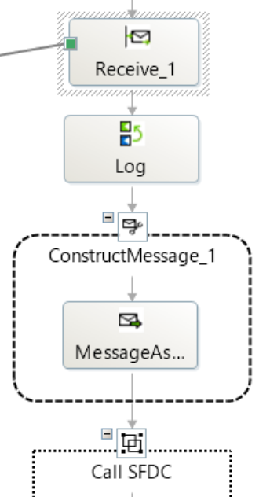
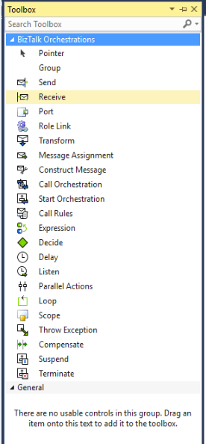
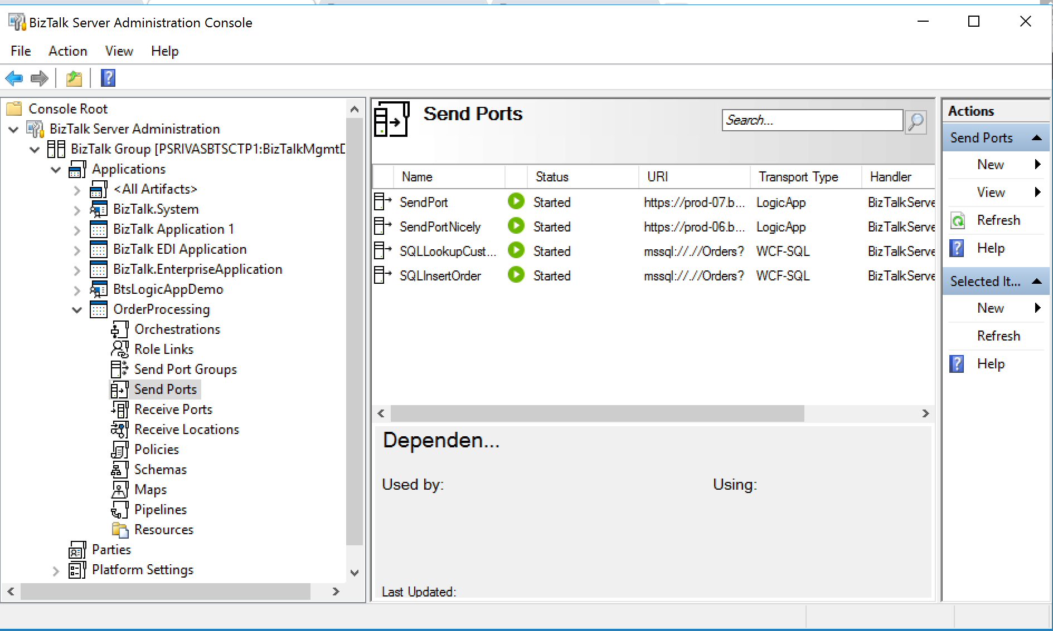
Repaint
Updating BizTalk UI elements
Consistent modern Win10 look and feel
Across all components

Slide 13
When
TAP
RTM
Q4
CTP2
Summer
CTP1
March 30

Slide 14
Call to Action
Download CTP1 – try it out
Talk to us about TAP participation
Direct PG access, go to production license
Give us Feedback
BizTalkPreRelease@microsoft.com

Slide 15
Reach Out / Reach In
@logicappsio
Logic Apps Blog | http://aka.ms/logicappsblog
Logic App User Voice | http://feedback.azure.com/forums/287593-logic-apps
Logic Apps Live Webcast | http://aka.ms/logicappslive
BizTalk Blog | https://blogs.msdn.microsoft.com/biztalk_server_team_blog
Integration Advisors | (sign-up) http://aka.ms/azureadvisors
Monthly Newsletter | (sign-up) mail to: biztalkintegration@microsoft.com

Slide 16
Thank you
Notes:
Dark gray background.

Slide 17
Notes:
Dark gray background.

Slide 18
BizTalk Server
Jon Fancey
Principal Program Manager

