Slide 1
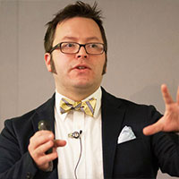

Dan Rosanova
Principal Program Manager, Microsoft
A Powerful, Scalable, Service Bus in the Cloud

Slide 2
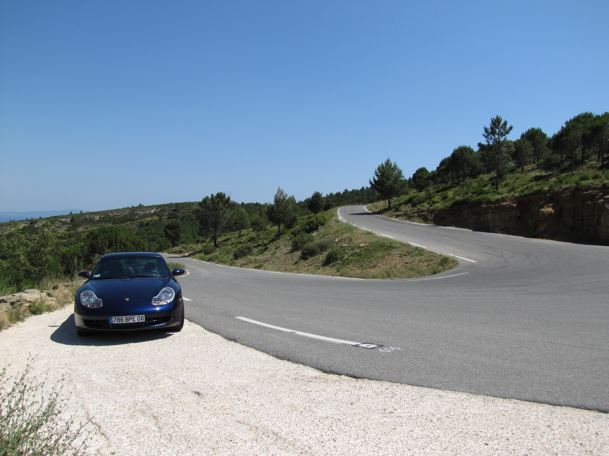
My personal journey through messaging from BizTalk to Azure

Slide 3
How I Learned to Stop Worrying and Love the Cloud

Slide 4

A quick story about my journey

Slide 5
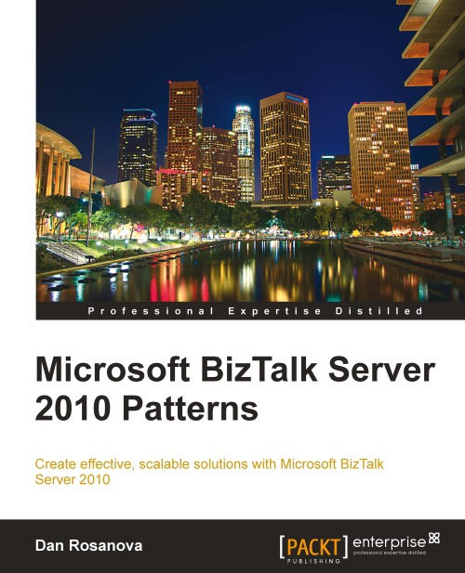
A quick story about my journey

Slide 7
My journey
I loved BizTalk because I knew BizTalk
Because I understood BizTalk
Because I could look at any problem and know how I could solve it with BizTalk
Or know when not to try… eventually

Slide 8
I was the Johnny Appleseed of BizTalk

Slide 9

But I have to reflect on my past
On my ideas
On my work and architectural notions

Slide 10
I got some things right
I got some things wrong
I tried to keep some things in mind

Slide 11

Embrace Simplicity:
Reduce things to their most base form

Slide 12
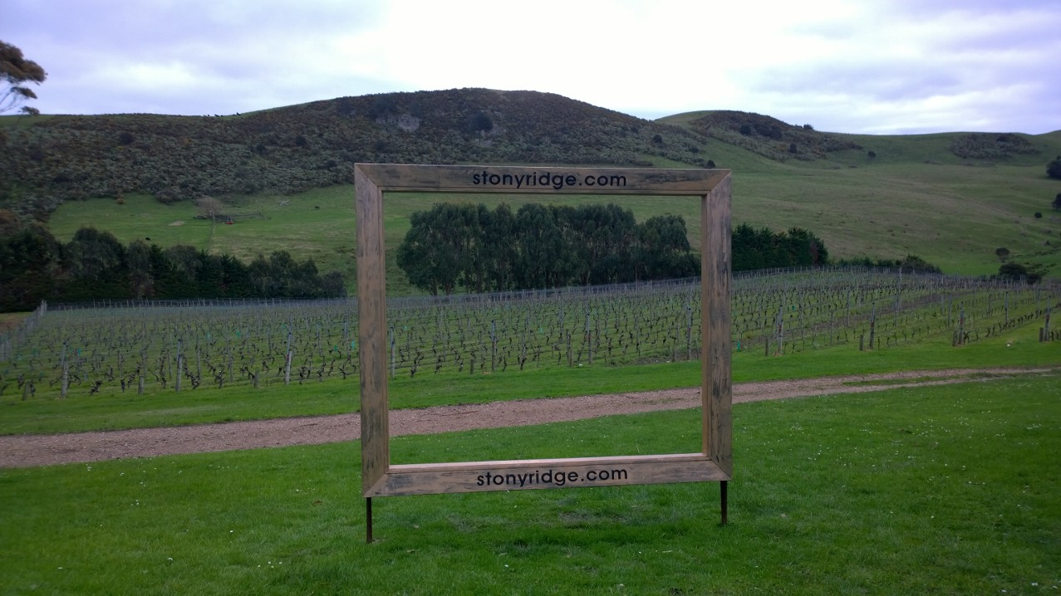
Frame issues clearly

Slide 13

Be Lean and relentless

Slide 14

Don’t be afraid to try new things

Slide 15
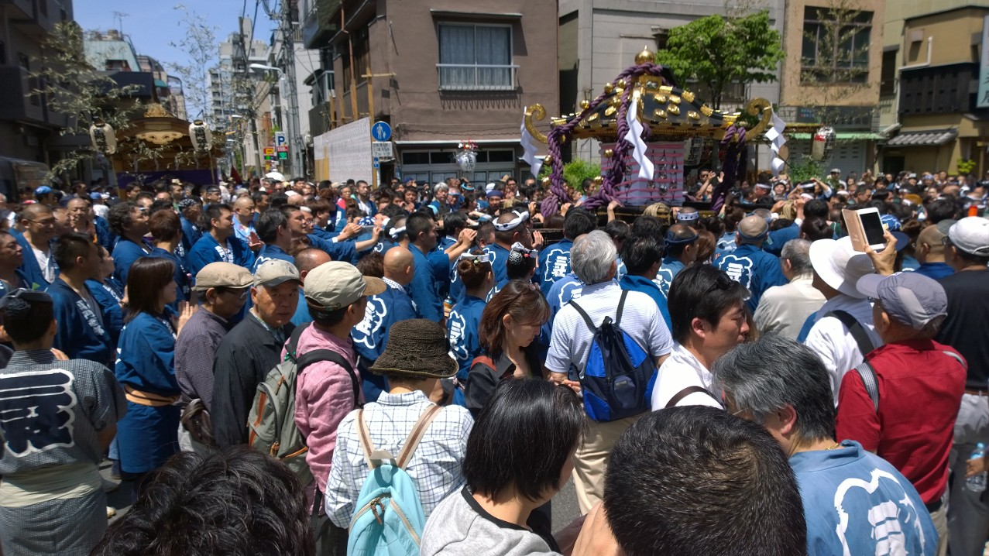
Respect people and diversity

Slide 16

What I got wrong about messaging: 1
Centralized schemas - seemed like a good idea…
So did centralized economy
Notes:
The Lord of the Rings Schema: One Schema to Rule them all

Slide 17
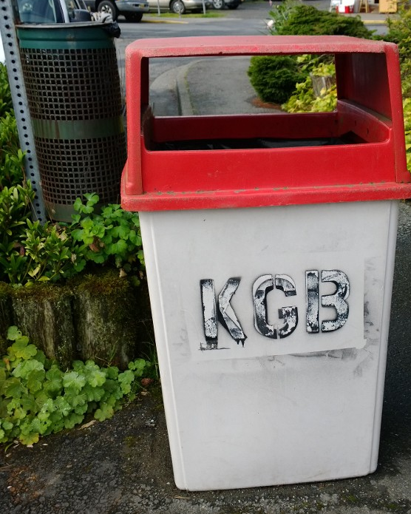
What I got wrong about messaging: 2
Always mapping at the port level
BizTalk didn’t give me an easy way to not do this
Notes:
The Lord of the Rings Schema: One Schema to Rule them all

Slide 18
What I got wrong about messaging: 3
Compensating for bad LOB design by doing more work in the middleware
This made initial progress faster, but only masked fundamental problems
Notes:
The Lord of the Rings Schema: One Schema to Rule them all

Slide 19
Why was this wrong?
Too much overhead
This invites the worst behaviors of large organizations: bodies, committees, etc.
The middleware ended up doing ALL of the work…
By being awesome and agile we can do a lot, but we're fundamentally doing it wrong.

Slide 20
Smart endpoints and dumb pipes
Martin Fowler on Microservices

Slide 21
Microservices != ESB

Slide 22
My pitfall in BizTalk also had technical aspects
Although BizTalk is truly distributed, the heavy use of DTC makes it all dependent on a single point of centralization
The Message Box

Slide 23

This is the limit of scale and I never got past it.
It may be possible…

Slide 24
What I got most wrong about messaging
I often left behind solutions that were difficult for the people running them to grow, change, maintain with the staff they had available
Advanced type loading
Too many sources and destinations for data
Too many paths into and out of a solution

Slide 25
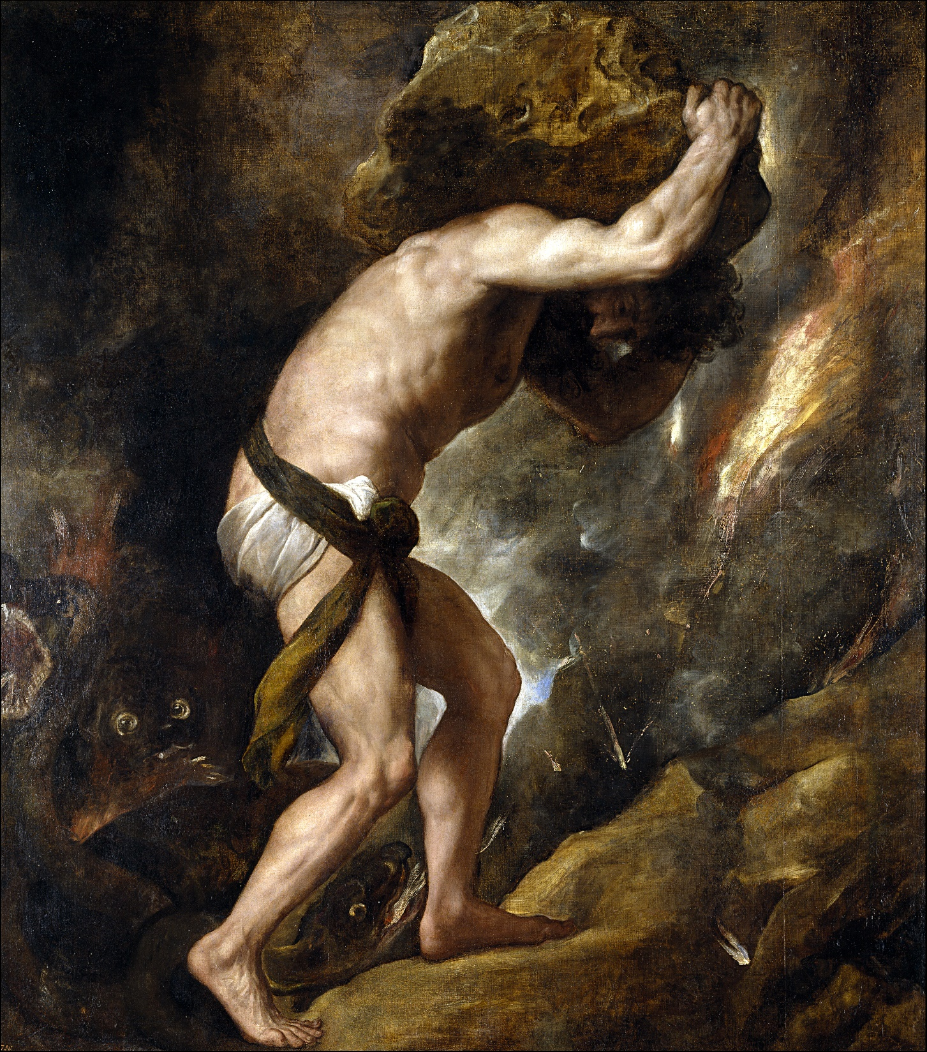
Ultimately…
Sisyphus (/ˈsɪsᵻfəs/;^{[2]} Greek: Σίσυφος, Sísuphos) was the king of Ephyra (now known as Corinth). He was punished for his self-aggrandizing craftiness and deceitfulness by being forced to roll an immense boulder up a hill, only to watch it roll back down, repeating this action for eternity.

Slide 26
What I got right!
Separation of concerns
Compartmentalization of logic
Minimization of lateral dependencies
Staying between the lines (avoid inline code -> Expression shape)
Small orchestrations
MSI Deployment & CI
Shameless plug for my book (if you do BizTalk, read it)

Slide 27
Brief Pause…
For dramatic effect

Slide 28
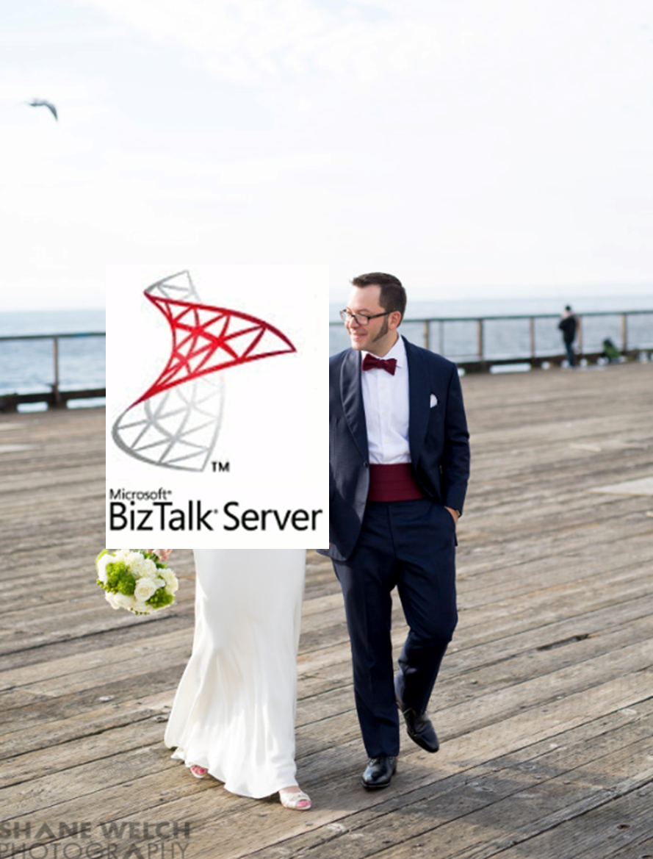
Why I love BizTalk Server
I made a small fortune off it doing something that today is an ARM template…
It's a great toolkit and is mature / stable
It can do most of what you want / need
It did XML right
It was superior to its competitors in every way

Slide 29
Why I love Azure even more
Who here uses BizTalk Server? Raise your hands.
Who uses Messaging in BizTalk? Keep your hand up.
Who uses Mapping in BizTalk?
Who Orchestration in BizTalk?
Who uses pipelines? Flat file pipelines?
Who uses EDI
Who uses the Rules Engine in BizTalk?
Who uses BAM?
You all pay for all of these features.

Slide 30
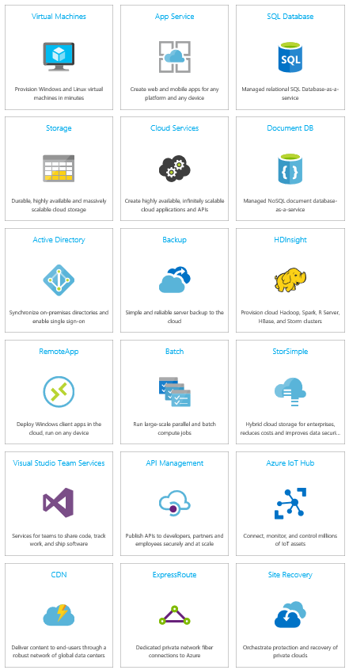
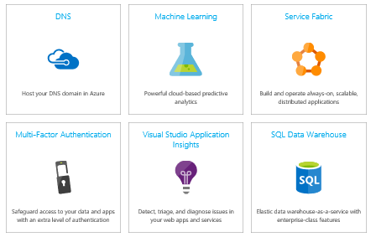
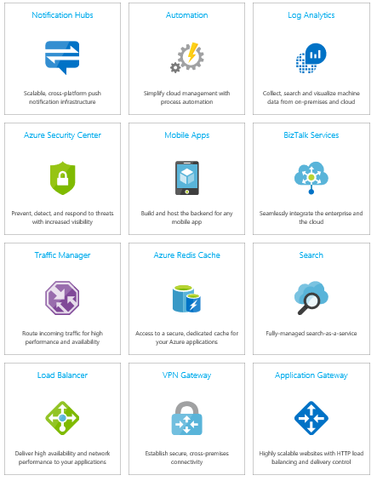
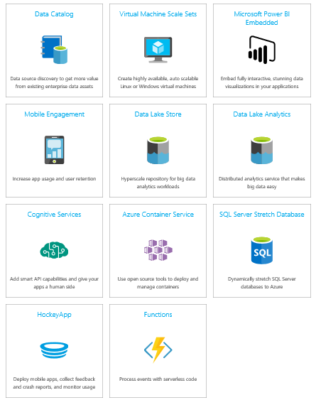
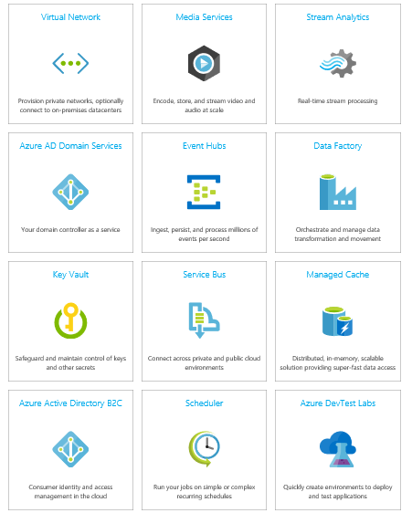
Why I love Azure even more

Slide 31
How cloud is different
  On-Premises
  IaaS
  PaaS
  SaaS
Applications
Data
Users
Middleware
Operating System
Virtualization
Hardware
Networking
Physical Security
Customer Responsibility
Microsoft Responsibility

Slide 32

Azure will still let you do things you shouldn’t

Slide 33
The cloud is fundamentally changing the way we
Discover and purchase software
Deploy solutions
Integrate multiple vendors products together

Slide 34
The way we used to do things…
Software procurement
Hardware procurement
Hardware installation
Software installation
Software configuration
Solution development
Solution deployment

Slide 35
What we’ve been up to…

Slide 36
Azure Messaging
>350 Billion
Message operations on
Azure Service Bus
Messaging (Standard)
per month
2 Million
Message Queues and
Topics in Production
>300 TB
Daily Data Volume
1.5 GBps
Ingress on a single small cluster
50ms
Average Event Hubs send latency
4,494,047
Requests per second to Azure Messaging
>60,000
Daily Active Service Bus Namespaces
2.75 Trillion
Events received every month with Event Hubs
Notes:
There are many different numbers you can pull in here from the all up “quotable statement list” maintained by PR which can be found here:
https://microsoft.sharepoint.com/teams/WAG/PM/Shared Documents/roadmap (in the Quotable Statements document).

Slide 37
We have broken and stayed above 100 billion ingress events / day
One hundred BILLION events / day
2.7182T Incoming Requests last week
4,494,047 / second
99.9984% Success Rate
44.5814M Internal Server Errors

Slide 38
We had a 99.9984% Success Rate
And we still had 44 million errors
There is no 100% at scale
Deal with it
STOP

Slide 39
Service Bus Premium Messaging
Built on resource isolation
Delivers the performance consistency enterprise customers have come to expect
  This is not about speed, it’s about predictability
  Predictable performance
  Predictable pricing
That said we all love to go fast: ~3000 msgs/s per MU
You can purchase 4 Messaging Units per namespace
Nearing GA

Slide 40
Let’s not repeat the mistakes of the past
Be realistic of what a single “anything” can and will do for you
Remember CAP Theorem

Slide 41
CAP Theorem
It is impossible for a distributed computer system to simultaneously provide all three of the following guarantees:
Consistency (all nodes see the same data at the same time)
Availability (every request receives a response about whether it succeeded or failed)
Partition tolerance (the system continues to operate despite arbitrary partitioning due to network failures)
https://en.wikipedia.org/wiki/CAP_theorem

Slide 42


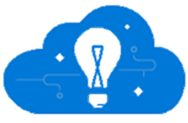

Azure Architecture for Processing Events
Event producers
Collection
Ingestor (broker)
Transformation
Long-term storage
Presentation and action
Stream Analytics
Service bus
PowerBI Dashboards
Applications
Event hubs
Azure DBs
Legacy IOT
(custom protocols)
Stream
processing
Search and query
Cloud gateways
(web APIs)
Azure storage
Devices
HDInsight
Storm
HDInsight
Cortana Analytics
IP-capable devices
(Windows/Linux)
Azure Data Lake
Low-power devices (RTOS)
Field
gateways
Take action

Slide 43
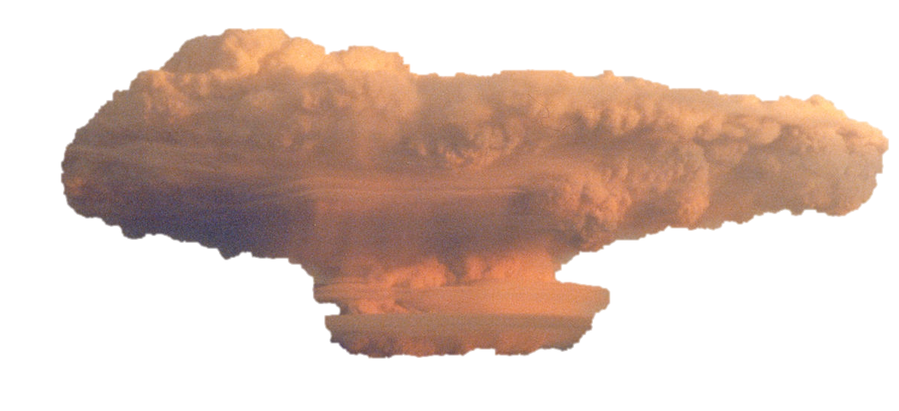
Event Hubs Native Java Clients
We wrote our own on top of Proton-J
https://github.com/Azure/azure-event-hubs
Works great with Docker
And with ACS and Docker Swarm

Slide 44
Announcing Azure Event Hubs Dedicated Capacity

Slide 45
Single tenant model for large scale customers
Same great service as Event Hubs
Totally dedicated resources
Limits and constraints relaxed or removed
  1MB messages
  No ingress and egress count limits
No per usage or per hour charges: fixed monthly pricing model
3 Month committed purchase

Slide 46

Bringing it all together

Slide 47
Microsoft is changing
We’re enabling you to do more
In less time
With less upfront cost
And still helping you work with the assets you already have today

Slide 48
Want to try something fun?
Try this out:
  1000s of events per second data
  A 5 min tumbling window showing values outside of a determined range
  Send to a queue
  Take action in a Logic App
Seriously – give it a try

Slide 49
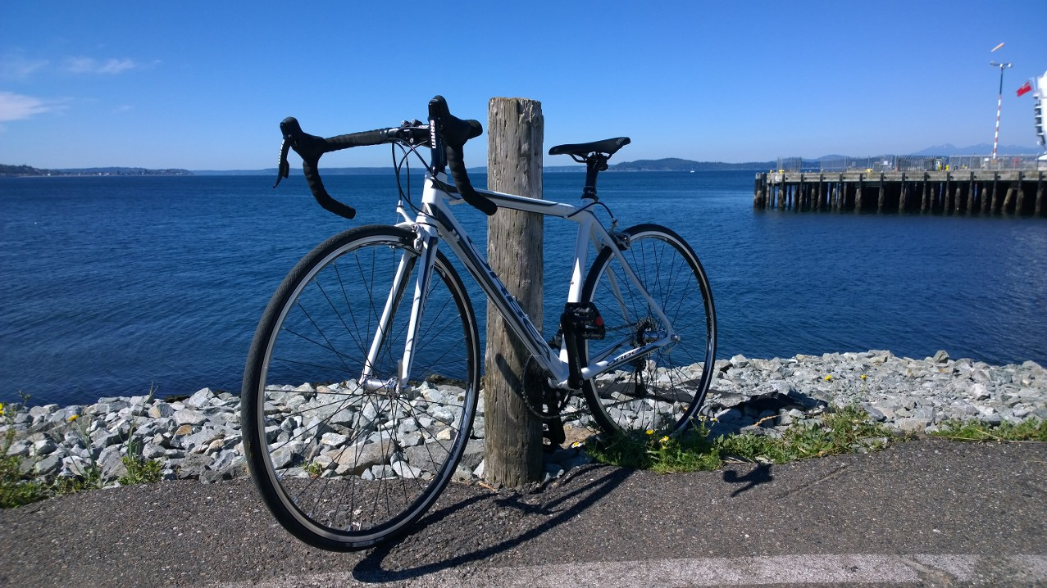
Where will your journey take you?

Slide 50

Thank you London
http://www.shanewelch.com/

