Slide 1

INTEGRATE 2014
Hybrid Connectivity Options
Michael Stephenson
Microsoft Integration MVP

Slide 2
ATTENTION: PLEASE READ
Photography and copyright infringement.
Due to copyright laws, please refrain from searching for photography online and utilizing them in your presentations. Using imagery from movies, television, music
and pop-culture is illegal, unless purchased from a stock photography site or given expressed written consent from the owner. If you have any questions regarding your imagery please contact Media Acquisitions Inquiries: mediaacq@microsoft.com.
At INTEGRATE, the Presentations and Content Recording teams will pull any session
deck or recording with questionable imagery and the speaker will be contacted
for resolution. If additional costs are incurred in editing (before or after the
session has been delivered) an I/O Code will be requested. The PPT deck and
Recording will not be available to attendees or on the post-show sites until
the editing is complete.

Slide 3
Who am I?
Michael Stephenson
  Azure and Integration Architecture Advisor
  Microsoft MVP for 7+ years
  Pluralsight Author
  Azure Insider/Advisor
  UK Connected Systems User Group
  BizTalk Maturity Assessment
  Worked on 30+ projects that have
  leveraged Azure
Contact info
  Blog: http://microsoftintegration.guru
  Twitter: @michael_Stephen
  Linked In: http://www.linkedin.com/in/michaelstephensonuk1
  Email: michael_stephensonuk@yahoo.co.uk

Slide 4
“Microsoft integration is about to level-up…
Are you ready?”

Slide 5
Outcomes
Highlight Azure opportunities
Share real world experiences
Discuss integration challenges
Inform about hybrid connectivity options

Slide 6
Agenda
The hybrid challenge
Technology options
Thoughts

Slide 7
The hybrid challenge

Slide 8
The modern enterprise
SaaS Applications
Partners
Cloud Platforms
Devices & things
Enterprise
Servers
Custom applications
Networking & infrastructure
Enterprise applications
Databases
Data & intelligence

Slide 9
The hybrid enterprise
Partners
Azure
SaaS Applications
Applications
Integration
Partners
What is this?
How do we connect our capability in the cloud with our capability
on premises?
Cloud platforms
Devices & things
Integration
Applications
On premise

Slide 10
Connectivity options
Connect Cloud and
On-premise
Express Route
Site to Site VPN
Point to Site VPN
Service Bus Relay
Service Bus Queues
BizTalk Adapter Service
BizTalk Hybrid Connection
Azure Networking
BizTalk Services
Azure Service Bus

Slide 11
Technology options

Slide 12
Express route
Add Azure to your WAN with MPLS network
Target scenarios | Key benefits | Constraints
Move lots of data between on-premises and cloud Connect Azure IaaS to on-premises (eg. Extended data centre) Shifting backup to cloud | Low latency High bandwidth More secure | Can be expensive Network provider constraints

Slide 13
Extended data centre
Azure Virtual Network
UK data centre
Denmark data centre
Network provider
MPLS network
Miami data centre
Notes:
If we have an existing MPLS network with out network provider then we can work with the network provider to add Azure so it appears like another site on the WAN

Slide 14
Extended data centre
On-premise data centre
Azure Network
Sync’d Read only copy
of AD
Active Directory
Active Directory
BizTalk
LOB servers
LOB servers
Network provider
MPLS network
BizTalk
IIS application servers
IIS Application servers
Database servers
Mainframe
Database servers
Notes:
By adding Azure to the MPLS network servers in Azure just appear like any other server on the WAN.
We can create a read only copy of AD in Azure to improve performance
Extended data centre opens up lots of opportunities for cloud hosted IaaS
Burst load
Dev / Test environments
Backup
Hardware reduction
Infrastructure cost saving

Slide 15
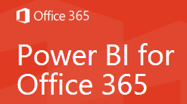
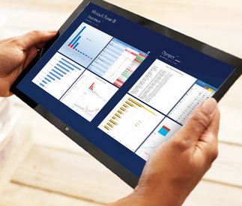
SQL Business Intelligence in Azure
Azure Network
UK
Network provider
MPLS network
SQL Server
Integration Services
Miami
SQL Server
data warehouse
Notes:
SQL Data Warehouse in Azure to support large scale compute based BI
How do we get the data to the data warehouse?
We wanted to bulk load data from databases in each site to a cloud hosted SQL Data Warehouse
MPLS network allows SSIS to reach the databases in each site
Express Route allows us to pull large amounts of data with good bandwidth

Slide 16
Point to site VPN
Easily connect from desktop to a VM in Azure
Target scenarios | Key benefits | Constraints
Solves some access restrictions from on -premise for RDP | Tunnels RDP over SSTP to make firewall/proxy server friendly Can make VM not publically accessible | Needs VM to be on a Virtual Network in Azure

Slide 17


Difficult to access Cloud Dev Lab
India off-shore team
Romanian near-shore team
Azure Development Lab
Active Directory
Build server
Dev Machine 1
Dev Machine N
Use Point to Site
VPN here
UK Developers
USA Developers
Notes:
We were creating a global BizTalk development environment hosted in Azure
Most developers were easily able to access VM over public internet
In UK on premise restrictions stopped us doing that
Point to Site VPN was used to tunnel over HTTP using SSTP allowing developers to connect the VPN software and access VM

Slide 18
Site to Site VPN
Easily connect your Azure network to your on-premise network
Target scenarios | Key benefits | Constraints
Infrastructure connectivity VM → VM Cloud Service → VM | Network level access between on-premise and cloud resources Familiar to infrastructure teams Relatively easy to setup | Needs cloud resource to be part of a virtual network in Azure Lower latency and bandwidth then Express Route

Slide 19
BizTalk in Azure IaaS
On-premise data centre
Azure Network
Active Directory
IIS application servers
LOB servers
VPN
BizTalk
Database servers
Mainframe
Notes:
Customer moving infrastructure to cloud
BizTalk was being upgraded and they wanted to host new version in the cloud
BizTalk still needed to access many resources on premise with no significant re-development
This is also great for dev/test scenarios and temporary environments

Slide 20
Azure Service Bus Relay
Firewall friendly bridge to expose WCF & REST endpoint via cloud.
Target scenarios | Key benefits | Constraints
Exposing on-premise WCF Services to the Cloud Expose WCF Service from one cloud provider to another | Very simple Can be very low cost | Can only use WCF relay bindings Limited management and monitoring story
“Imagine you have put a secure router in the cloud
that can direct traffic to your on premise services”

Slide 21
Hybrid integration in a day
Azure
Azure Service
Bus Relay
AN-OTHER data centre
Denmark data centre
WCF routing service
Partner Management
Application
IBM websphere
Notes:
Why did we choose Relay and not VPN
Cost
Setup Time
Fewer infrastructure challenges
Fail fast & Cheap
Don’t have to worry about controlling access to other resources, the endpoint is the only resource
Can easily expose to other consumers
Why not just expose the services publically
I don’t need to worry about my DMZ
I don’t need to worry about DOS
I don’t need extra infrastructure
Why did we use WCF Routing Service
Allowed us to expose non Microsoft technologies
Routing Service can forward calls to another web service
WCF Routing Service was a simple listener
We can control which services are exposed via routing rules

Slide 22
Even better if you have BizTalk
Azure
Azure Service
Bus Relay
Partner data centre
My data centre
Partner Management
Application
BizTalk
Notes:
If you’re a BizTalk customer and you want to expose your integration processes in BizTalk outside of your organisation then Service Bus Relay is probably the easiest way you can do this.

Slide 23
Azure Service Bus Messaging
Cloud hosted PaaS Message Queue Platform
Target scenarios | Key benefits | Constraints
Asynchronous messaging Durable messaging Publish & subscribe | Pretty simple Can be very low cost High volume Different communication patterns support | Not all applications can talk to it AMQP REST SB-Messaging
“Decoupled the sender and receiver”

Slide 24
Global API
Azure
API
Azure
Service Bus
Business 1
Business 2
BizTalk
Websphere
Notes:
Key Benefits
Decoupled architecture with API not aware of each business
Supports publish / subscribe pattern
One way and two way messaging
Plug in new business units

Slide 25

Event broadcasting
Azure
Azure Service Bus
My data centre
BizTalk
SQL Server
Notes:
In this example BizTalk is using a SQL Query to get some recent changes, debatches them and then publishing event messages for each change
Service Bus Queues support a good on-premise to cloud integration pattern
Queues are a good way to deal with high volume event publishing
Receivers can be inside the organisation or outside of it
Key Benefits
Low cost
No infrastructure requirements
Queue is PaaS so can be accessed from anywhere
Supports the Pull based integration pattern

Slide 26
BizTalk Adapter Service
Combines Azure Service Bus Relay + BizTalk Adapter Pack WCF Adapters + Management experience into a package to allow you to connect to common
LOB applications from the cloud.
Target scenarios | Key benefits | Constraints
Access SQL Server, SAP, Oracle etc. in a BizTalk adapter style fashion | Similar experience to using BizTalk Adapter Pack from BizTalk Server Can be used by BizTalk Services Can be used by other applications as a WCF service | Needs a BizTalk Services subscription

Slide 27
Bridge to SAP
BizTalk Adapter Service
Management
BizTalk Adapter Service
Endpoint
Mobile device
BizTalk Services
EAI Bridge
On-premise data centre
BizTalk Adapter Service
On-premise Agent
BizTalk Adapter Pack
LOB Adapters
Notes:
BizTalk Adapter Service is really about taking advantage of the LOB Adapter SDK + BizTalk Adapter Pack but in Cloud Scenarios
The Key benefits are around the simplicity for connecting to LOB applications
We chose the BizTalk Adapter Service because of the specialist capabilities for connecting to SAP or any other application we need to connect to

Slide 28
BizTalk hybrid connections
Install an Agent on premise and create a port level hybrid connection
to on premise resources
Target scenarios | Key benefits | Constraints
Access “anything you can access at port level” Azure Websites & Mobile Services simple access to on-premise resources Azure Website hosted API’s | Simple to set up Similar to Service Bus Relay but wider scope of usage | Needs a BizTalk Services Subscription Pricing is a key consideration if you aren’t using other BizTalk Services features

Slide 29
Bridge to Oracle Database
Azure Websites
Azure BizTalk Services
Hybrid Connection
Management
Hybrid Connection
Endpoint
Website
On-premise data centre
Hybrid Connection
Agent
Website
Notes:
In the scenario we move the website to the cloud
We still need to connect to the on premise oracle data base
If we set up BizTalk Services Hybrid Connections we are able to reach through to the Oracle Database
We are unlikely to need to change any code our ODP.net code would be routed through hybrid connections simply by changing the connection string
Key Benefits
Migrate to the cloud with potentially no code changes
Can support almost any port so its open for a wide range of connectivity types
Lower level of abstraction than Service Bus Relay which is WCF this can be any port
Word of Caution
Your application authorization model may be affected if your no longer on premise

Slide 30
Thoughts

Slide 31
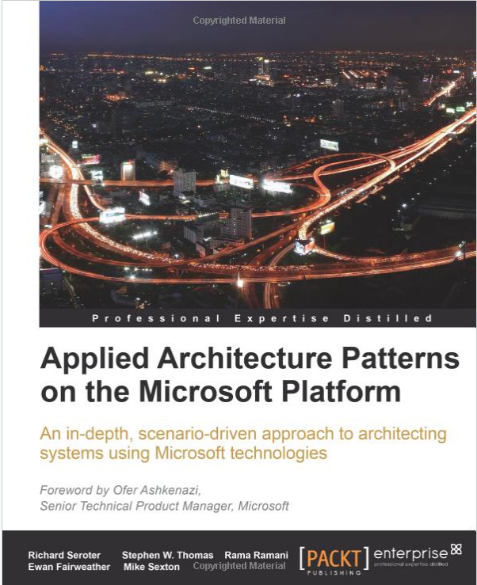
Thoughts
Which approach should I use?
  Its ok to use more than one approach
  No approach solves every problem
Use a framework to guide your decisions
Think about your choices in terms of:
  Design
  Delivery
  Operations
  Strategy

Slide 32
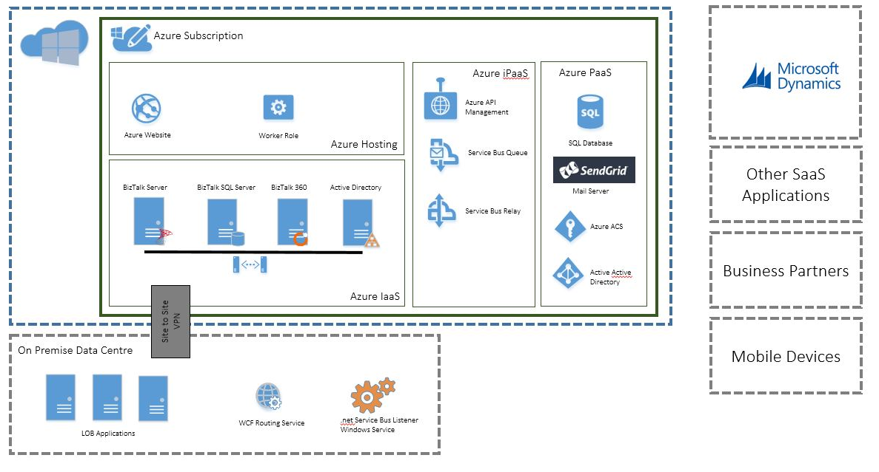
If you like this you might also like:
Building an Azure based Integration Platform
http://tinyurl.com/azure-integration-platform

Slide 33
Questions

Slide 34
Thank you

