Slide 1

INTEGRATE 2014
Business Process Management
Alok Jain
Principal Program Manager
Microsoft

Slide 2
Agenda
Business process overview
BPM requirements
Building blocks
Under the hood

Slide 3

So, what is a Business Process?
Conference Registration
Customer Account Sign-up
Healthcare Administration
Mortgage Applications
Performance Reviews
Bill processing
Employee Training
Loyalty Programs
Case Escalation
Contract Renewals
Order Processing
College Applications
Lead Scoring

Slide 4
So, what is a Business Process?
Assign shipper
No
Compute order value
Value
> $1,000
Customer order
Ship order
Yes
Input
Approve order
Output
Validate order

Slide 5

2000
LOB System
HR System
Proceed
Result
Resume
Job Opening
Offer
Schedule
Reference
Interview Feedback

Slide 6









2020
LOB System
2014

Slide 7
Business Process Management
Automating and managing processes
across SaaS and LOB systems

Slide 8


Approval workflow
Process payment to employee
Approved
Submit Expense Report (FTP)
Upload Scanned Receipts
Manager Approval
Rejected
Send request denied email
Long running
Conditional execution

Slide 9

Common workflow (Sub workflow)
New loan application
Validate inputs
Call Credit Check workflow
Get outstanding loans
Run Rule Policy for loan approval
Get credit history
Run Rule Policy for credit check
Output credit check result
Call another workflow (Wait for response)
Start another workflow (trigger)

Slide 10



Sequential Convoy
Priority Shipping
Customer Order
Wait till order count >50
Find best Quotes
Calculate Order Value
Regular Shipping
Batching
Message Assurance
Custom code
Conditional Execution

Slide 11


Parallel Convoy
Patient Request
(HTTP)
Wait for complete patient information
Schedule Appointment
Send confirmation
by SMS
Insurance Approval
(FTP)
Lab Reports
(SQL)
Support for out-of-order input set
Connectivity to SaaS systems

Slide 12

Scatter-Gather
Search Twitter
Twitter digest
Scheduler
Merge reports
Send mail
Search Facebook
Facebook digest
Scheduler
Parallel execution
Custom code
More connectivity!

Slide 13
BPM key tenets
Connectivity to SaaS and LOB systems
Agile
Persist State
Sequential and conditional control flows
Rich business functionality
Message Assurance
End-to-end tracking
Extensible

Slide 14


Putting it together
Functionality!
Process!
Developer
Business Analyst
Builds functionality as “Microservices”
Independently deployable functionality
REST API based, Multiple language support
Out-Of-Box & 3rd Party
E.g. Connectors, Mediation, Custom Logic
Builds processes by orchestrating “Microservices”
Configures Microservices
Setup conditional flows
Web based business process designer
Workflow Engine

Slide 15
Workflow Engine
  Calls into Microservices or other API offering
  Supports sequential or conditional control flow
  Supports long-running workflows
  Can start, pause, resume or cancel workflow instances
  Provides message assurance
  Logs rich tracking data

Slide 16
Demo

Slide 17






What you just saw…
Map survey to SalesForce
Add to SalesForce
Scheduler
SurveyMonkey
Filter
Priority Leads
Email

Slide 18
Let’s look under the hood…
Map survey to SalesForce
Add to SalesForce
Scheduler
SurveyMonkey
Filter
Priority Leads
Email
WORKFLOW ENGINE
Execution State
Data Store

Slide 19
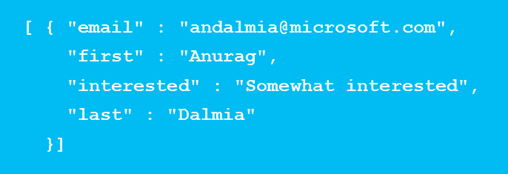
Let’s look under the hood…
Map survey to SalesForce
Add to SalesForce
Scheduler
SurveyMonkey
Filter
Priority Leads
Email
GetStatus
HTTP 200
OK
GetSurveyData
FilterData
ID | Status | Action | Duration
2654BE46 | Succeeded | SurveyMonkey | 0.001s
7454BE34 | Succeeded | MapToSF | 0.001s
HTTP 200
OK
4454AD9E | Succeeded | Filter | 0.001s
Trigger
Workflow
HTTP 202
Accepted
1982AEE3 | Succeeded | SendToSF | 0.001s
93ADADE | Succeeded | Email | 0.001s
WORKFLOW ENGINE
Execution State
Data Store

Slide 20
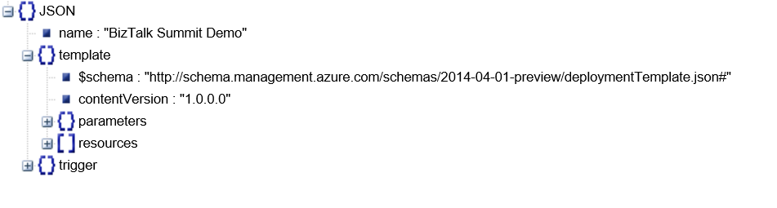
How is a workflow defined
Workflows are JSON templates that define:
  How does the workflow trigger and what inputs it requires
  What actions (APIs) to call under what condition
  What parameters to pass into the APIs – these parameters can be outputs of any previous steps

Slide 21
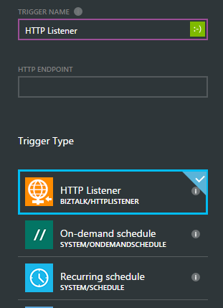
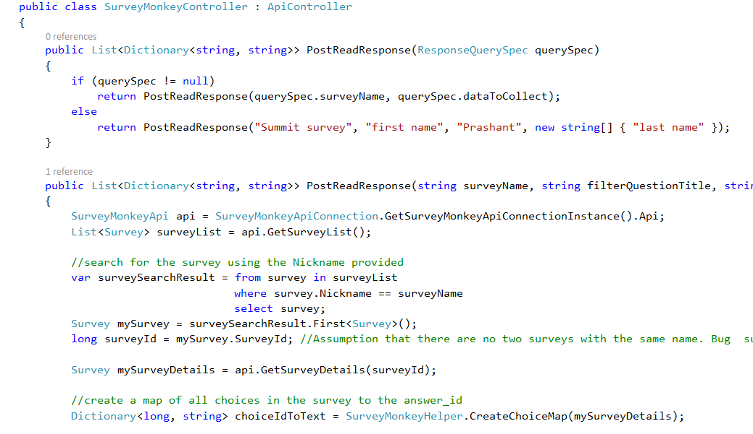
Building triggers and actions
API
Inputs
Outputs
1. Implemented your Microservice
2. Define your API metadata
3. Register with process designer

Slide 22
Recap – Key Concepts
Triggers
  Scheduled, Push (e.g. HTTP listener) and Pull (e.g. FTP)
  Cause a new instance of workflow to get created

Slide 23
Recap – Key Concepts
Triggers
  Actions
  Building blocks that wrap APIs
  Support input and output data
  Return “In Progress” or “Success/Failure” status

Slide 24
Recap – Key Concepts
Triggers
  Actions
  Workflows
  Invokes “Actions” sequentially/conditionally
  Persists state after every step
  Instances can be started, paused, resumed or cancelled
  Can be authored via rich user interface or manually
  Generates rich logs for tracking

Slide 25
Wrapping up…
Powerful Workflow engine designed for modern business process
Extensible platform for ISVs and enterprises
Rich web-based experience for Business Analysts

Slide 26
Wrapping up…
Microservices
EAI
B2B
Rules
Workflow Engine

Slide 27
Thank you

