Slide 1

Integration Cloud
Integration as a service

Slide 2

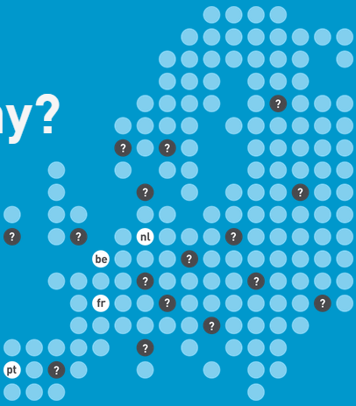
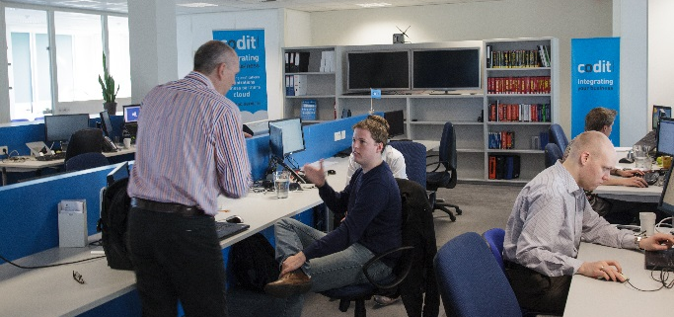




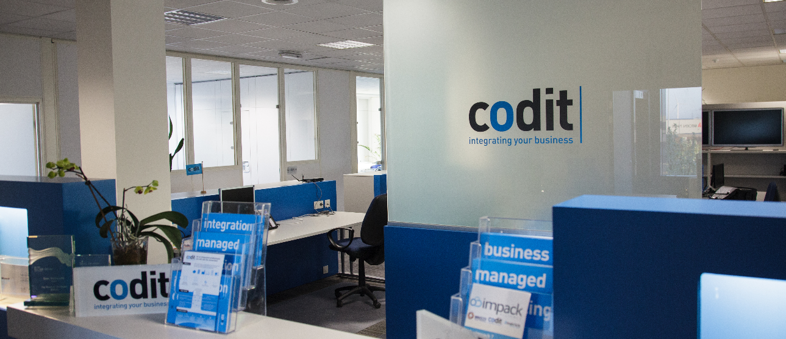




About us
2000 Belgium
2004 France
2013 Portugal
Focused on integration solutions
RV 2012 5,1 M€
Codit Intl
> 60 Active integration customers
e-news + SoMe
60 employees
> 50 consultants BizTalk certified
2012 & 2013
Partner of the Year
Award Finalist
Application Integration
Close collaboration with Microsoft
> 200 succesful integration projects

Slide 3





Integration Cloud
offering integration as a service to our customers
building on Microsoft Azure
Offering
24/7 integration as a service
managed services on flow level
Added-value services
e-Invoicing – business reports…
Architecture
Out of the box components
Self-service portal
Built on Azure
Using BizTalk for flat file & edi

Slide 4
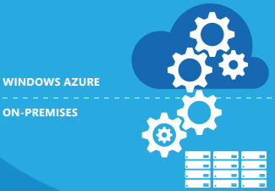
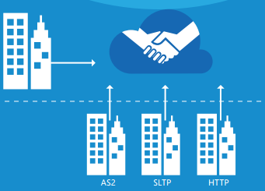





Integration scenarios
ENTERPRISE
TO ENTERPRISE
(B2B/EDI)
HYBRID APPLICATION
INTEGRATION
MOBILITY & API’s
SAAS INTEGRATION
API
SOA

Slide 5
Some history
Development started in 2010 (Red Dog)
  Joined various SDR’s
First customer live in Q2 2011
  No BizTalk Services
  No IaaS Virtual Machines
  No Virtual Networking
Performance lab with Azure CAT team in 2012
MABS Launch partner in 2013

Slide 6





Architecture
BizTalk Server
BizTalk Services
Azure DB
Config
Tenant
Tracking
Tenant
Web Role
Worker Roles (2+)
Portal
Runtime
Worker role (runtime)
Worker role (runtime)
Angular..JS
Web API
Config.svc
Tracking.svc
Receiver Threads
Workflow Threads
Transmitter Threads
Auth.
Mgmt threads
SQL Azure
messaging topic
Service Bus
watchdog topic
Blob Storage
message repository
custom activities & modules

Slide 7




Challenges when building in the cloud
Constant change
Multi-tenancy
Roadmap
DR Planning

Slide 8


What our cloud customers want
Stability
Visibility
Service & Solutions
Availability

Slide 9
Invoice Approval Workflow
Match against DB
AS/2
or
FTP
SharePoint online
e-Invoicing demo
Manual Approve
Auto
Approve
invoice approval
Generate PDF
On prem file share
Sign PDF

Slide 10


FMCG: Largest kiwifruit brand in the world
Largest kiwifruit brand in the world
“We were able to outsource the full e-Invoicing project, because of the Integration as a Service approach”
François Caudron
e-Invoices get archived for 10 years in the cloud
Decrease cost of an invoice with more than 50%
Start small, grow big
Now full enterprise integration in the cloud

Slide 11
Microservices – what’s next
Current status
  All our runtime services are currently pluggable ‘micro services’
  Service Bus as durable pub/sub gateway
Next plans
  Provide micro services through the gallery
  Build tooling on top of Azure microservices
End goals
  Provide abstraction to our customers – as a service

Slide 12

Benefits
For our customers
Hybrid connectivity bridges the on premises world with the cloud
For codit
lower TCO
no license concerns
easy to grow
no inhouse technical skills needed
integration as a service
centralized management
growing with the platform
multi-tenancy for better reach
Azure BizTalk

Slide 13






Thank you!
Keep in touch!
Call or mail us. Ask questions. Happy to help.
Stay tuned
LinkedIn
Twitter
blog
.codit.eu
codit.eu
Newsletter
Pay us
a visit

